Slide 1
The
Vegetable Orchestra
Roman Kotenko, 10 “C”

Slide 2

Introduction
Known in Europe as “Das erste Wiener Gemüseorchester” or “The First Vienna Vegetable Orchestra”, the orchestra is an Austrian one-of-a-kind musical group performing on instruments made up entirely of fresh vegetables.

Slide 3
Information
The Vegetable Orchestra was founded in 1998, and consists of 11 musicians, a sound engineer, a video artist and, of course, a cook. Based in Vienna, the Vegetable Orchestra plays concerts in Europe and Asia – even playing in large philharmonic orchestra halls. Instead of guitars and drums, the orchestra plays Cuke-o-phones, radish-marimbas, carrot flutes, pumpkin basses, leek violins, and other freshly made instruments.

Slide 4
Vegetable-instruments
The First Vienna Vegetable Orchestra blows carved-out carrots, taps turnips, claps with eggplant cymbals, twangs on rhubarb fibers, and rustles parsley and greens, all in the creation of an experimental sound that eventually winds up – literally – in the audience's stomach.

Slide 5
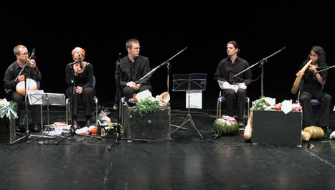

An example of the “vegetable music”

Slide 6
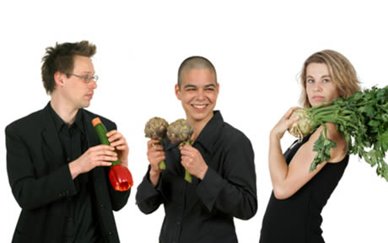
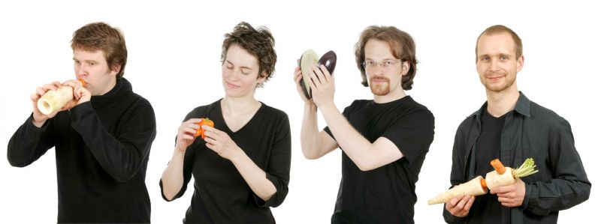

Slide 7
Thanks for attention!

