Slide 1


Slide 2
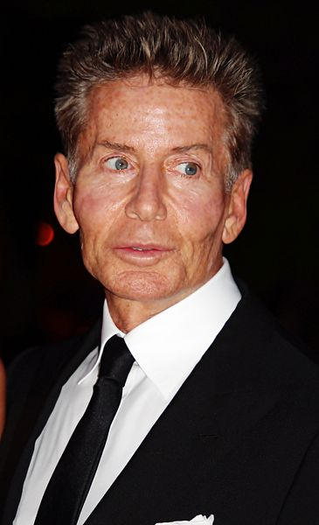
Calvin Richard Klein (born November 19, 1942) is an American fashion designer who launched the company that would later become Calvin Klein Inc., in 1968.

Slide 3
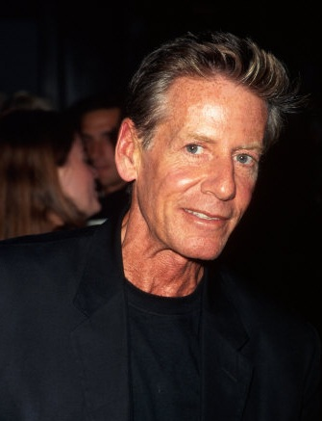
Klein was born in The Bronx. He attended the High School of Art and Design and matriculated at, but never graduated from, New York's Fashion Institute of Technology, receiving an honorary Doctorate in 2003.

Slide 4
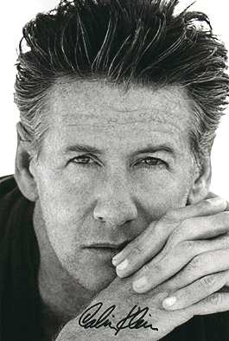
He did his apprenticeship in 1962 at an oldline cloak-and-suit manufacturer, and spent five years designing at other New York shops. In 1968, he launched his first company with a childhood friend.
Klein was immediately recognized for his talent after his first major showing at New York Fashion Week.

Slide 5
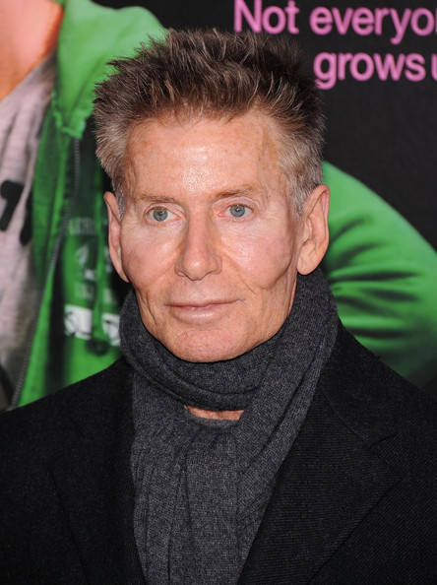
AWARDS

Slide 6
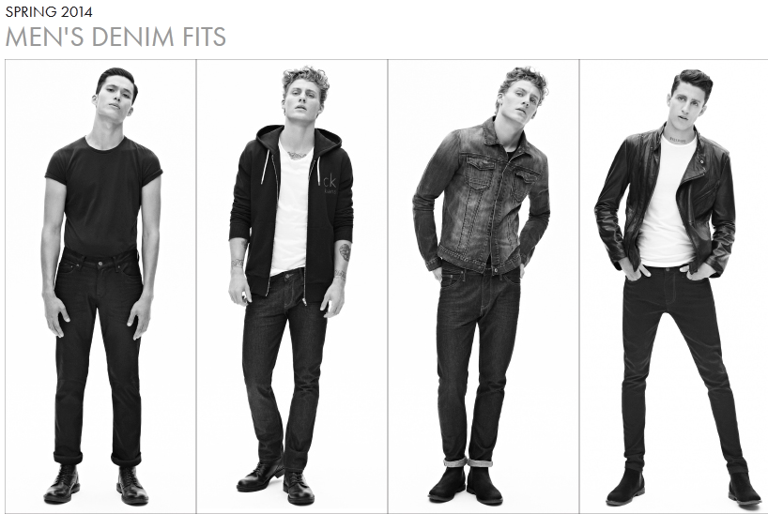

Slide 7
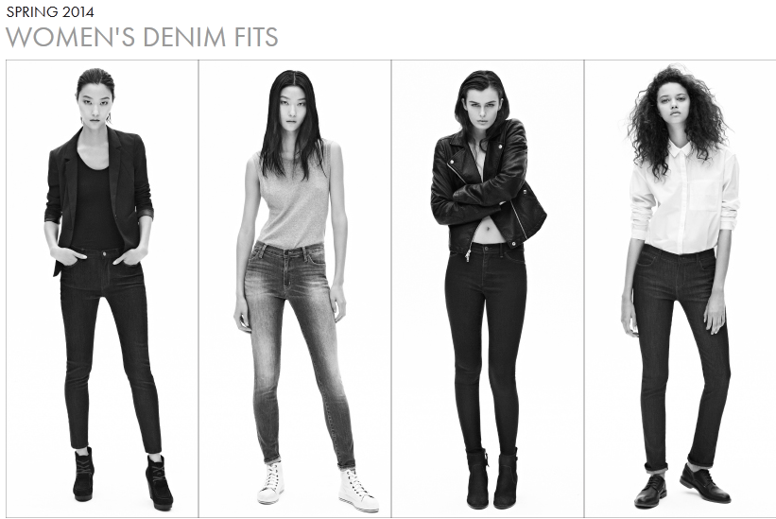

Slide 8
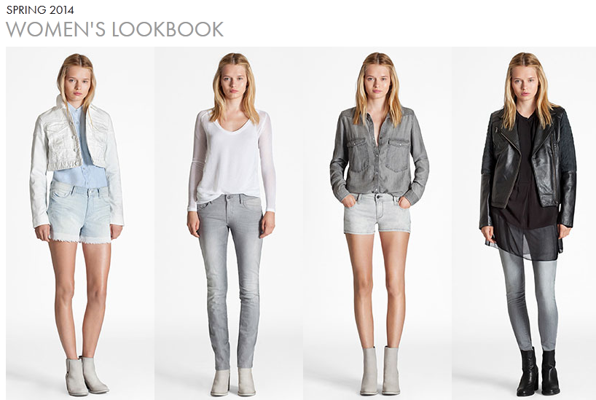

Slide 9
