Slide 1
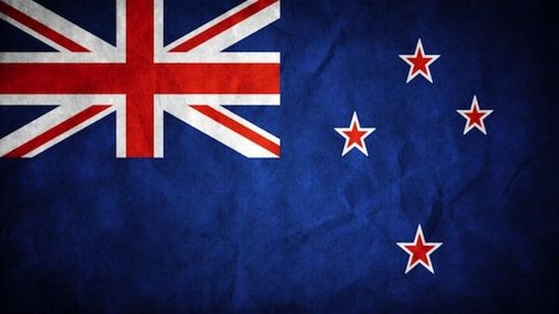
New Zealand
Olga Novik
10-B form

Slide 2
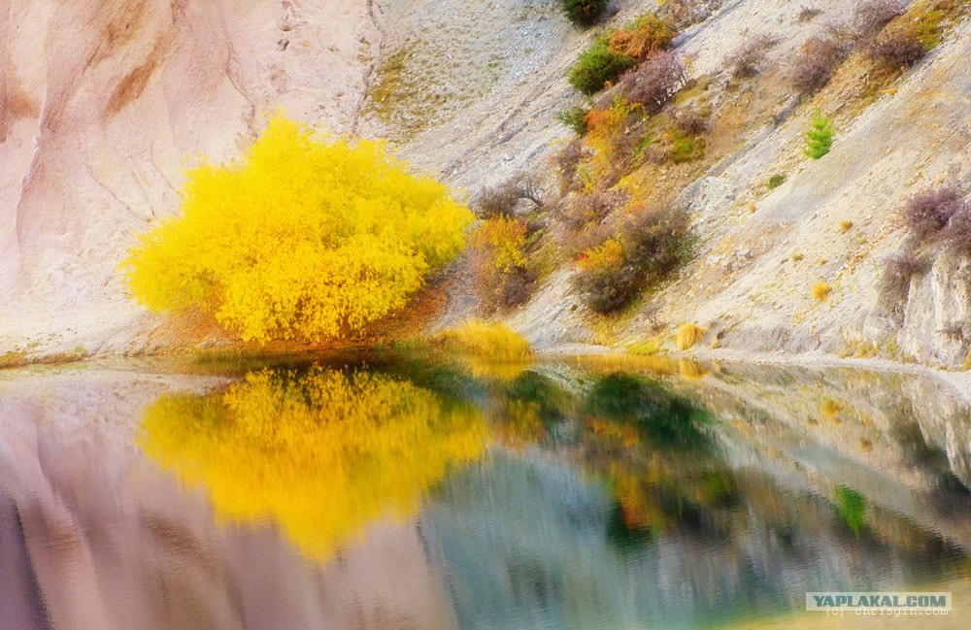
New Zealand is a very interesting and beautiful country.

Slide 3
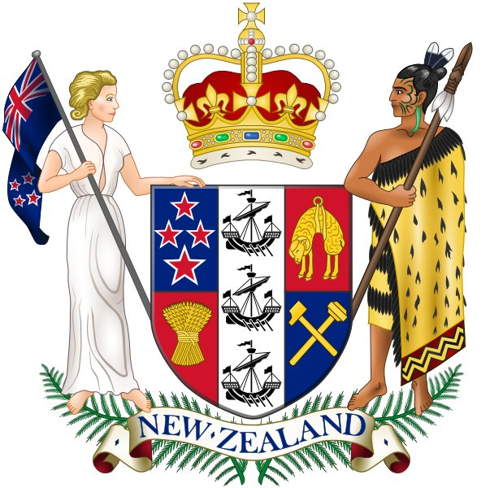
New Zealand is an island country in the southwestern Pacific Ocean. The country geographically comprises two main landmasses – that of the North Island, or Te Ika-a-Māui, and the South Island, or Te Waipounamu – and numerous smaller islands.

Slide 4
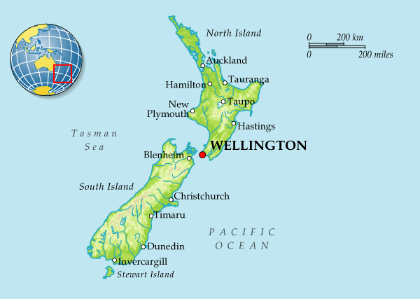
New Zealand is an independent island country in the Southwest Pacific Ocean.
Its area is about 269 000 km².
New Zealand belongs to a large island group called Polynesia.
It’s a country consisting of two large islands and several dozen smaller islands, that can be far away from the main ones.

Slide 5
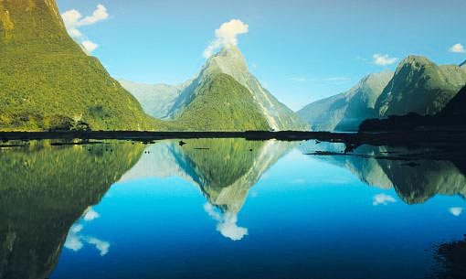
New Zealand has a mild and temperate climate. It never gets too hot in summer and there are not too cold in winter.
Feature of New Zealand is that summer months are December, January and February.
The average temperatures is – ( from 10 °C to 16 °C ).
Also, Smoke and steam are characteristic features of New Zealand (they come from volcanoes and geysers). That’s why the Maoris called it the country of long white clouds.
Because of the mild climate there are a lot of green forests and walleys.

Slide 6
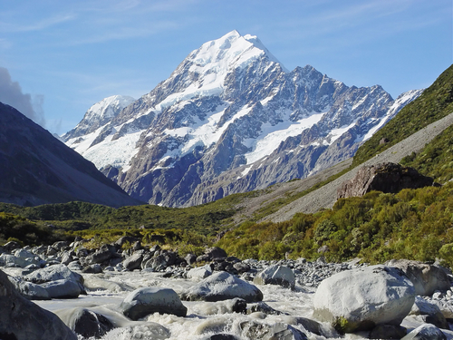
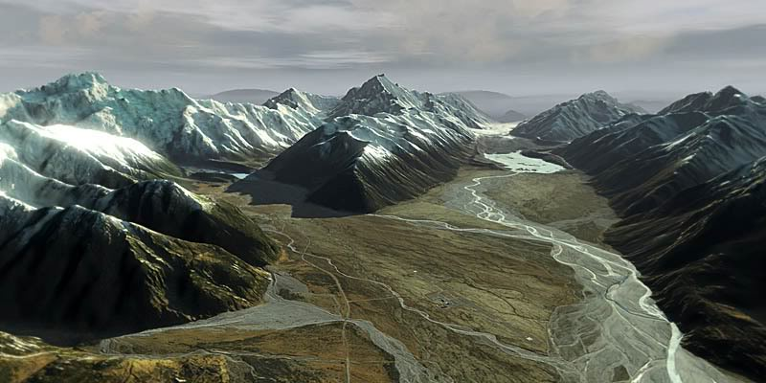
There are many mountains in New Zealand. The highest is Mount Cook

Slide 7
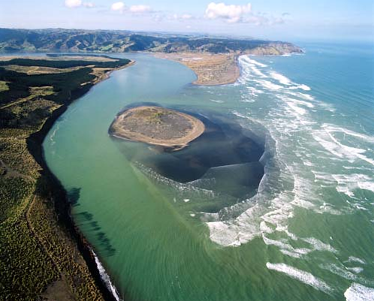
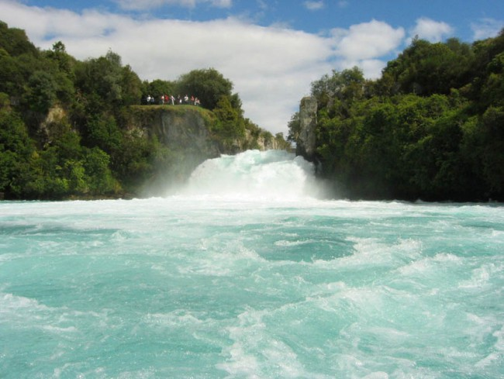
There are many rivers and lakes in the country. The chief rivers are the Waikato and the Wairu.

Slide 8
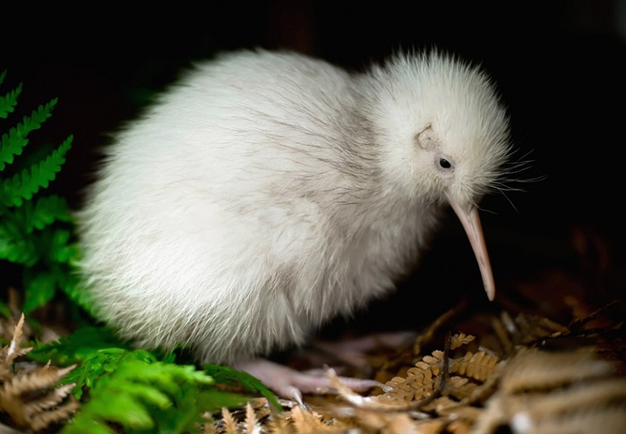
The native animals in the country is the kiwi. This interesting bird lives in the wet parts of the thick bushes. In the day-time the bird does not go out. It comes out only at night to find food. Kiwis cannot fly. Many years ago kiwis were hunted for food. Now the government does not permit the hunting the kiwis. The kiwi is now the symbol of New Zealand.

Slide 9
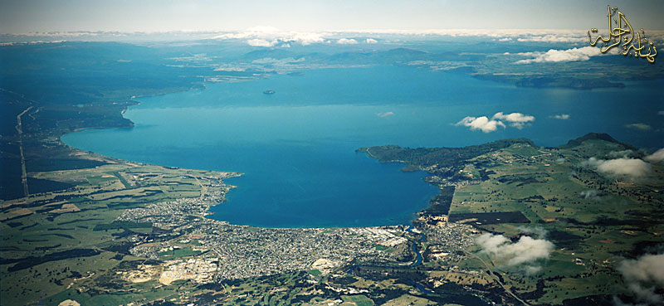
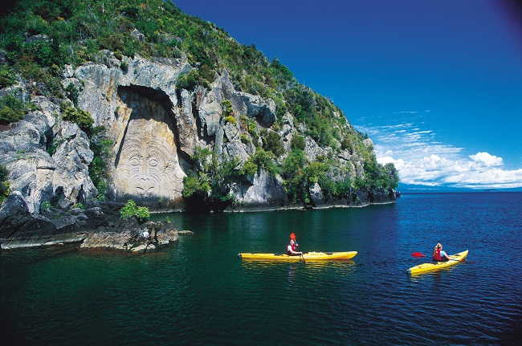
A popular place for tourists visiting New Zealand - lake Taupo. It was formed by volcanic eruption about 27 000 years ago.

