Slide 1
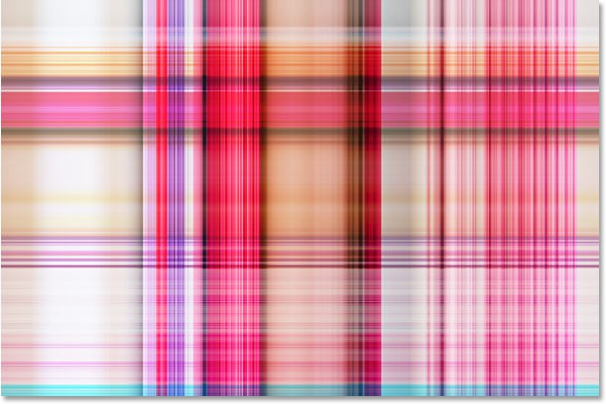
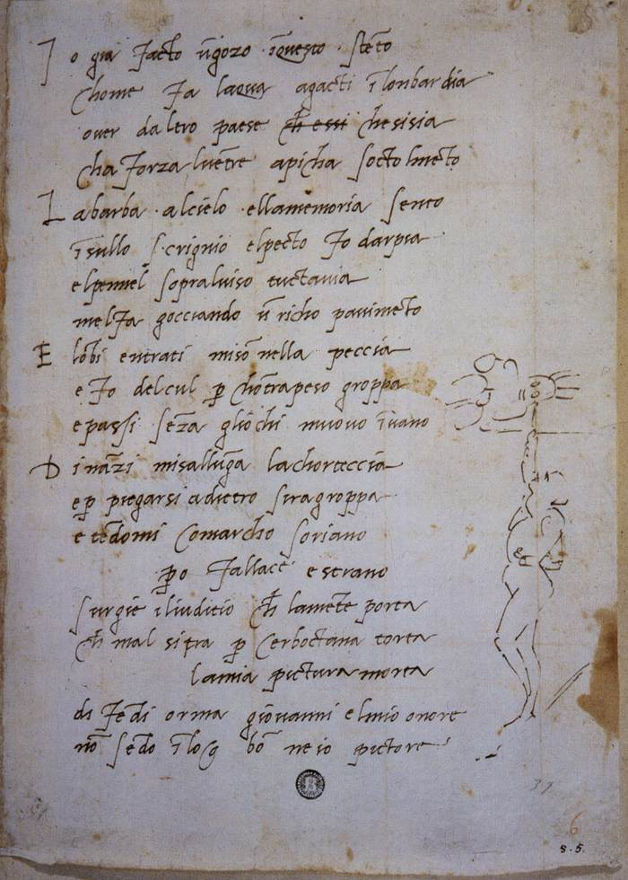

Мy favorite book of poems Michelangelo Buonarroti

Slide 2

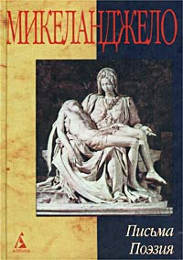
Michelangelo was a painter, sculptor, poet. His sculptures and paintings are well-known masterpieces, but he wrote poetry, few people know.

Slide 3

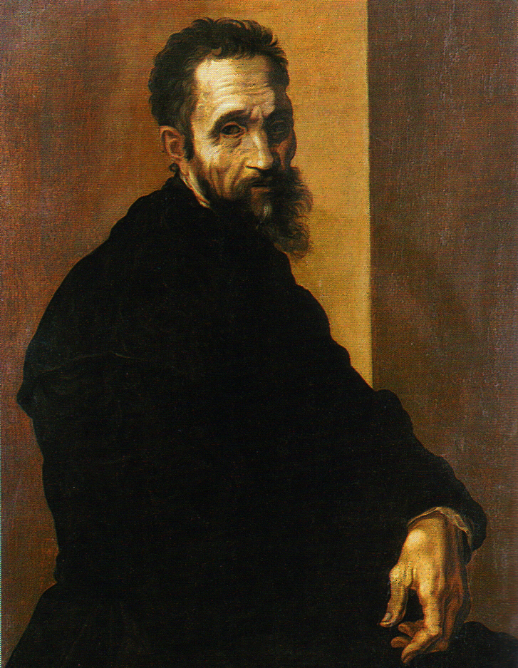
And it's not fair! With years of his poetic dialogue with the outside world goes into a monologue. In the poet's voice is increasingly heard a groan like most pain pen drives and lines written by the blood of the heart.

Slide 4

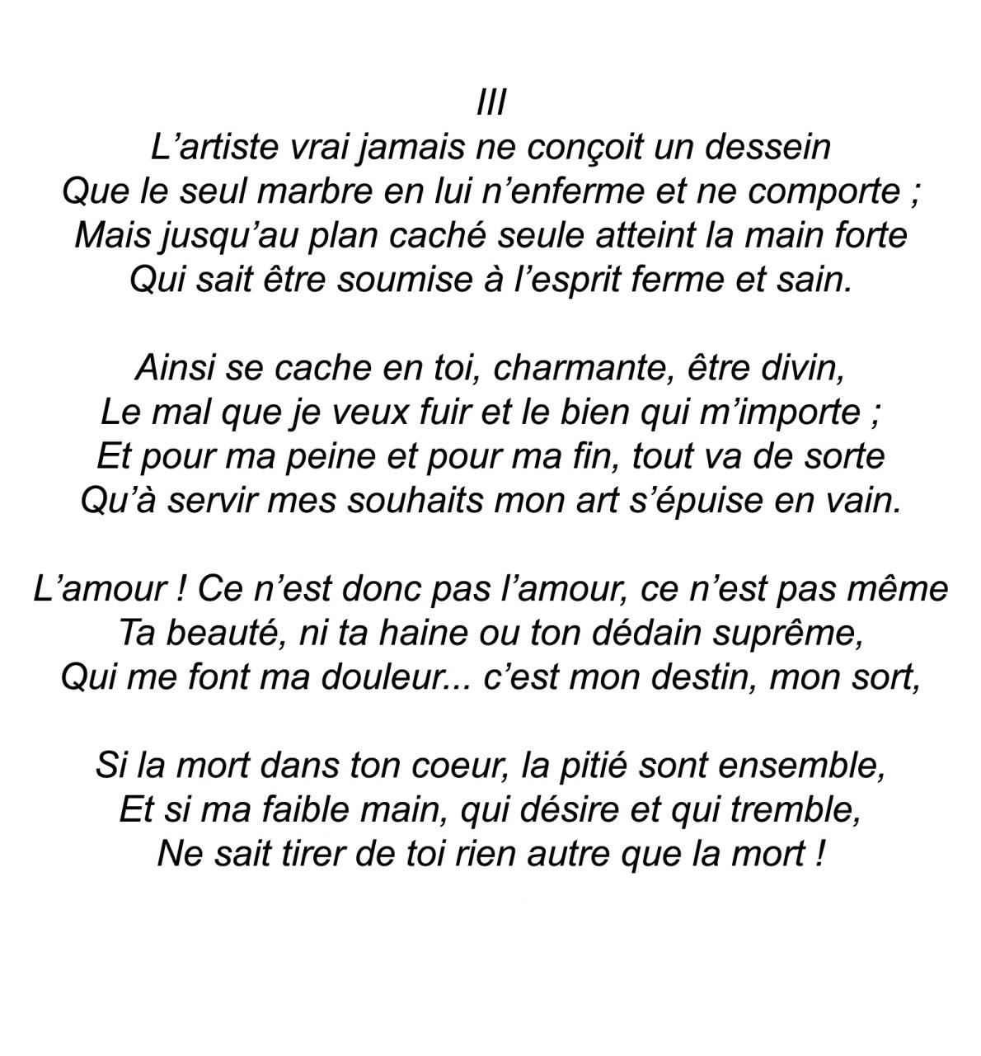
Read them and you will feel pain, delight doubt thinking of this great man .. These poems describe the passion and love.

Slide 5
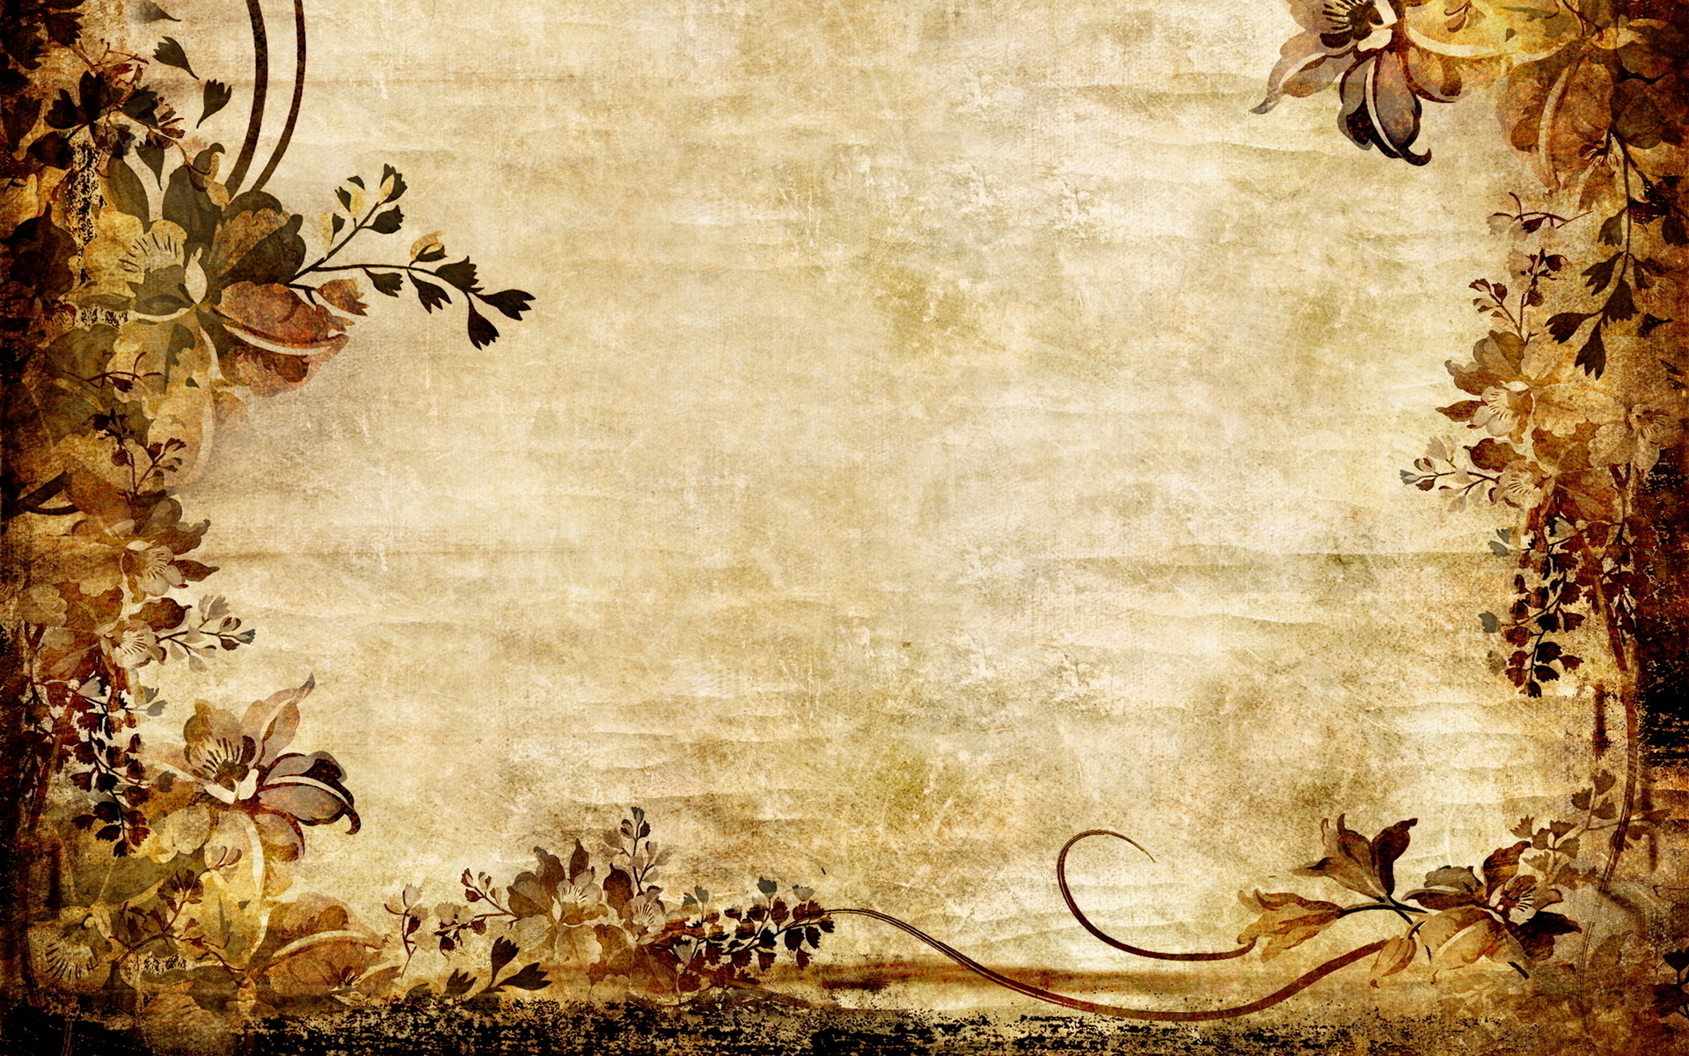
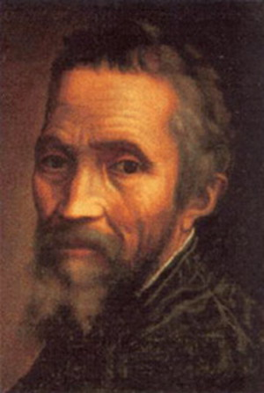
My favorite poems are "Message friends." This poetry is described by a sincere and genuine friendship.

