Slide 1
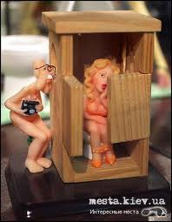
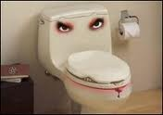
Museum of the toilets in Kiev

Slide 2
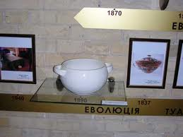
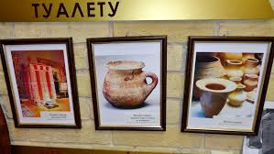
One of the most unusual museums in Kiev is a museum of the history of the toilet, opened September 5, 2007. This museum is even more attractive to tourists, given the fact that such museums in the USSR did not exist.

Slide 3
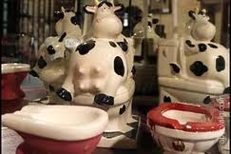
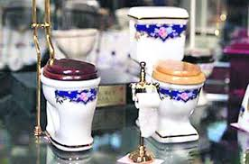
Throughout the museum is divided into several sectors, each of which has their own idea of ​​art, based on the chronology of the present sample.

Slide 4
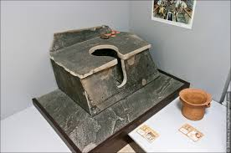
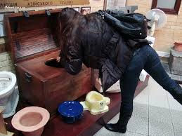
Total number of toilets on display in the museum is about 3 hundred items. Collection features various toilets are even examples of porcelain, stone and metal.

Slide 5
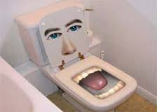
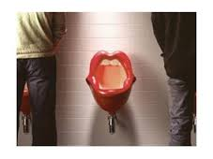
Exposure history museum toilet is represented not only toilets but also other attributes associated with them. Visitors can enjoy the humorous miniature toilets, collection.

Slide 6
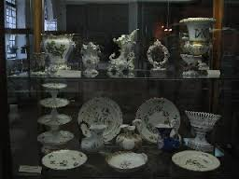
Museum of Decorative Arts

Slide 7
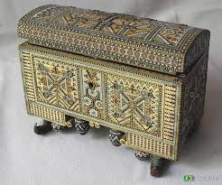
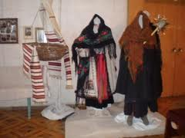
The exposition of the museum has more than 70 000 pieces made folk artists starting with the 17th century and ending with the Soviet period.

Slide 8
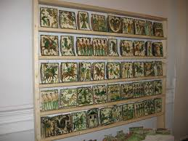
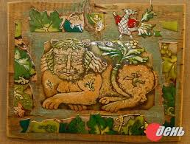
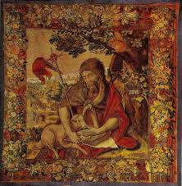
State Museum of Ukrainian Decorative Folk Art presents an opportunity to get acquainted with the rich collection of carpets, rugs, fabrics, hand-made and factory-made, printed fabric samples 17-19 century manufacturing, tablecloths, towels, traditional dress.

Slide 9
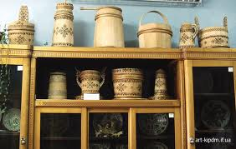
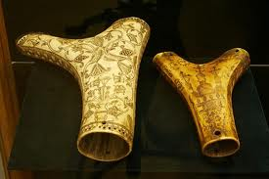
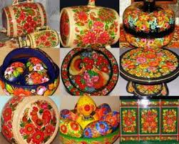
One should pay attention to the collection of carvings of bone and wood.

Slide 10
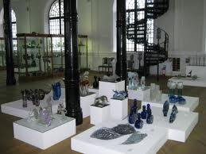
Museum of Decorative Arts is also dnoy of the most significant in Ukraine collection of glassware.

Slide 11
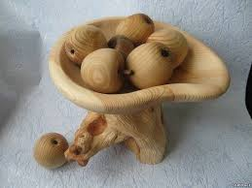
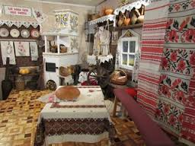
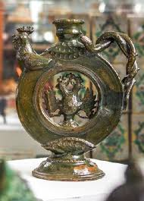
Now the museum's collection Ukrainian decorative arts continues to grow as the ancient discoveries, and examples of modern Ukrainian folk art.

