Slide 1
National Bulgarian Cuisine

Slide 2
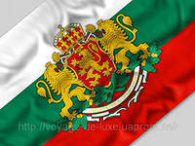
Bulgarian national cuisine was influenced by both Orthodox Christian and Muslim traditions.
Bulgarian cuisine is rich in a variety of meat and vegetable dishes.

Slide 3
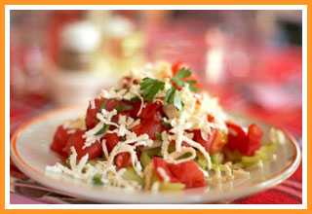
Bulgarian cuisine is rich in a variety of meat and vegetable dishes
Truly, the national dish of Bulgarians - is shopska salad ( " Sheppard's salad " )
Salad is a mixture of tomatoes , cucumbers, baked sweet peppers , herbs , onions, feta cheese and can be found in almost every menu

Slide 4
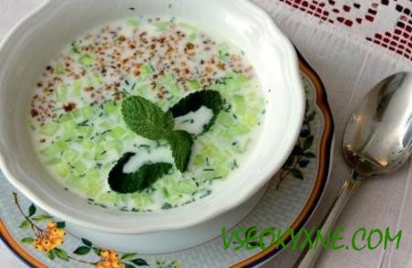
The present Bulgaria - a cold soup " Tarator ." It is usually made ​​from crushed walnuts and chopped fresh cucumbers with grape vinegar , crushed garlic and salt and vegetable oil and seasoned with sour milk . " Kisel mlyako "

Slide 5
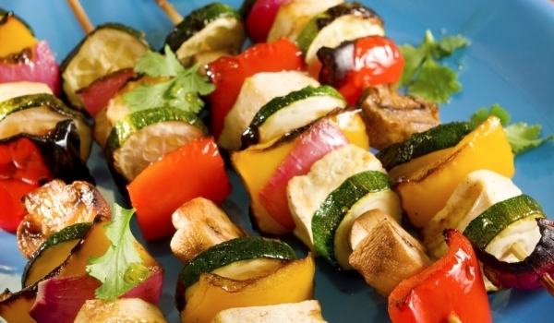
" Shishcheta " - in our kebab , small skewers of chicken, pork , lamb , grilled

Slide 6
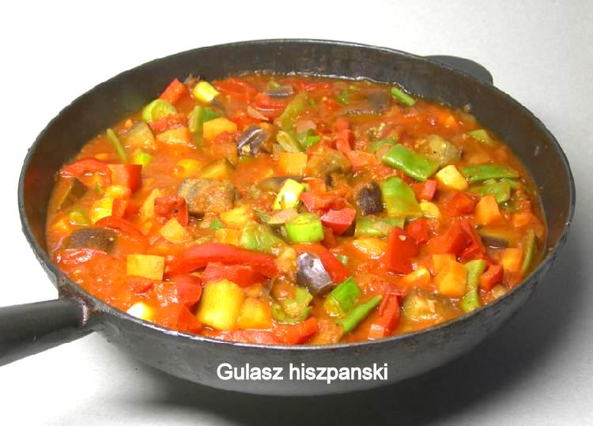
Meat is a frequent speaker in accompaniment with vegetables and served in a clay pot . There are three popular types: " gyuvech " - a stew with potatoes, mixed vegetables , tomatoes

Slide 7
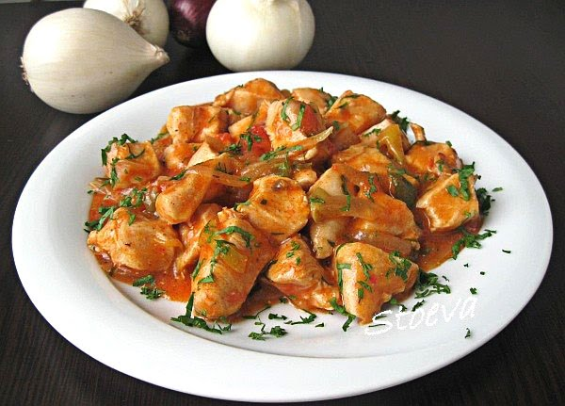
" kavarma " - meat with mushrooms, onions , bell peppers , is poured on top of the egg , baked in the oven

Slide 8
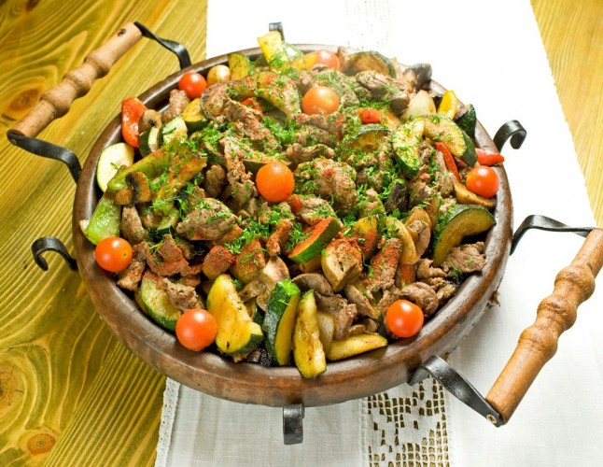
" sac " - grilled meat with various vegetables , tomatoes, mushrooms in a special Bulgarian pan , which is called sac . Traditionally, the sac is placed directly on the coals in the oven and served at the table

Slide 9
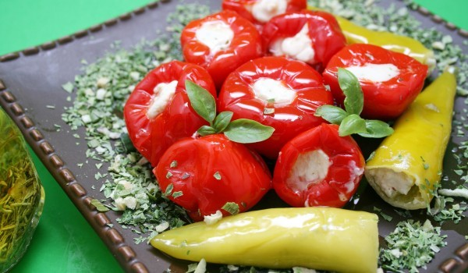
" plneni pig " - stuffed peppers with meat and rice, watered like a bechamel sauce .

Slide 10
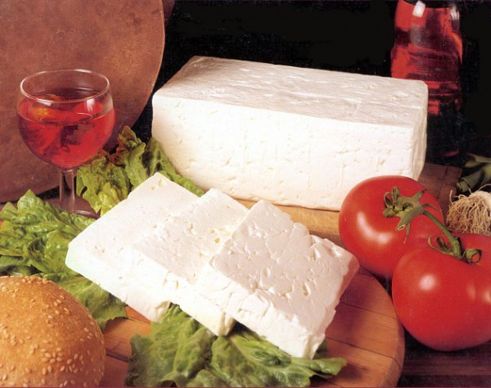
About BRYNZA ( " Siren " ) is worth mentioning separately . It is extremely popular in Bulgaria. It is eaten as a snack with wine , as a component of many meat and vegetable dishes , cakes of dough , and even omelets . Feta cheese with white bread and green peppers is considered the national dish of the Bulgarians , like the British, for example - sandwiches or puddings

Slide 11

Baked apples with honey and nuts

