Slide 1

National Ecological Centre of Ukraine

Slide 2
About National Ecological Centre of Ukraine
National Ecological Centre of Ukraine (NECU) is a non-governmental not-for-profit organization created in 1991 when Ukraine has obtained independence. NECU consolidates individuals for common action to protect the environment. Among NECU members are scientists, journalists, artists, students and other people who are willing to add their own effort to environmental protection. The organization has branches in a dozen of Ukrainian cities.

Slide 3
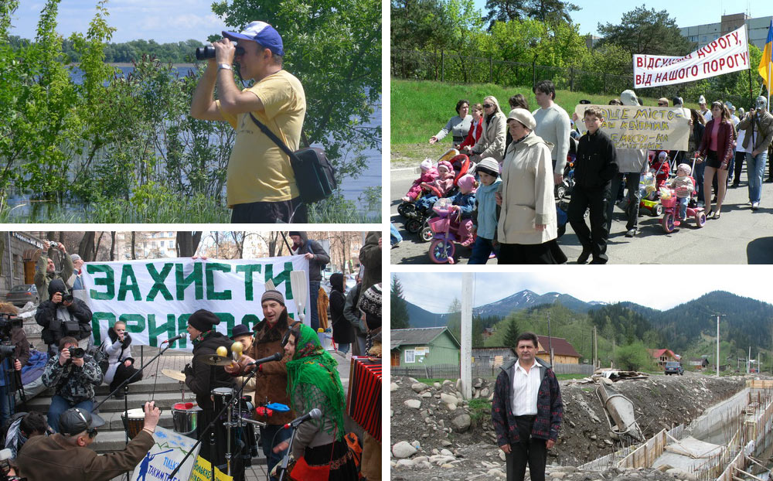

Slide 4

NECU works to bring environmental consideration into the core of any decision. We aim to bring concerns of local population and experts to the politicians, to redesign strategies and projects. We work both to save nature, by maintaining and creating new protected areas, and to decrease human impact on environment, through policy changes in energy and transport sectors. By combining analytical research, fact-finding, campaigning and advocacy activities we defend civil rights of local communities for healthy environment. We see many policies and projects that cause problems for people and environment are the results of non-transparent decisions made by officials and business that are not accountable to the public. NECU challenges such a decisions and acts to change decision-making systems.

Slide 5
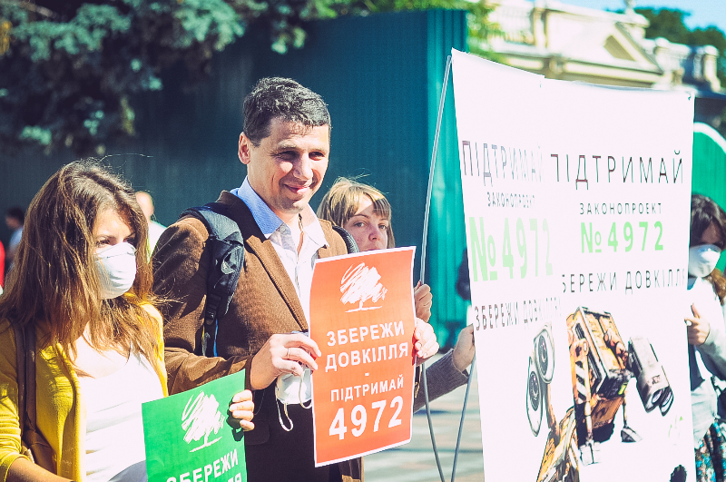
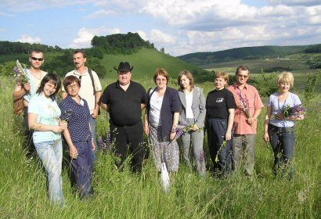
NECU is willing to maintain political and economic independence, therefore it doesn’t accept money from political parties or business corporations. Currently NECU relies on funding from development programs of European governments and private foundations. However, we aim to get more support through donations from individual NECU supporters.

Slide 6
NECU is working in such major directions:
Biodiversity: NECU is campaigning for new nature protection zones creation to keep unique species of animals and plants in their natural environment. NECU also makes sure that the existing protected territories remain untouched. With the help of public actions and legal procedures, such as courts and public hearings, NECU stands firm against illegal building construction on green territories in Kyiv region and works with local activists arround Ukraine.
Energy: NECU is trying to redirect the energy policy of Ukraine away from intensive coal and nuclear energy development to energy efficient economy and alternative energy sources. NECU is working with politicians and officials educating them about the new approaches of energy sector management.
Global climate change: NECU is a member of Ukrainian NGO Working Group on climate change that works to integrate climate change issues into Ukrainian government policies. NECU also takes active part in international negotiations on the reduction of greenhouse gas emissions, monitors the implementation of Kyoto protocol mechanisms in Ukraine, works with media and general public.

Slide 7

Transport: NECU develops policy recommendations to reduce the negative impact of the transport sector. We stress the vital importance of proper land use during road construction and develop effective solutions of transport problems in cities and nationwide.
Multilateral Development Banks: NECU is monitoring the activities of development banks (such as EBRD, EIB, World Bank, etc) in Ukraine to prevent the negative impacts of their projects on environment and local people. We believe that tax-payers money must not be used to harm the society.
Russia, Caucasus and Central Asia: NECU cooperates with NGOs in the region, sharing its experience of working with development banks and on Climate Change issues. NECU monitors the projects connected to oil and gas extraction and transportation from the Caspian Region.
NECU is a member of CEE Bankwatch Network, NGO Working Group on climate change, Ukrainian River Network, IUCN, Climate Action Network International.

Slide 8





