Slide 1
Blue whale

Slide 2
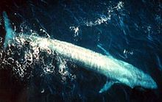
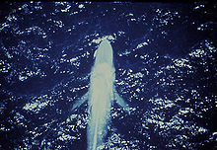
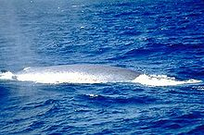
Blue whale-mammals of the family razorback. Blue Whale is the largest known animal that ever lived on Earth. Suffered and suffers from whaling through the population of blue whales is very mala.

Slide 3
Body bluish-gray with gray patches of various sizes and shapes. The head and lower jaw dark back and sides lighter.
Like all cetaceans, the blue whale produces the so-called fountain: with plenty of water breathing

Slide 4
Currently, there are about 120 species of marine mammals. Отряд Sirenia
Отряд Cetacea
Отряд Carnivora
For example: Baleen whales, toothed whales, walruses, seals, sea otters

