Slide 1
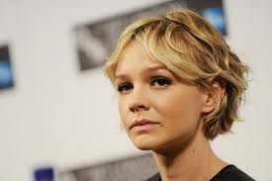
Carey Hannah Mulligan
By Marina Samchuk

Slide 2
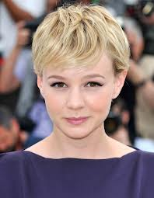
Birth name: Carey Hannah Mulligan
Birth: May 28, 1985 London, England
Citizenship: UK
Occupation: actress
Husband: Marcus Mumford (2012-present)
Awards: BAFTA (2009)

Slide 3

Personal life
From August 2009 to October 2010 met with Shia Labeouf, a partner in the film "Wall Street: Money Never Sleeps."

Slide 4
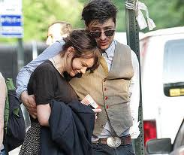

In August 2011, is engaged to musician Marcus Mumford, the leader of the group Mumford & Sons.
April 20, 2012 they were married, the wedding took place in Somerset, England.

Slide 5
Career
His debut in cinema was the role of Kitty Bennet in "Pride and Prejudice." Since 2006, Mulligan is working on television, and in 2007 she made her debut on Broadway and received positive reviews from critics.
Mistress rewards «BAFTA» for best actress, nominee for the award "Golden Globe" and "Oscar".

Slide 6
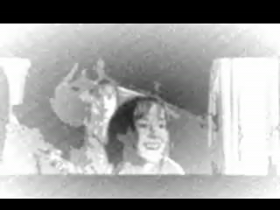

Slide 7


Slide 8


Slide 9
Thank you for your attention!

