Slide 1
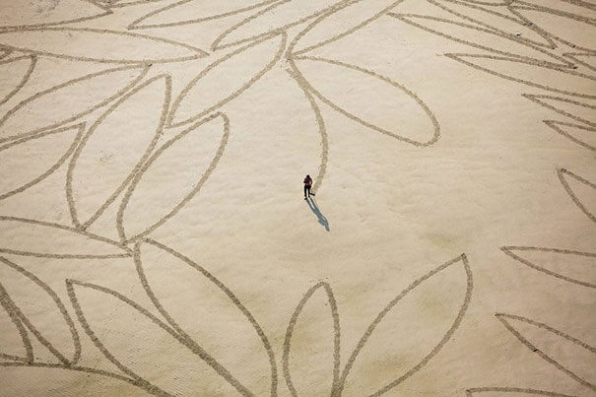
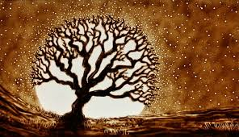
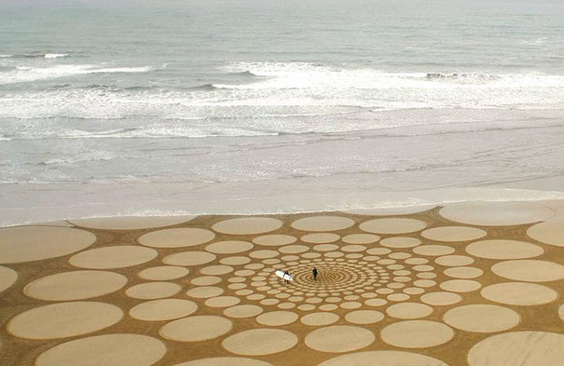
Sand drawing

Slide 2
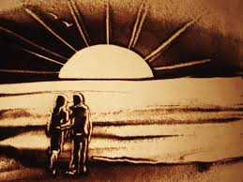

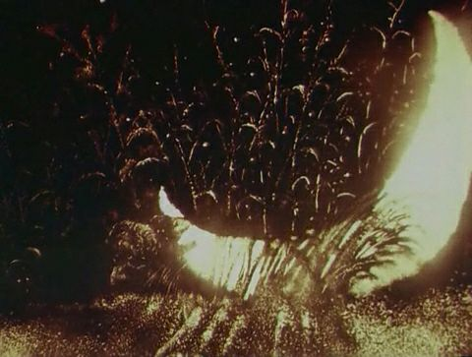
SAND ART is a young and perspective art form which came about the 1970s. The founder of this trend is an American Caroline Leaf who created the animated cartoon film "Peter and the Wolf" by Sergei Prokofiev's symphonic fairy tale. It was her graduation work in Canada's National Film Center. The film was made in a completely strange to that time technology. Young painter on glass scattered black powder and create some images from it by fingers.

Slide 3
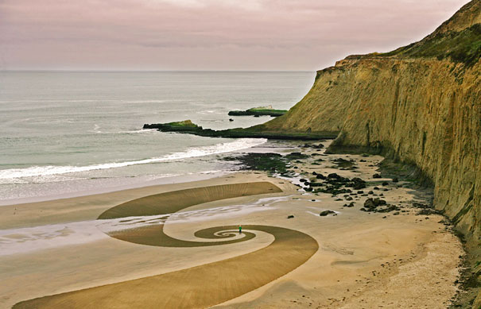
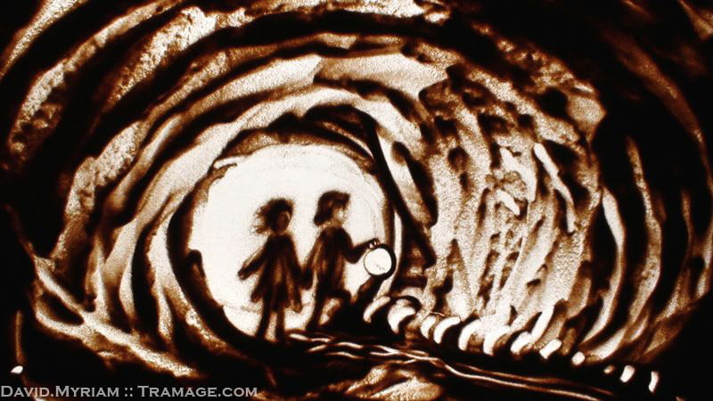
Sand drawing is a spectacular and original sort of painting art. The moving sand creates fantastic and poetic figures.
Sand animation can take place on stage: the performer creates sand drawings using a lightboard and an overhead projector. The sand animated images are projected in real time on a wide screen.
Also it can take place on a big area somewhere near the see for example on the beach.

Slide 4
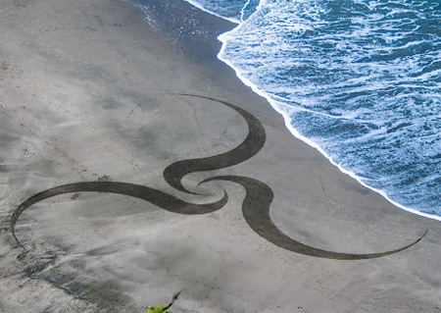
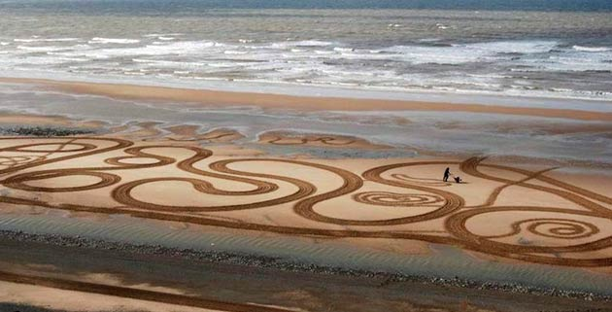
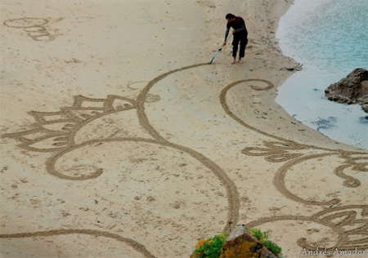
The artist and surfer Jim Denevan was born in 1961. He spend hours of drawing the most beautiful paintings on beaches. He creates his geometric paints during low tide using ordinary wooden stick. Over the past 17 years Jim has drawn hundreds of unique images around the world. Washed away by the tide, now they can be seen only in photographs.

Slide 5
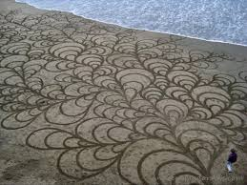
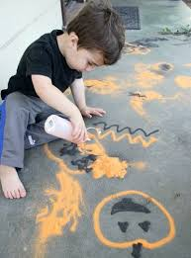
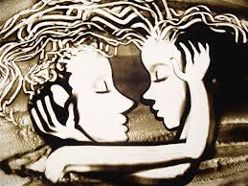
Besides the aesthetic senses creating paintings has healing properties especially for the human mental that is a type of art therapy. This is very useful in any age. The kids 4-5 years develop motor skills of hands. Older children develop creative thinking, they learn to draw storyboards, writing the script. Adults relieve stress. Sometimes half an hour is enough to calm down.

Slide 6
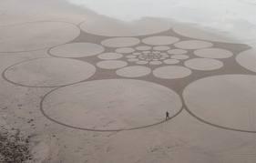
Five reasons to learn how to draw with sand
Simplicity. To try your hand at sand animation you don’t need to buy expensive supplies, go to special shops. It will take only clean screened sand, lamp and glass, instead of sand will fit any other loose substance, such as semolina or coffee.
Beauty. Clips of sand animation beat records online viewing because the work of artists in the sand can not be observed without holding your breath.
Popularity. Artists who work in this genre it is easy to count on the fingers. And each of them deserve the respect of the public.
Stress management. In any work is antidepressant side effects. Man gets rid of negative emotions. Drawing happens fingers on the sand that promotes the development of sensory experiences. Also it harmonizing and relaxing.

