Slide 1
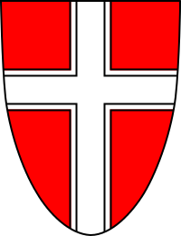
Vienna

Slide 2
Austria is located in Central Europe.
It is boarded by the Czech Republic, Germany, Hungary, Slovakia, Slovenia, Italy, Switzerland and Lichtenstein.

Slide 3
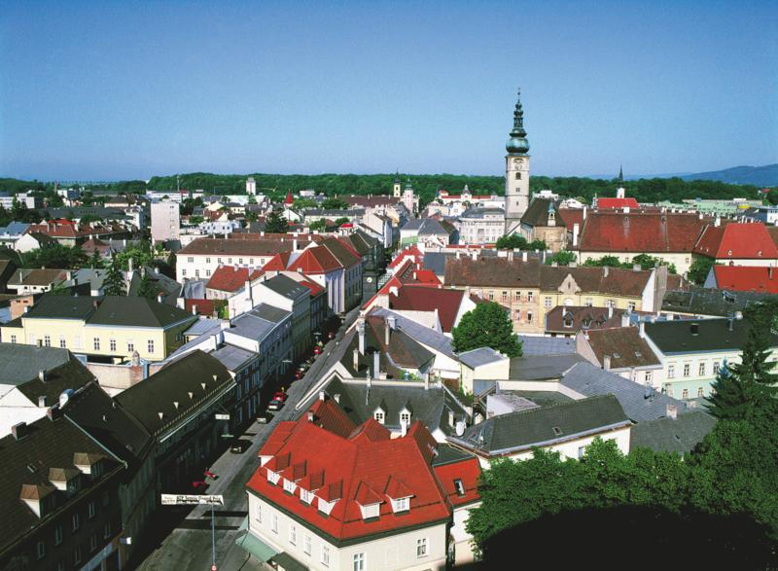
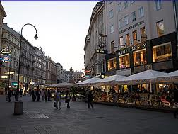
The population of this country is 8,47 million people, which live in more than 72 cities and towns.

Slide 4
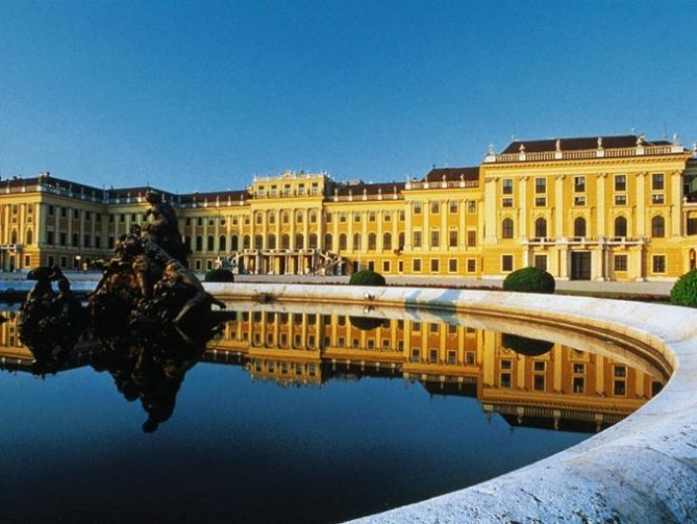
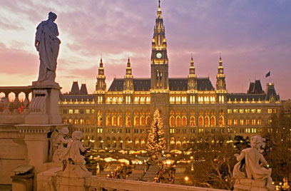
One of such cities is Vienna – the capital of Austria.

Slide 5
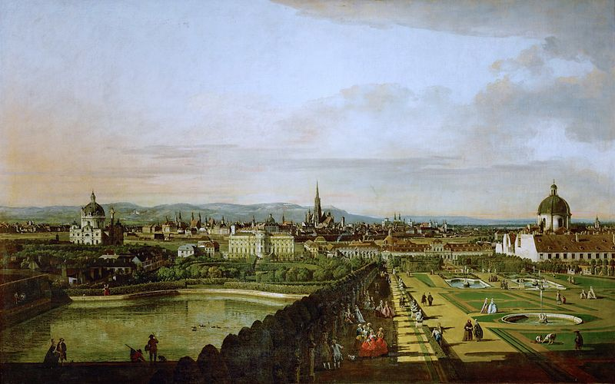
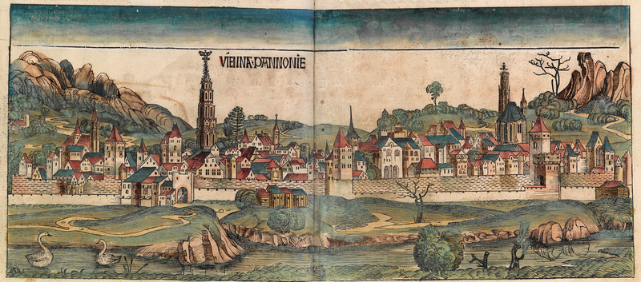
Vienna was founded in 500 BC.

Slide 6
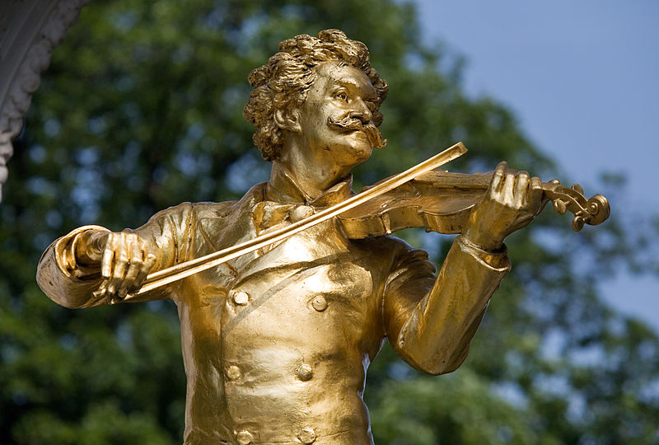
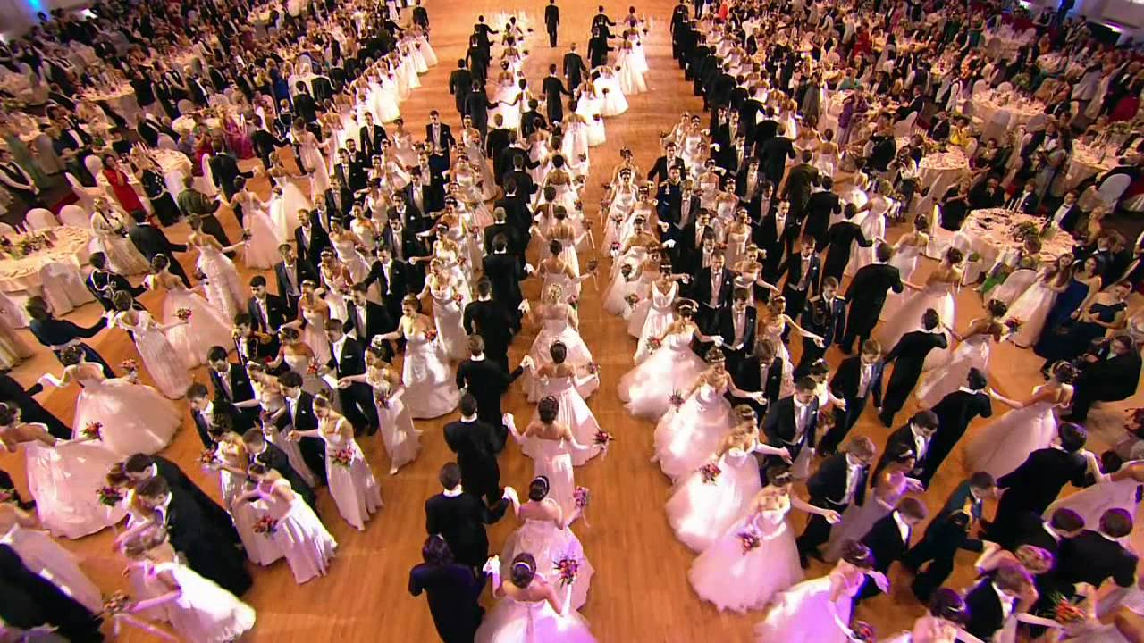
The “City of Music”

Slide 7
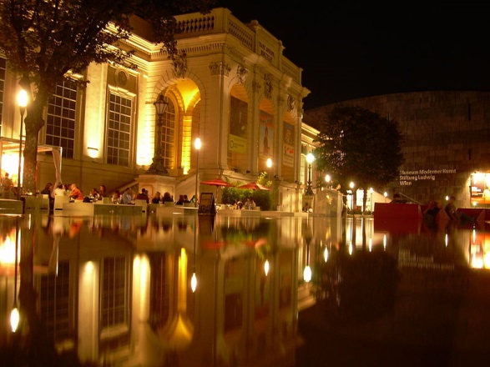
The world famous Vienna’s Opera

Slide 8
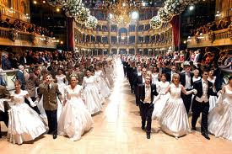
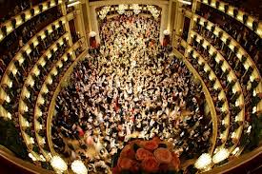
Vienna balls
Vienna is the last great capital of the nineteenth-century ball. There are over 200 significant balls per year, some featuring as many as nine live orchestras.

Slide 9
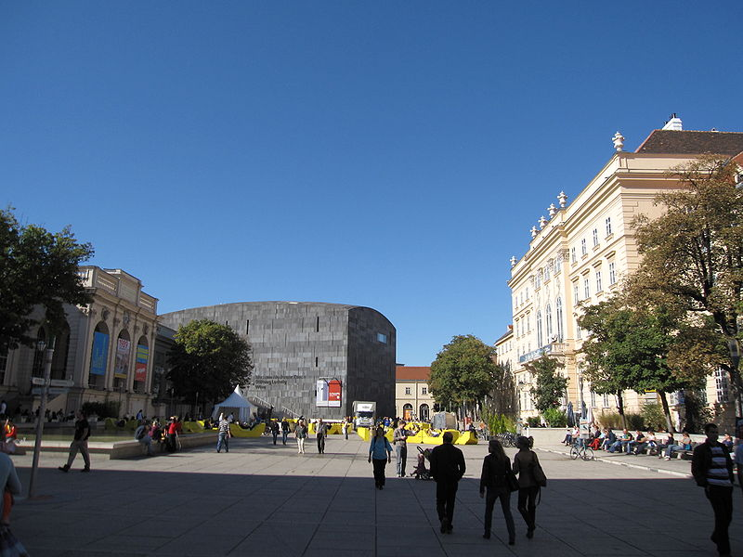
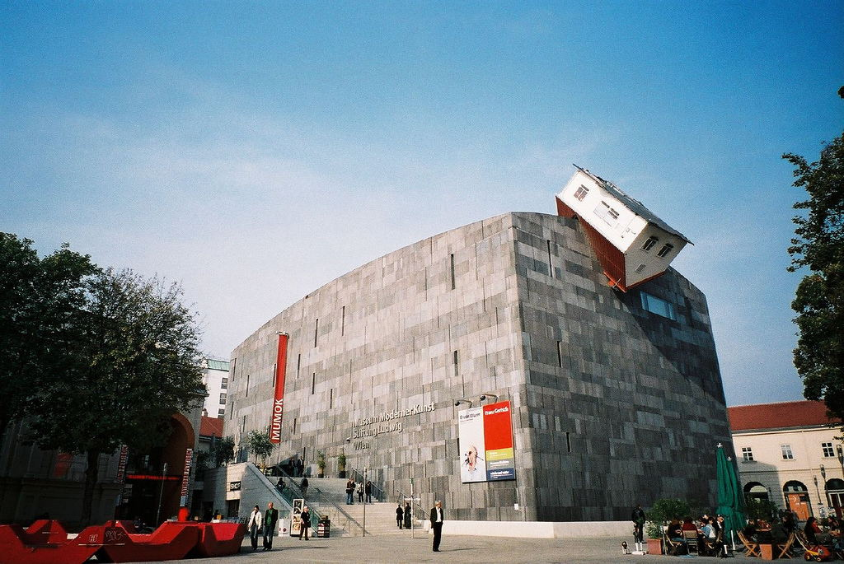
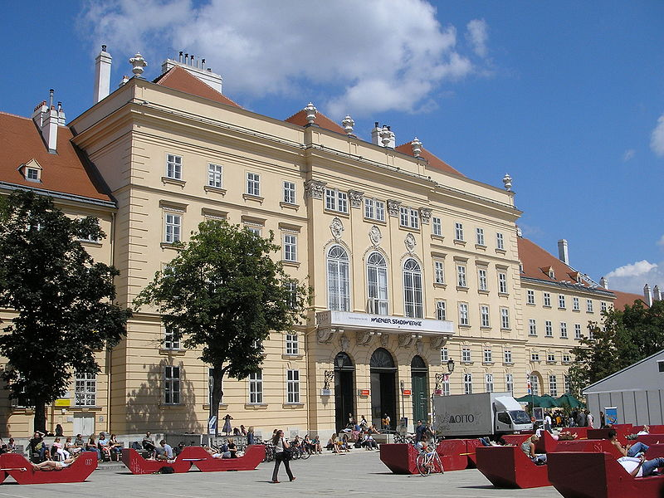
The Museumsquartier (MQ) is a 60,000 m² large area in the 7th district of the city of Vienna; it is the eighth largest cultural area in the world.

Slide 10
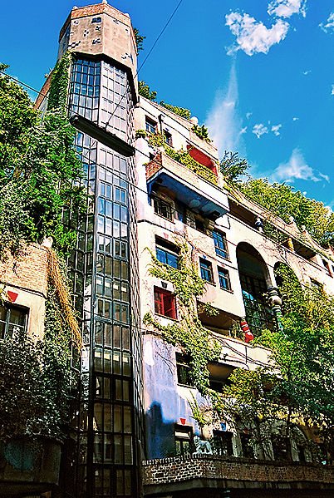
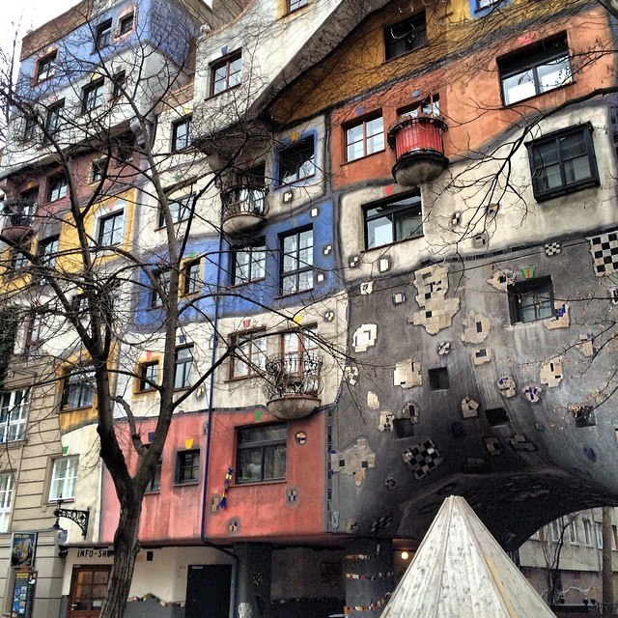
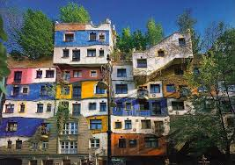
The Hundertwasserhaus is an apartment house in Vienna, built after the idea and concept of Austrian artist Friedensreich Hundertwasser with architect Joseph Krawina as a co-author.

Slide 11
Wiener Riesenrad (Riesenrad)

Slide 12
Approximately 50 per cent of Vienna (about 200 square kilometres) are green areas. A large part of these green areas is for free public use.

Slide 13
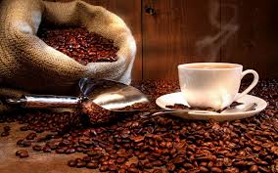
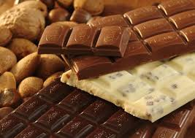
Everyone knows fomous Vienna’s coffee and chocolate.

Slide 14
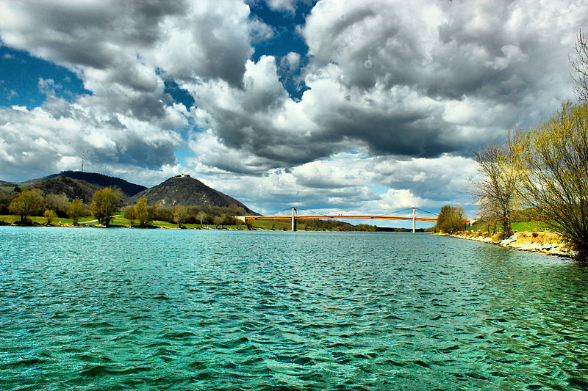
Danube in Vienna

Slide 15
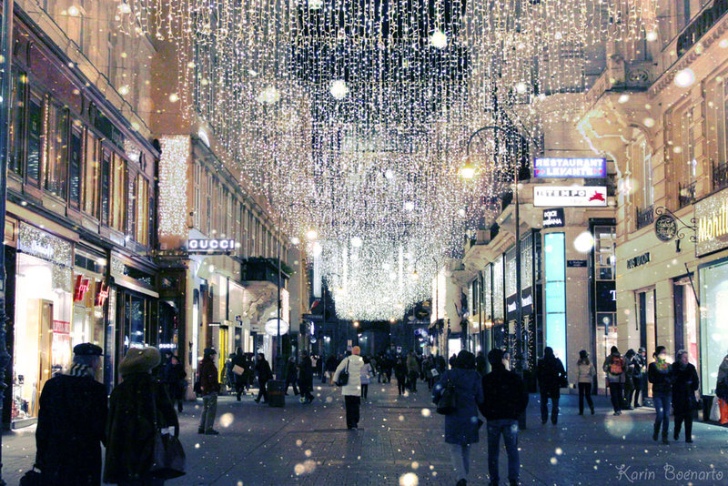
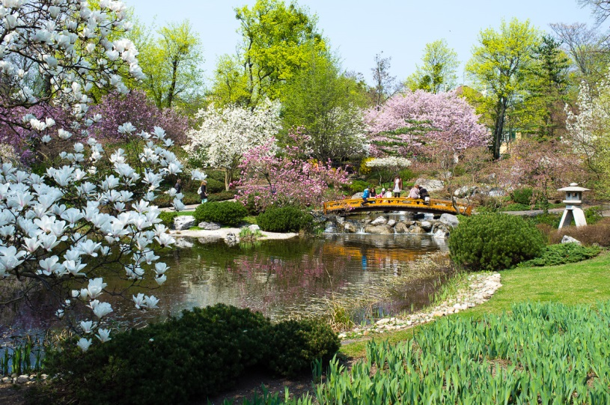
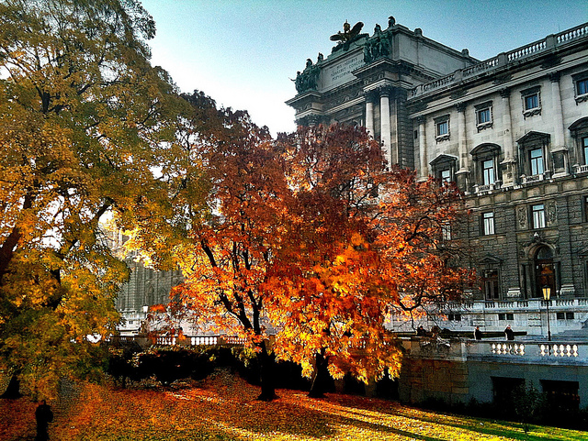
Seasons in Vienna

Slide 16
Thank you for your attention!
Mariya Kalashnyk
Form 10-A
School 18
Lviv - 2014

