Slide 1
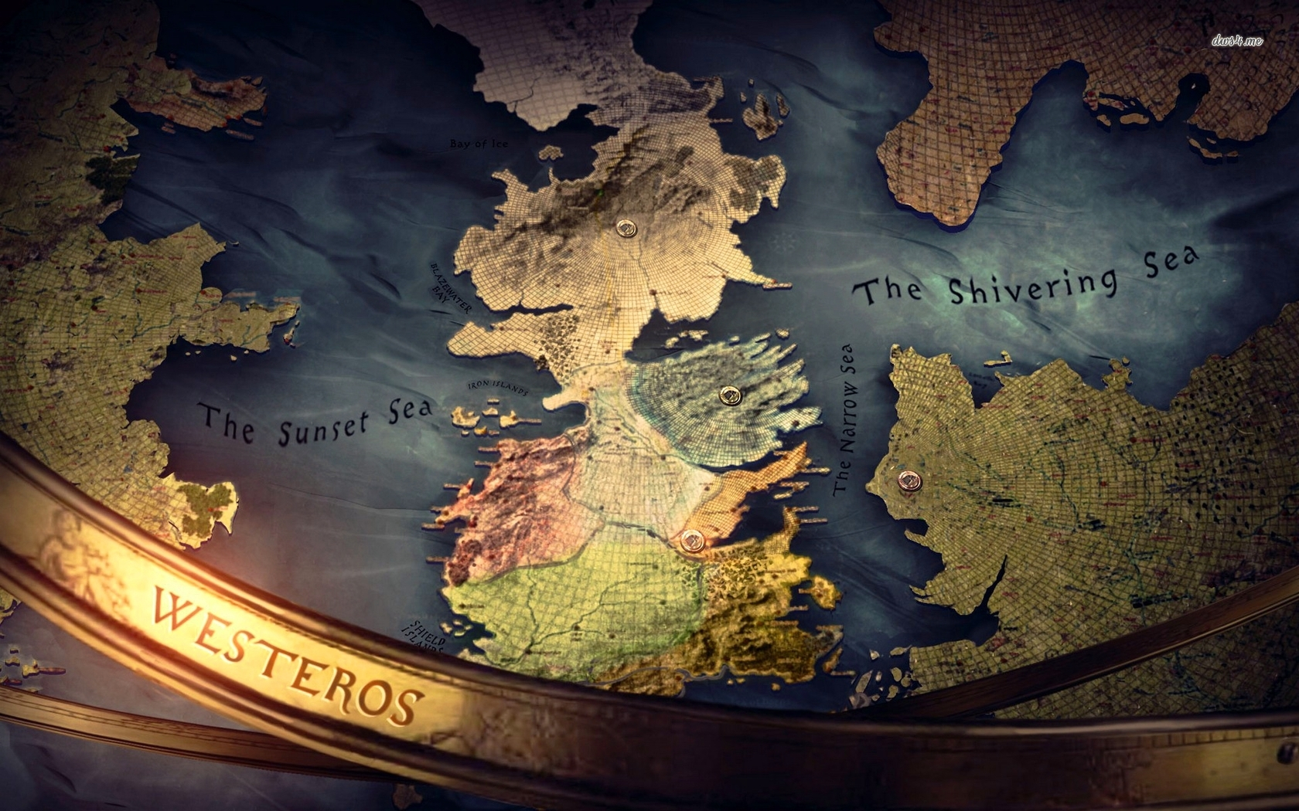
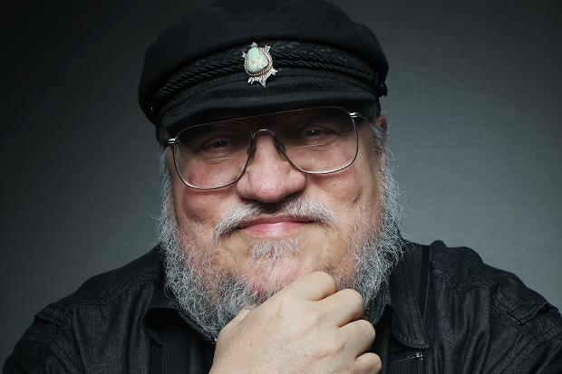
George Martin

Slide 2
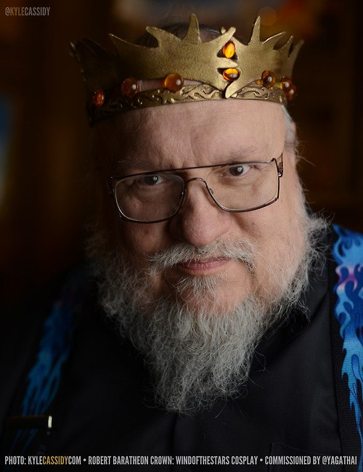
GE
OR
GE
MARTIN
George Raymond Richard Martin (born September 20, 1948), often referred to as GRRM, is an American novelist and short story writer in the fantasy, horror and science fiction genres, as well as a screenwriter and television producer. He is best known for A Song of Ice and Fire, his international bestselling series of epic fantasy novels that HBO adapted for its dramatic series Game of Thrones. Martin serves as the series' co-executive producer, while also scripting one of each season's 10 episodes. Martin was selected by Time magazine as one of the "2011 Time 100," a list of the "most influential people in the world."

Slide 3
GE
OR
GE
MARTIN
George Raymond Martin was born on September 20, 1948,in Bayonne, New Jersey the son of longshoreman Raymond Collins Martin and his wife Margaret Brady Martin. He has two younger sisters, Darleen and Janet. Martin's father was half Italian, while his mother was half Irish; his family also contains German, English, and French ancestry. The family first lived in a house on Broadway, belonging to Martin's great-grandmother. In 1953 they moved to a federal housing project near the Bayonne docks. During his childhood, his whole world consisted pretty much of "First Street to Fifth Street", between his grade school and his home; this limited world made him want to travel and experience other places, but the only way of doing so was through his imagination, and he became a voracious reader.

Slide 4
GE
OR
GE
MARTIN
The young Martin began writing and selling monster stories for pennies to other neighborhood children, dramatic readings included.
In 1970 Martin earned a B. S. in Journalism from Northwestern University, Evanston, Illinois
Martin began selling science fiction short stories professionally in 1970, at age 21. His first sale was "The Hero", sold to Galaxy magazine and published in its February 1971 issue; other sales soon followed. His first story to be nominated for the Hugo Award

Slide 5
A Song of Ice and Fire
A Song of Ice and Fire is a series of epic fantasy novels written by American novelist and screenwriter George R. R. Martin. Martin began the first volume of the series, A Game of Thrones, in 1991. He published it in 1996. Martin gradually extended his originally intended trilogy to seven volumes, the fifth of which, A Dance with Dragons, took him five years to write before its publication in 2011. Martin's work on his sixth, The Winds of Winter, is still underway.

Slide 6
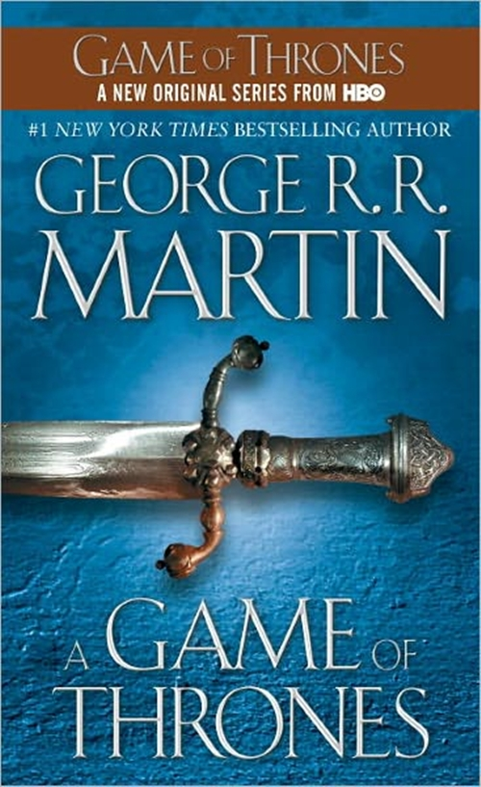
The series, set on the fictional continents of Westeros and Essos at the end of a decade-long summer, interweaves several plot lines. The first follows the members of several noble houses in a civil war for the Iron Throne of the Seven Kingdoms; the second covers the rising threat of the impending winter and the mythical creatures of the North; the third chronicles the attempts of the exiled last scion of the realm's deposed dynasty to reclaim the throne. Through its morally ambiguous characters, the series explores the issues of social hierarchy, religion, loyalty, corruption, civil war, crime, and punishment

Slide 7
Game of Thrones is an American fantasy drama television series created for HBO by Davi Benioff and D. B. Weiss. It is an adaptation of A Song of Ice and Fire, George R. R. Martin's series of fantasy novels, the first of which is titled A Game of Thrones. Filmed in a Belfast studio and on location elsewhere in Northern Ireland, Malta, Scotland, Croatia, Iceland and Morocco, it premiered on HBO in the United States on April 17, 2011. Two days after the fourth season premiered in April 2014, HBO renewed Game of Thrones for a fifth and sixth season.

Slide 8
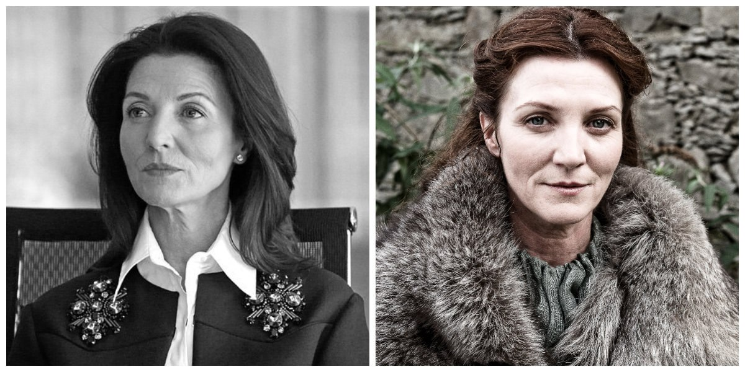
Sean Bean
as
Eddard Stark
Michelle Fairley
as
Catelyn Stark

Slide 9
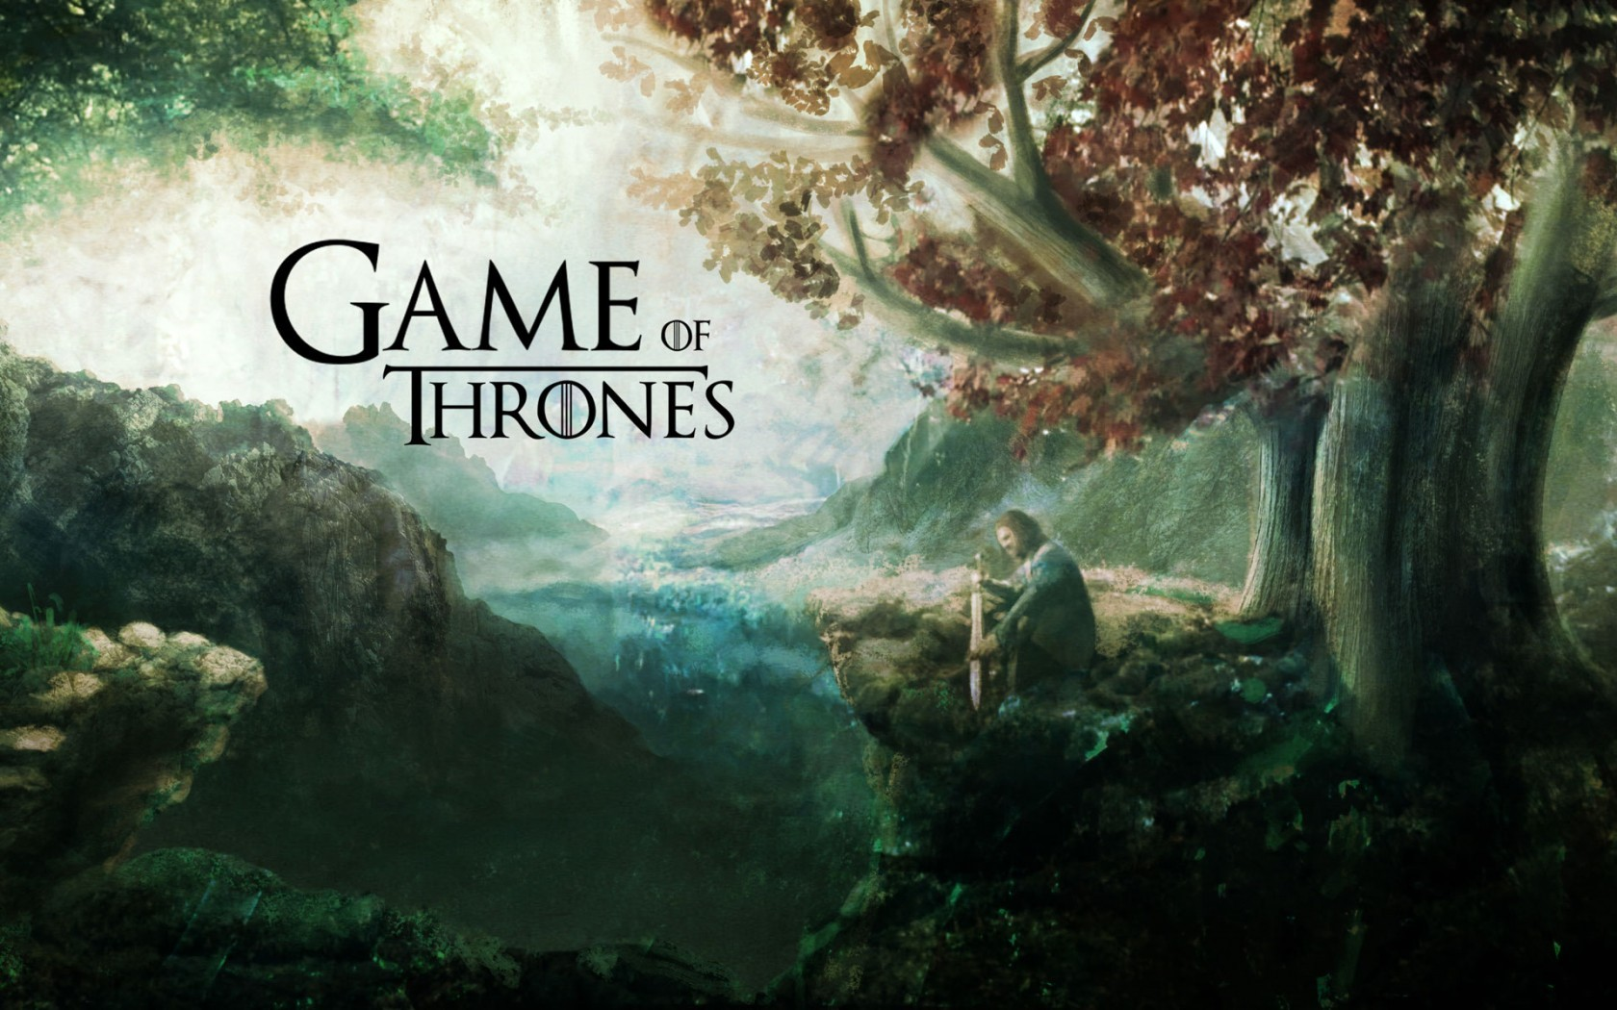
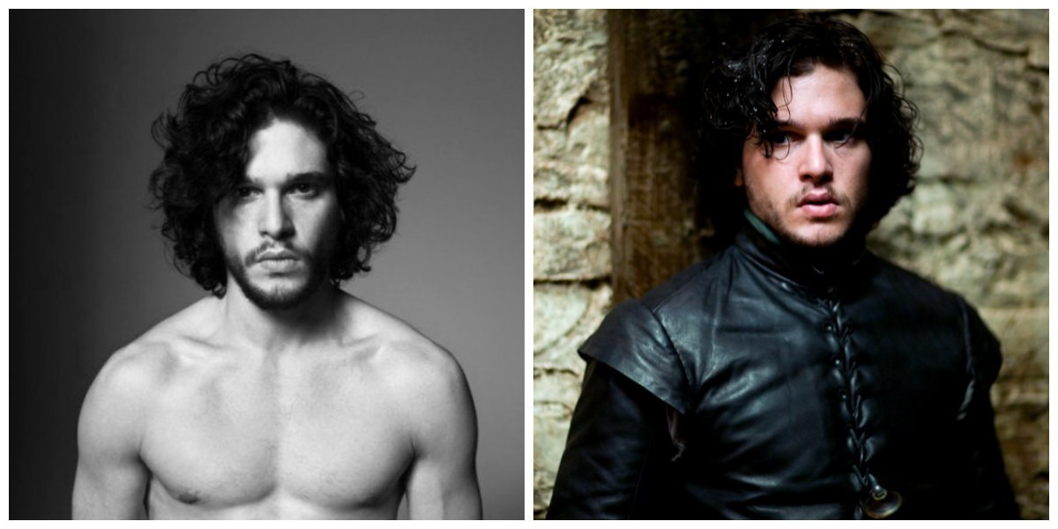
Richard Madden
as
Robb Stark
Sophie Turner
as
Sansa Stark
Kit Harington
as
Jon Snow

Slide 10
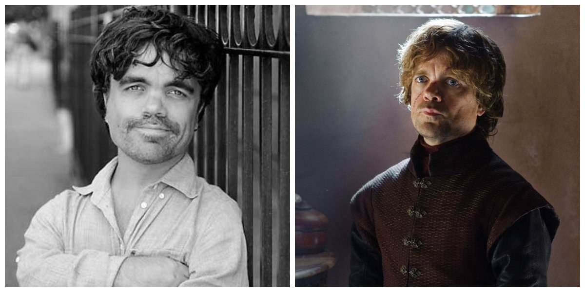
Peter Dinklage
as
Tyrion Lannister
Emilia Clarke
as
Daenerys Targarien

Slide 11
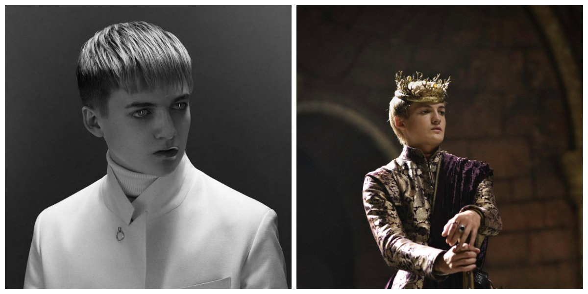
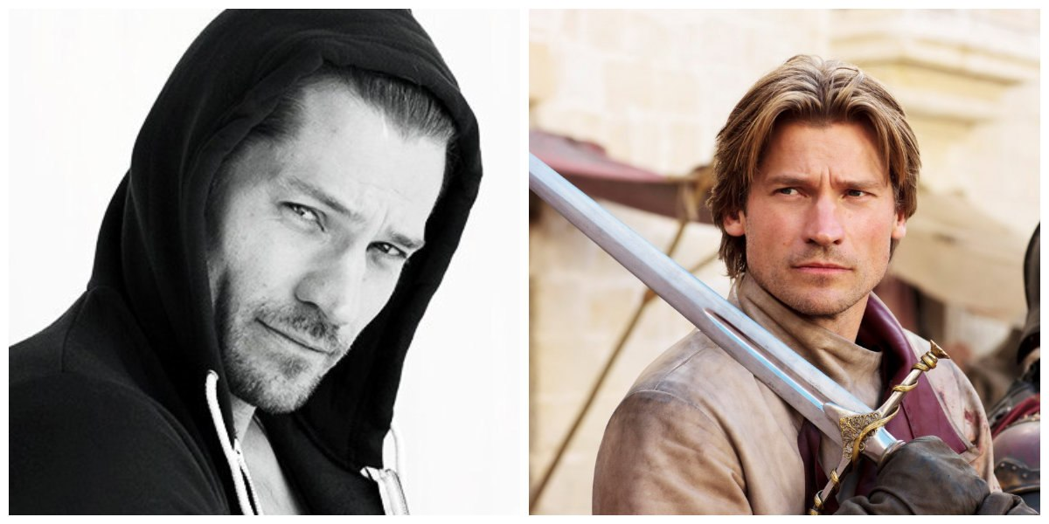
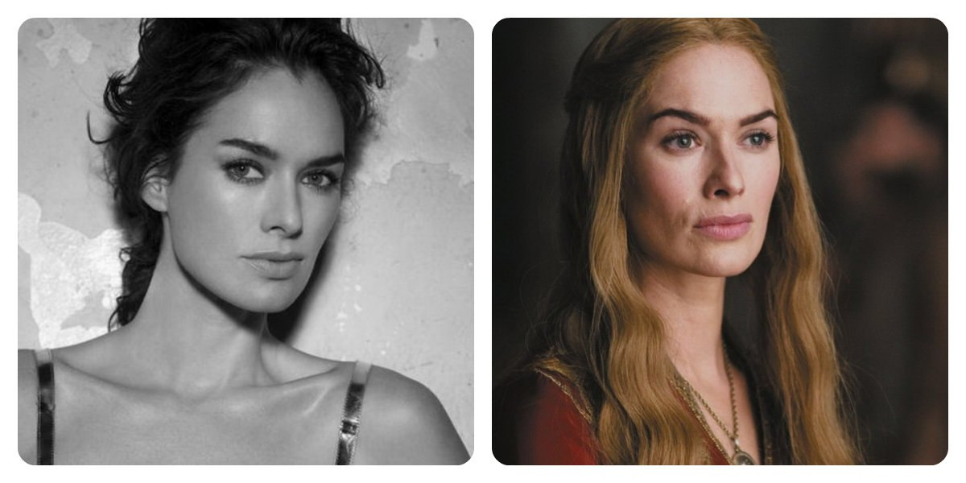
Jack Gleeson
as
Joffrey Lannister
Nicolai Coster-Waldau
As
Jeime Lannister
Lena Headey
as
Cersei Lannister

Slide 13
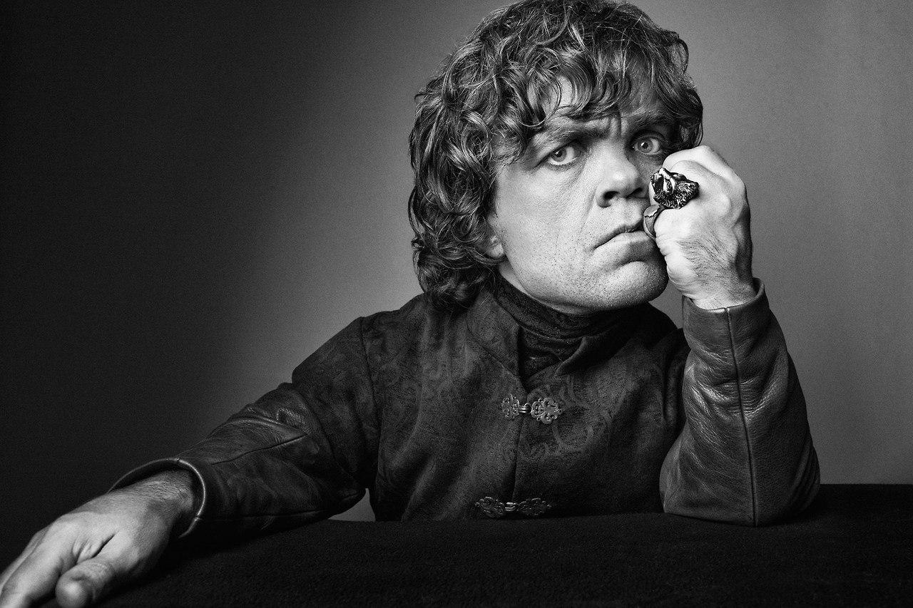
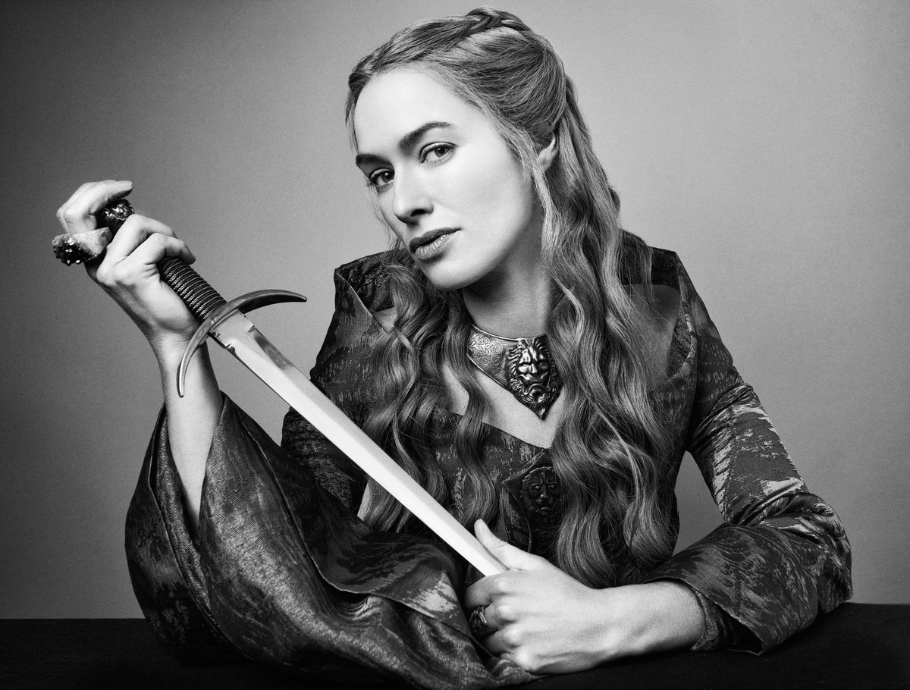

Slide 14
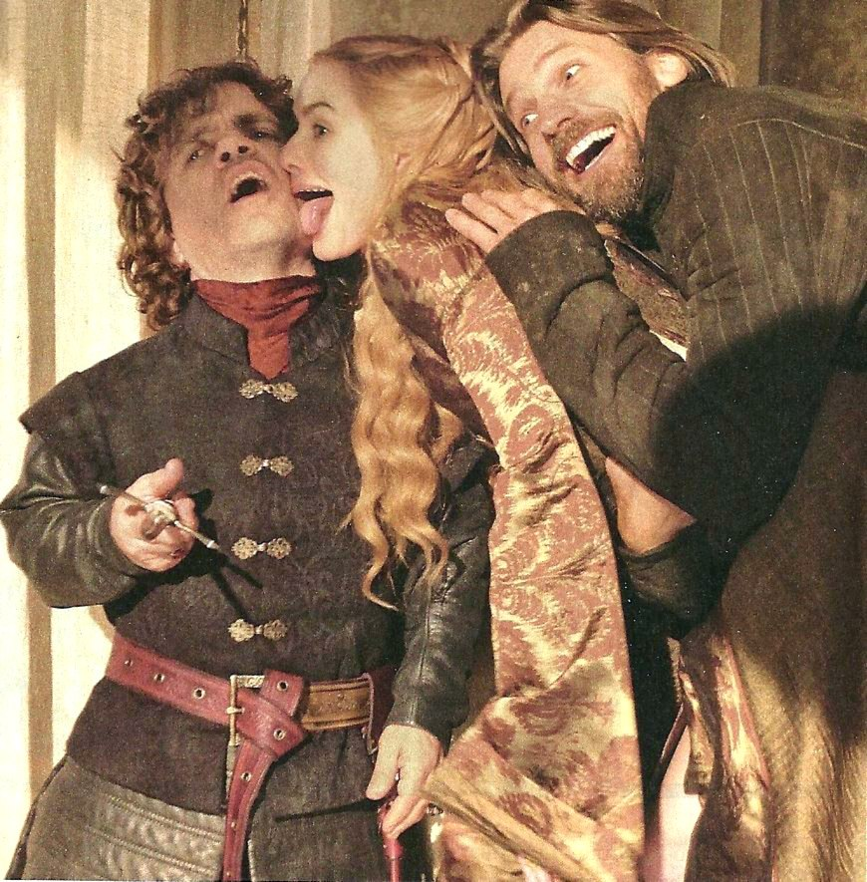
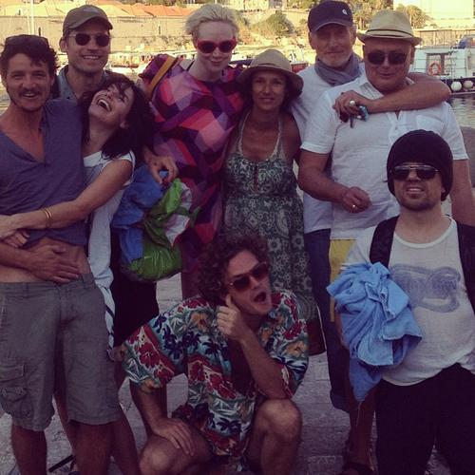

Slide 15
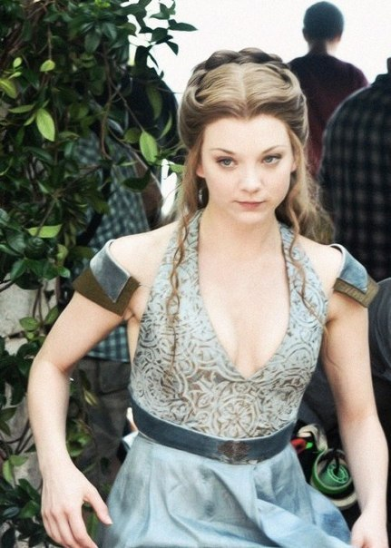
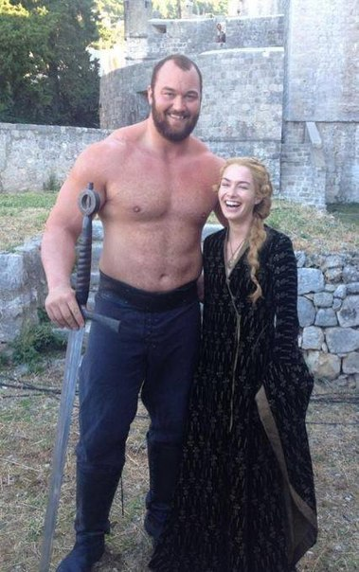
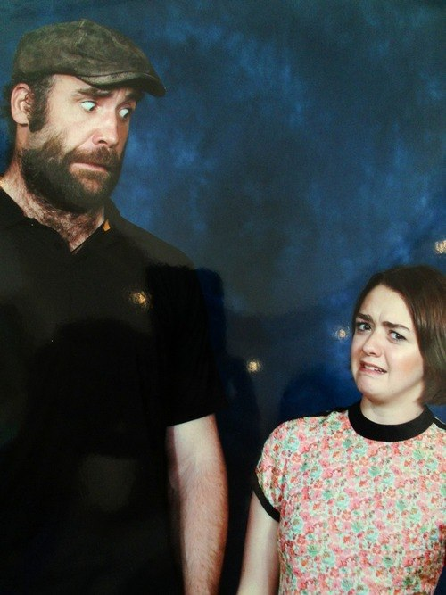

Slide 16
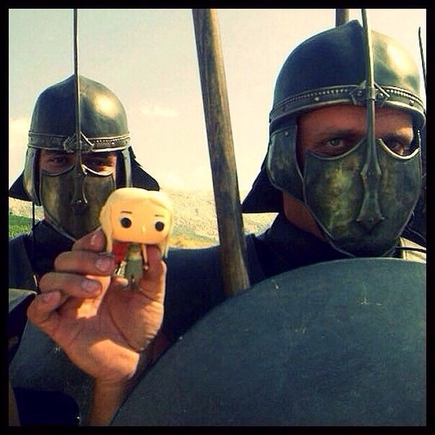
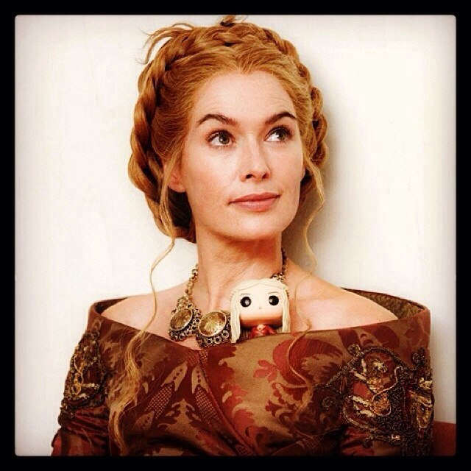
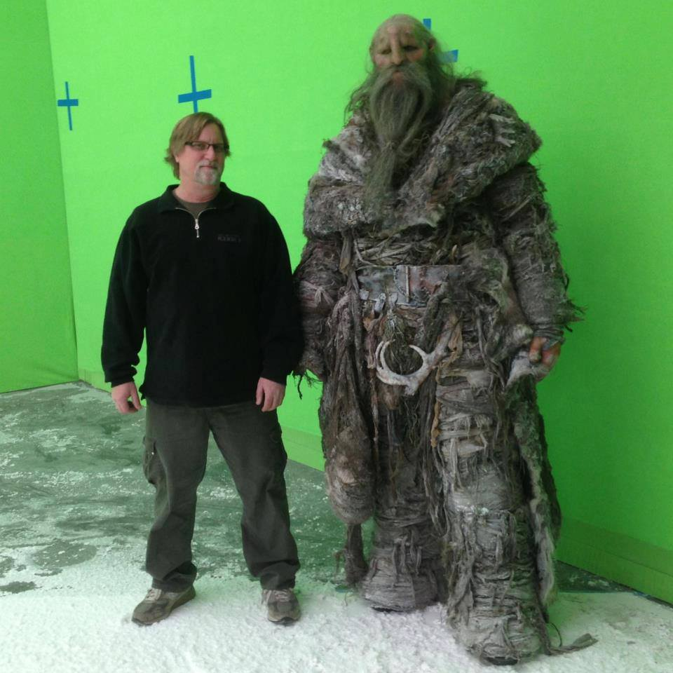
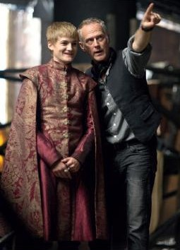

Slide 17
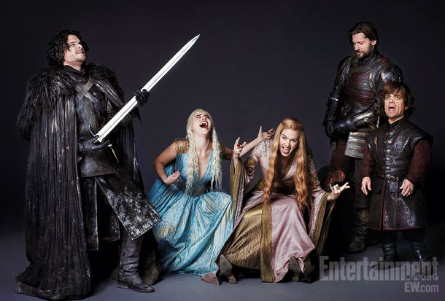

Slide 18
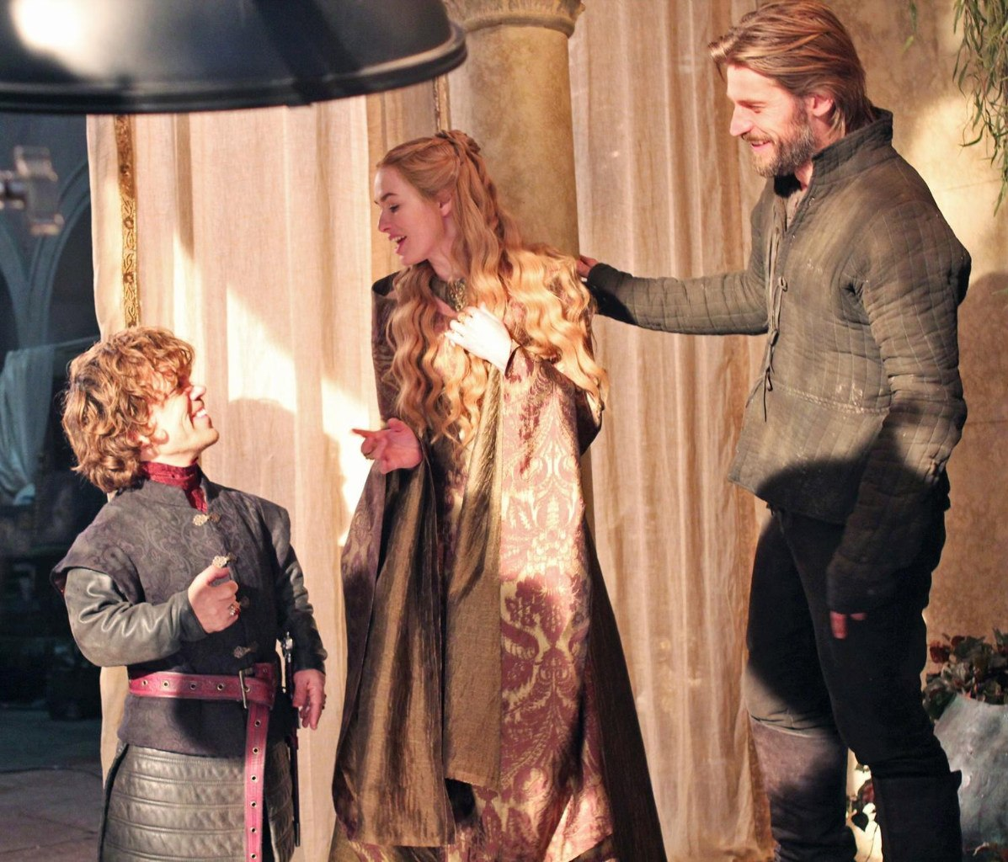
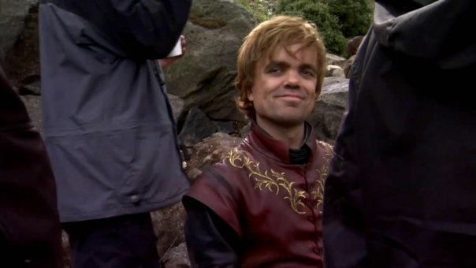
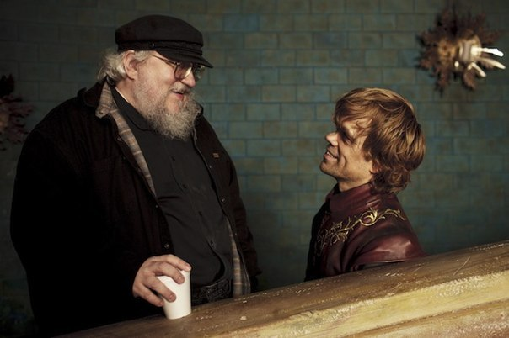
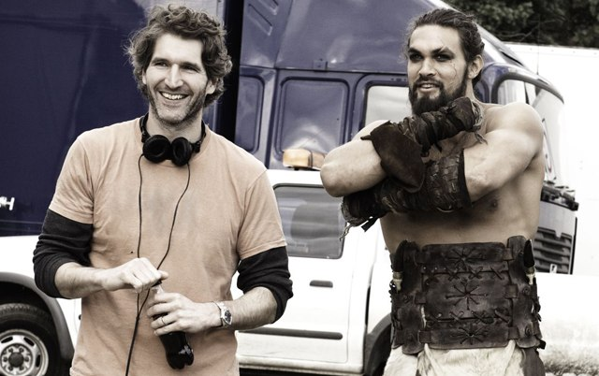
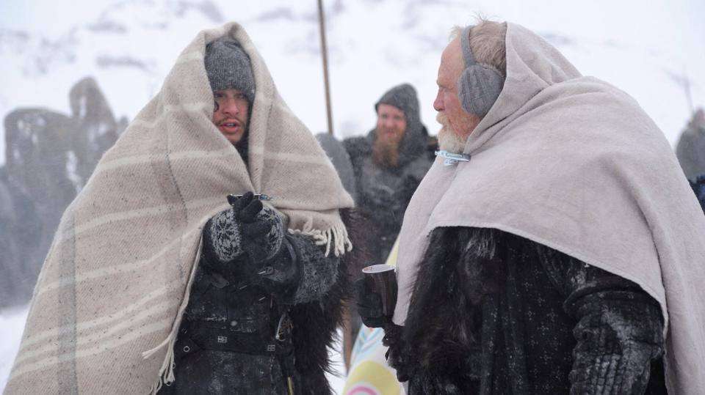
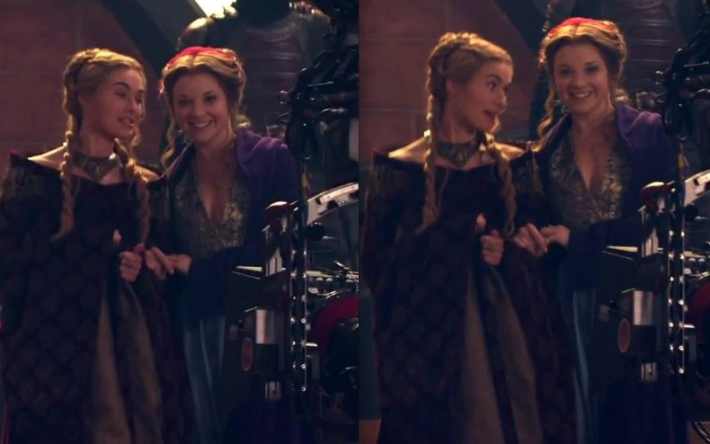

Slide 19
