Slide 1
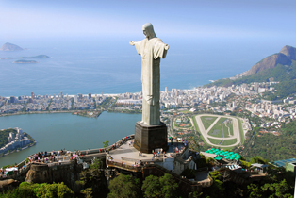
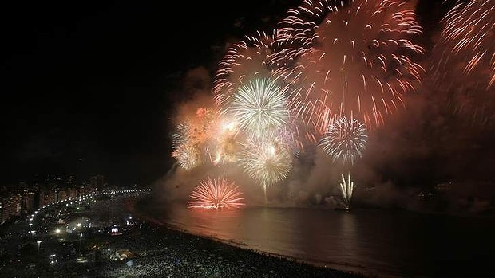
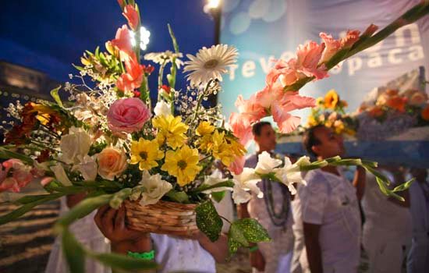
New Year's Traditions in Rio, Brazil
Olga Gavrulyuik, 10-B

Slide 2
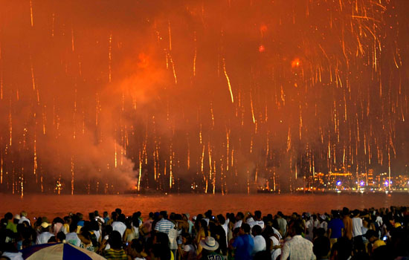
The Important Role of New Year's Eve Traditions in Rio de Janeiro
Millions of people from several places around the world meet up and experience the majestic fireworks across kilometers of beaches all around Rio de Janeiro’s shores, especially in Copacabana. The joy of the New Year's celebration Rio-style is filled with parties and amazing experiences that will shock you if you have not yet experienced something like that before.
However, there are some
important aspects of the
celebration that tourists
might be missing out, what
makes this a genuine
Brazilian New Year's style.

Slide 3
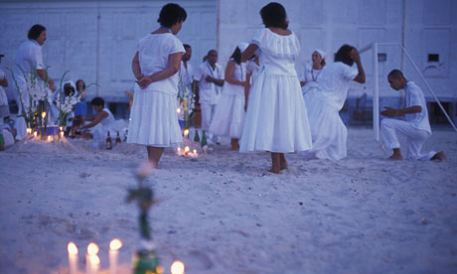
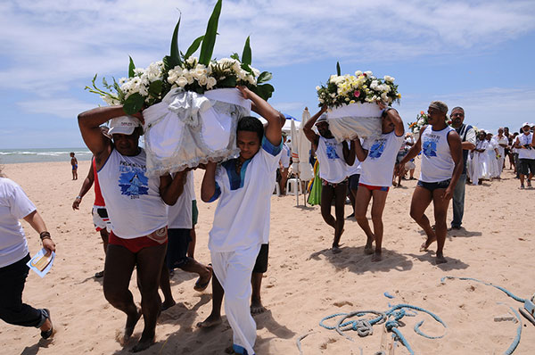
Tradition on clothes
White is the base outfit for anyone coming in for New Year's Eve in Rio. It is not mandatory, you should not be wearing a color more predominant than white. However, since white is a bit light, you can use traditional accent colors for the bikini, trunks and undergarments. The different colors attract different kinds of luck. White is of course about peace. Green means good health. Yellow pertains for money. Red is to attract passion and romance. Purple denotes inspiration. Choosing the right underwear will make you look good and trendy.

Slide 4
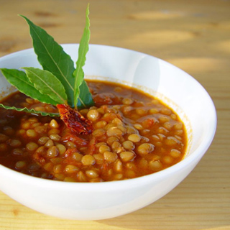
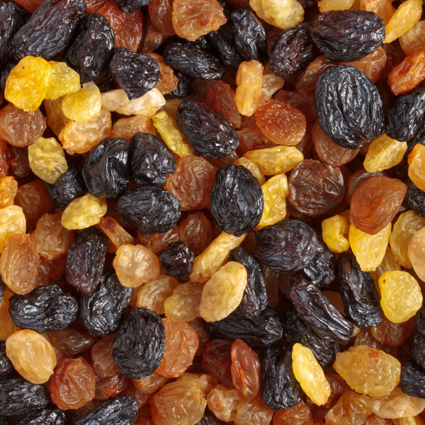
Tradition on Food
Food is everything in New Year's Eve in Rio. Eating the right kinds of food products will ensure a more prosperous year ahead. For the New Year's Eve in Rio, Lentils are very important staples. This food means health. Pork and fish are also quite common.
By midnight, you have to eat 7 pieces of raisins. Do not throw the seeds though. Keep it in your wallet and you will surely have money in that wallet all the time.

Slide 5
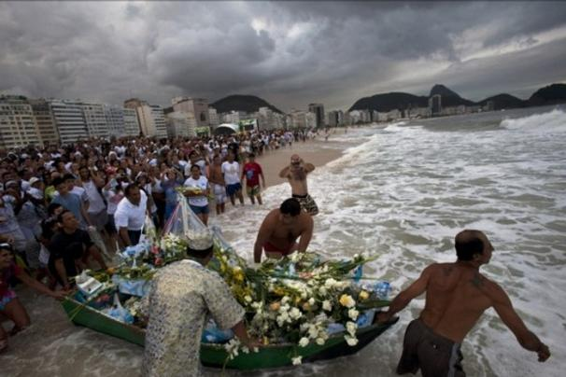
The offerings for the sea
Iemanja is a popular goddess in the Brazilian myths and she is the deity that has control over the waters. It is important to appease her with gifts such as flowers on New Year's day or the day before. If you are in the beach, light some candles and throw flowers toward the sea. There are some that make a small flotation
device to put in
bouquets of flowers
as well as material
goods. They say
that if the goods
were sent back,
they were not
accepted. It is fine.
You can try it out
again next time!

Slide 6
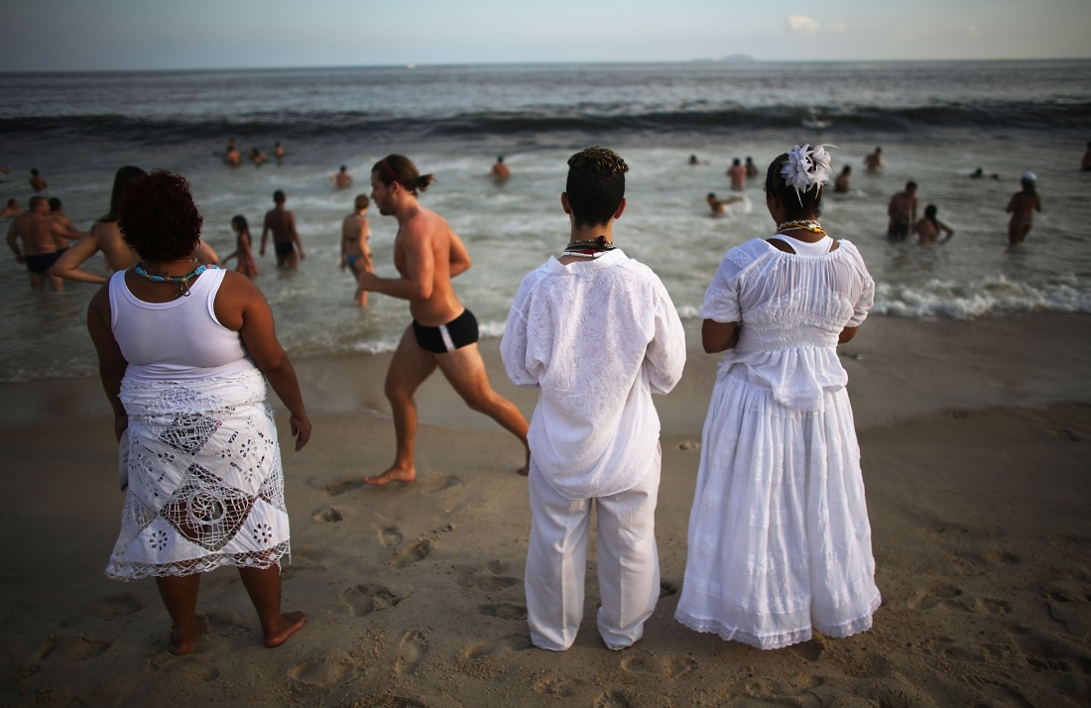
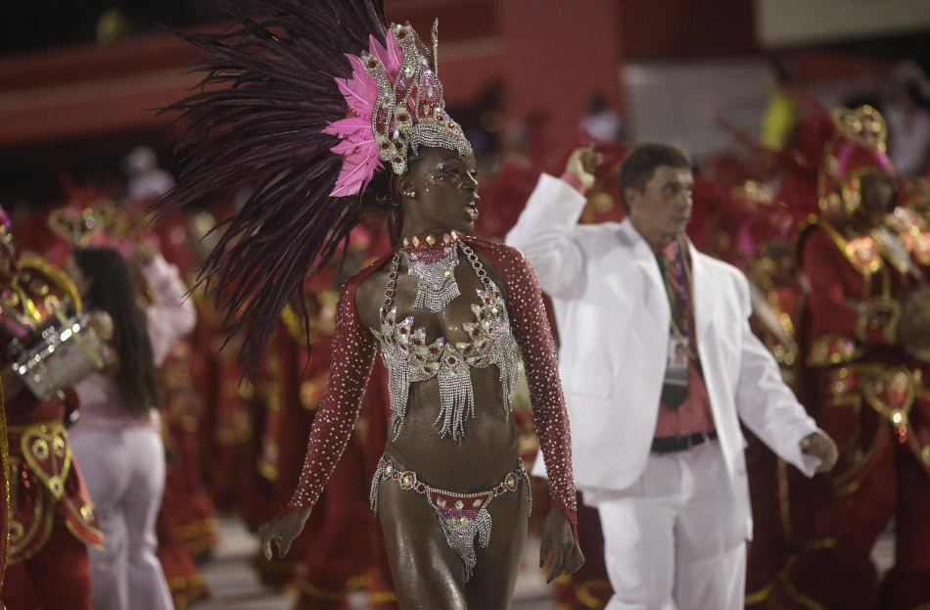
Other kinds of Traditions
Good luck can increase if you jump over 7 different waves while making your New Year's wishes, one for each wave. This will make your wishes possible and your luck better for the coming year. If you have celebrated the New Year's Eve in Rio out of the beach, you can jump 3 times with your right foot or you can also use a chair and climb down using your right feet first. If you want to increase your luck in love, make sure that the first person you greet when the New Year comes is someone of the opposite sex.
Remember, the best experience of the New Year's Eve in Rio will not be complete without these amazing traditions that will make it much more than just partying all night long.

Slide 7
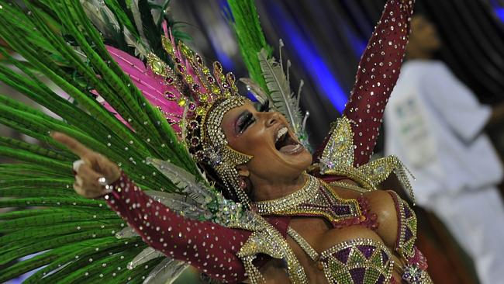
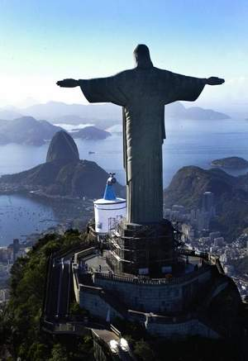
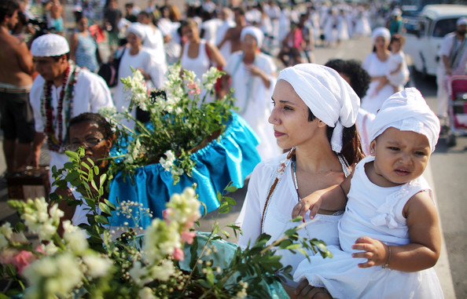
Thanks for your attention

