Slide 1
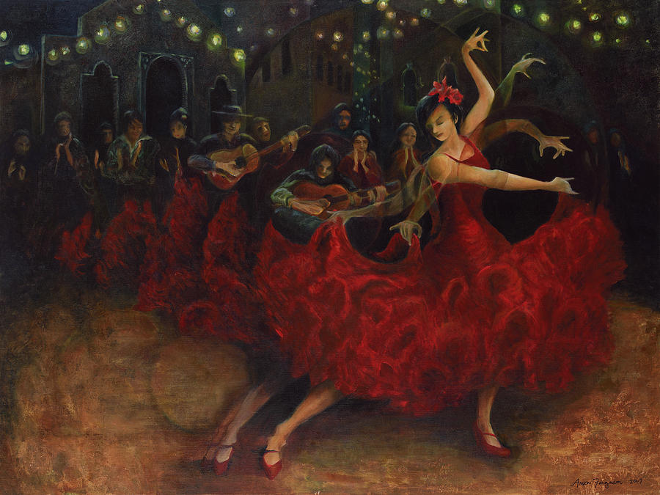
Rhythm of Flamenco

Slide 2

Flamenco - is a form of Spanish folk music and dance from the region of Andalusia in southern Spain

Slide 3
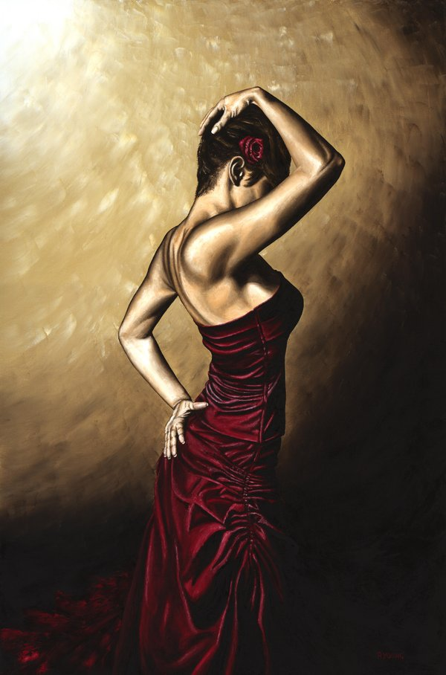
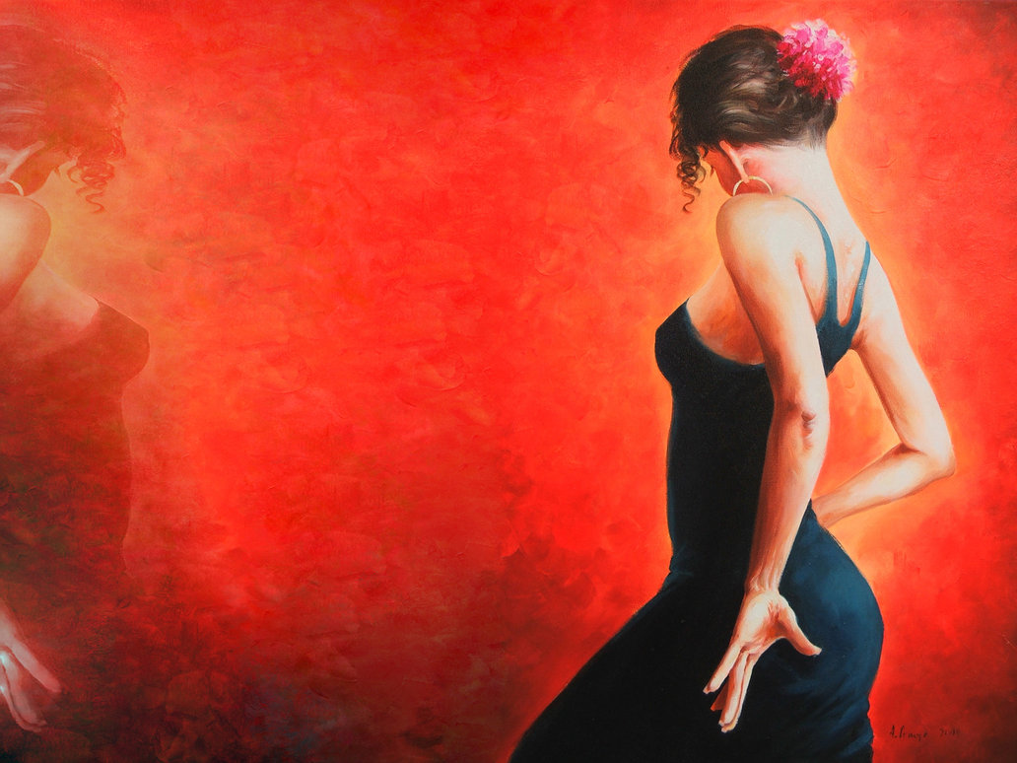
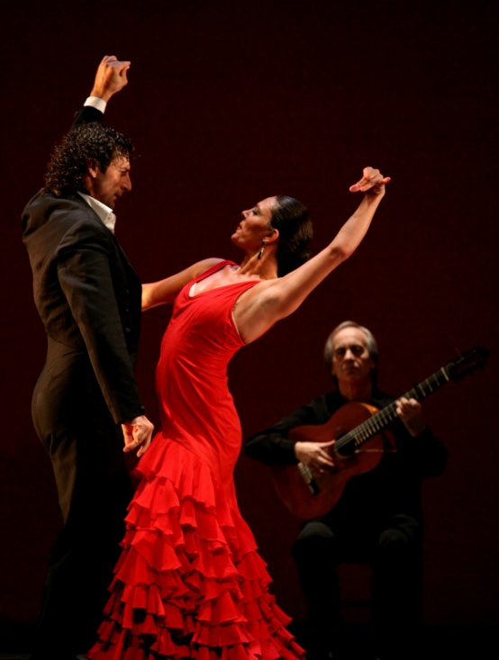
In recent years flamenco has become popular all over the world and is taught in many countries: in Japan there are more academies than there are in Spain

Slide 4
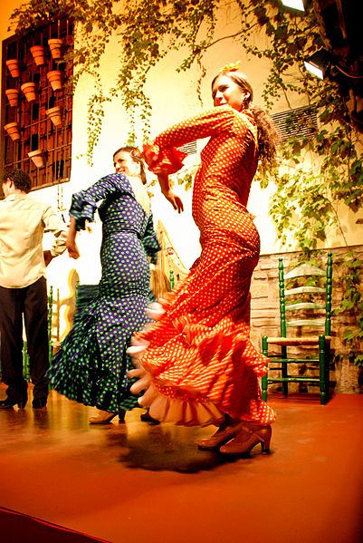
"Classical flamenco" is the style most frequently performed by Spanish flamenco dance companies, tending to exhibit more clearly the characteristics derived from the Seguidilla, a traditional Spanish dance. It is danced largely in a proud and upright way. For women, the back is often held in a marked back bend. Unlike the more gitano influenced styles, there is little movement of the hips, the body is tightly held and the arms are long, like a ballet dancer. In fact many of the dancers in these companies have trained in ballet as well as flamenco

Slide 5
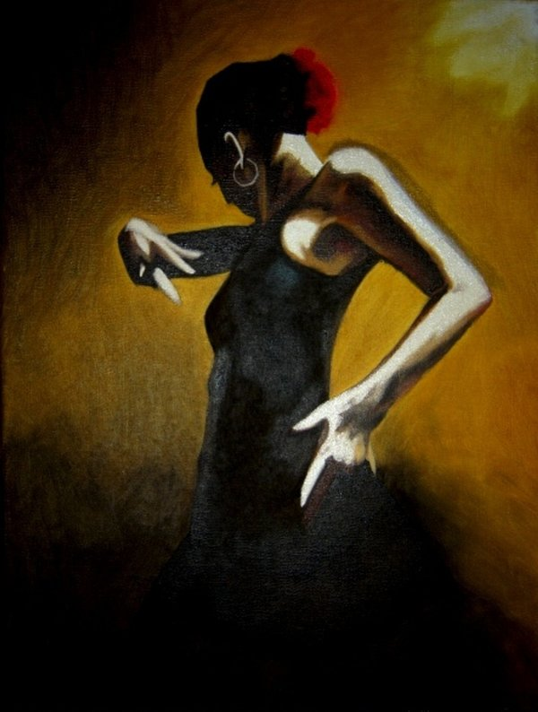
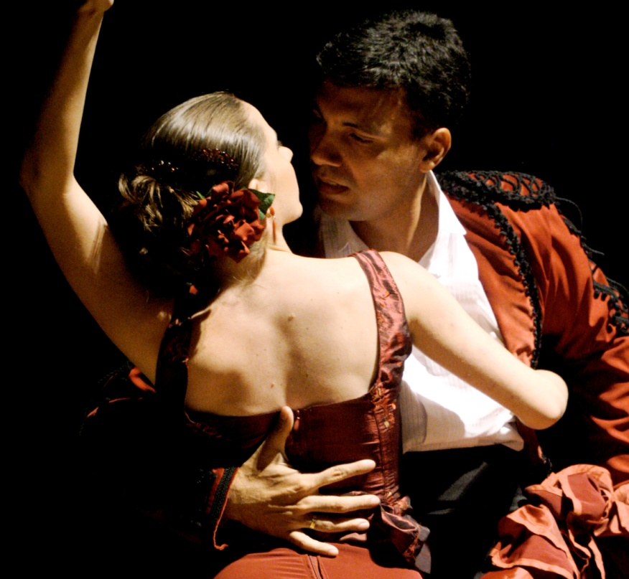
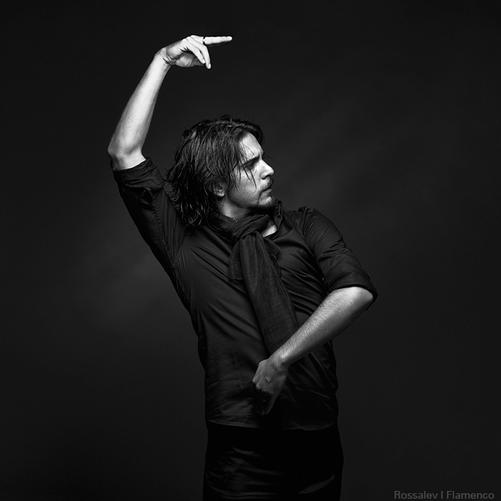
Modern flamenco is a highly technical dance style requiring years of study. The emphasis for both male and female performers is on lightning-fast footwork performed with absolute precision. In addition, the dancer may have to dance while using props such as castanets, shawls and fans.

Slide 6
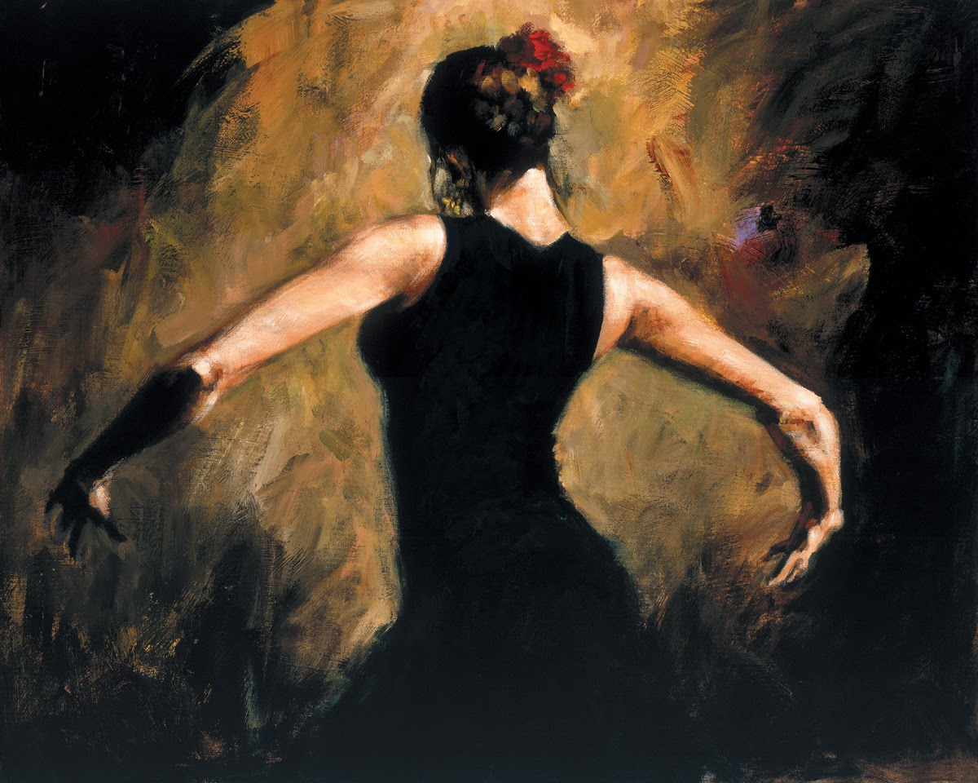
Thank you for attention

