Slide 1
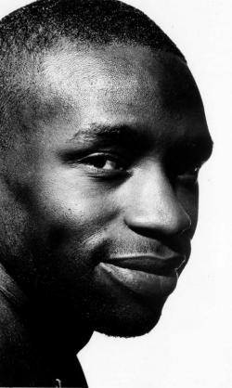
Diran Adebayo

Slide 2
Education and career
Diran Adebayo (born 30 August 1968) is a British novelist, cultural critic and broadcaster best known for his vivid portrayals of modern London life and his distinctive use of language.

Slide 3
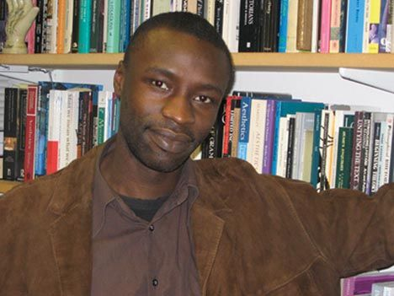

Slide 4
Publications
Some Kind of Black (1997)
My Once Upon A Time (2001)
New Writing 12 (2004)
Underwords: The Booktrust London Short Story Competition Anthology (as co-author) (2005)
Ox-Tales: Air (as co-author) (2009)
The Ballad of Dizzy and Miss P (pending)

Slide 5
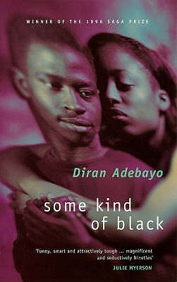

Slide 6
diranadebayo.com

Slide 7
Thank you for your attention

