Slide 1

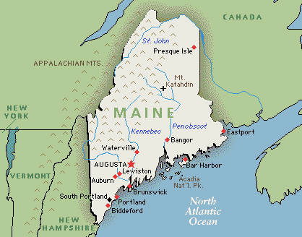
MAINE

Slide 2

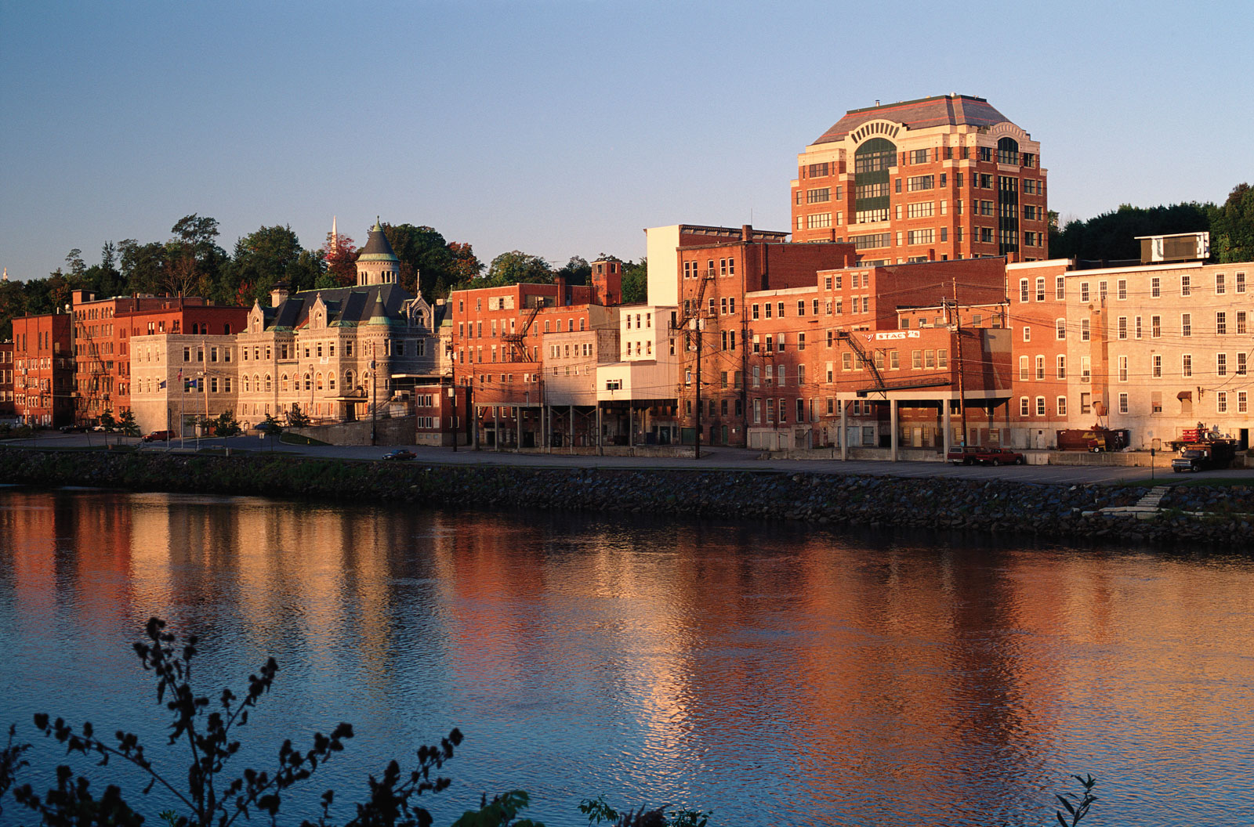
Augusta, Maine

Slide 3

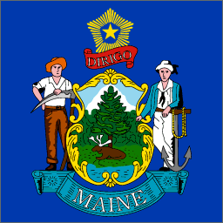
The flag of the state of Maine features the state coat of arms on a blue field. In the center of the shield, a moose rests under a tall pine tree. A farmer and seaman represent the traditional reliance on agriculture and the sea by the state. The North Star represents the state motto: Dirigo ("I Lead").

Slide 4




Slide 5
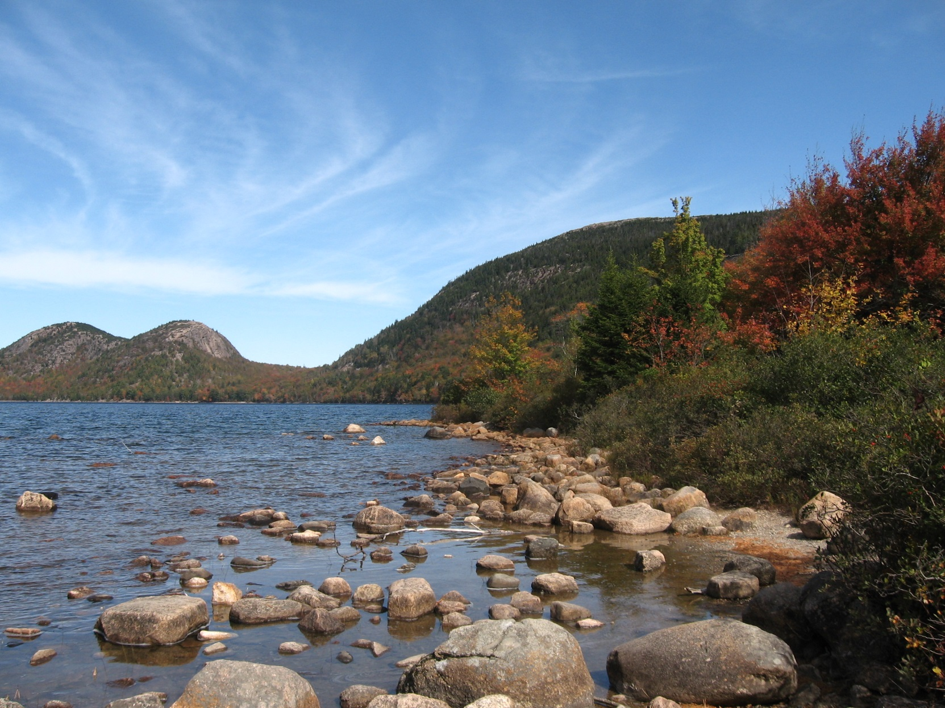
Acadia National Park

Slide 6

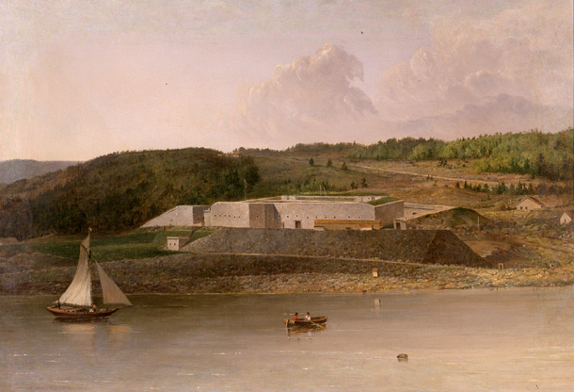
Fort Knox

