Slide 1
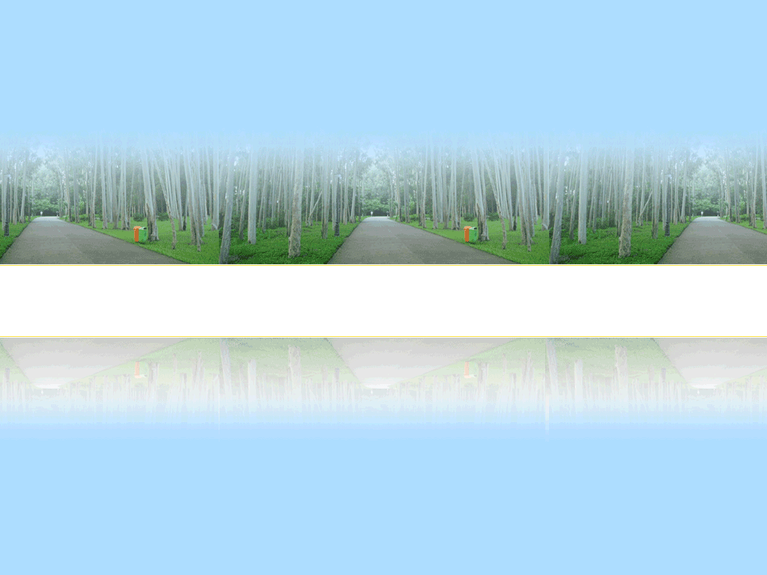
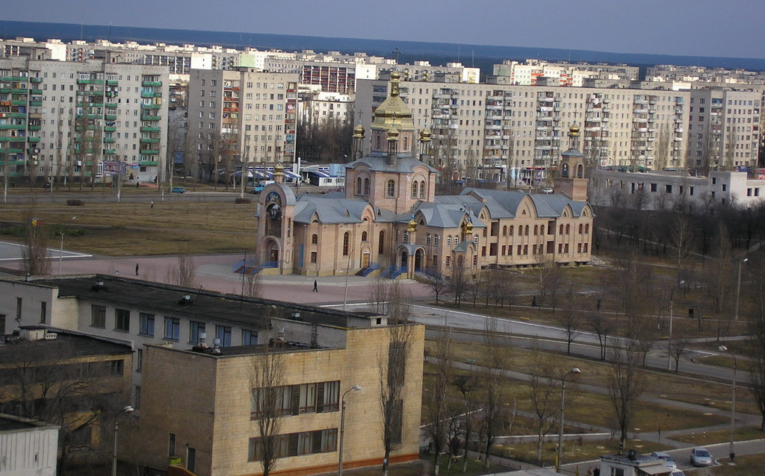
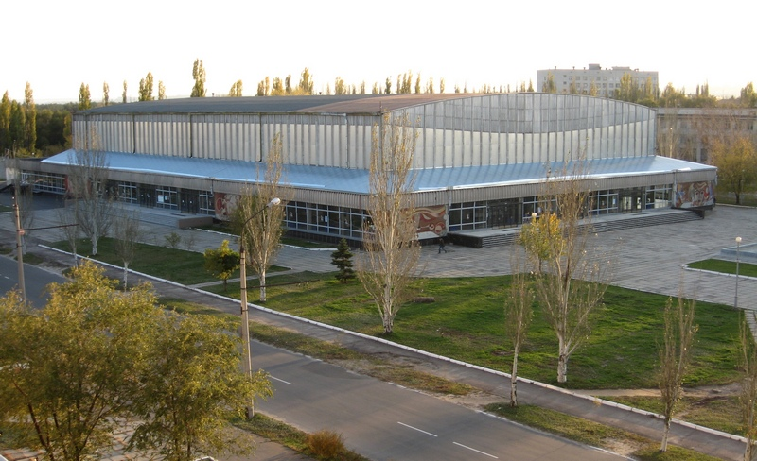
Ecological problems in Severodonetsk

Slide 2

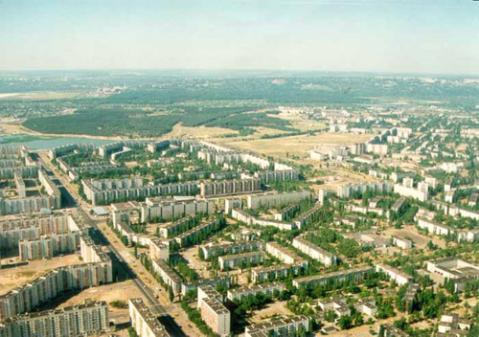
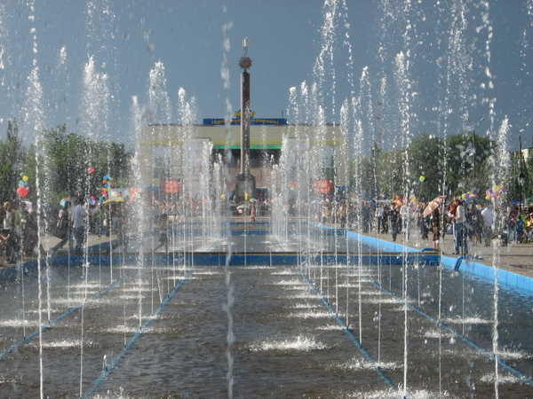
LOGO
Our town needs protection, so we should help it to develop and to be clean at once.

Slide 3
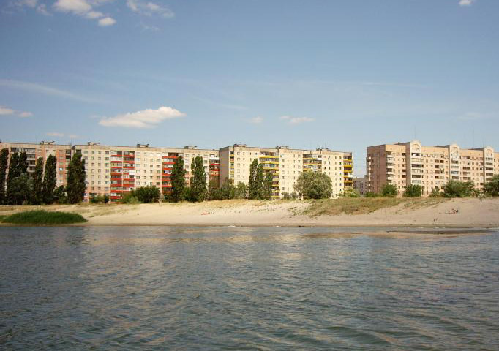
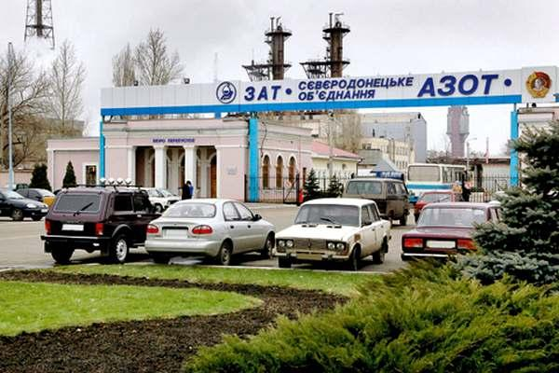
People should pay attention to our problems.
LOGO
I know that simple people such me or my classmates can’t help our polluted air or rivers.
Unfortunately our plant Azot pollutes all components of our environment.

Slide 4
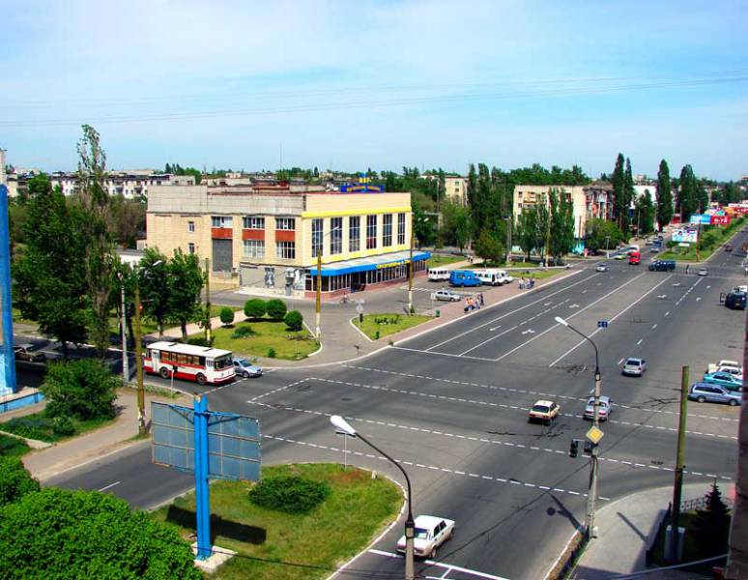
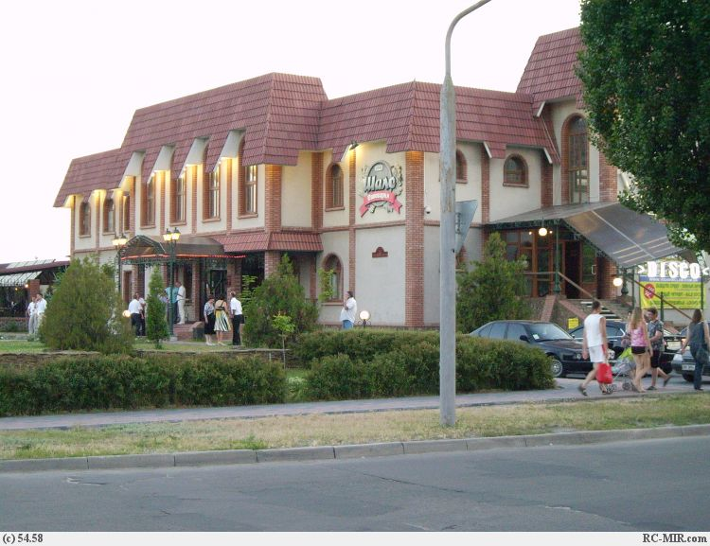
But we can do some simple things.
At least we can through our rubbish in special places, but not in streets.
Many of us are not content about the condition of our streets.Why don’t we help them to become cleaner?
LOGO

Slide 5
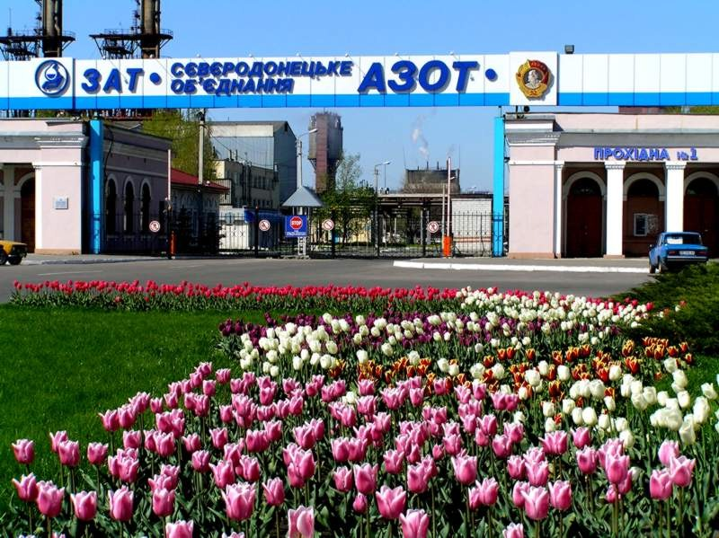
Our rivers and air are polluted by Azot. But we can’t stop its work as it gives workplaces to most our citizens.
LOGO

Slide 6
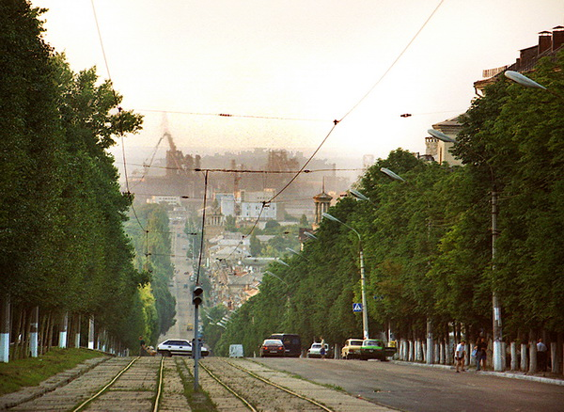
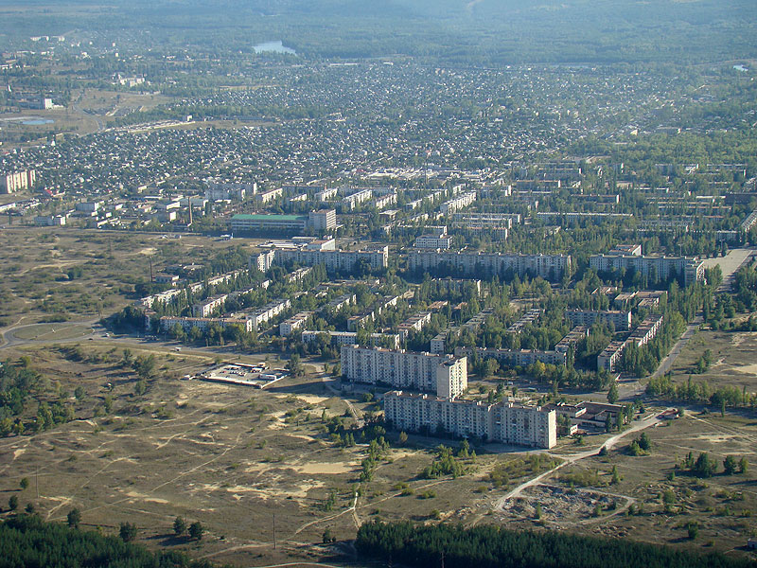

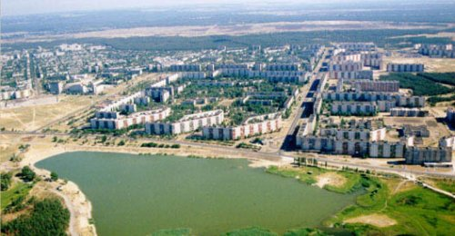
But what is good in our town is that around it there is a big forest.
LOGO

