Slide 1
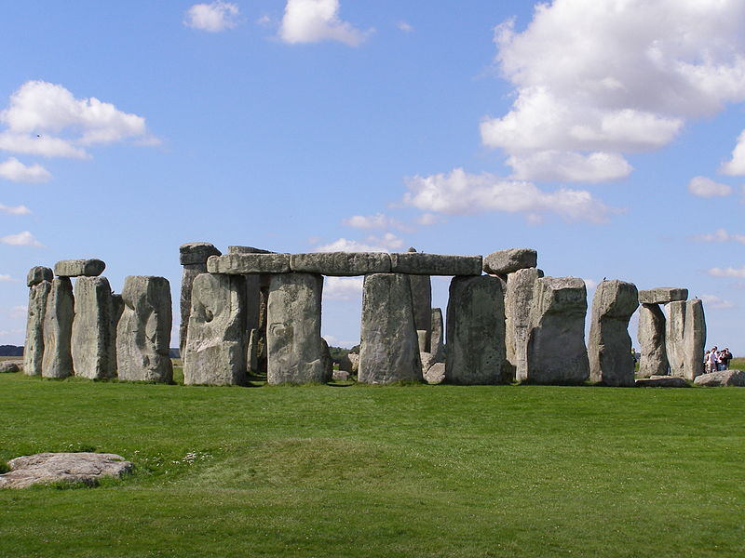
Stonehenge

Slide 2
Stonehenge, sunset, 2004

Slide 3
Computer rendering of the overall site

Slide 4
The 1905 mass initiation ritual held by the Ancient Order of Druids at Stonehenge.

Slide 5
10th Battalion, CEF marches past, winter 1914–15 (WW I); Background: Preservation work on stones, propped up by timbers.

Slide 6
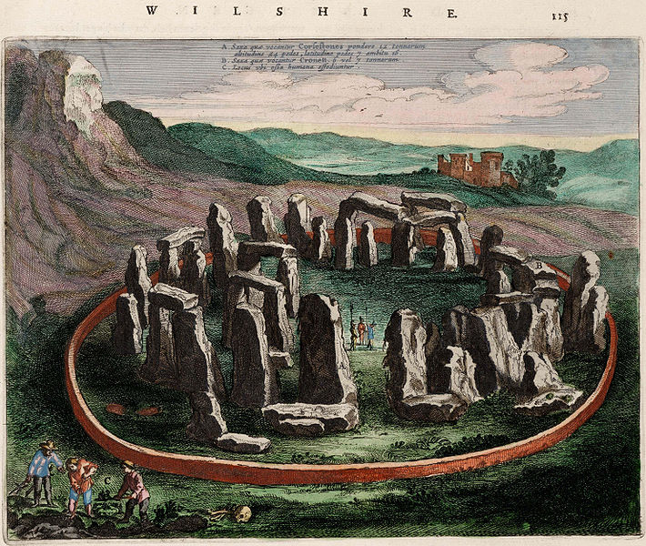
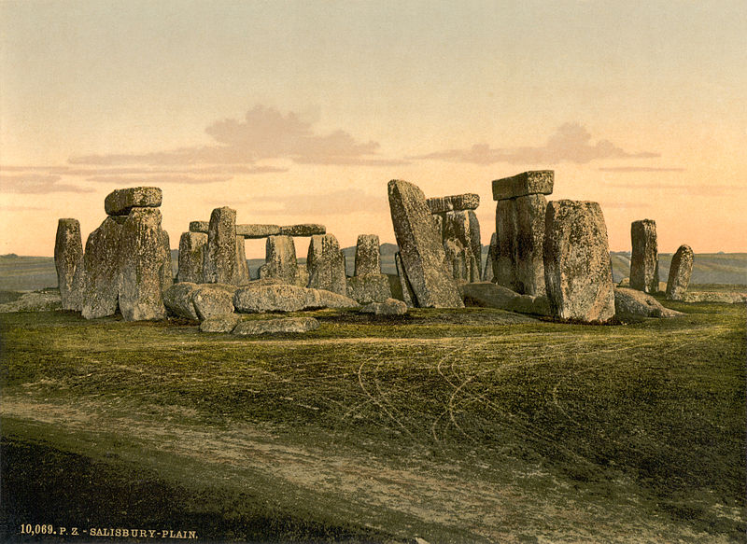
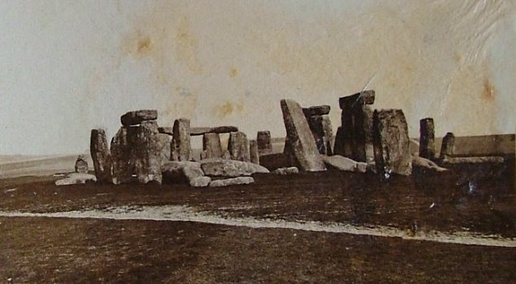
Print of Stonehenge, 1895
17th century depiction of Stonehenge
An early photograph of Stonehenge taken July 1877

