Slide 1
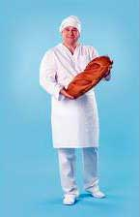
Baker

Slide 2

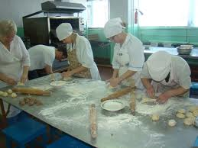
Bakers make bread of the miscellaneous sort, long loafs, muffins, kinds of roll with distinctive shape, etc.
He forms the recipes or uses the confirmed recipe, chooses the source material (flour, additives and pr.), will add the future muffin a form (by itself or distributing on the forms), but then baked them in stove.

Slide 3
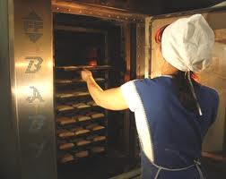
Bakers checks the endurance of the test, spreading on the forms before boarding in stove, defines readiness of bread in the oven. The Experienced Bakers a great deal can define with their eyes.

Slide 4
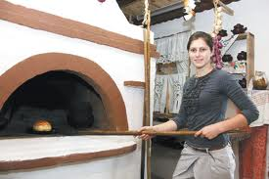
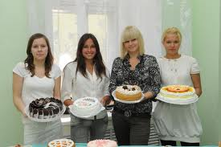
Baker can organize own business on baking of bread.

Slide 5
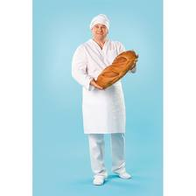
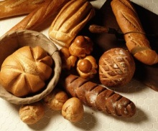
The Baker in modern production can be identified differently, depending on assigned qualifications and level of the formation.
Possible find miscellaneous a formation for instance : Average vocational training or Initial vocational training.

Slide 6
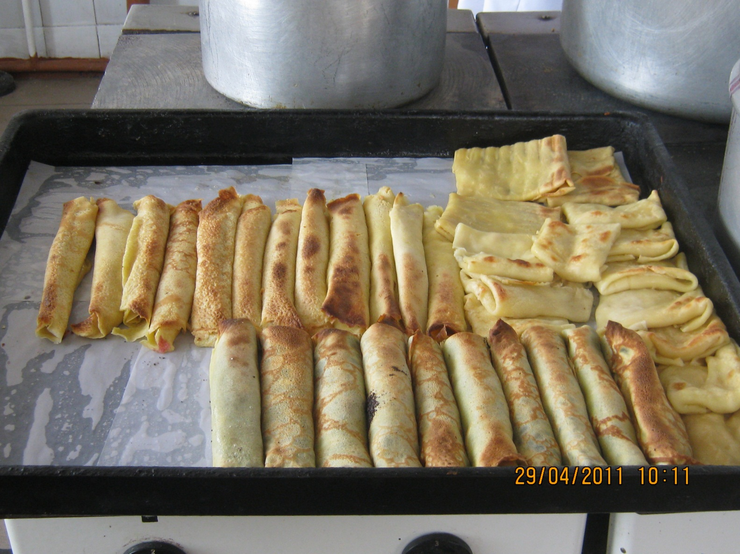
Наші Витвори

