Slide 1
Everyone has the right to…
(The Universal Declaration of Human Rights)

Slide 2
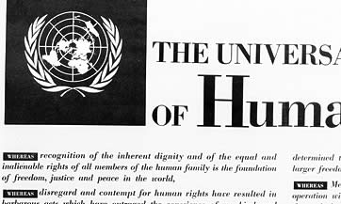
History
The Universal Declaration of Human Rights, which was adopted by the UN General Assembly on 10 December 1948, was the result of the experience of the Second World War. With the end of that war, and the creation of the United Nations, the international community vowed never again to allow atrocities like those of that conflict happen again.

Slide 3
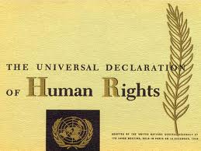
Now, Therefore THE GENERAL ASSEMBLY proclaims THIS UNIVERSAL DECLARATION OF HUMAN RIGHTS as a common standard of achievement for all peoples and all nations.

Slide 4

Article 1.
All human beings are born free and equal in dignity and rights. They are endowed with reason and conscience and should act towards one another in a spirit of brotherhood.

Slide 5
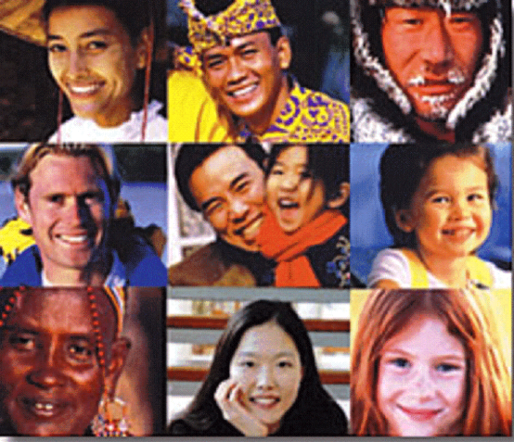
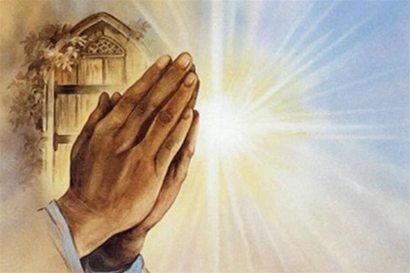
Article 2.
Everyone is entitled to all the rights and freedoms set forth in this Declaration, without distinction of any kind, such as race, colour, sex, language, religion, political or other opinion, national or social origin, property, birth or other status.

Slide 6
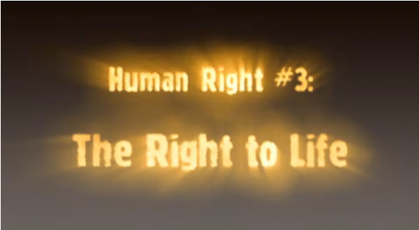
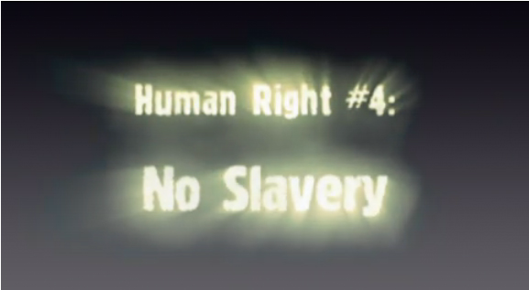
Article 3.
Everyone has the right to life, liberty and security of person.

Slide 7
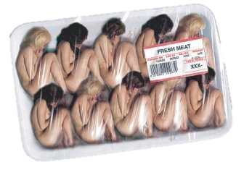
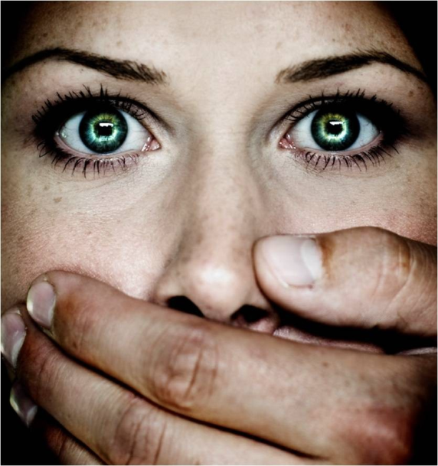
Article 4.
No one shall be held in slavery or servitude; slavery and the slave trade shall be prohibited in all their forms.

Slide 8
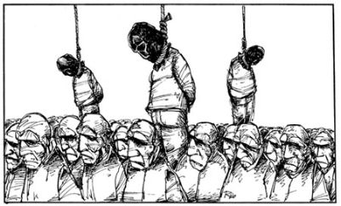

Article 5.
No one shall be subjected to torture or to cruel, inhuman or degrading treatment or punishment.

Slide 9
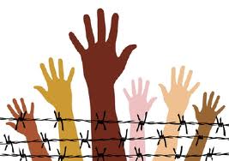
Article 6.
Everyone has the right to recognition everywhere as a person before the law.

Slide 10
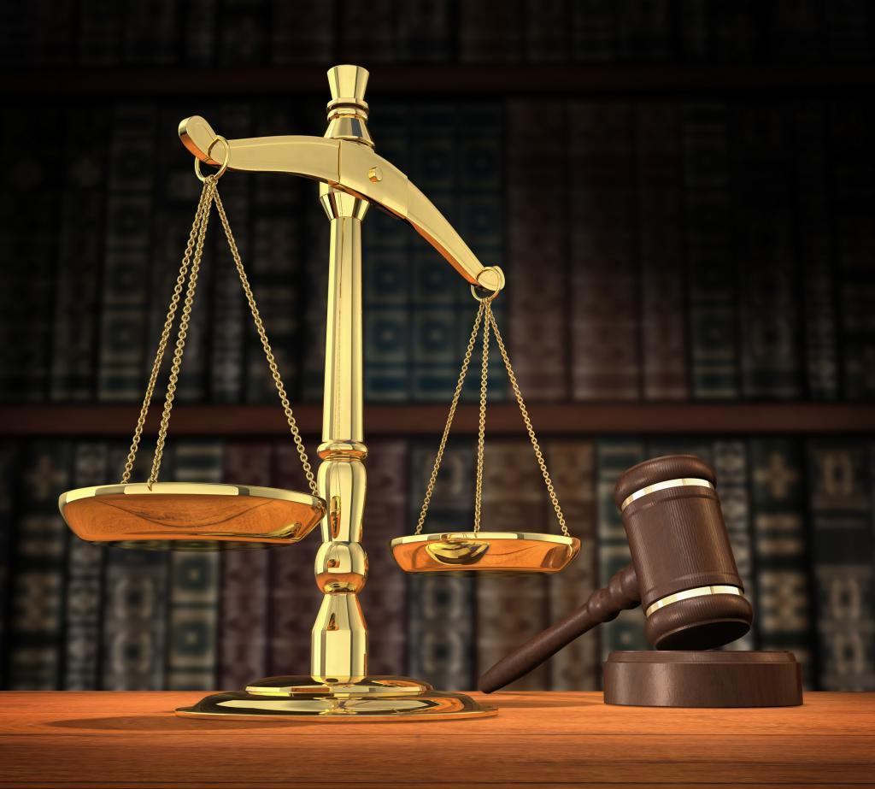
Article 7.
All are equal before the law and are entitled without any discrimination to equal protection of the law.

Slide 11

Article 8.
No one shall be subjected to arbitrary arrest, detention or exile.

Slide 12
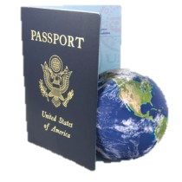
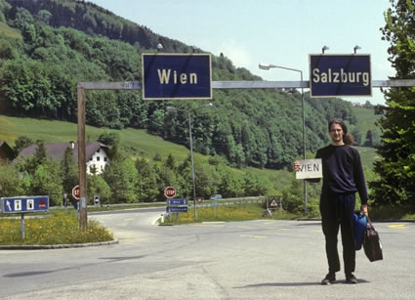
Article 9.
Everyone has the right to freedom of movement and residence within the borders of each state.

Slide 13
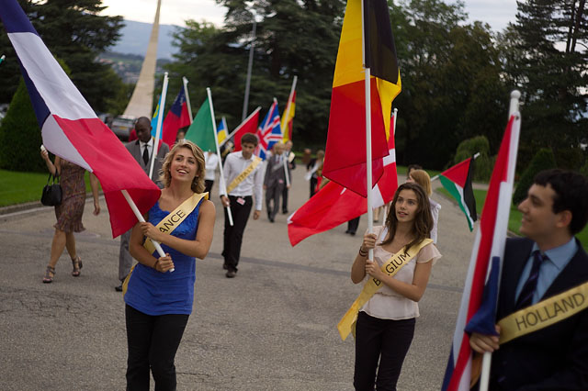
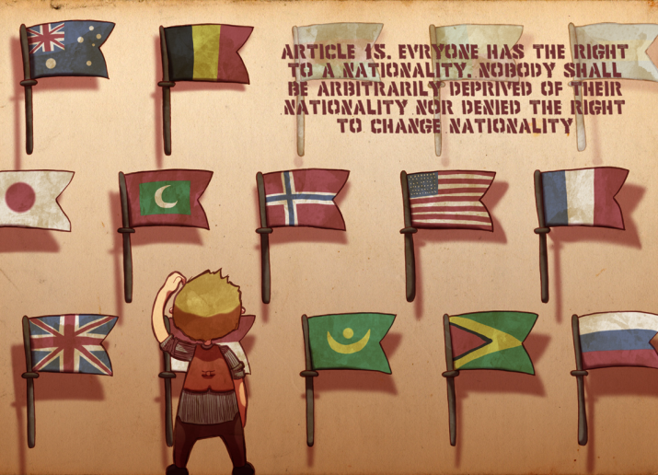
Article 10.
Everyone has the right to a nationality.

Slide 14
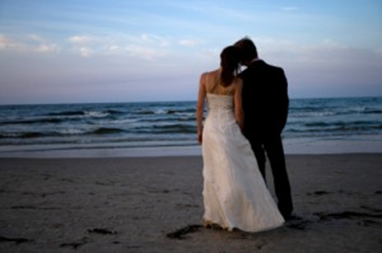
Article 11.
Men and women of full age, without any limitation due to race, nationality or religion, have the right to marry and to found a family. They are entitled to equal rights as to marriage, during marriage and at its dissolution.

Slide 15
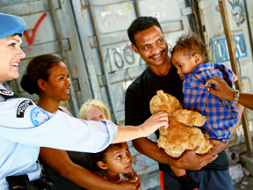
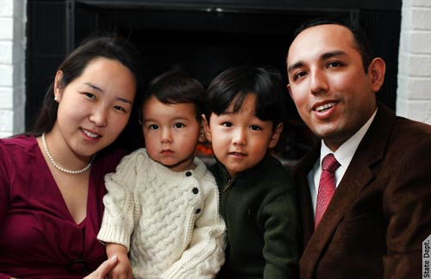
Article 12.
The family is the natural and fundamental group unit of society and is entitled to protection by society and the State.

Slide 16
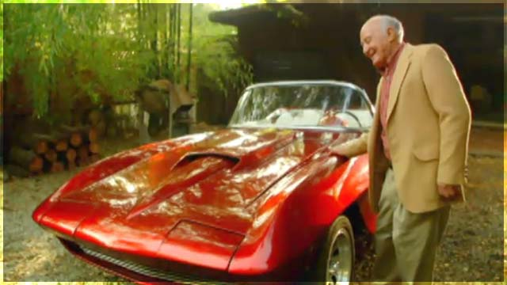

Article 13.
Everyone has the right to own property alone as well as in association with others.

Slide 17
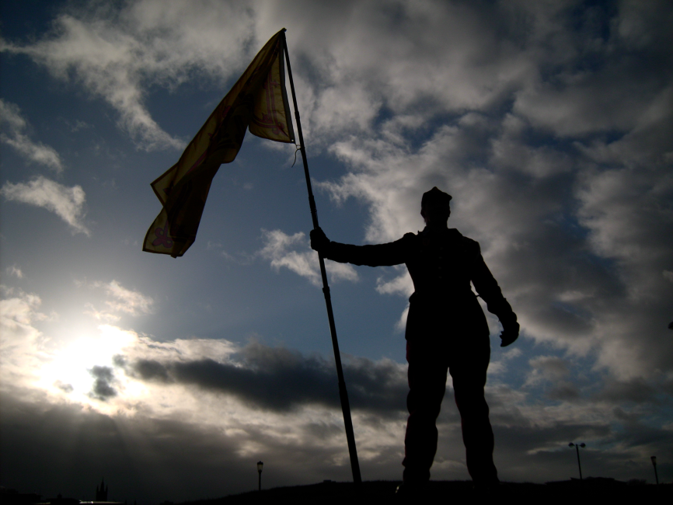
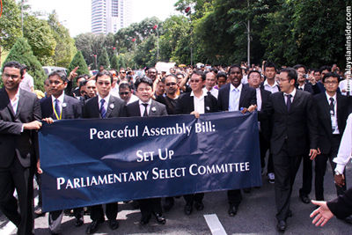
Article 14.
Everyone has the right to freedom of peaceful assembly and association.

Slide 18


Article 15.
Everyone has the right to work, to free choice of employment, to just and favourable conditions of work and to protection against unemployment.

Slide 19
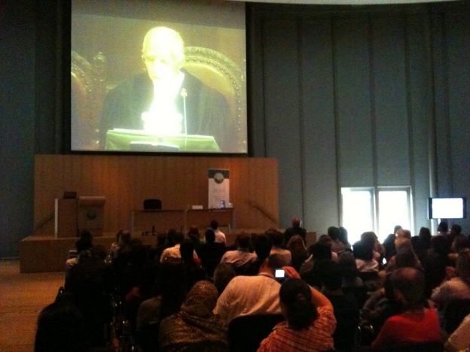
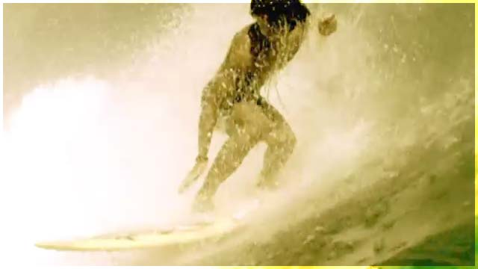
Article 16.
Everyone has the right to rest and leisure, including reasonable limitation of working hours and periodic holidays with pay.

Slide 20
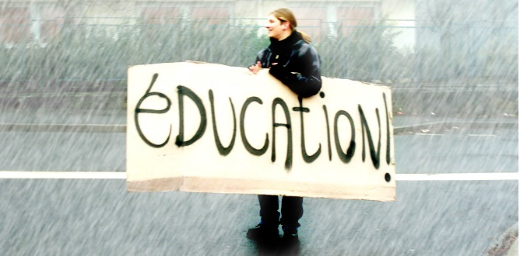
Article 17.
Everyone has the right to education. Education shall be free, at least in the elementary and fundamental stages.

Slide 21
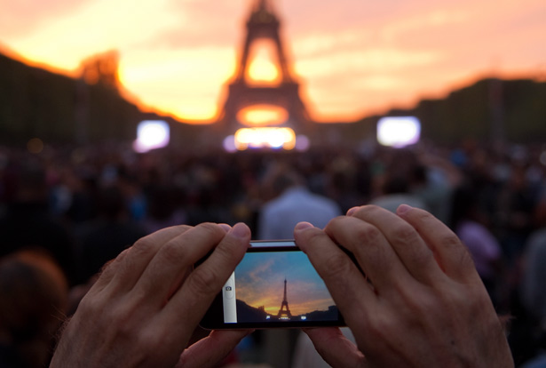
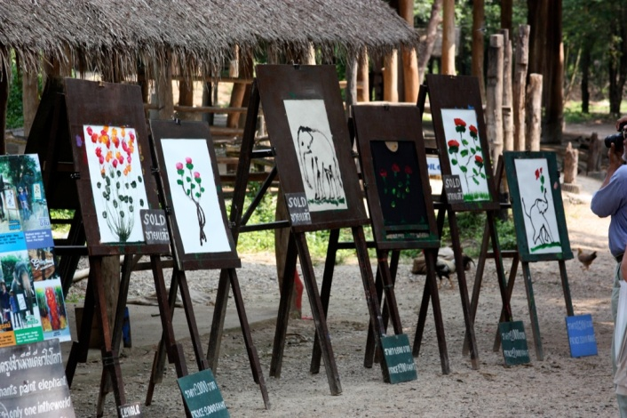
Article 18.
Everyone has the right freely to participate in the cultural life of the community, to enjoy the arts and to share in scientific advancement and its benefits.

Slide 22

Article 19.
Everyone has duties to the community in which alone the free and full development of his personality is possible.

Slide 23
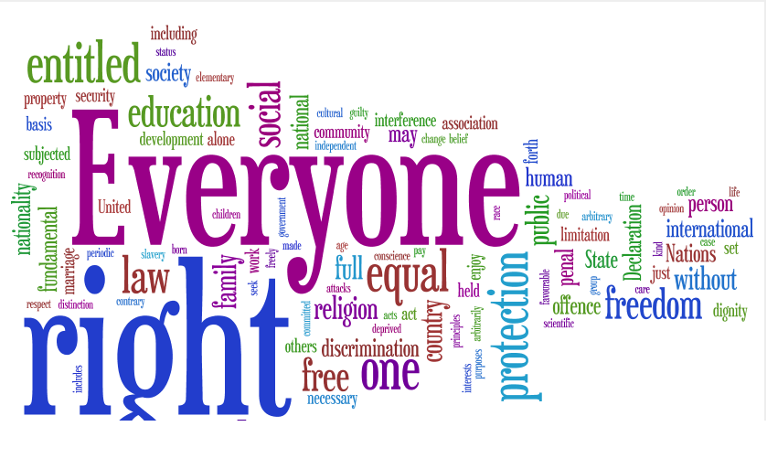
The entire text of the UDHR was composed in less than two years. At a time when the world was divided into Eastern and Western blocks, finding a common ground on what should make the essence of the document proved to be a colossal task.

Slide 24
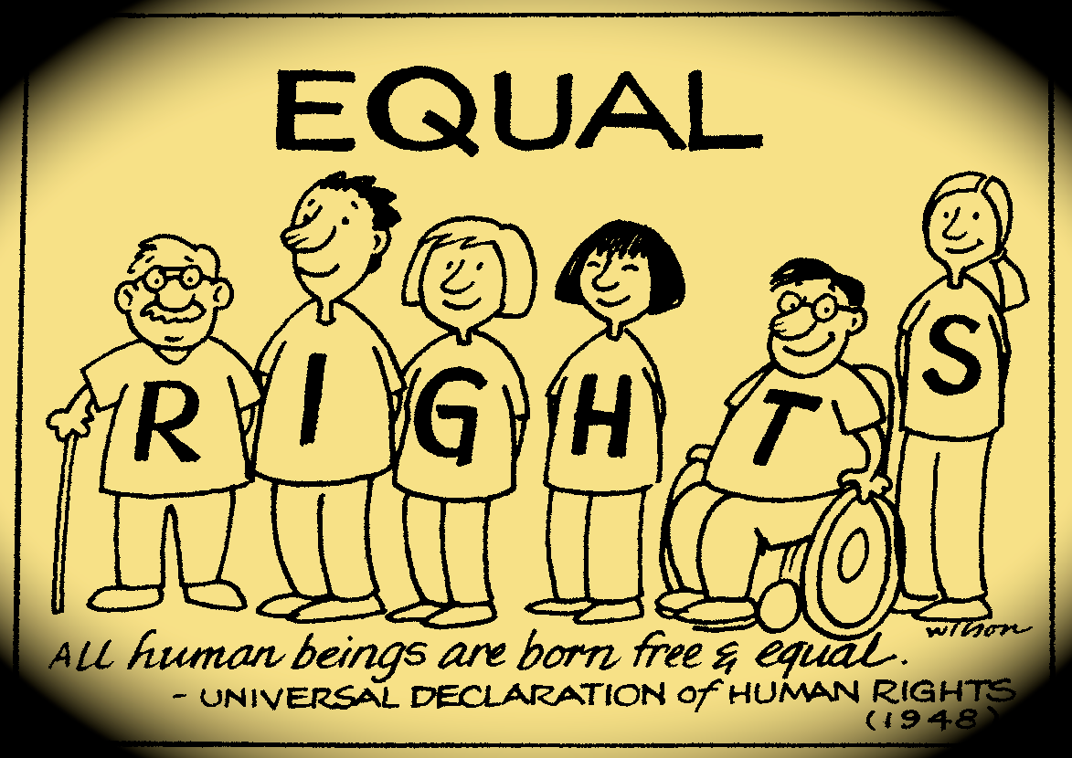
THE DRAFTERS OF THE UNIVERSAL DECLARATION OF HUMAN RIGHTS

Slide 25
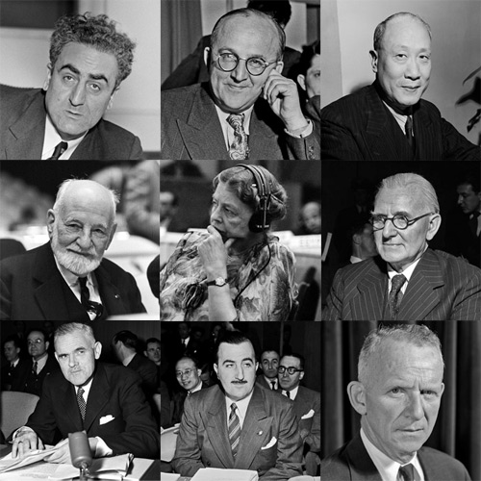
Dr. Charles Malik (Lebanon)
Dr. Peng-chun Chang (China)
Alexandre Bogomolov (USSR)

Slide 26
René Cassin (France)
Charles Dukes (United Kingdom)
Eleanor Roosevelt (US)

Slide 27
John P. Humphrey (Canada)
William Hodgson (Australia)
Hernan Santa Cruz (Chile)

