Slide 1
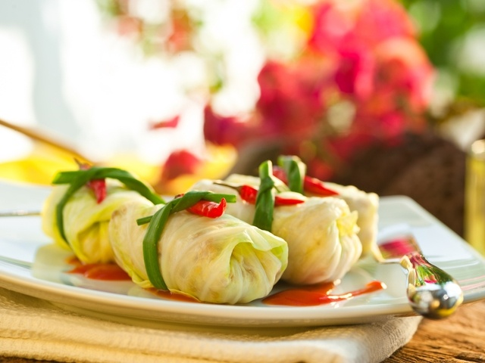
Ukrainian cuisine
Holubtsi

Slide 2
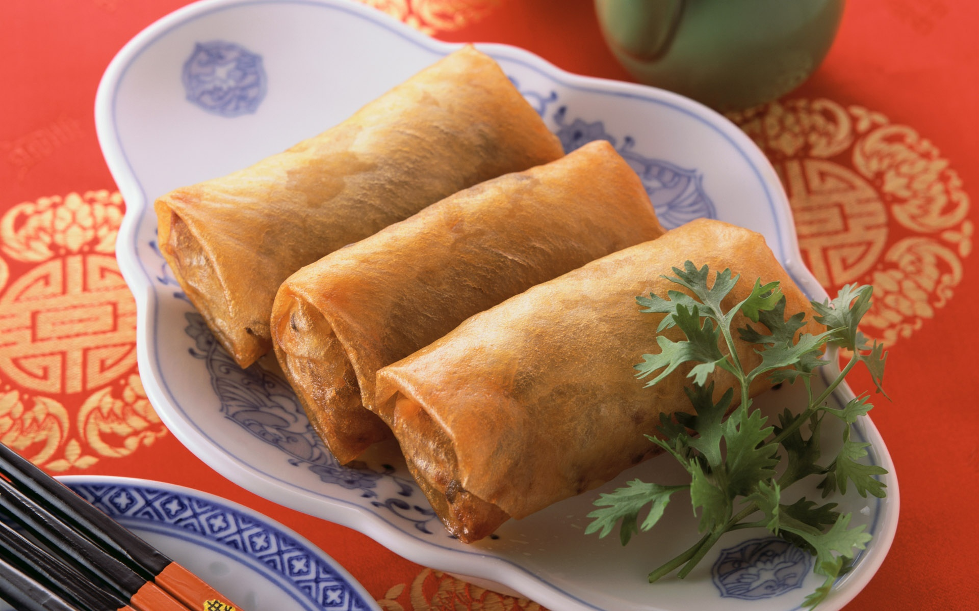
Something about Ukrainian cuisine
Ukrainian cuisine - national cookery, which has a long history and is famous for its diversity, has hundreds of recipes: soup and dumplings, palianytsia and dumplings, dumplings and sausages, roasts and drinks with fruit and honey, known far beyond Ukraine. Some foods have a long history, such as holubtsi.

Slide 3
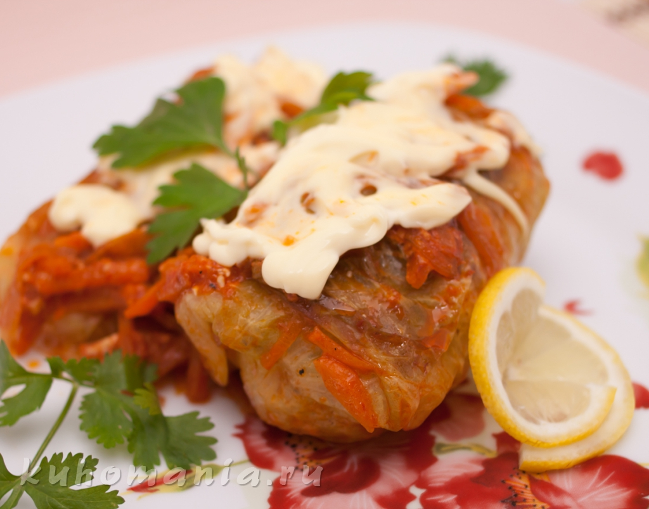
Ingredients for cooking holubtsi
Cabbage 1 piece
Minced 200-300 g
Rice 1 cup
Onion 3 pieces
Margarine 1/2 pieces
Carrots 3 pieces
oil
spices
Tomato Paste

Slide 4
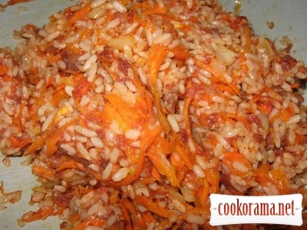
Description of cooking holubtsi
Cabbage leaves to decompose, steamed them in hot water, add a little vinegar.
Boil rice. Cut onions fried in oil (1 pc) tremors carrots and fry well. Kneaded rice, stuffing, carrots and onions, add salt and spices.
Spread on a sheet stuffing and wrapped stuffed cabbage.

Slide 5
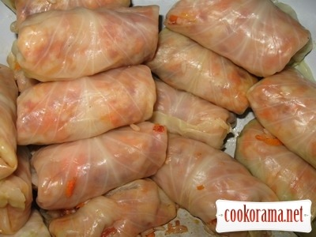
Description of cooking holubtsi
4) At the bottom of the pan put cabbage leaves
5) Cut into slices and put the onions
Now make the sauce.
The required amount of water diluted with tomato paste and sour cream. Bring to a boil. Fill with cabbage and put on the fire until cooked.

Slide 6
