Slide 1
Jerome David Salinger
By Natali Burgelya

Slide 2
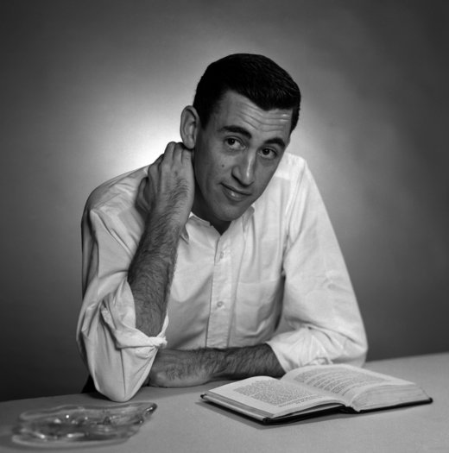
Jerome David Salinger
(January 1, 1919 – January 27, 2010) was an American writer, best known for his 1951 novel ”The Catcher in the Rye”.

Slide 3
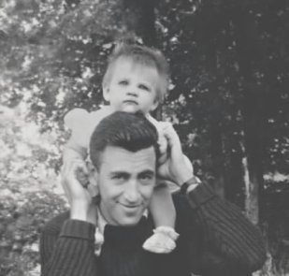
Salinger was born and raised in Manhattan, New York City. He began writing short stories while in secondary school. He went to work in Austria in 1936, but left two years later, just before Germany took Austria over.
He published several stories in the early 1940s before serving in World War II. In 1948 he published the story "A Perfect Day for Bananafish" in The New Yorker magazine, which also published most of his following work.

Slide 4
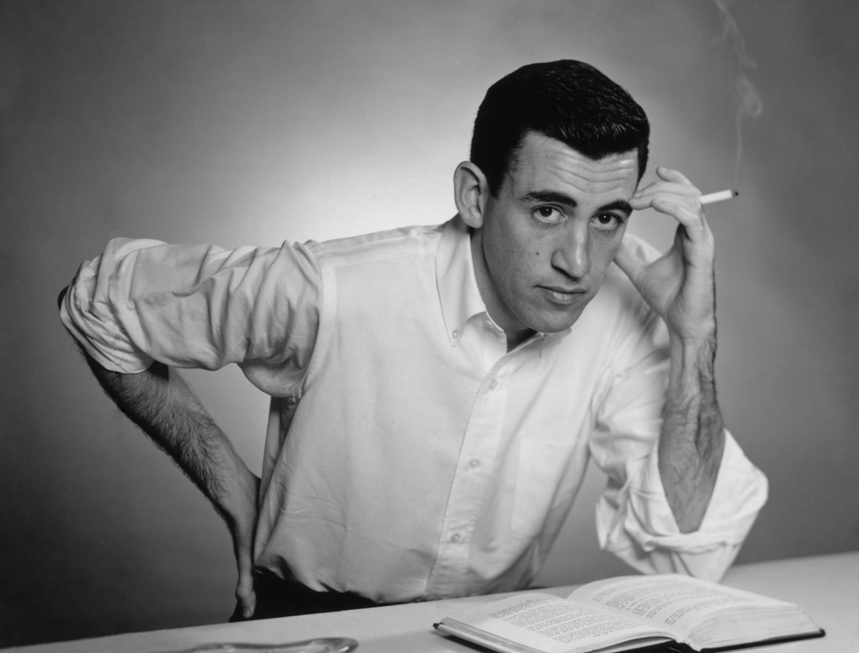
In 1951, Salinger's first novel, The Catcher in the Rye, was published. It became an immediate popular success.
Salinger died at his home in Cornish, New Hampshire of natural causes on January 27, 2010.

Slide 5
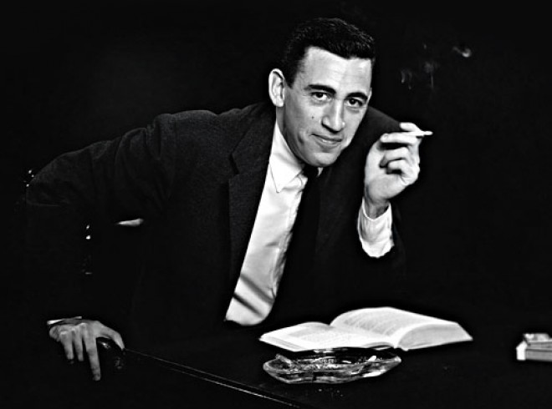
Salinger did not like publicity: He never published an original work after 1965 and was never interviewed after 1980. In fact, he told his agent to burn any mail that fans sent him. He also did not want his photograph on the jacket of his books.

Slide 6
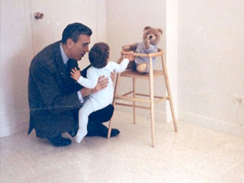
On November 28, 2013, scans of three unpublished Salinger stories were uploaded to the Internet. It was done by a user of What.CD, an invite-only BitTorrent tracker site. The file was quickly removed by administrators of the site. It is not currently clear how the unpublished material was uploaded, as the original sources came from two different locations (the University of Texas and Princeton). This shows that the works may have been obtained on separate occasions and then put together. Salinger's unpublished works quickly spread over to open BitTorrent sites like The Pirate Bay and image-sharing sites such as Imgur.
Despite What.CD's quick response, Salinger's unpublished writings will forever be available on the internet.

Slide 7
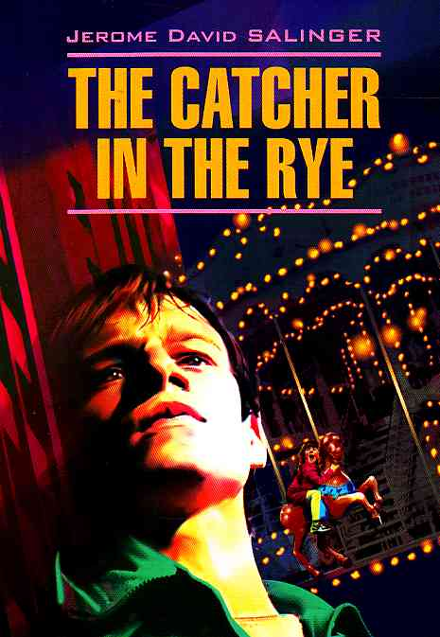

Unpublished stories
"Mrs. Hincher" (1942)
"The Last and Best of the Peter Pans" (1942)
"The Children's Echelon" (1944)
"Two Lonely Men" (1944)
"The Magic Foxhole" (1944)
"Birthday Boy" (1946)
"The Ocean Full of Bowling Balls" (1947)
"Paula" (1948)

Slide 8

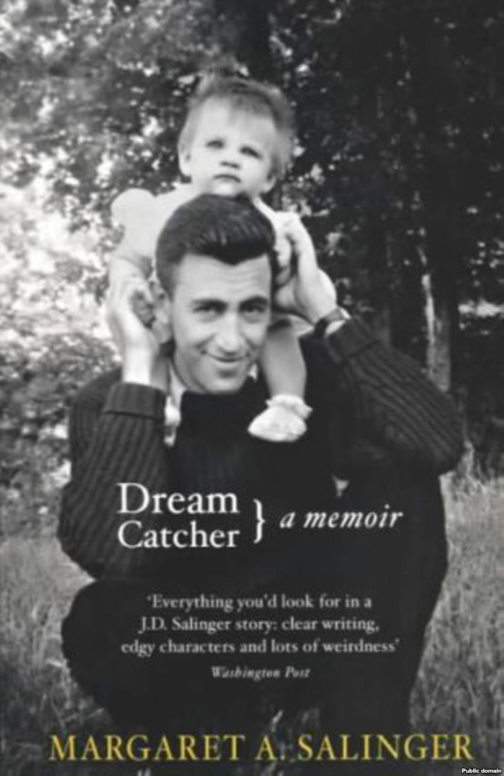
Books
The Catcher in the Rye (1951)
Nine Stories (1953)
"A Perfect Day for Bananafish" (1948)
"Uncle Wiggily in Connecticut" (1948)
"Just Before the War with the Eskimos" (1948)
"The Laughing Man" (1949)
"Down at the Dinghy" (1949)
"For Esmé—with Love and Squalor" (1950)
"Pretty Mouth and Green My Eyes" (1951)
"De Daumier-Smith's Blue Period" (1952)
"Teddy" (1953)
Franny and Zooey (1961)
"Franny" (1955)
"Zooey" (1957)
Raise High the Roof Beam, Carpenters and Seymour: An Introduction (1963)
"Raise High the Roof-Beam, Carpenters" (1955)
"Seymour: An Introduction" (1959)

