Slide 1
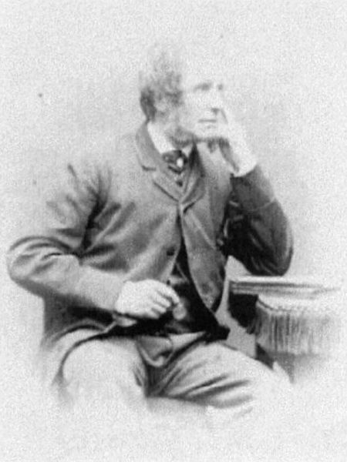
Edward William Cooke
27 March 1811 – 4 January 1880

Slide 2
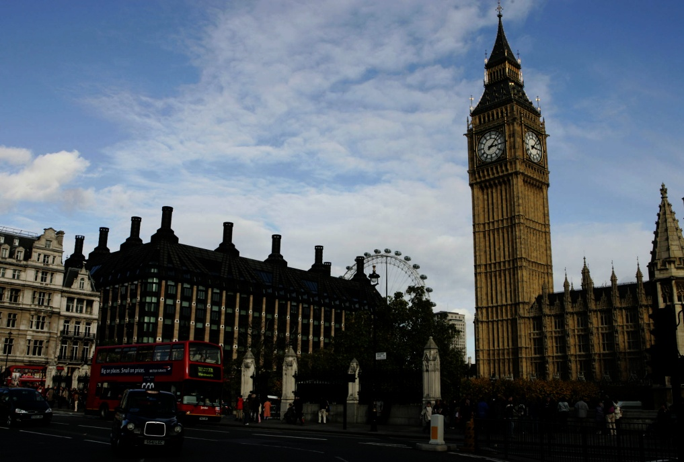
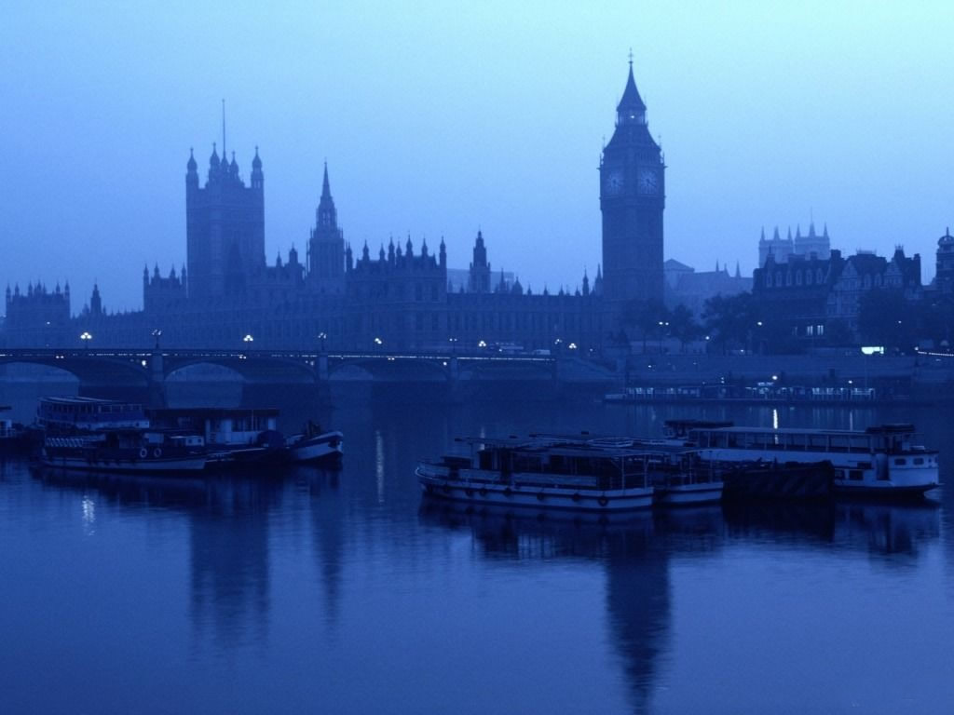
Early years
English painter Edward William Cook was born in London. His father and uncle were well-known engravers, and a boy from an early age has mastered their craft, and in the age of 18 independently carried out a series of engravings. In 1833 he began to paint in oils, particularly attracted marine themes.

Slide 3
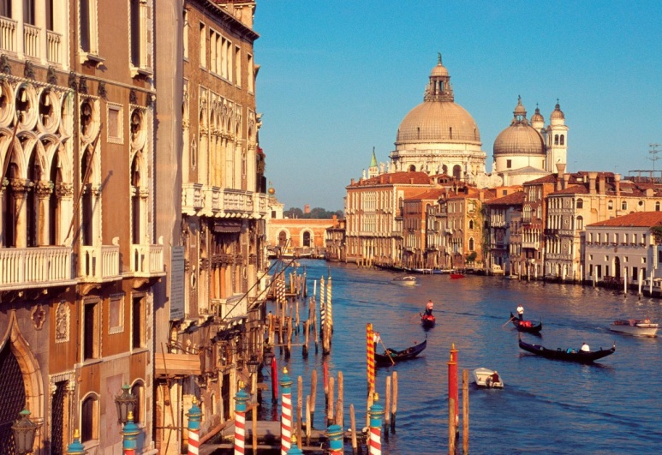
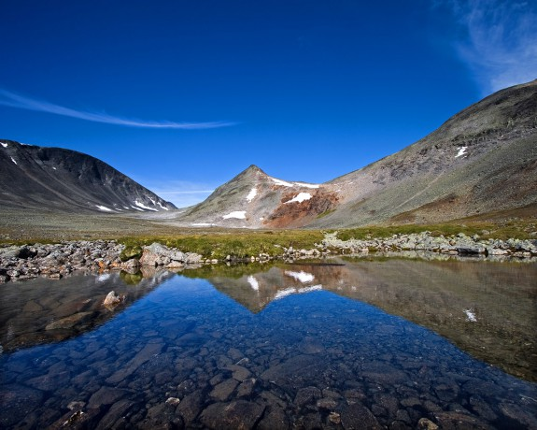
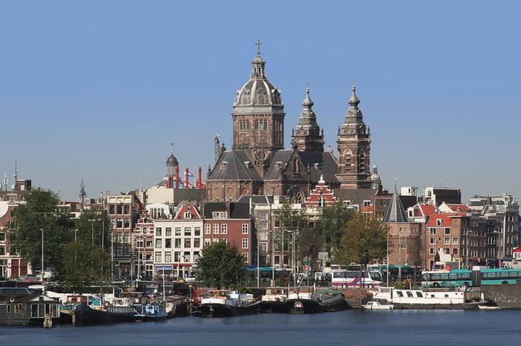
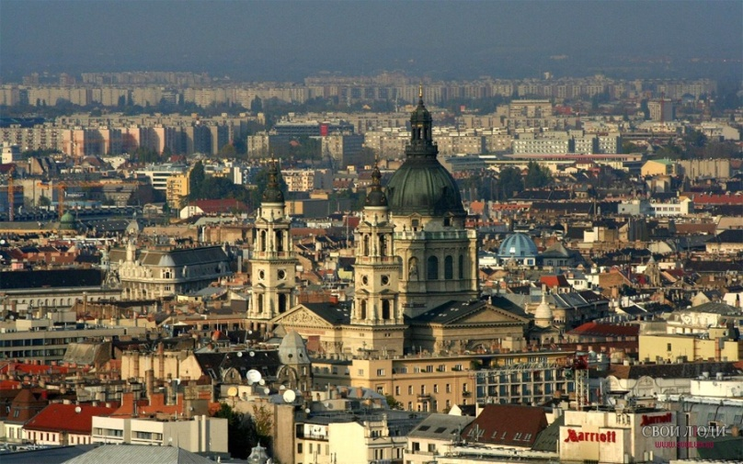
Traveling artist
In 1837, he went to travel, and visited first in Holland, and then followed by a trip to Scandinavia, Spain, Italy and North Africa. During his trip to the Isle of Wight, he observes life fishing villages, exploring the life of fishermen, their boats, their utensils, fishing tackle, beaches scattered with different stones, and doing a lot of sketches, which are then reflected in his oil paintings.

Slide 4
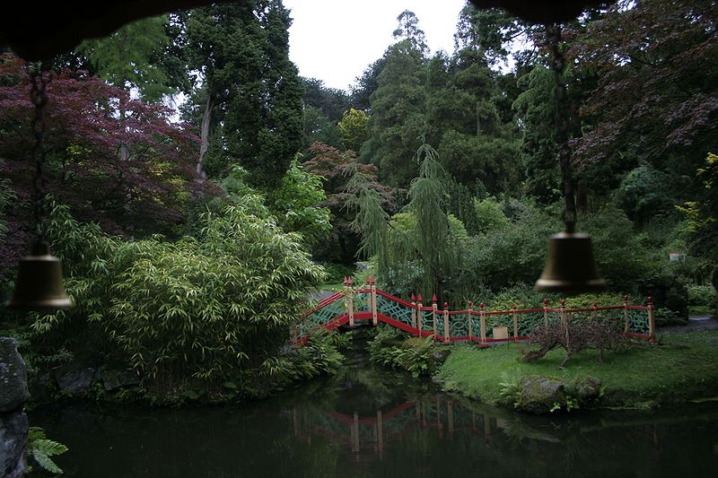
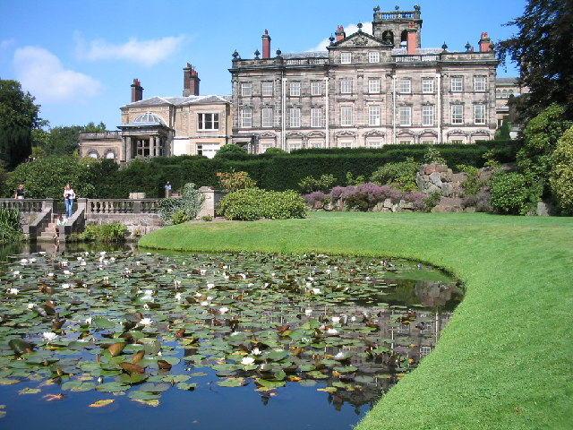
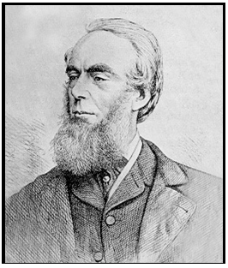
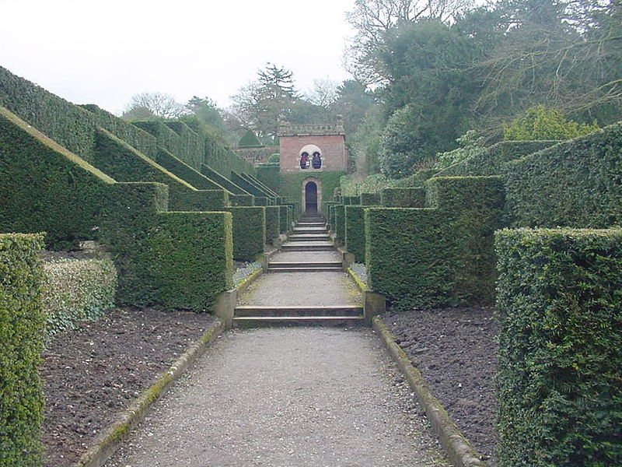
Biddulph Grange Gardens
Cook was interested in not only the stones but also to plants. In 1840, he began to help his friend, gardener James Batman in setting up the famous gardens of Biddulph Grange in Staffordshire, so much so carried away that as a result of all the orchids and rhododendrons this garden was designed and planted them.
I must say that Cook was not only an artist and gardener, but a scientist. He was a member of the Linnean Society, the Geological Society and the Society of antiquity. In 1863 he was elected to the Royal Society, and even became an academician in 1864.

Slide 5
All of the major events of his life: travel, observation, scientific interests - are reflected in his paintings, as we shall see now. Enjoy!

Slide 6
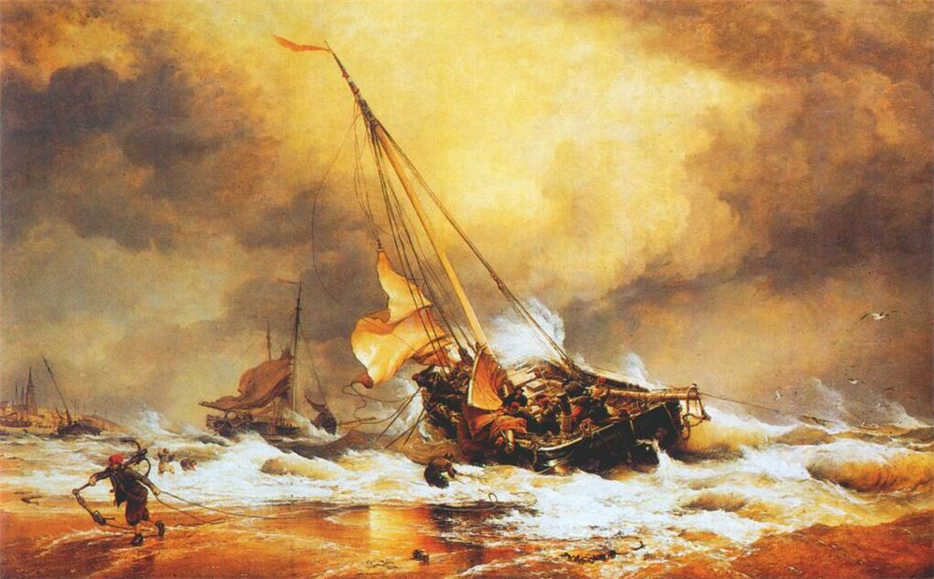
Beaching a Pink at Scheveningen

Slide 7
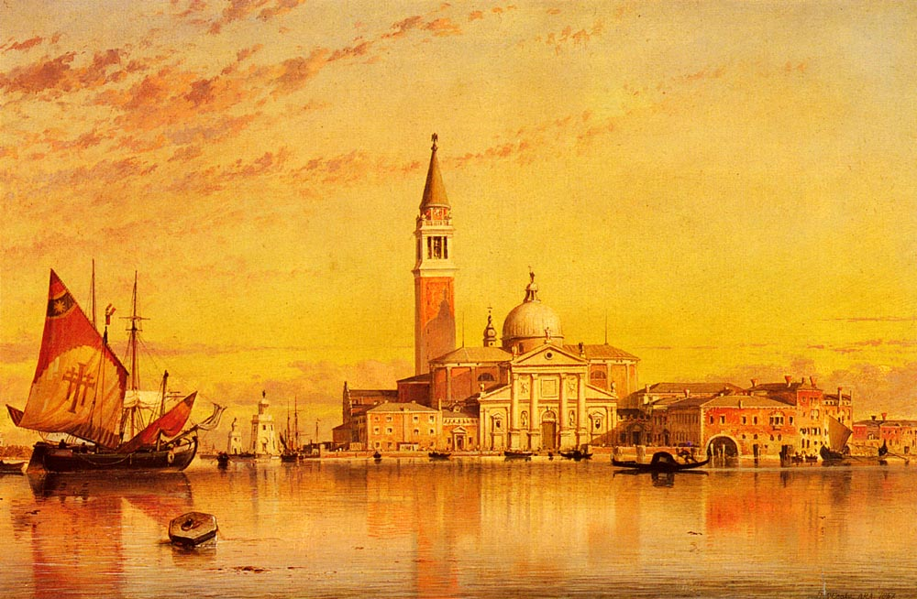
San Giorgio Maggiore. Venice.

Slide 8
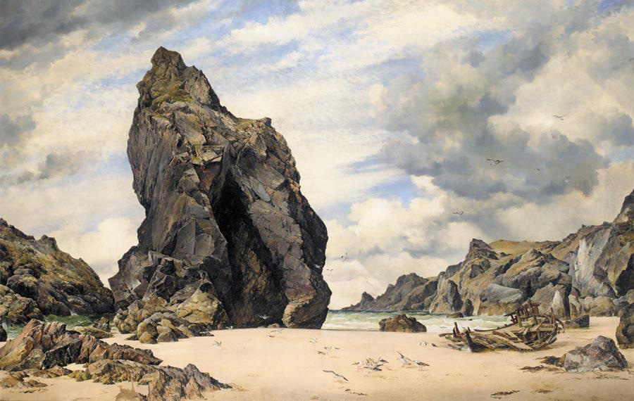
Steeple Rock Kynance Cove Lizard Cornwall Low Water

Slide 9
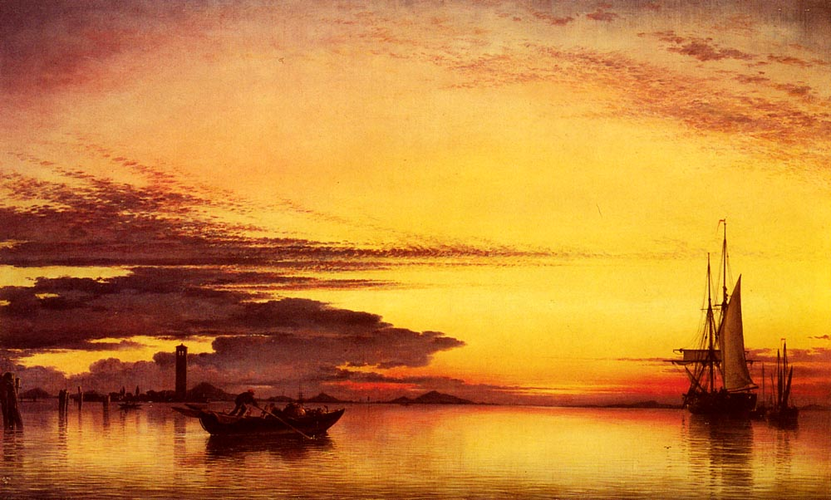
Sunset On The Lagune Of Venice

Slide 10
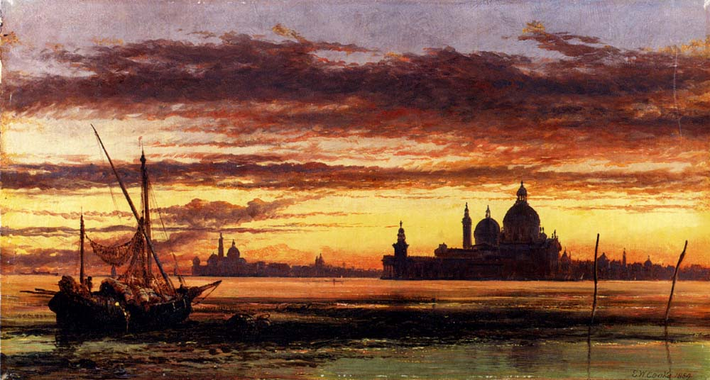
Sunset Sky Salute And San Giorgio Maggiore. Venice.

Slide 11
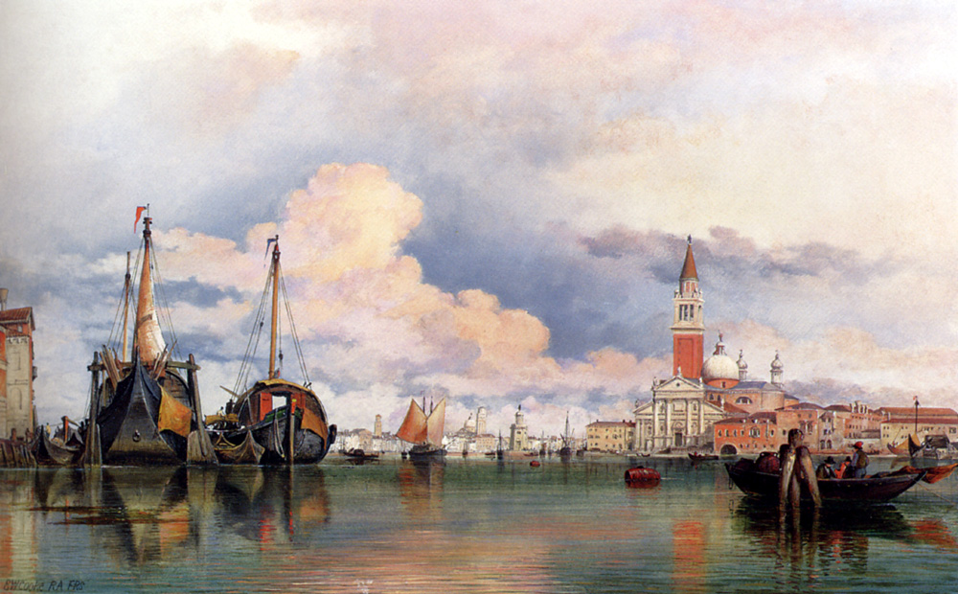
The Church Of The Gesuati And Riva Delle Zattere

Slide 12
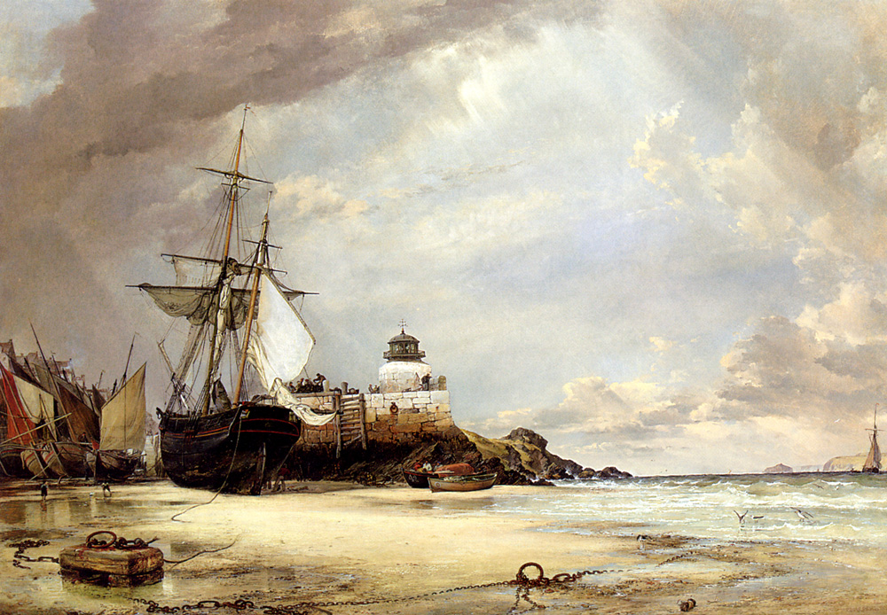
The Pier and Bay of St Ives Cornwall

Slide 13
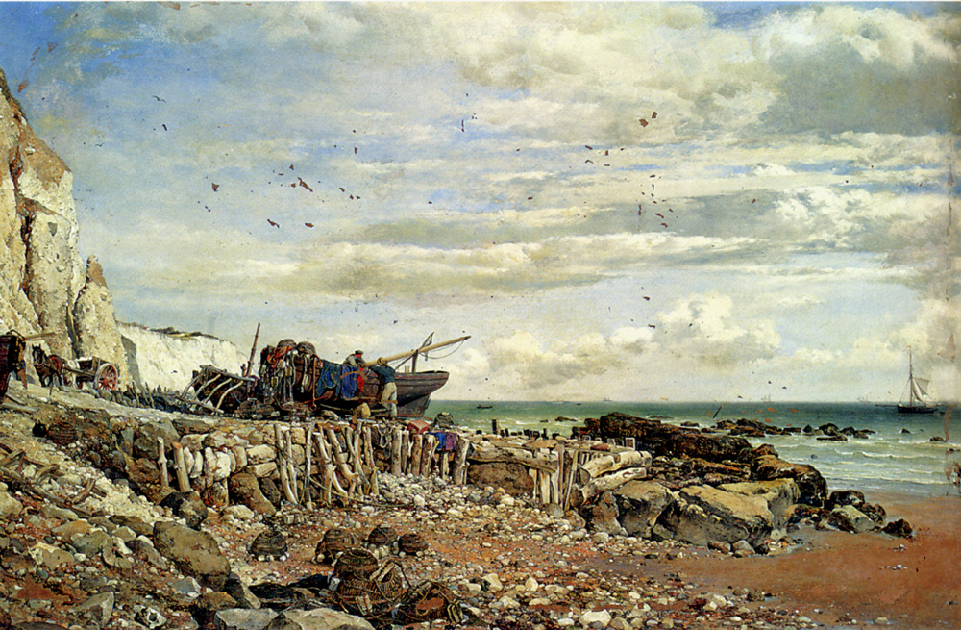
The Undercliff At Bonchurch Isle Of Wight

Slide 14
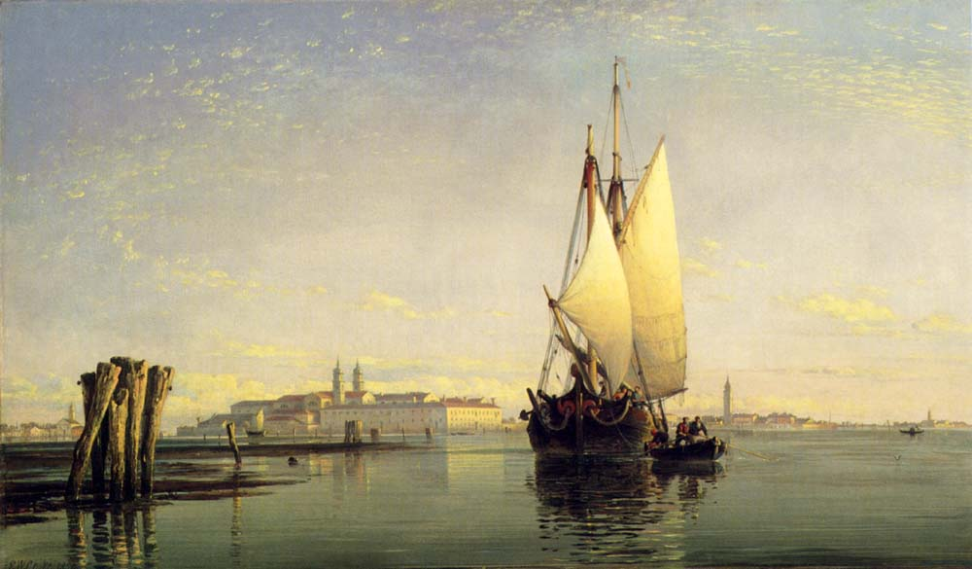
On The Lagoon Of Venice

Slide 15
Thank you!

