Slide 1
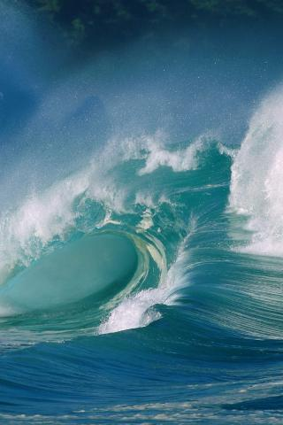
«Tsunami»
Olena Chornobaeva
Form 11

Slide 2
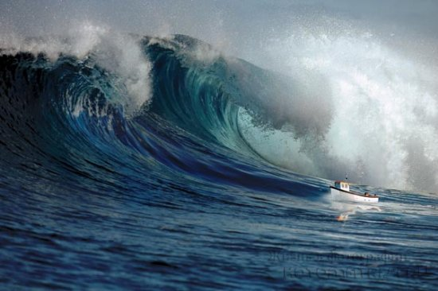
Tsunami - long waves generated by the powerful influence of the whole mass of water in the ocean or other body of water.

Slide 3
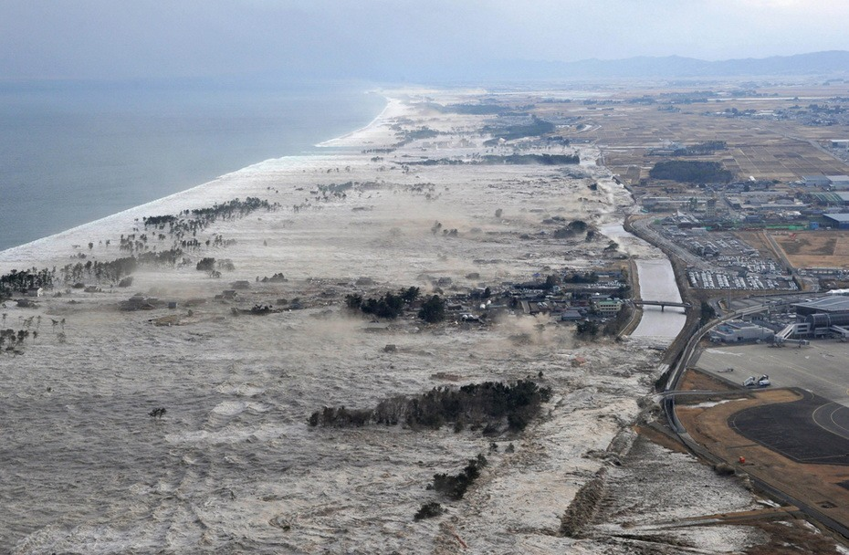
The reason most tsunamis are underwater earthquakes, during which there is an abrupt shift (raising or lowering) of the area of the seabed.

Slide 4
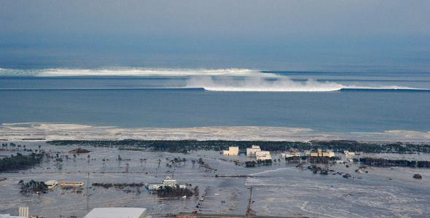
The tsunami generated by an earthquake of any force, but large forces reach those that arise due to strong earthquakes.

Slide 5
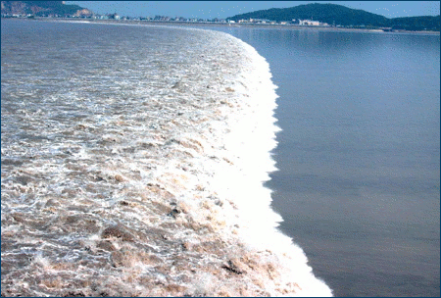
Earthquakes, volcanic eruptions and other underwater explosions, glaciers, meteorites and other damage above or below the water - all this has the potential to cause a tsunami.

Slide 6
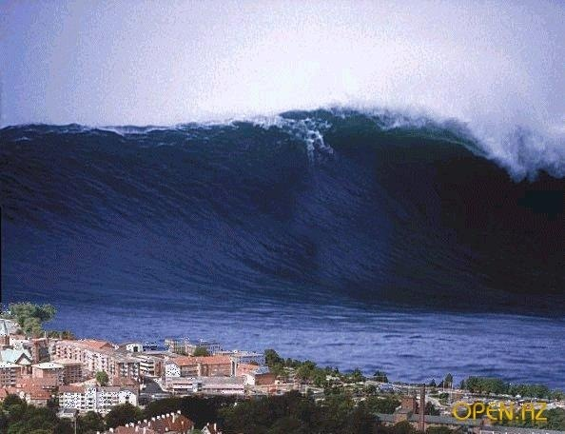
Symptoms of tsunami

Slide 7
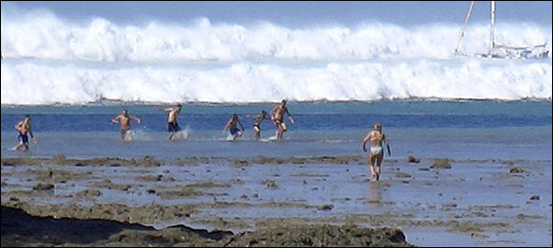
Sudden rapid withdrawal of water from the coast for a considerable distance and drying bed. The farther the sea receded, the above can be a tsunami wave. People on the beach and do not know about the danger may remain out of curiosity or to collect fish and seashells. In this case, as soon as possible to leave the coast and away from it at the maximum distance.

Slide 8
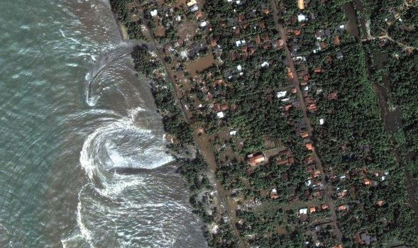
Earthquake. The epicenter was located, as a rule, in the ocean. On the bank of the earthquake is usually much weaker, and it is often not at all.

Slide 9
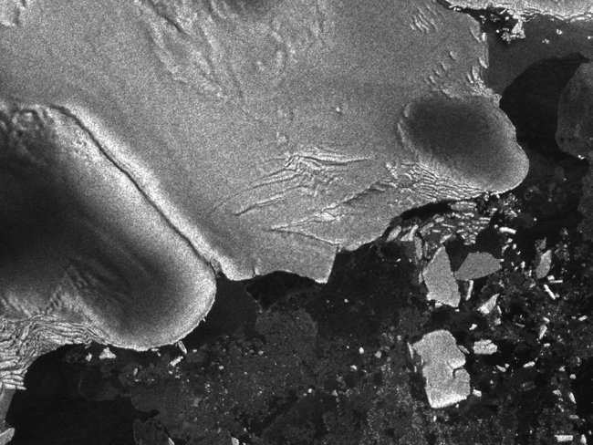
Unusual drift ice and other floating objects, cracking in the fast ice.

Slide 10
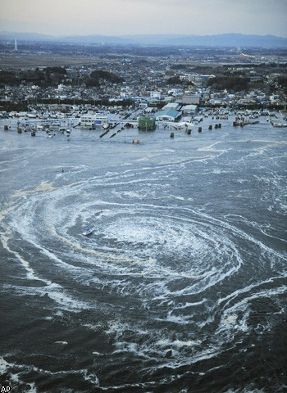
Huge reverse faults at the edges of fast ice and reef education crowding and flow.

