Slide 1
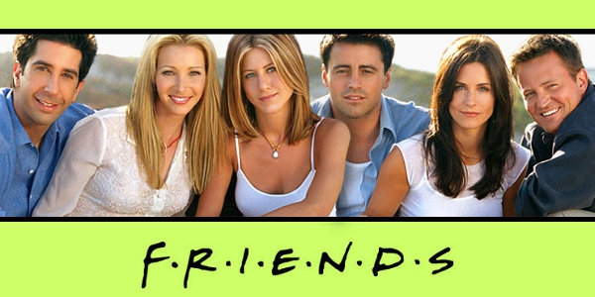
My favorite serial

Slide 2
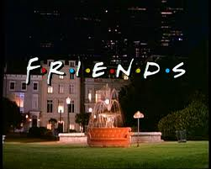
Friends is an American comedy television series. It was on television from September 22, 1994 to May 6, 2004. It is about 6 friends who lived in Manhattan, New York City. They were in their 20s and 30s. The names of the "friends" were: Monica, Chandler, Rachel, Ross, Phoebe and Joey.

Slide 3

Friends got positive reviews through most of its run. It is one of the most popular sitcoms of all time. The series won many awards and was nominated for 63 Primetime Emmy Awards. TV Guide ranked it #21 on their list of the 50 greatest TV shows of all time.

Slide 4
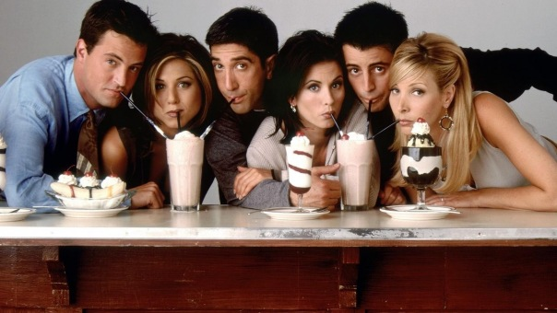
The series was produced by Bright/Kauffman/Crane Productions, in association with Warner Bros. Television. At first, the executive producers were Crane, Kauffman and Kevin Bright. Other producers were brought in during later seasons. In all, there were 236 episodes. There is a sequel to this show named Joey.

Slide 5
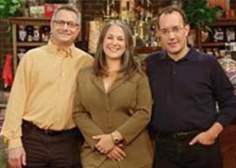
Kevin Bright, Marta Kauffman, Kevin Bright.
Sitcom
Created by | David Crane Marta Kauffman

Slide 6
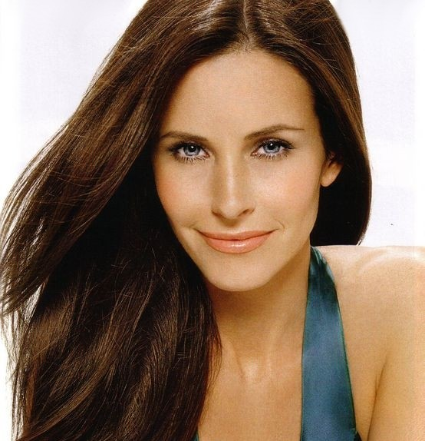
Monica Elizabeth Geller (Courteney Cox)
She used to be fat, is a control freak, and is compulsively organized. She is Ross' sister and in season 7, marries long-term boyfriend Chandler and adopts 2 babies (Jack and Erica) in the last episode of the series.

Slide 7
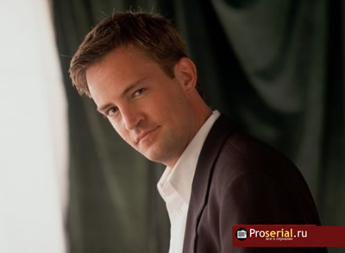
Chandler Muriel Bing (Matthew Perry)
Early in the series, he was a self-confessed commitment-phobe, but in season 7 finale, he marries Monica, his girlfriend of three years. One of his most famed traits is his finely-tuned sense of humour. His father is a transsexual, and works in Las Vegas and his mother is a renowned adult book writer.

Slide 8
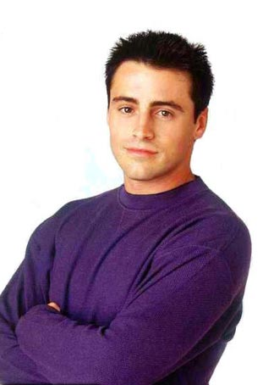
Joey Francis Tribbiani (Matt LeBlanc)
He's the 'stupid' one, and is a struggling actor, but scored a break in season 2 in the soap opera Days Of Our Lives, and then again in season 7. He remained on Days of Our Lives until the end of the series. He had a lot of sexual partners and flings throughout the series, but had strong feelings for a fellow actress in season 3 and fell in love with his roommate, Rachel, in season 8. Post-finale he was the main character in the spin off, Joey.

Slide 9
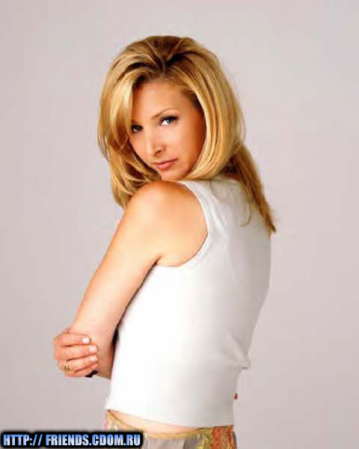
Phoebe Buffay (Lisa Kudrow)
She's quirky, flakey, and fun-loving. She got married to Mike in season 10, but before this relationship she had never had a serious commitment. She also plays guitar and is a masseuse. Phoebe is known to have lived on the streets as a young adult after her mother committed suicide.

Slide 10
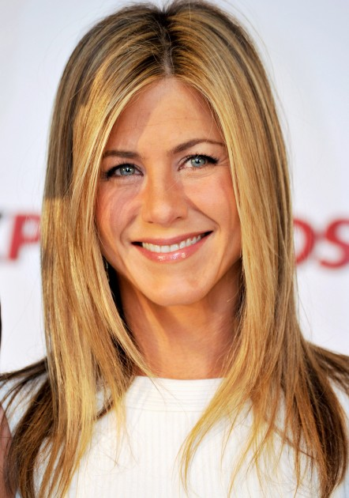
Rachel Karen Green (Jennifer Aniston)
She first moved to New York in the first episode after running off from the altar. She is perhaps the character who has made the most development (going from spoiled, rich Daddy's girl to an independent and confident woman). She had a famous on-off relationship with Ross, which spanned the entire series. She has a daughter with Ross Geller named Emma.

Slide 11
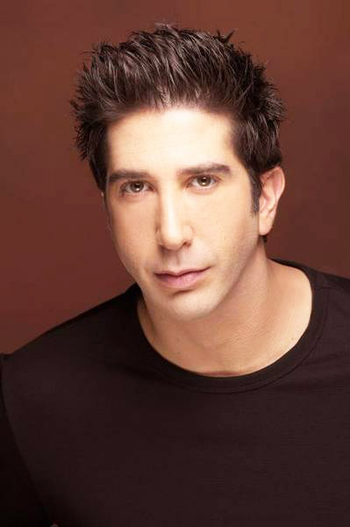
Ross Eustace Geller (David Schwimmer)
A paleontologist. He had a famous on-off relationship with Rachel, who he had a crush since he was 15. He has been married three times, once to Carol, once to Emily and once to Rachel, in a drunken Vegas wedding. He is not married at the end of the show, but has two children- Ben, to his first wife and Emma, to Rachel. He and Rachel seem to be back together at the end of the show.

Slide 12
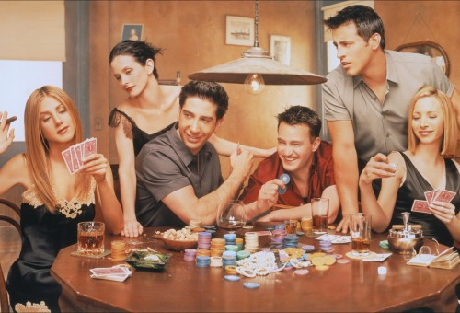
Many guest stars of the show include: Hank Azaria, Cosimo Fusco, Larry Hankin, Tom Selleck, Susan Sarandon, Bob Balaban, Denise Richards, Winona Ryder, Sean Penn,, Kathleen Turner, and Brad Pitt.

Slide 13
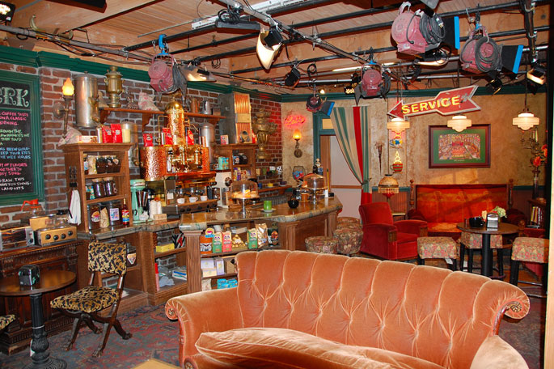
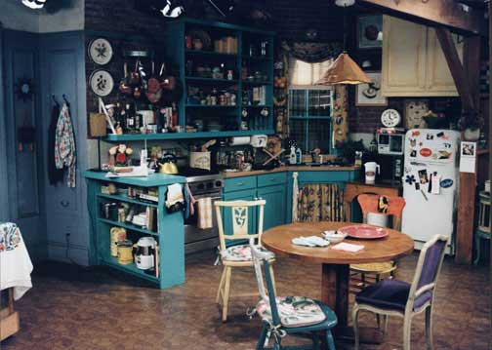
It is the most popular places, where the shooting occurred.

Slide 14
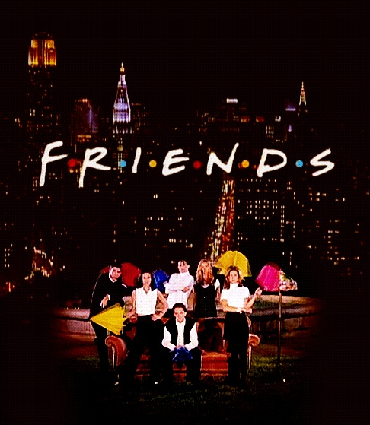
THE BEST SERAIL IN THE WORLD

