Slide 1
Welcome to
Park Plaza Sherlock Holmes

Slide 2


Slide 3

Luxurious Accommodation
The Park Plaza Sherlock Holmes London comprises two 18th century houses over five floors accommodating 119 beautifully re-designed bedrooms, all air-conditioned and including Superior Rooms, Executive Rooms, Executive Studio Suites and Loft Suites. Stylishly designed guest bathrooms offer a unique touch with frosted glass sliding doors to maximise bathroom space.
Each room is equipped with Wireless high-speed Internet access (at a charge), modem data ports, international power sockets, telephone with 2 lines, a work desk, cable TV, movies on demand, mini-bar, quality hair dryer and laptop safe.

Slide 4
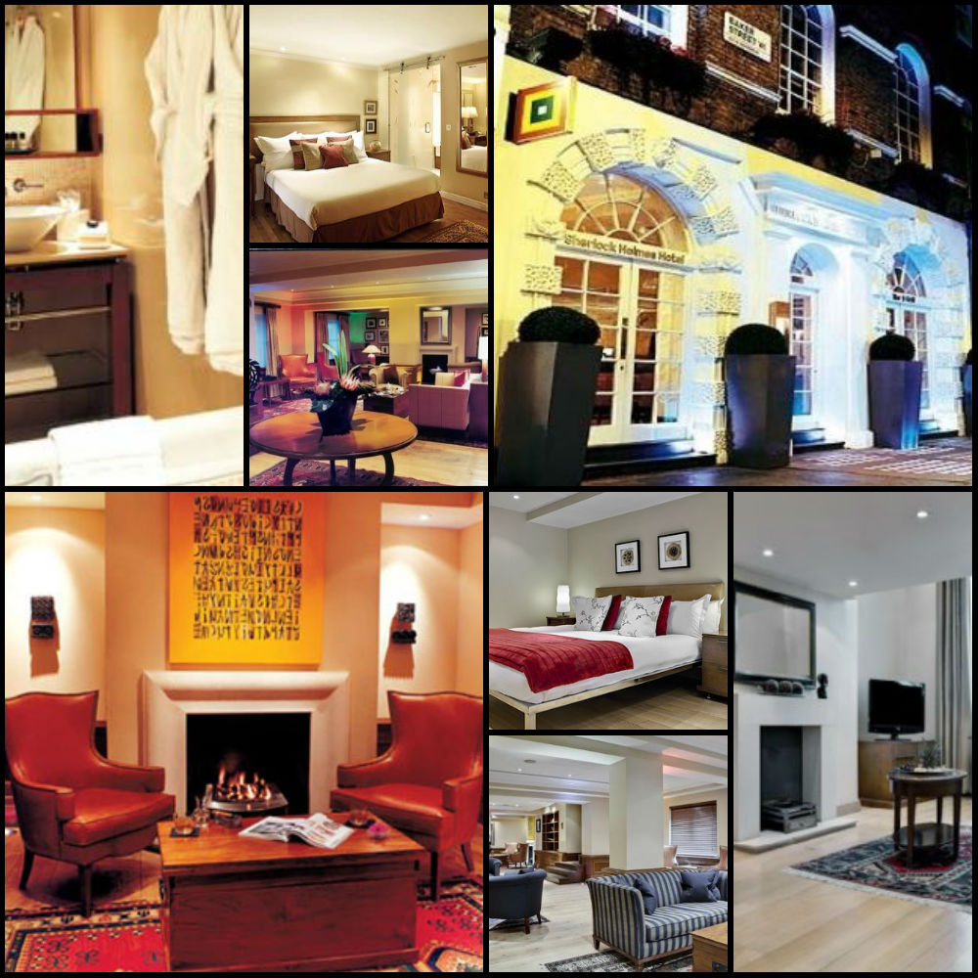

Slide 5
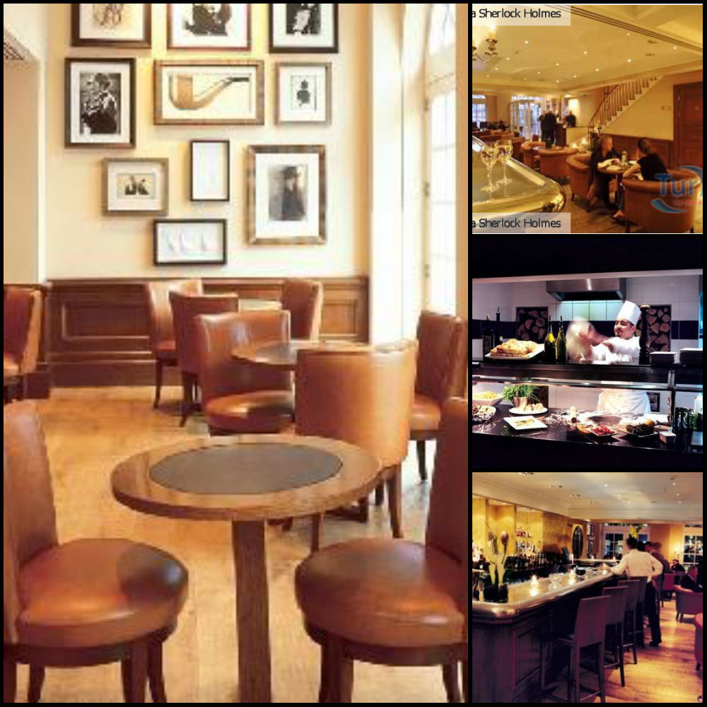
Sherlock's Bar & Grill
The trendy Sherlock's bar offers a wide selection of cocktails, wines, beers, Champagnes and coffees along a bar menu of Mediterranean Tapas, pizzas from the mesquite wood oven and a variety of salads, sandwiches and other light meals in a stylish and lively atmosphere available to enjoy by the fireplace in the winter or alfresco on bustling Baker Street during the summer months - perfectly London.
Sunday evening's our restaurants is closed - However, a full bar menu is served in the bar, lounge and room service is available.

Slide 6
Meetings & Events
The Park Plaza Sherlock Holmes London offers some of the most intimate and stylish meeting space in central London with 7 stunning function rooms all equipped with the most modern technology for small and large meetings.
The hotel also provides a wide variety of menu options from canapes and buffets to a la carte menus created by our Executive Head Chef to add an exclusive touch to any event making it the ideal venue for hosting a private dinner in one of the seven stylishly designed function rooms.

Slide 7
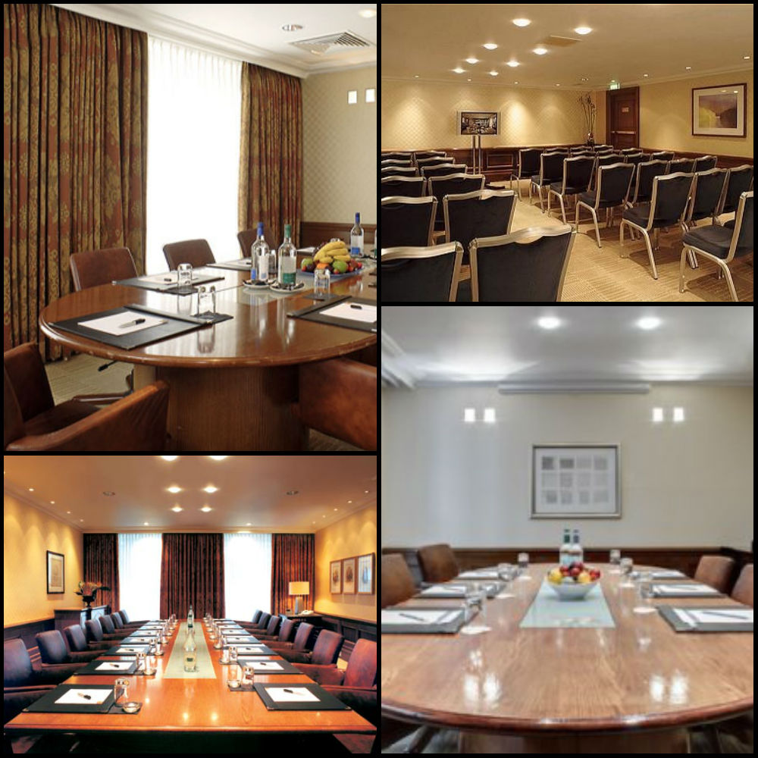

Slide 8
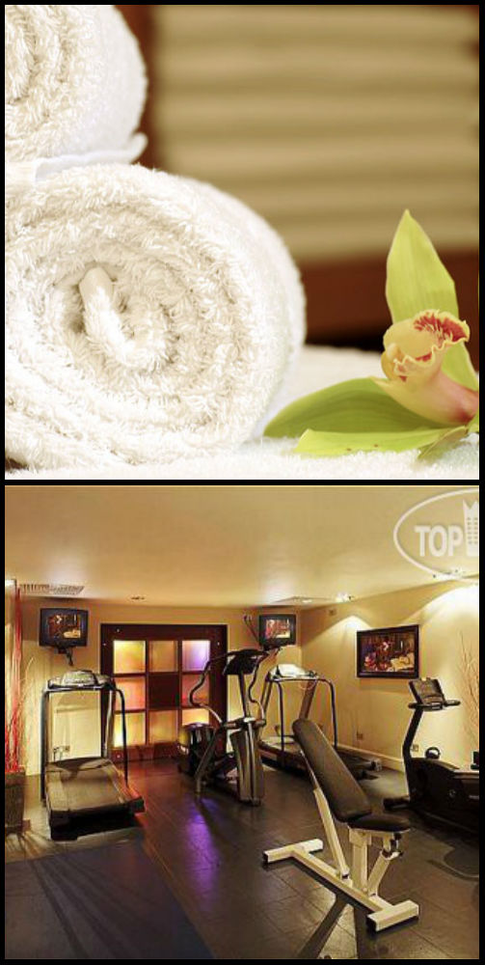
Health & Fitness
The modern and stylish Health Club is located on the lower ground floor of the hotel and provides a perfect area to work-out or relax after a hard day's work, sightseeing or shopping.
A visit to the hotel's Aurora spa for a beauty treatment, massage or sauna is a must for the ultimate unwind. Choose from an extensive range of Swedish massages and facials, muscle de-stresses and hot stone treatments.

Slide 9
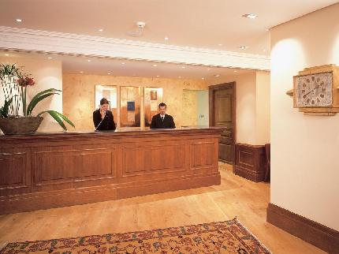
Services
The Park Plaza Sherlock Holmes London offers a wide range of services available on request includinig:
24hr room service
Wi-fi is available in the public areas and bedrooms
Broadband is available in the rooms and charges are applicable
Express check-in & check-out
Wake-up calls
Morning newspapers and magazines
Cribs & high chairs
Guest laundry service
Multi-lingual staff
Foreign currency exchange
Concierge and luggage porters
Guest Relations
Baggage storage
For your safety and security, 24hr video surveillance is in operation in all public areas.

Slide 10
Will be glad to see you

