Slide 1
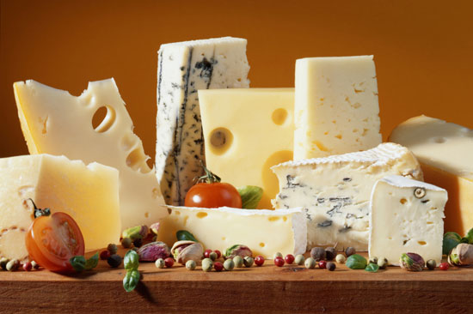
«Dutch cuisine»
Chornobaeva Olena
Form 11

Slide 2
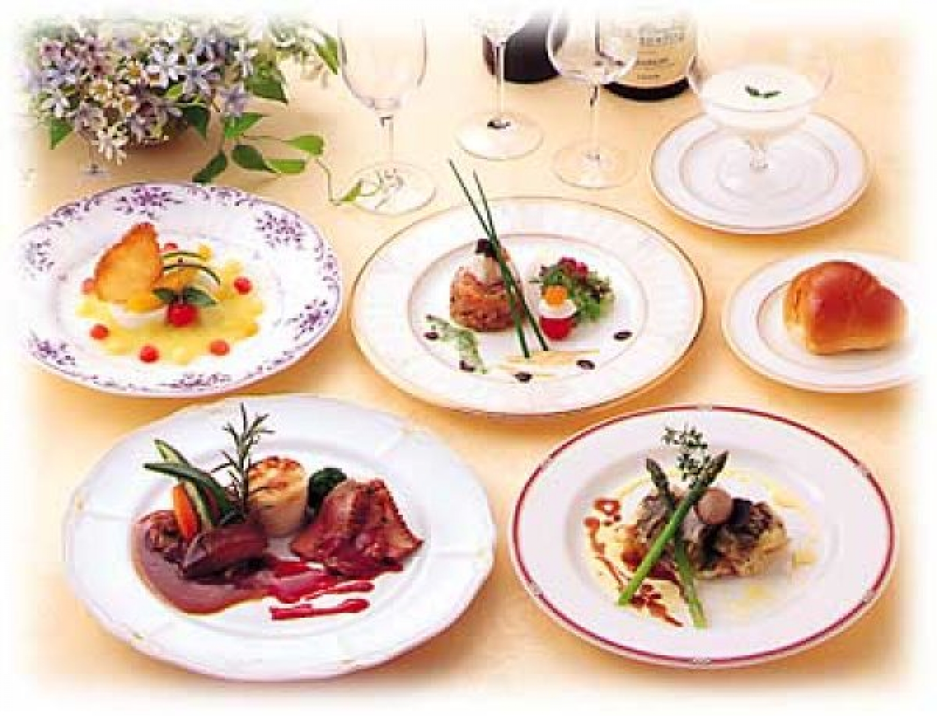
Dutch housewives do not like to spend much time in the kitchen, though, they keep close track of the fact that all the food served on the table, were tasty and go well with each other.

Slide 3
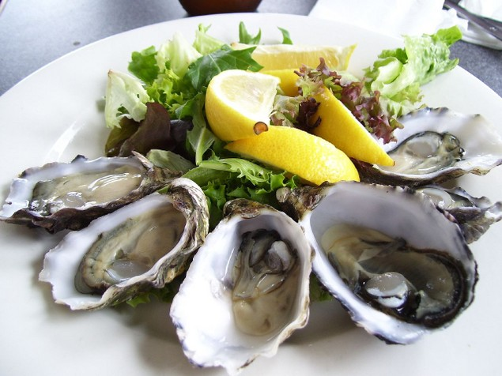
In Holland the daily dishes are fresh fish - herring, sea eel, bondage, halibut, oysters.

Slide 4
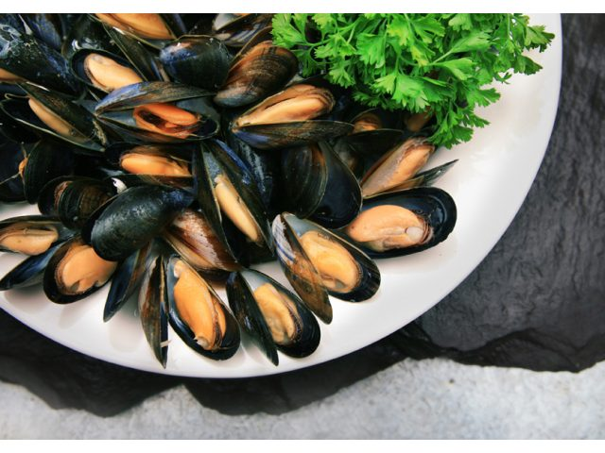
In the year to each resident of the country have an average of nearly 10 pounds of meat mussels. It is cooked, add salt, processed for canning. Fish fed mainly stewed, poured melted butter, and boiled potatoes.

Slide 5
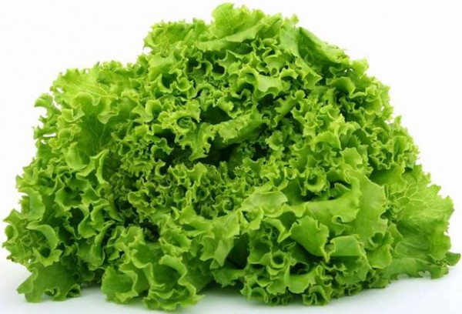
For baked fish dishes are usually served lettuce.

Slide 6
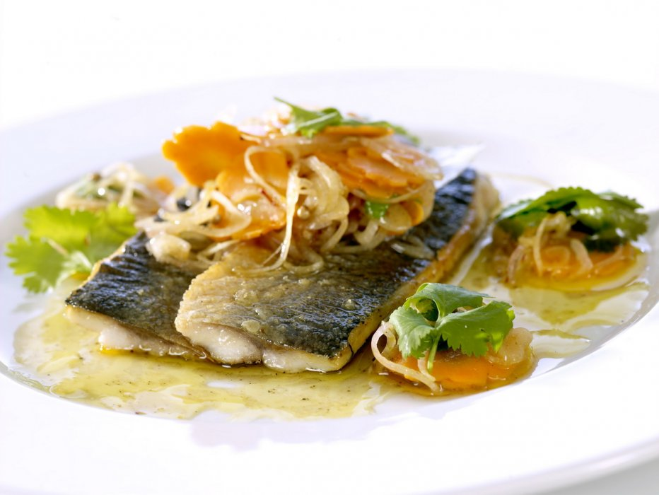
The most common: fried in pork fat fillet of fresh herring with chopped onion rings, green beans, boiled potatoes, liberally sprinkled with chopped parsley, and perch, braised in the oven with vegetables and boiled potatoes drizzled with melted butter and sprinkle with parsley.

Slide 7
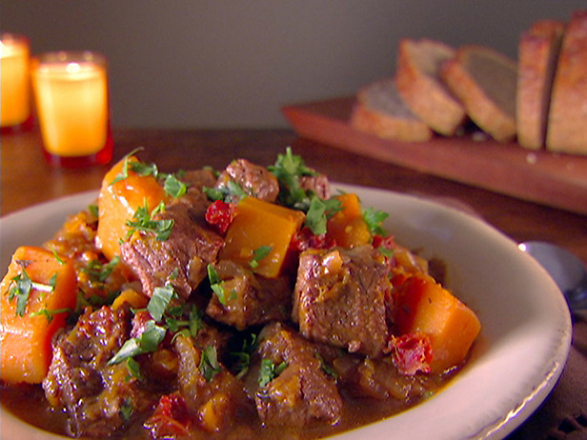
National dish of Dutch cuisine is hutspot (or hot pot) - sliced ​​slices boiled or braised beef, served on a platter garnished with vegetable puree, made from boiled carrots, onions and potatoes.

Slide 8
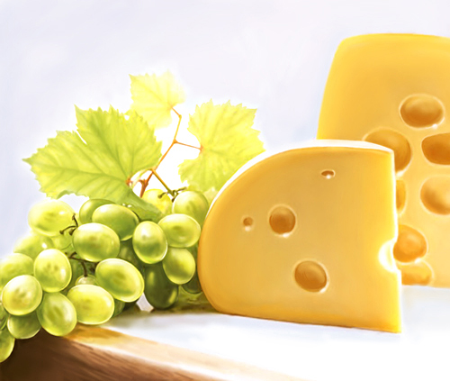
Popular canape with cheese, ham and butter. Holland is famous for high-quality cheeses, their range is not too great, but true connoisseurs of cheese accurately determine cheese, cooked according to the rules formulation in Holland.

