Slide 1
The British Royal Family
Презентацію підготувала
учениця 10 класу:
Жернова Є.О.

Slide 2
At Present the British royal family is headed by Queen Elizabeth.

Slide 3
When the Queen was born on the 21 st of April 1926, her grandfather, King George V, was on the throne and her uncle was his heir. She came to the throne after her father’s death in 1952 and was crowned in Westminster Abbey in June 1953.

Slide 4
The marriage of the young Princess Elizabeth to Philip, Duke of Edinburgh took place in November 1947.

Slide 5
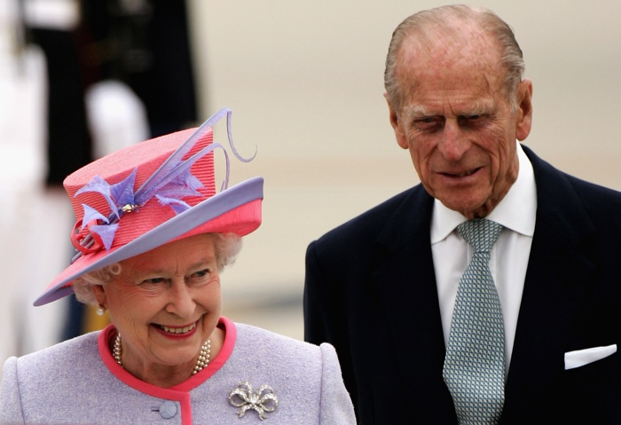
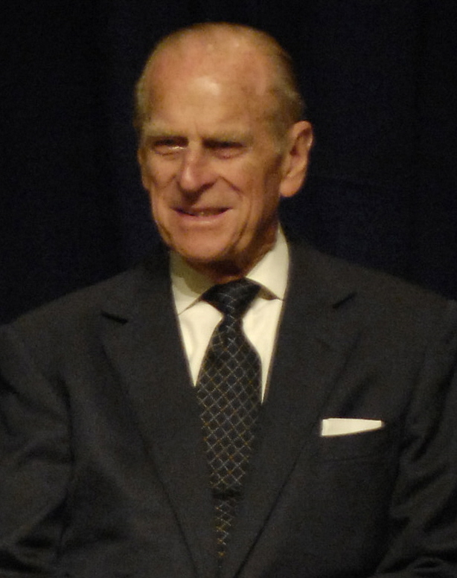
The Queen’s husband, Duke of Edinburgh, was born in 1926 and served in the Royal Navy. He takes a great deal of interest in industry and in saving raise wild animals from extinction.

Slide 6
The Queen’s heir is Charles, Prince of Wales, who was born in 1948.

Slide 7
In 1981 Prince Charles married Lady Diana Spencer.

Slide 8
Lady Diana became very popular in Britain and was called “ the Queen Hearts”

Slide 9
In 8 years the death of Princess Diana Prince Charles got married Camilla Parker – Bowles, Duchess of Cornwall.

Slide 10
Prince Charles has two children, Prince William and Prince Harry.

Slide 11
Thank you for your attention!!!

