Slide 1
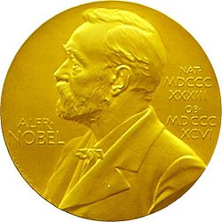
Women – laureates of Nobel Prize
Made by Maryna Zimenko

Slide 2
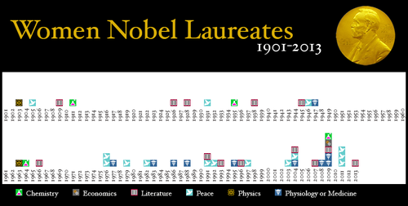
The Prize awarded every year since 1901 for outstanding achievements.

Slide 3
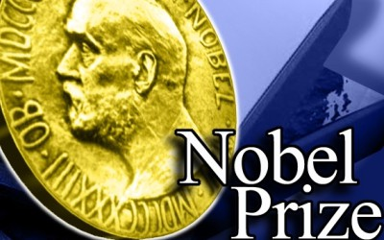
Nobel Prize awarded laureates in the following areas:
in Physics
in Chemistry
in Physiology
in Medicine
in Literature
for peace
in Economics

Slide 4
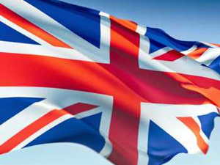
Women – laureates of Nobel Prize in Great Britain

Slide 5
In Great Britain was four women laureates
Dorothy Mary Hodgkin
Doris May Lessing
Betty Williams
Mairead Corrigan Maguire

Slide 6
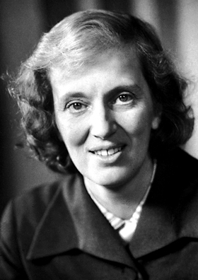
Dorothy Mary Hodgkin
Dorothy Hodgkin was born on May 12, 1910 in Cairo, Egypt. Her father, John Winter Crowfoot was an archeologist, so the family constantly moved to different parts of the world. Dorothy's childhood was spent in Egypt, Britain and Sudan. From Dorothy's father inherited a love of history and archeology. Dorothy's mother - Grace Mary Crowfoot was a good botanist. From his mother, Dorothy got a good knowledge of botany.

Slide 7
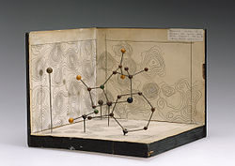
In 1964 she got the Nobel Prize in Chemistry "for the determination with X-ray structures of biologically active substances."

Slide 8
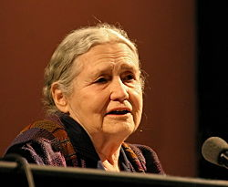
Doris May Lessing
Doris May Lessing was a British writer. She was born in Kermanshah, Persia , on 22 October 1919. In 1925, the family moved to the British colony. Lessing was educated at the Dominican Convent High School.

Slide 9

Lessing was awarded in the 2007 Nobel Prize in Literature.

Slide 10
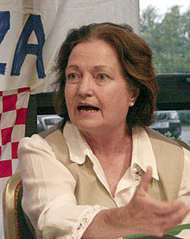
Mairead Corrigan Maguire
Maguire was born into a Roman Catholic community in Belfast, Northern Ireland, the second of eight children – five sisters and two brothers. Her parents were Andrew and Margaret Corrigan. She attended St. Vincent's Primary School, a private Catholic school.

Slide 11
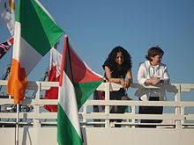
She co-founded with Betty Williams and Ciaran McKeown, the Women for Peace, which later became the Community for Peace People.

Slide 12
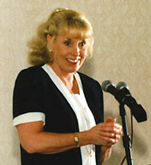
Betty Williams
Betty Williams was born 22 May 1943 in the city of Belfast in Northern Ireland, is a co-founded with Mairead Corrigan of the Nobel Peace Prize in 1976 for her work as a cofounder of Community of Peace People.

Slide 13


