Slide 1
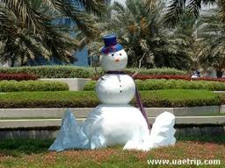
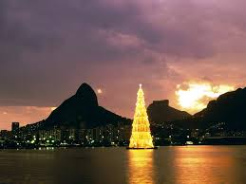
New Year in Brazil

Slide 2
New Year Celebration in Brazil
During the New Year time, the South American nation of Brazil seems to get immersed deep in the tides of celebration. Big parties are organized all over the Brazil. The biggest ones are organized in the beautiful city of Rio de Janeiro. Preparation for the New Year parties begins a day before the celebration day. Special efforts go into the crafting of the fireworks, which is lit up exactly at the midnight of the New Year to welcome and celebrate it.
A half an hour firework show sees people celebrating and wishing for everyone's good luck for the coming year. It is followed by dinner, which has Brazilian cultural dishes like rice, chicken, farofa, salads, and marajucá mousse on the platter. The whole celebration mood remains on a constant high for the entire New Year night with people playing music and dancing altogether. Major cities of Brazil also host musical concerts, dance performances, and special art shows for the day.

Slide 3
Traditional Celebrations of New Year in Brazil
New Year celebrations in Brazil revolve largely around the customs and traditions, which can be stated as countless in numbers. A significant one among those customs is to consume lentils and rice on the day. Doing so is considered to confer blessings, good luck, fortune, and prosperity in one's life. Also, there is a tradition of wearing white on the day, as doing so is traditionally believed to bring and sustain good luck for the rest of the year. On the midnight of the arrival of New Year, local people residing in and around the beach city gathers at the beach, and as a part of tradition jumps seven times into the beach and throw flowers in the beach while wishing for a happy and prosperous year ahead.

Slide 4
New Year in Rio de Janeiro
The Rio de Janeiro city of Brazil puts ‘Feste de Iemenja' in order as a part of New Year celebrations, which in particularly is celebrated with lot of faith and determination by the local fisherman. In the beliefs of Brazilian people, Iemenga is considered as the Goddess of the Sea and the Mother of Waters. As a part of their tribute to the Goddess and in order to get bestowed with Her blessings, Brazilian people depart a boat in the sea, which is laden with presents, scented flowers, colorful candles, jewelry, scents, and rice.
The famous Copacabana beach in Rio de Janeiro hosts beach parties, where people participate, eat, drink, dance, and celebrate the mood of New Year. Brazilian Carnival is another major attraction, where people dressed up in flashy clothes walk down through streets while celebrating New Year by singing and dancing to the tunes of traditional music of sambha, frevo, forro, pagoda, Axe etc.

