Slide 1
St. Patrick's Day
Ksenofontova 10-А

Slide 2

St. Patrick's Day - a cultural and religious feast that is celebrated annually on March 17, the day of the death of Ireland's the heavenly patron St. Patrick.

Slide 3
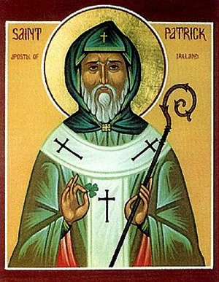
Who was St Patrick?
The exact time and place of his birth is unknown, apparently, he was born in Roman Britain in a place called Bannaventa. At the age of sixteen, Patrick been kidnapped by Irish brigands and delivered to Ireland as a slave.

Slide 4
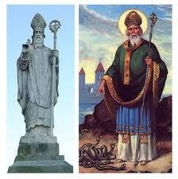
In childhood and youth, he did not know the true God, but for the years of slavery appealed to him, he spent days and nights in constant prayer, and six years later, God helped him get out from slavery. Patrick afterwards becomes a servant of the church. And the rest of his life serving God.

Slide 5
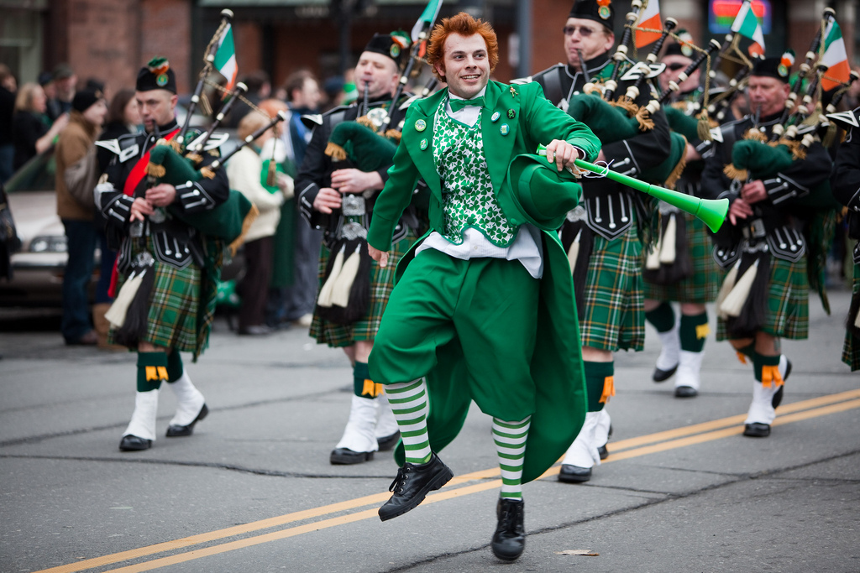
Traditions feast
Parades

Slide 6
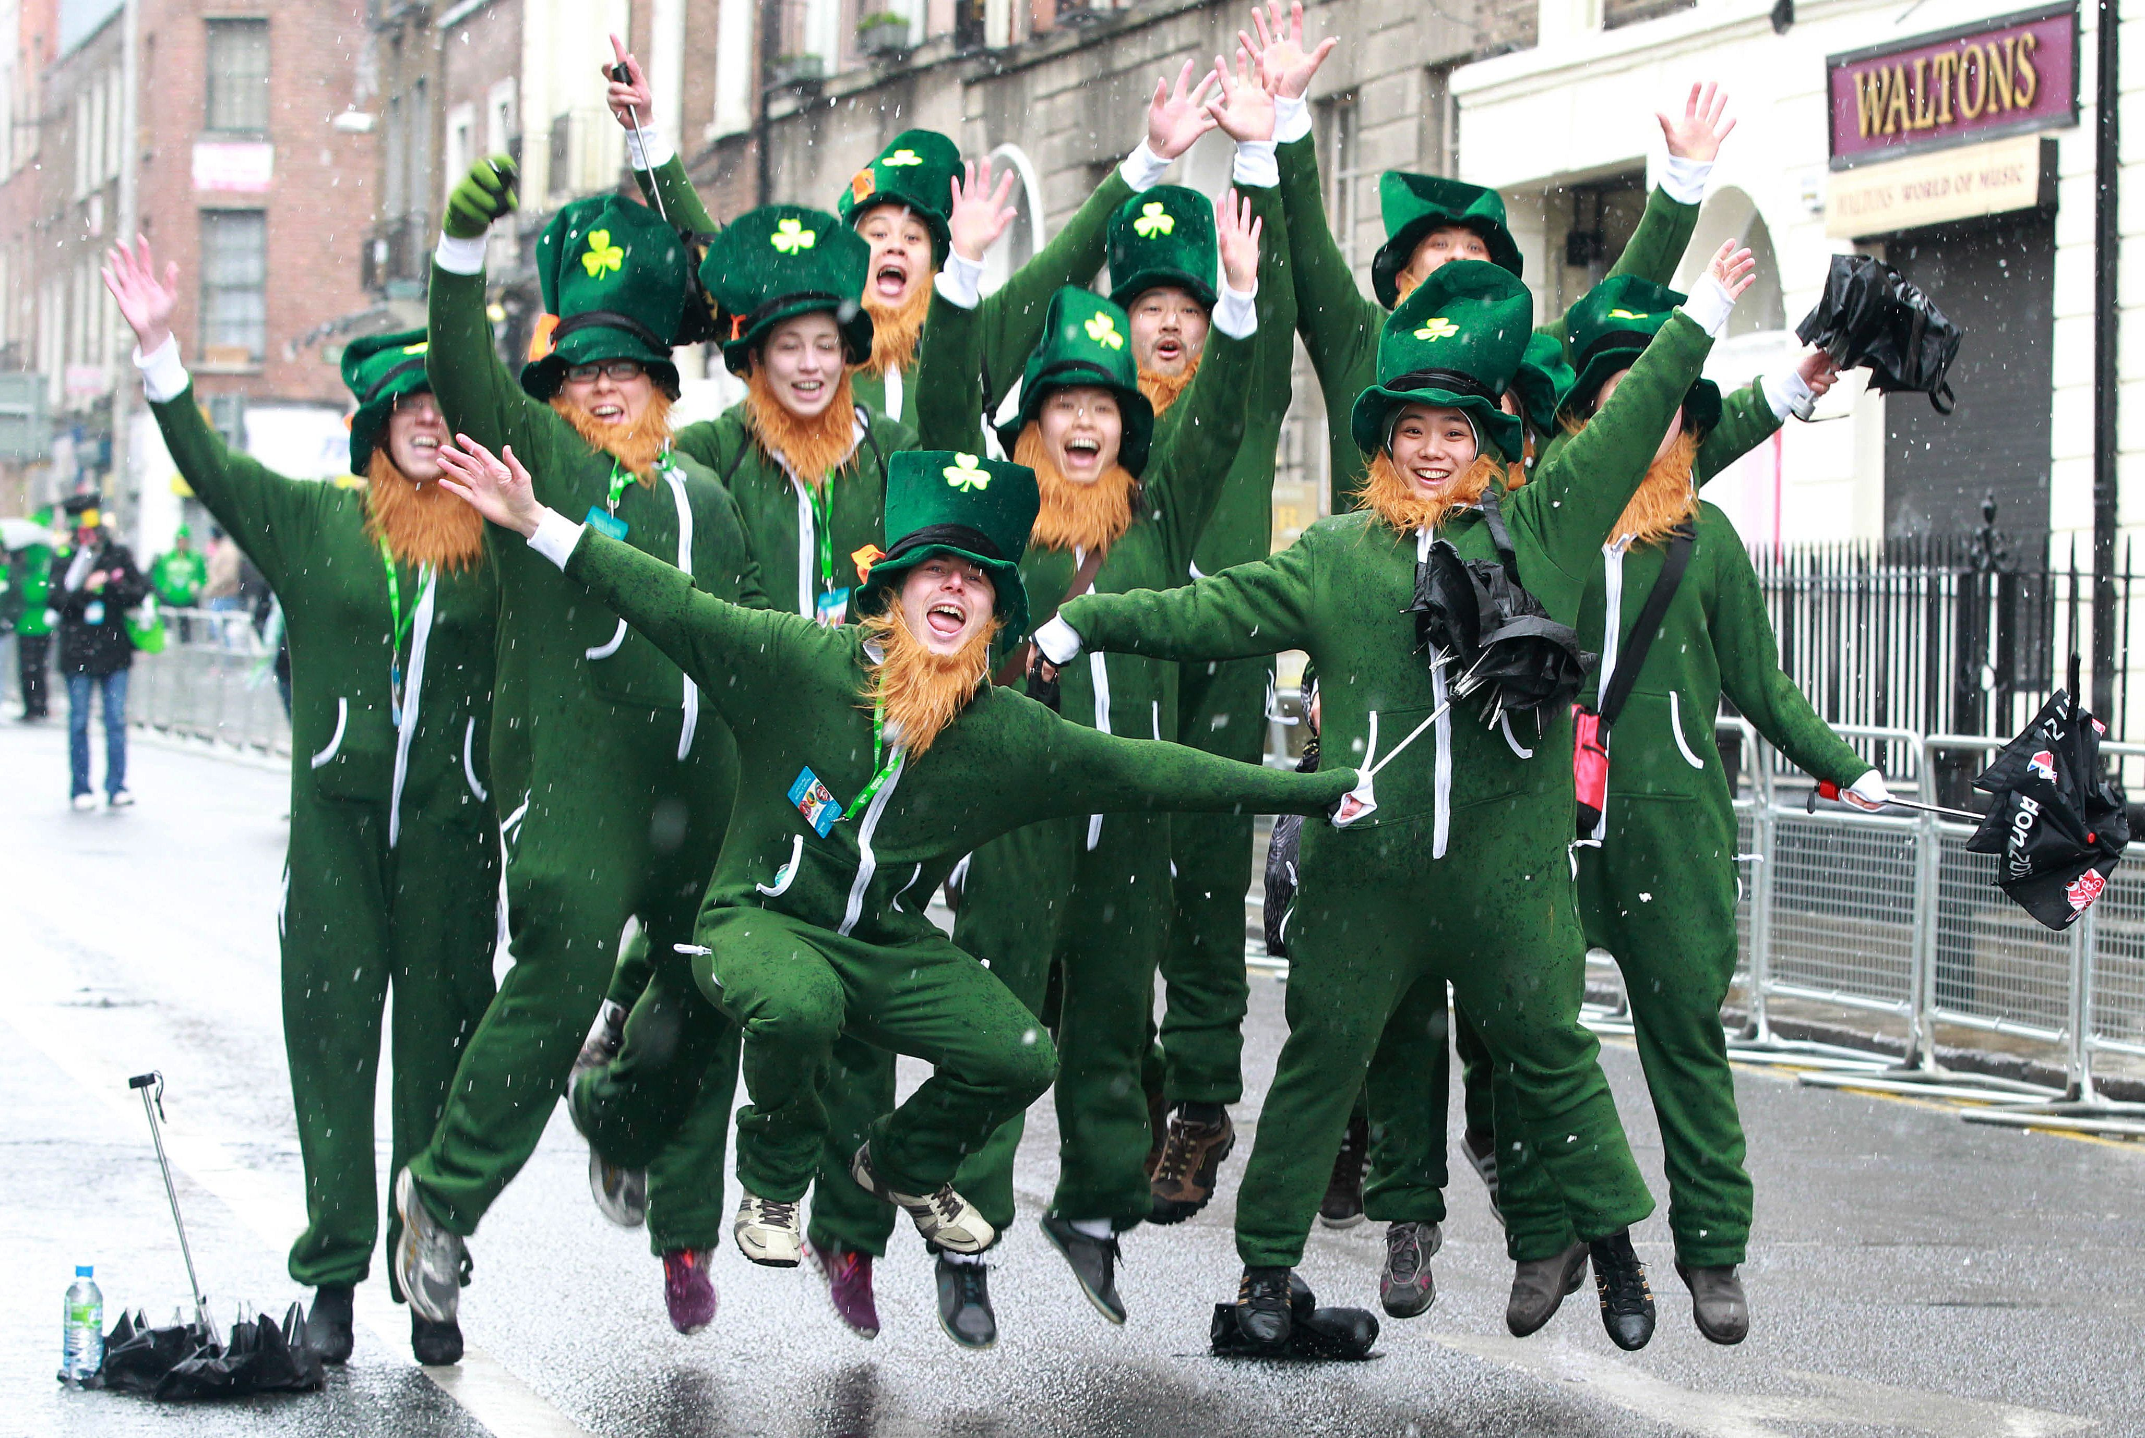
Accepted wearing green clothes.

Slide 7
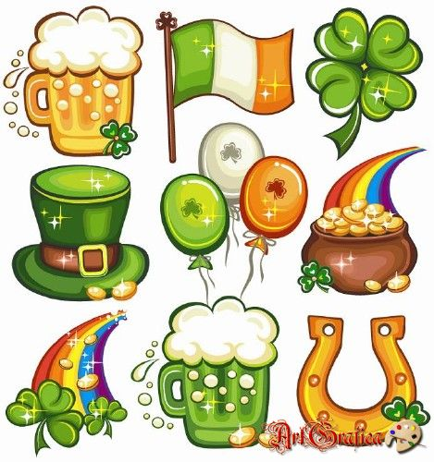
The official symbol of the holiday is the Trefoil - is a graphical representation leaf clovers and leprechauns and Irish flags.

Slide 8
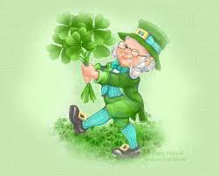
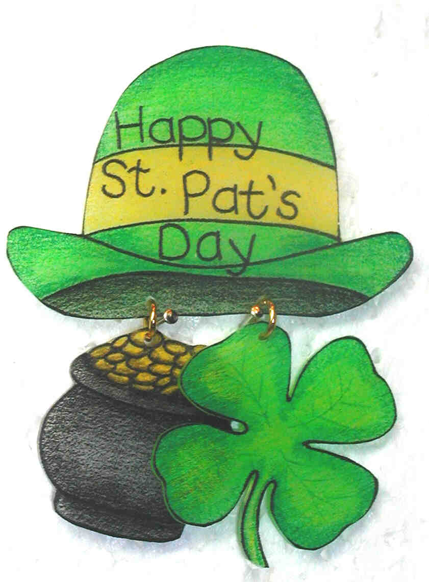
Leprechaun - Irish folklore the character traditionally portrayed as a small, stocky man.

Slide 9
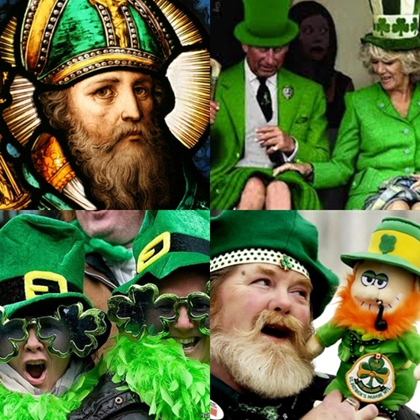
St. Patrick's wore blue vestment. Green - the color of of nature spirits and inmates of the underworld. In the old Irish tried to avoid this color because it brings bad luck. Not in any way not be dressing in green children: can kidnap.

Slide 10


