Slide 1


Death Is a Lonely Business
«Venice, California, in the old days had much to recommend it to people who liked to be sad. It had fog almost every night and along the shore the moaning of the oil well machinery and the slap of dark water in the canals and the hiss of sand against the windows of your house when the wind came up and sang among the open places and along the empty walks.»
by Ray Bradbury

Slide 2

«Insanity is relative. It depends on who has who locked in what cage.»
Death Is a Lonely Business is a mystery novel by Ray Bradbury published in 1985. The story, set in 1949, is about a series of murders that happen in Venice, California, then a declining seaside community in Los Angeles where Bradbury lived from 1942 to 1950. The main character and narrator (who never mentions his name) is a sensitive, modest writer, with a girlfriend studying in Mexico City. In the course of the story he meets Elmo Crumley, a detective who helps him solve the mystery behind all the semi-murders occurring among a series of eccentric characters in the forgotten town.

Slide 3
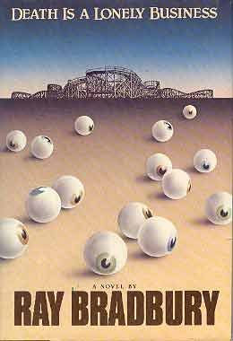
Plot introduction
According to the biography in the book, this was Ray Bradbury's first novel since the publication of Something Wicked This Way Comes (not counting the young adult novel The Halloween Tree). It evokes both the milieu and style of other mystery writers Raymond Chandler, Dashiell Hammett, James M. Cain, and Ross Macdonald, all of whom Bradbury names in the book's dedication, and James Crumley, after whom Bradbury named his detective. Yet the main character is undoubtedly Bradbury himself, portrayed in a period of his life just before his marriage and his success with The Martian Chronicles.
Two sequels followed: A Graveyard for Lunatics (1990), and Let's All Kill Constance (2003), advancing the writer's career to 1954 and 1960, respectively.
«His smile could open wrists.»

Slide 4
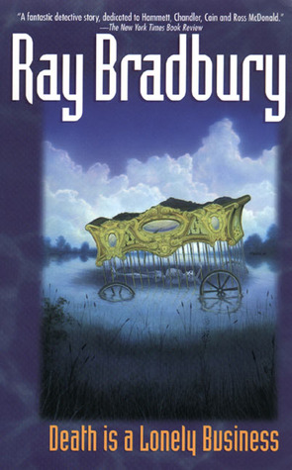
"Never look back. Eyes can kill. If you look at someone, and he sees that you want to be killed, he will follow you."
It is in this place, filled with loneliness, so scared of dying. It is in this place, as if created for the perfect scene detective novel and a murder occurs. That feeling is the book. Detective Bradbury - it's not a detective in the traditional sense, it is something more emotional, more human. It seems that the novel was written, not in order to lead us to the killer, but for that we have like Venice and the mood of the protagonist - a writer (apparently, the prototype of which was the author himself).

Slide 5

«Do not mist it beats on my door, leaving bruises on her?»
Sad characters wander through the pages of the novel - they're all so sad, lonely and unhappy:
* The old man found in the cell.
* Lady with canaries.
* Escaped hairdresser Cal.
* Formten with mild craziness in his eyes.
* Hopwood with the body and face of Apollo dictator
* Fatty Fanny, a lover of classical music
* Blind Negro Henry, who does not like to be touched
* Recluse actress Constance Rettig.
* Pietro, and feeds a collecting all living creatures in the area.
* Homeless Jimmy, who drowned in the bathtub.
* Sam - Mexican napivshiysya three sheets.
* Crumley stupid detective and clever writer.
Murderer, of course, find, but still there is a feeling that is not the main thing. The main thing is that the characters find themselves.

Slide 6
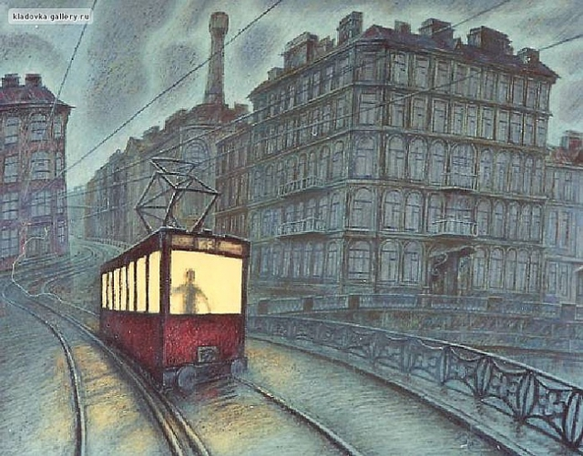
“… And if heard somewhere in the distance a large grated red tram, turning to rain, and as the voice behind me muttering again, became the name of the book that says Crumley…"

Slide 7

Bradbury offers an amazing recipe to cope with loneliness, effective even at the chronic stage. Where loneliness - this is not the yoke and shackles, first of all, an opportunity to realize their dreams, desires, and do something for a long time and wanted to put off, to do what had not dared.
«- Everyone should have two or three classes - without hesitation I replied. - One case of as little as one life. I'd like a dozen lives and a dozen works.
- Beats right on target! The physician should dig ditches. Digger on duty once a week in kindergarten. Philosophers twice in ten days to wash dirty and greasy dishes. Mathematics let supervise classes in school gymnasiums. Poets for diversity let drive trucks. A police detectives ...
- ... Must raise their own gardens of paradise - I finished quietly.»

Slide 8

«Fear of death is akin to fear of loneliness - before the face of death every single, you can not die in the company, no help, no one closes the door of death, loneliness - the first step toward her.»
"To sum up the lives of some very simple - it's life is like banging doors slamming or cough resounded on a dark street.
You look out the window, and the street was empty. Whoever coughed, had disappeared.
There are people who survive to thirty to forty years, but they do nothing to attract attention, their lives go unnoticed, invisible, burning down quickly, like a candle. "

Slide 9
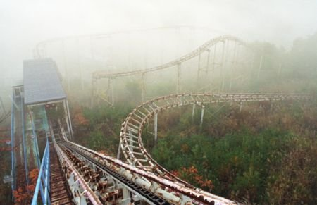
«It was raining hard now as the big red trolley bucketed across a midnight stretch of meadow-grass and the rain banged the windows, drenching away the sight of open fields. We sailed through Culver City without seeing the film studio and ran on, the great car heaving, the floorboard whining underfoot, the empty seats creaking, the train whistle screaming.
And a blast of terrible air from behind me as the unseen man cried,
“Death!”
The train whistle cut across his voice so he had to start over.
“Death”
Another whistle.
“Death,” said the voice behind me, “is a lonely business”.»

