Slide 1
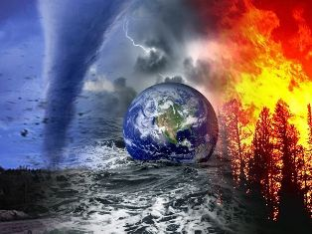
Natural disasters
in Ukraine
Prepared
Olga Draganchuk

Slide 2
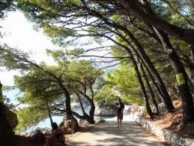
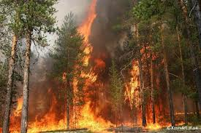
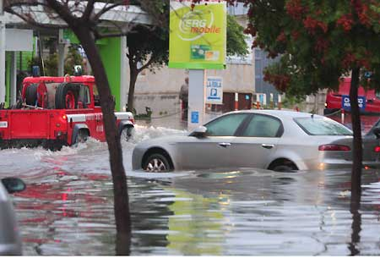
Natural disaster - it is an extraordinary natural phenomenon, acting with great destructive force, causing considerable damage to the area in which it takes place violates the normal activity of the population, destroying wealth.

Slide 3
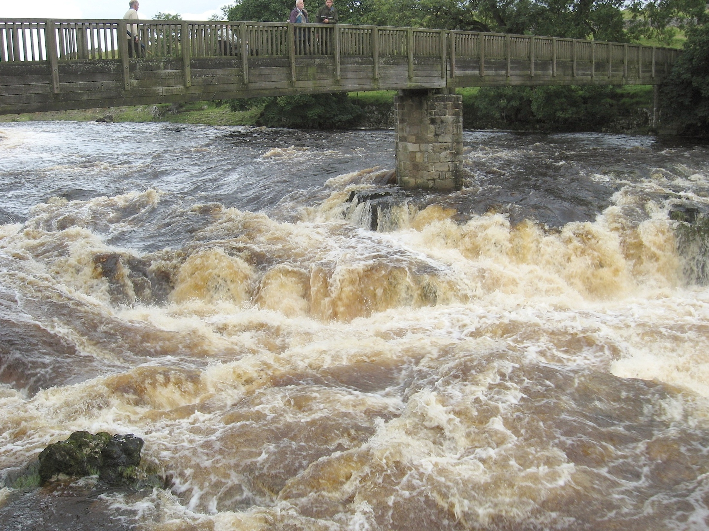
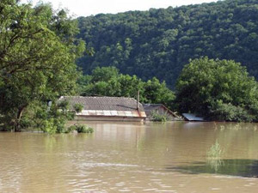
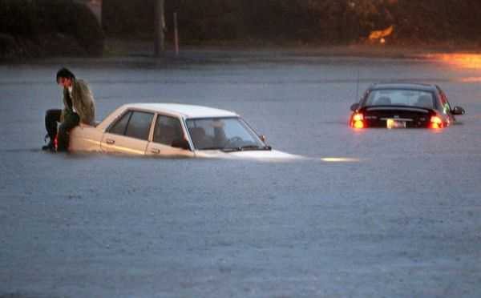
Flood
Flood - a phase of the water regime of the river, which annually repeated in these climatic conditions in the same season, characterized by the highest water content, high and continuing rises and falls in water levels.
For most rivers in Ukraine flood lasts from March to June and is due to snowmelt and prolonged intense rains in spring and early summer.

Slide 4
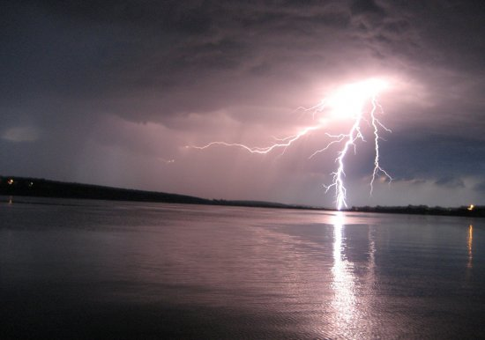
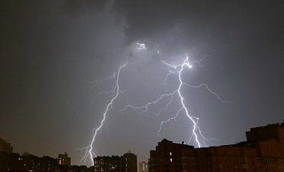
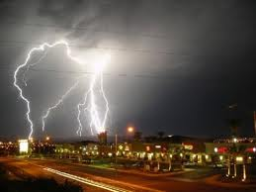
Thunderstorm
Thunderstorm - atmospheric phenomenon associated with electrical discharges in Cumulonimbus clouds. Accompanied by lightning and thunder.
Thunderstorms in Ukraine constantly occur even in the winter months. They are particularly dangerous in the steppe zone, strikes of lightning striking all that little bit towering above the grass or bushes.

Slide 5
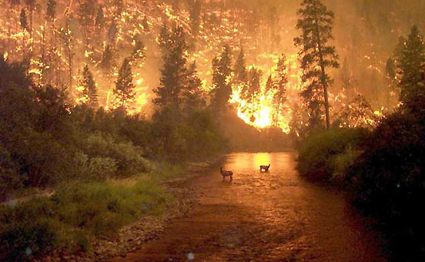
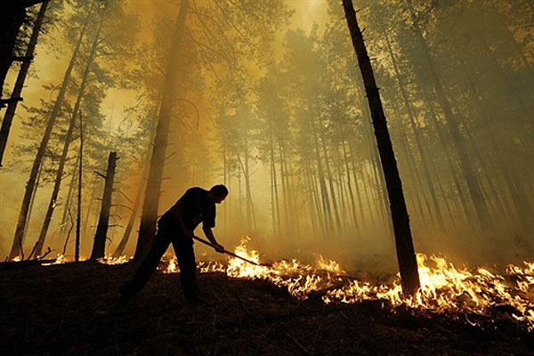
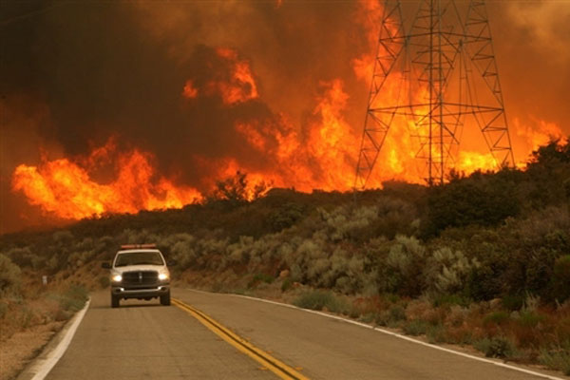
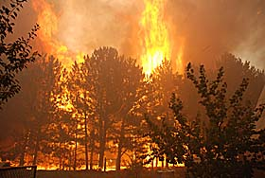
Forest fire
Forest fire - forest fires are divided into grassroots, riding, underground. The intensity of burning wood fires are divided into weak, medium, strong.

Slide 6
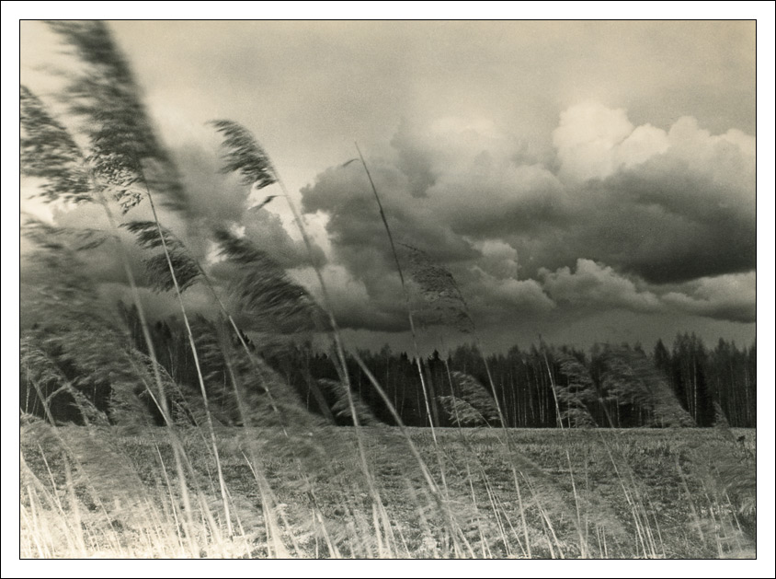
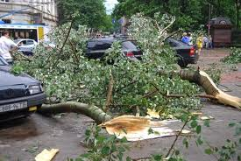
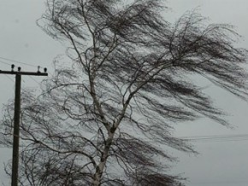
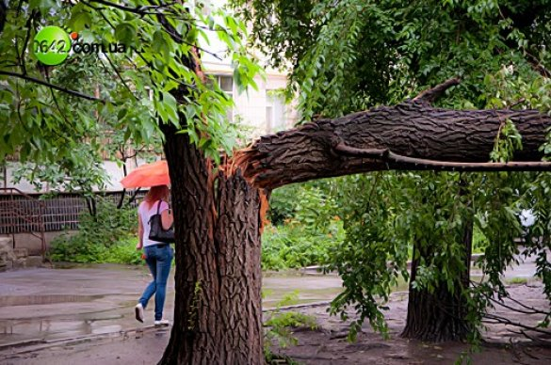
Wind - is one of the most important components of life. But it can be devastating, much more dangerous on many elements.
Wind

Slide 7
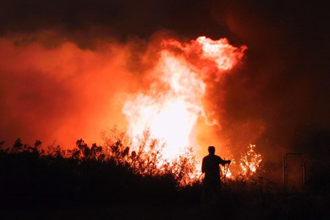
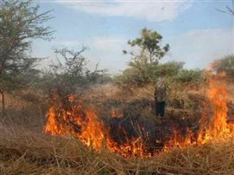
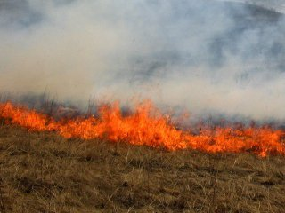
Field fire
Field fire - having an open area where there is a faded dry grass or grain that is ripe. They are seasonal and are more often in the summer, less in spring and almost no winter. Light distribution can reach 20-30 km / h.

