Slide 1
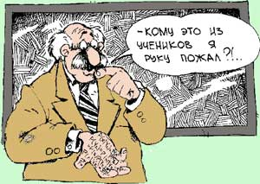



Exams in USA
Завалкевич Анастасія
Учениця 11-Б

Slide 2


Educational system:
Еlementary school
Мiddle school
Нigh school

Slide 3

Exam – is a testing of knowledge/ knowledge monitoring
SAT (Scholastic Aptitude Test)
AST
GRE (Graduate Record Examination)

Slide 4



SAT:
SAT I,
reasoning test)
SAT II,
subject test

Slide 5


AST
motivates students to perform to their best ability.
Test scores reflect what students have learned throughout high school and provide colleges and universities with excellent information for recruiting, advising, placement, and retention.

Slide 6


GRE
Verbal Reasoning
Quantitative Reasoning
Analytical Writing

Slide 7




TOEFL (Test of English as a Foreign Language)

