Slide 1
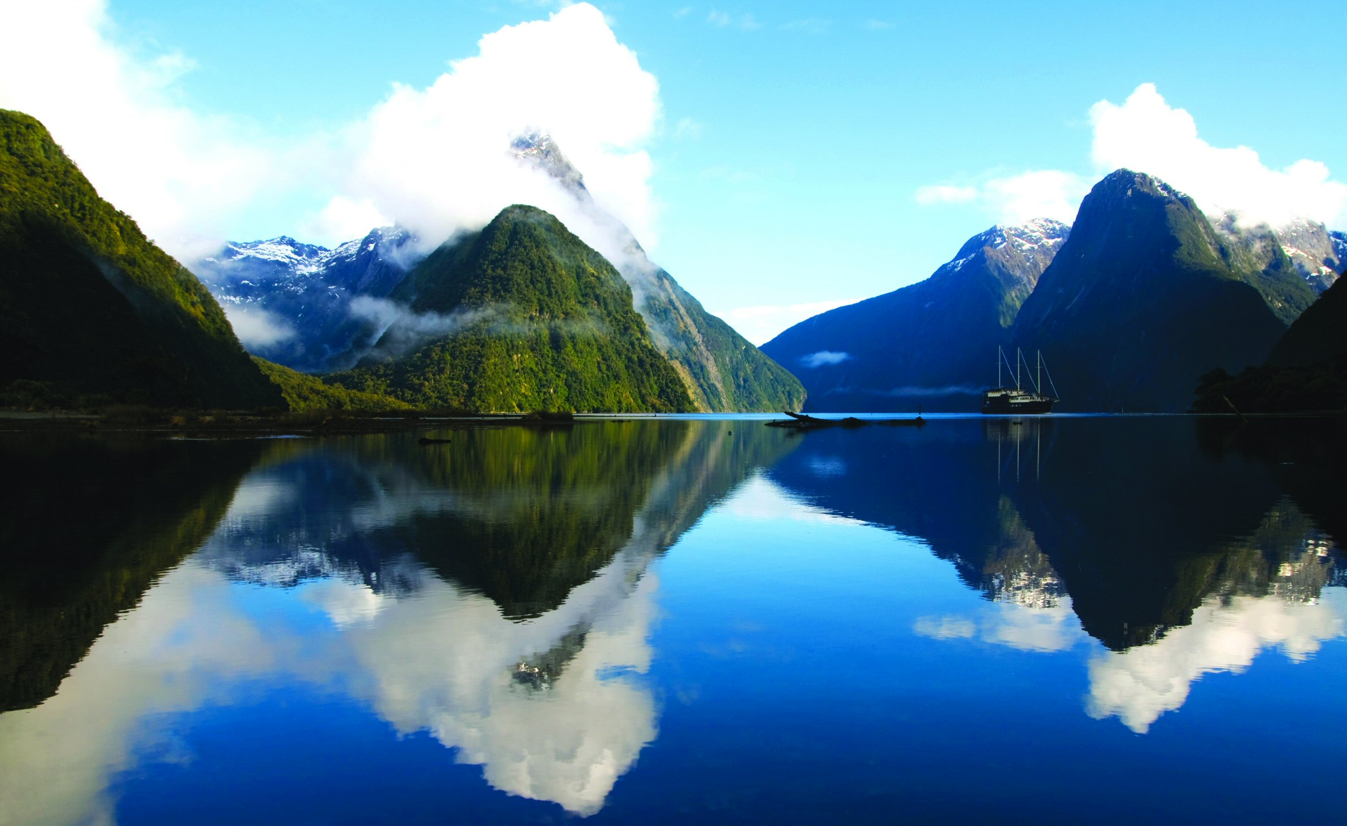
New Zeland

Slide 2
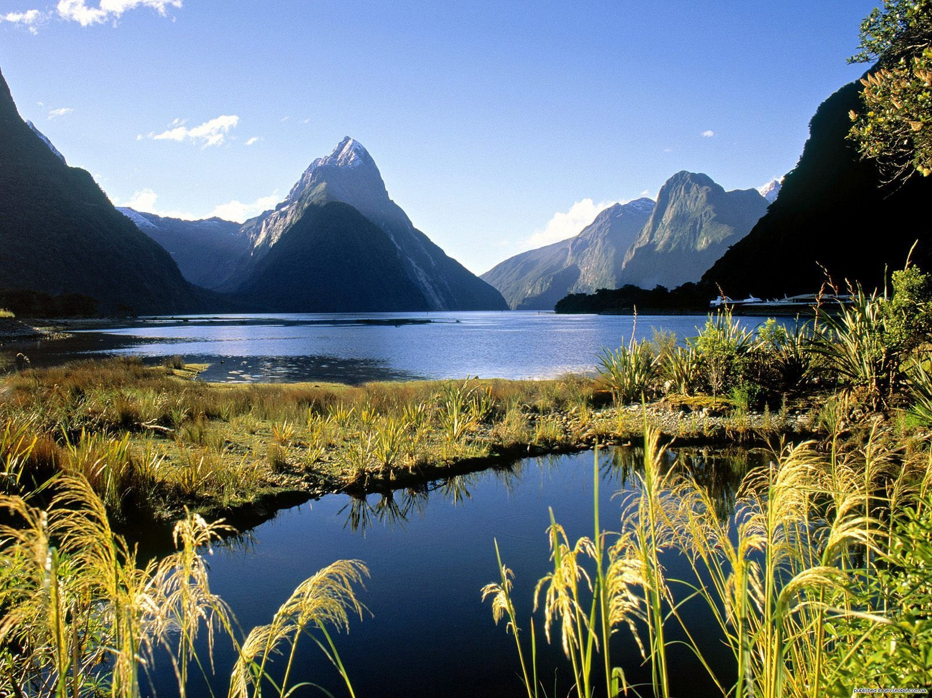
When to go?
The autumn weather in New Zealand is cooler, but still warm enough for swimming and other water sports.

Slide 3
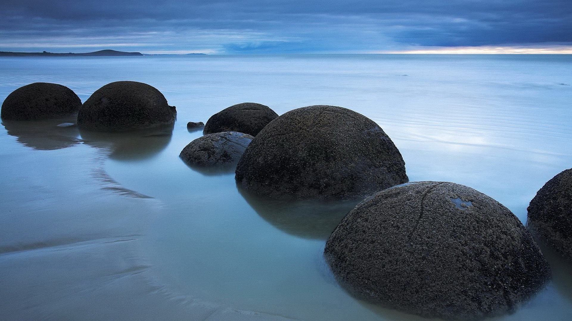
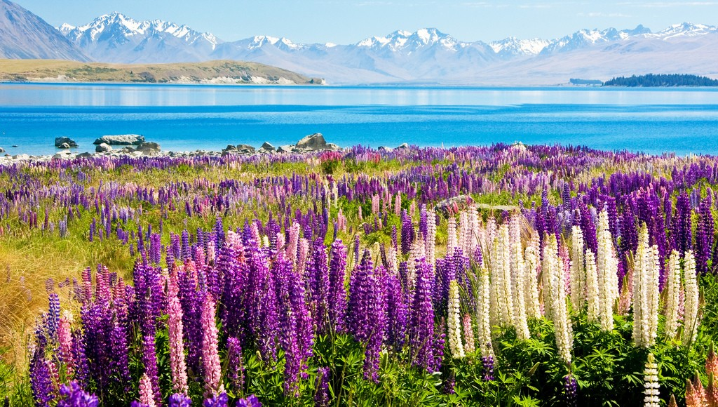
Where to go?
Tekapo - Lake on the South Island in New Zealand. Located in the region of Canterbury.

Slide 4
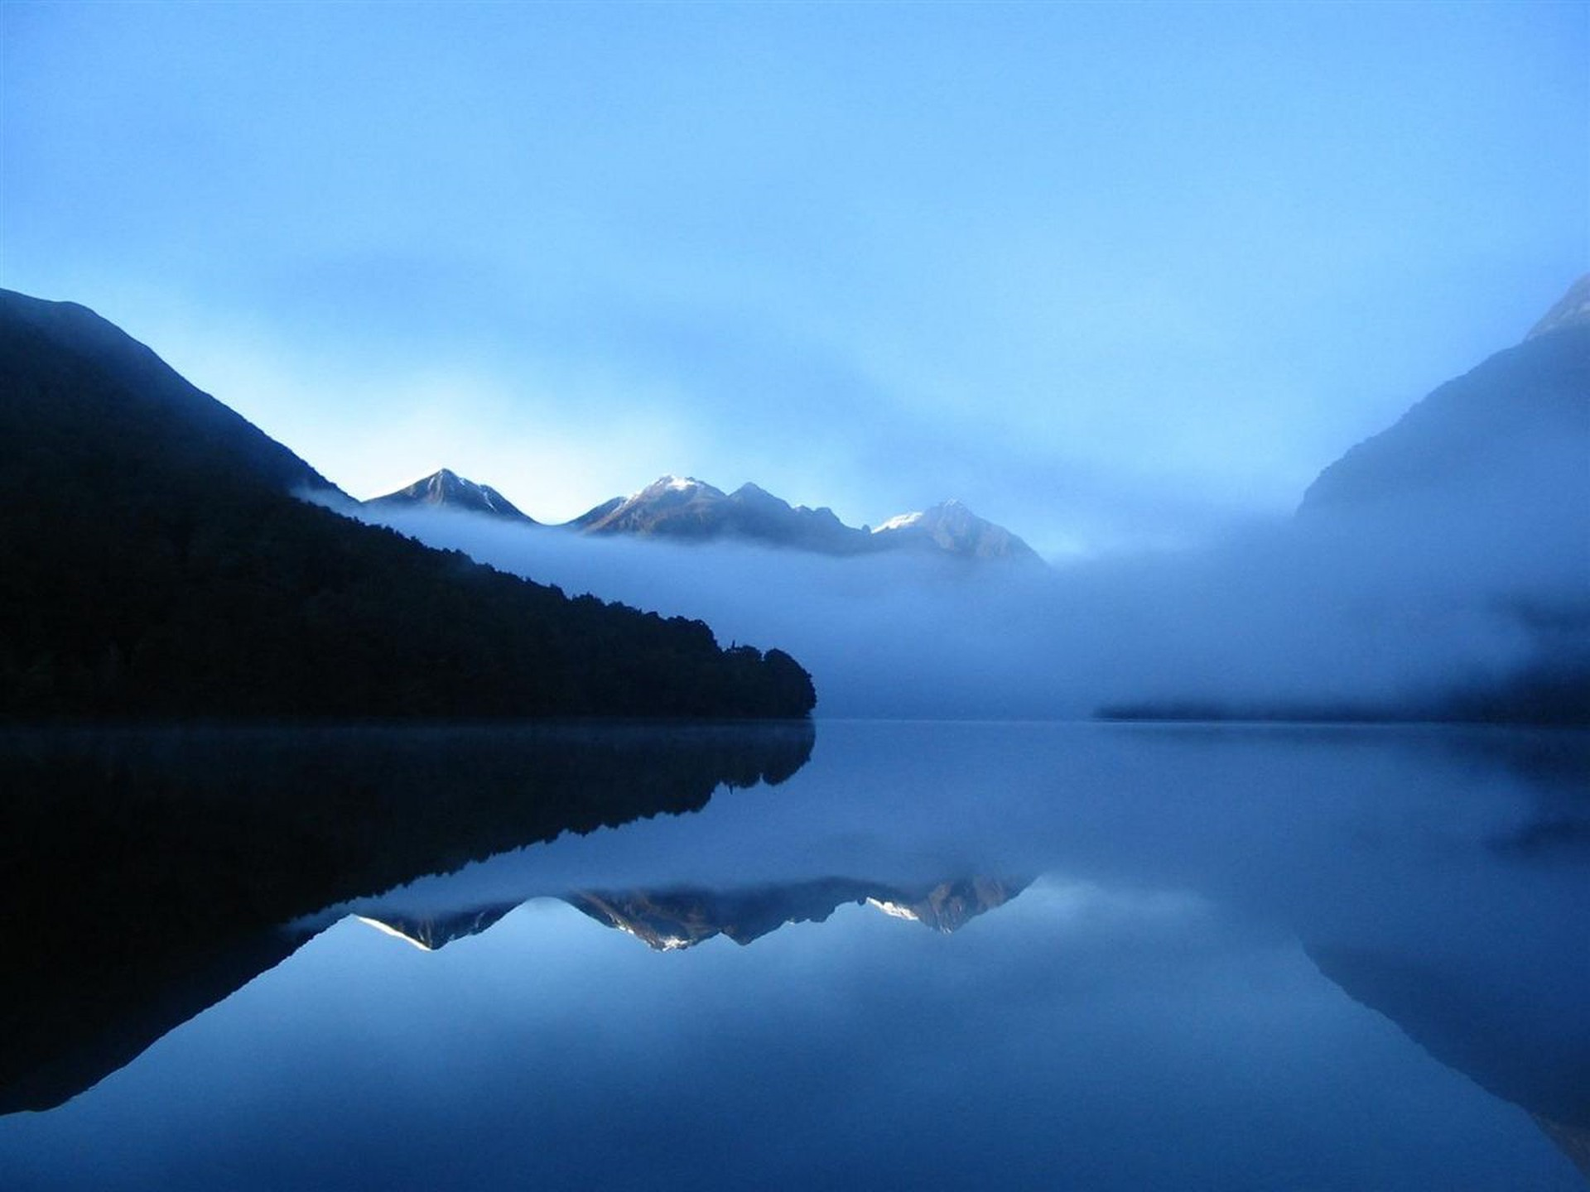
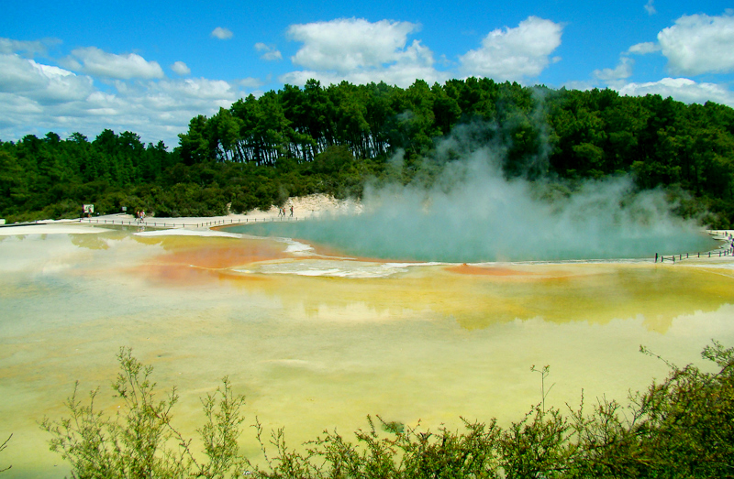
Rotorua, here are the Valley of Geysers, Aboriginal cultural center of New Zealand Maori, the thermal park and at the same time "Maori village" where you can see kiwi flightless bird - a symbol of the country, as well Maori Museum, waterfalls, botanical garden.

Slide 5
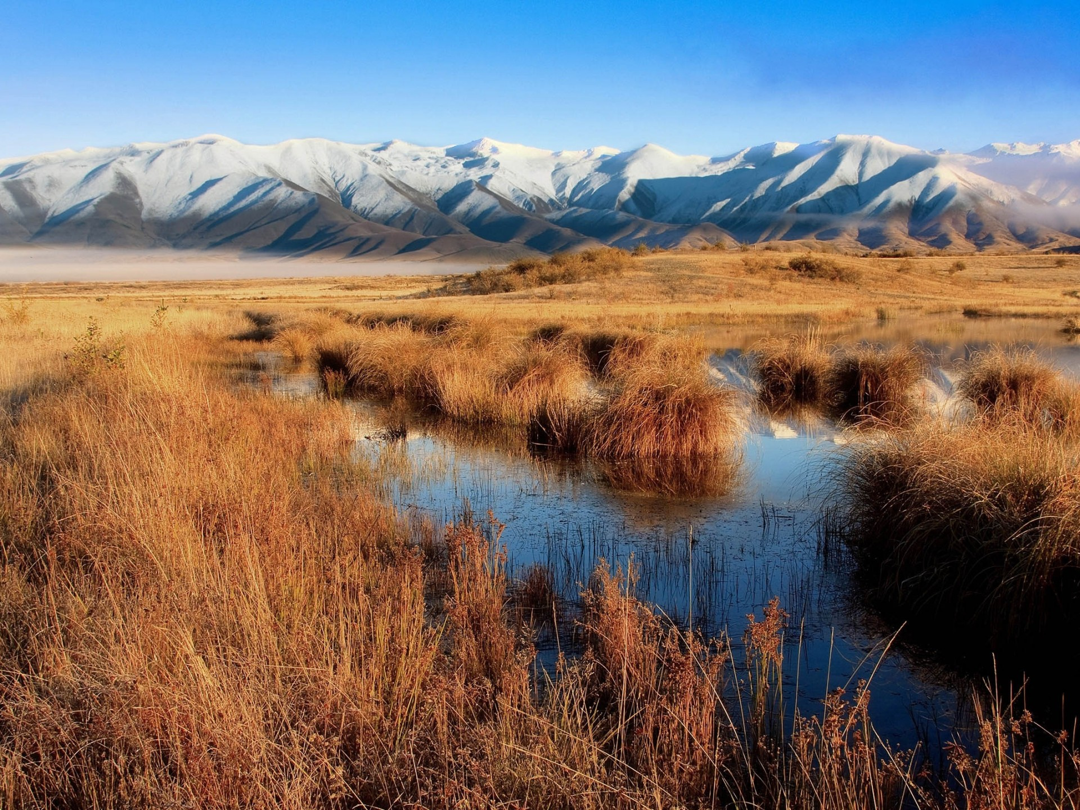
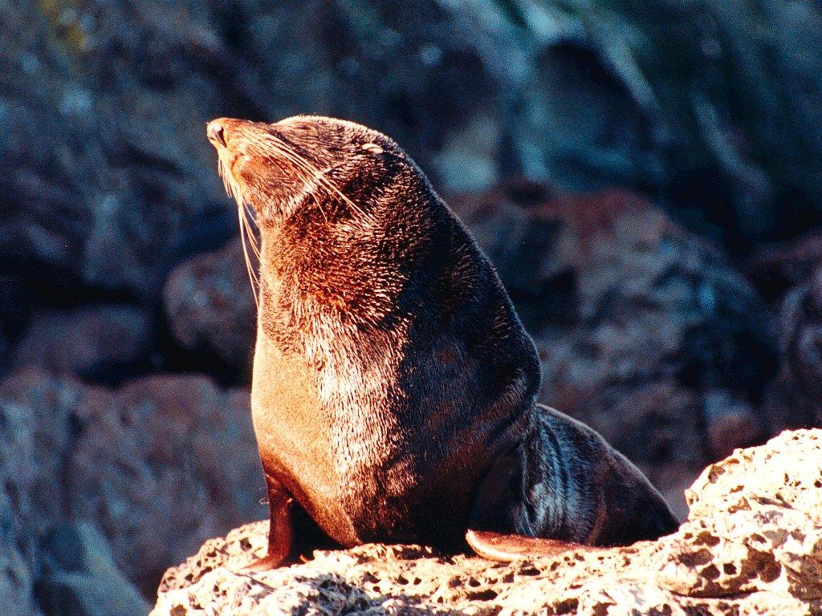
Kaikoura - a place on the east coast of the South Island north of Christchurch, where you can observe sea lions.

Slide 6
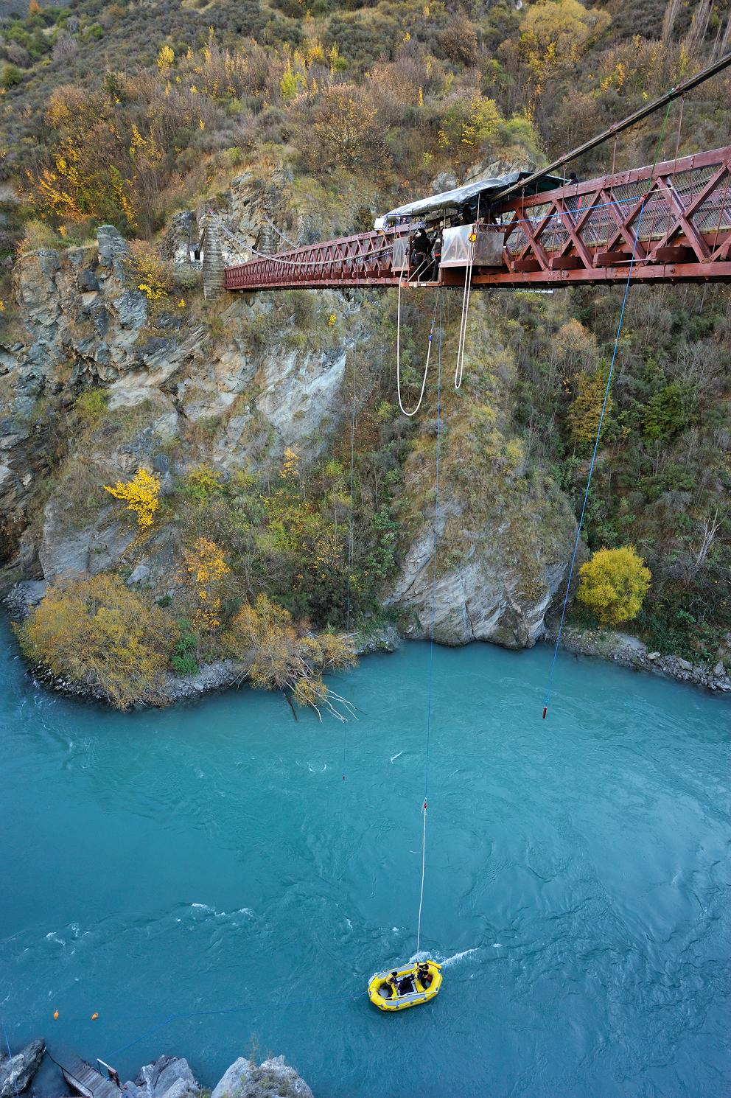
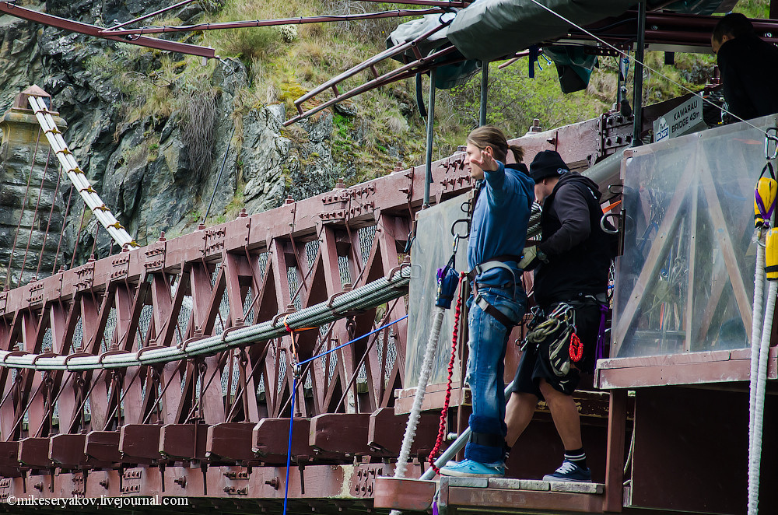
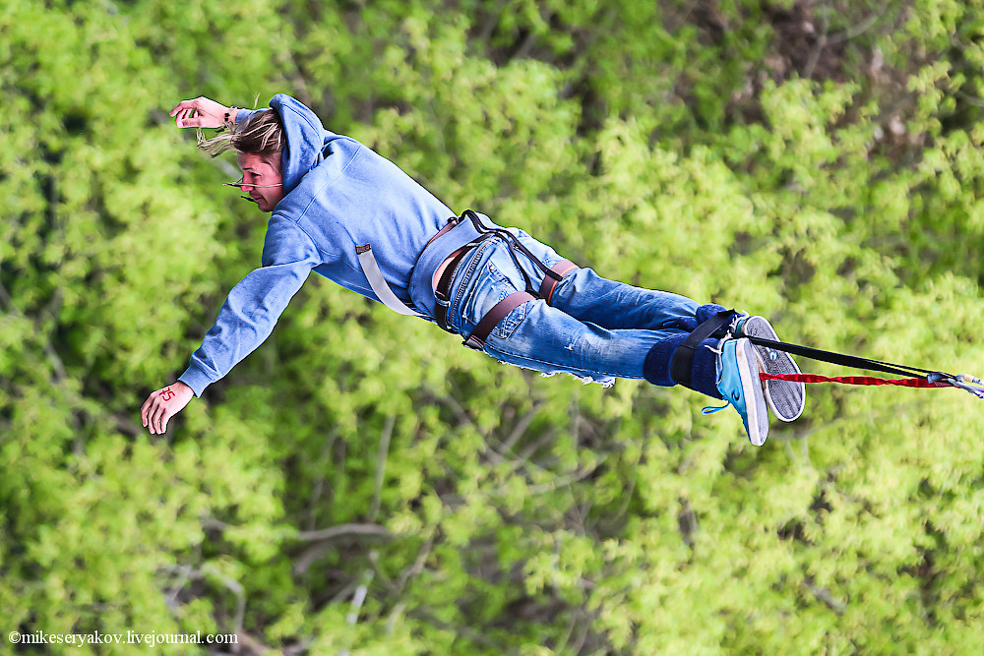
What to do?
Bungee Jumping

Slide 7
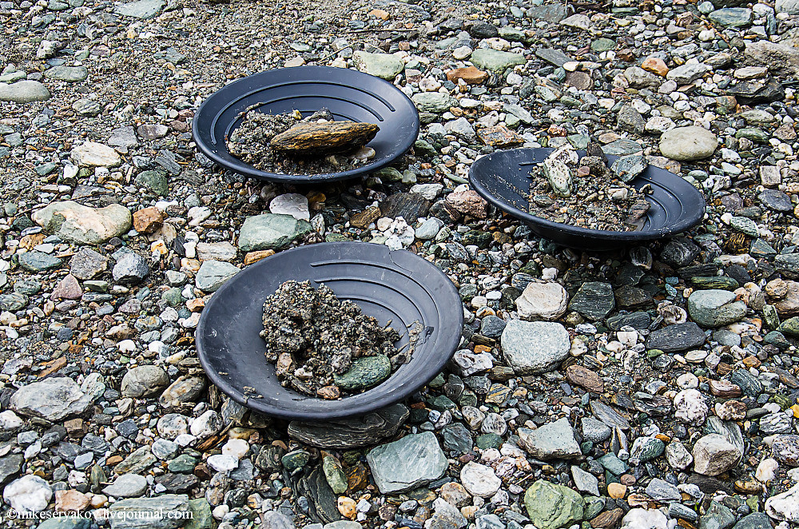
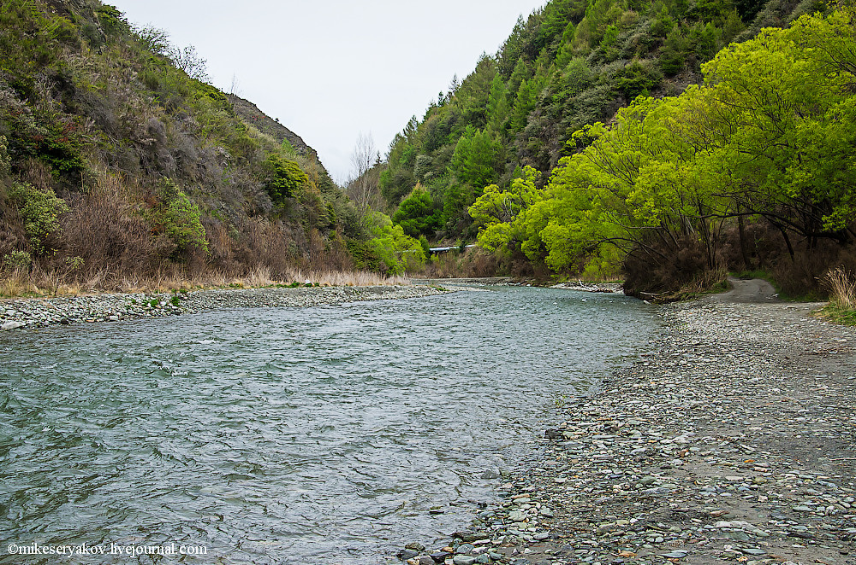
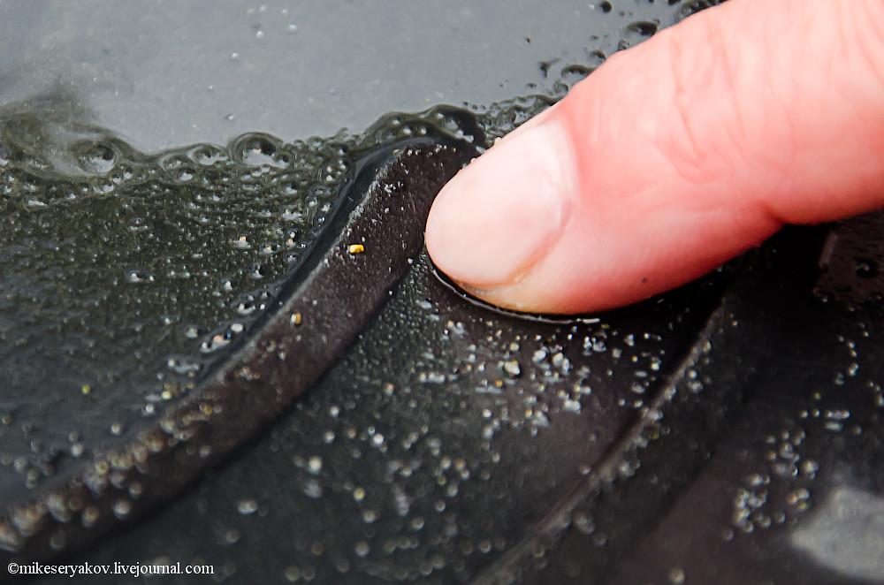
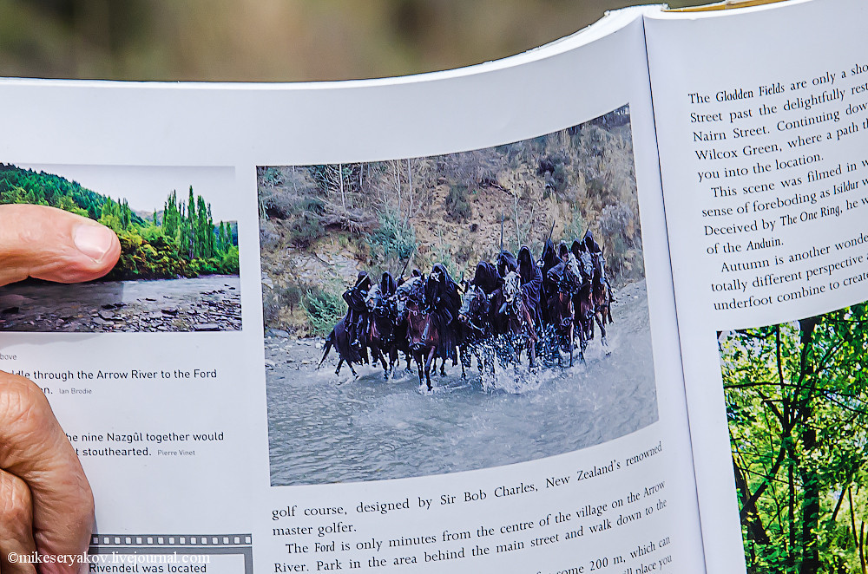
Gold mining in the river on the Defender

Slide 8
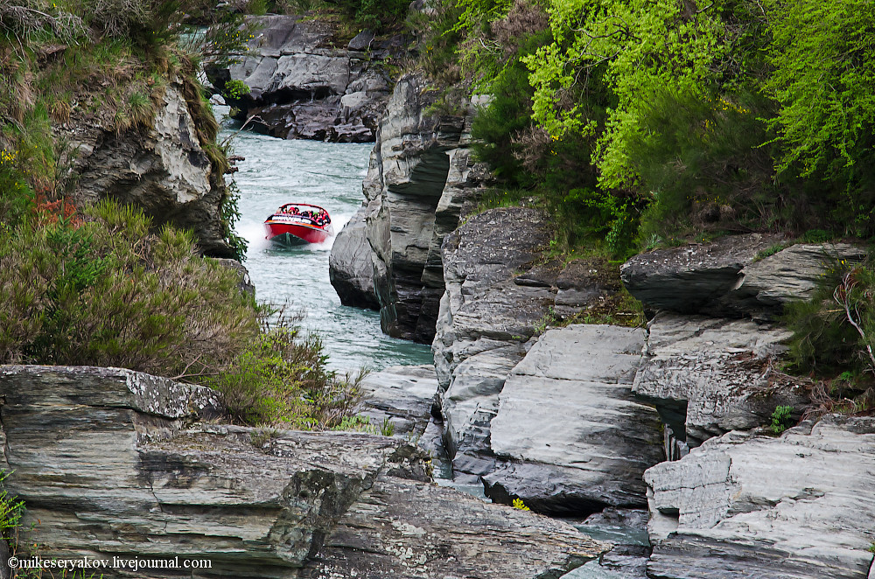
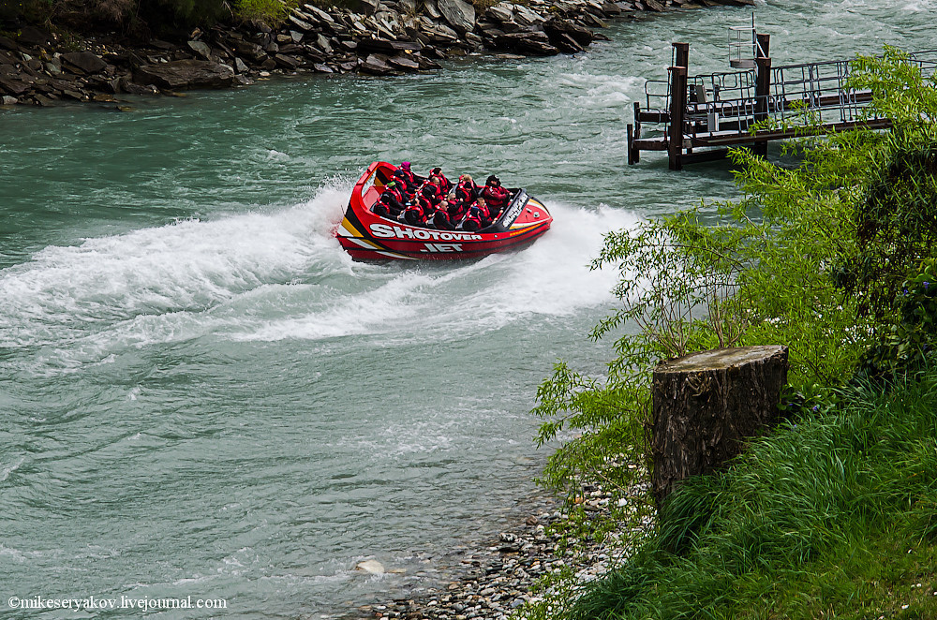
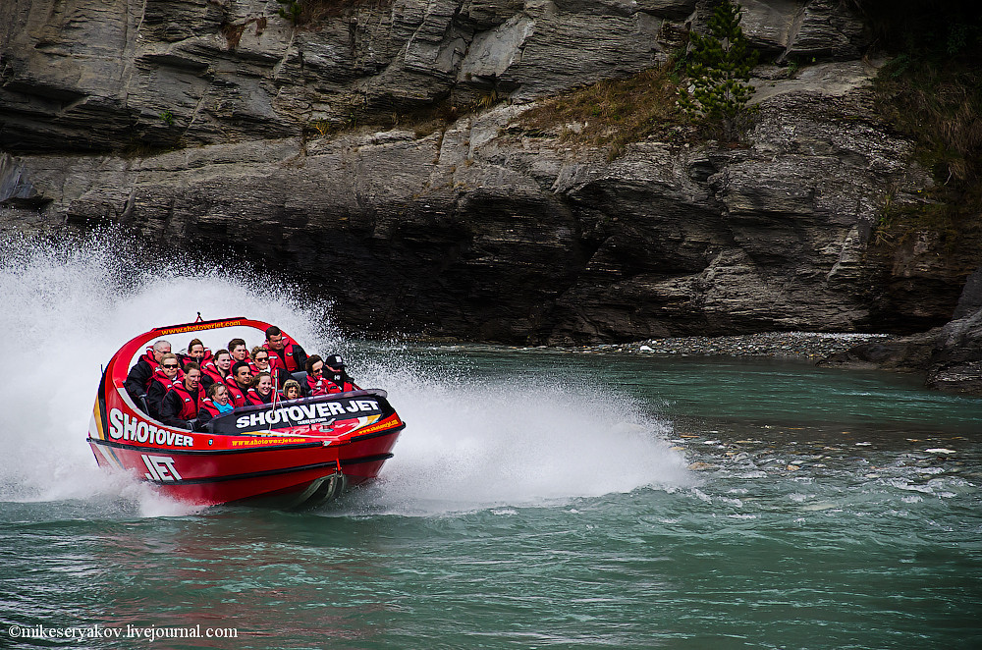
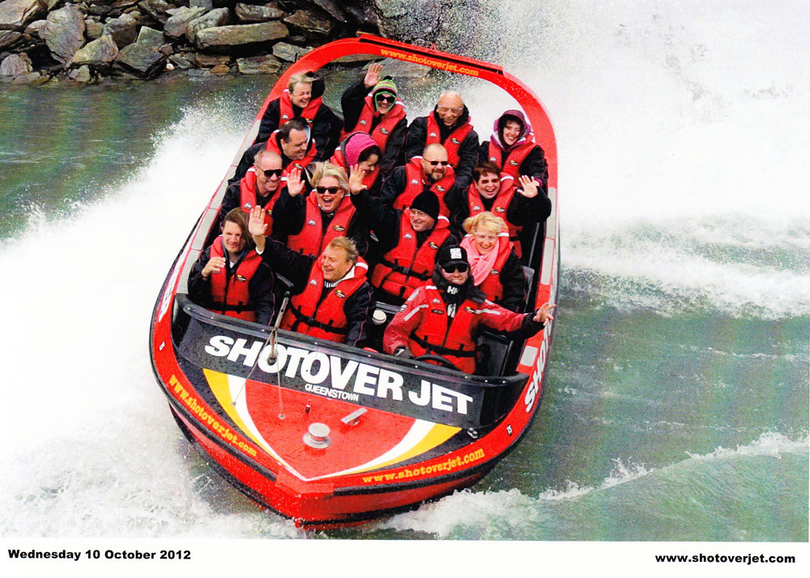
Boating on a mountain river

Slide 9
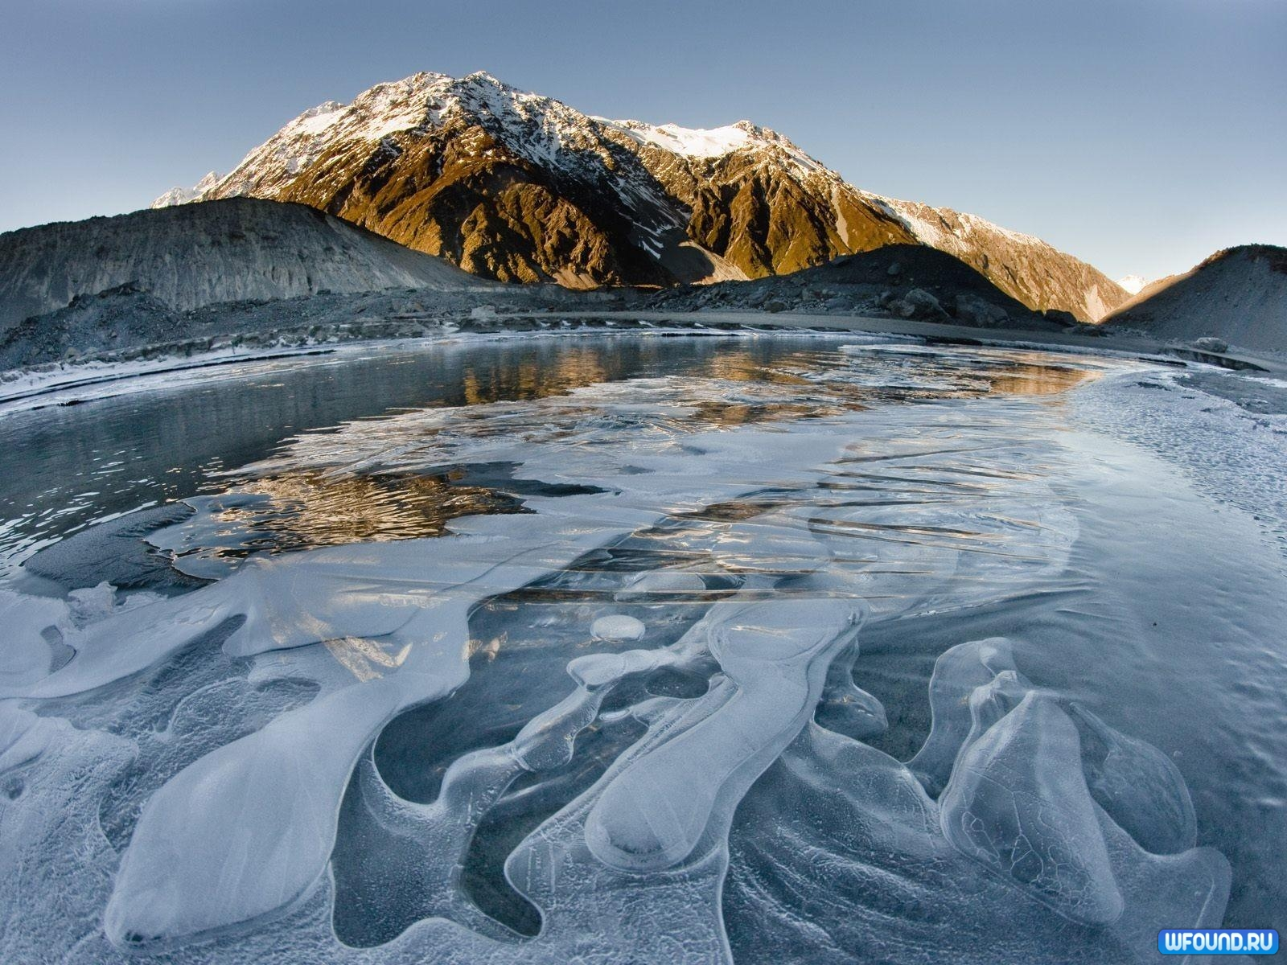
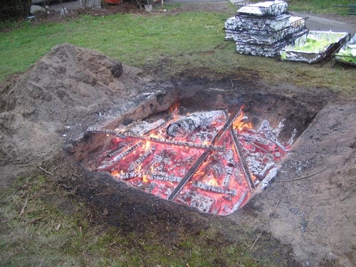
What to eat?
Hangi - a way of cooking Maori aborigines. The main "trick" is that the food is cooked in a special oven underground.

Slide 10
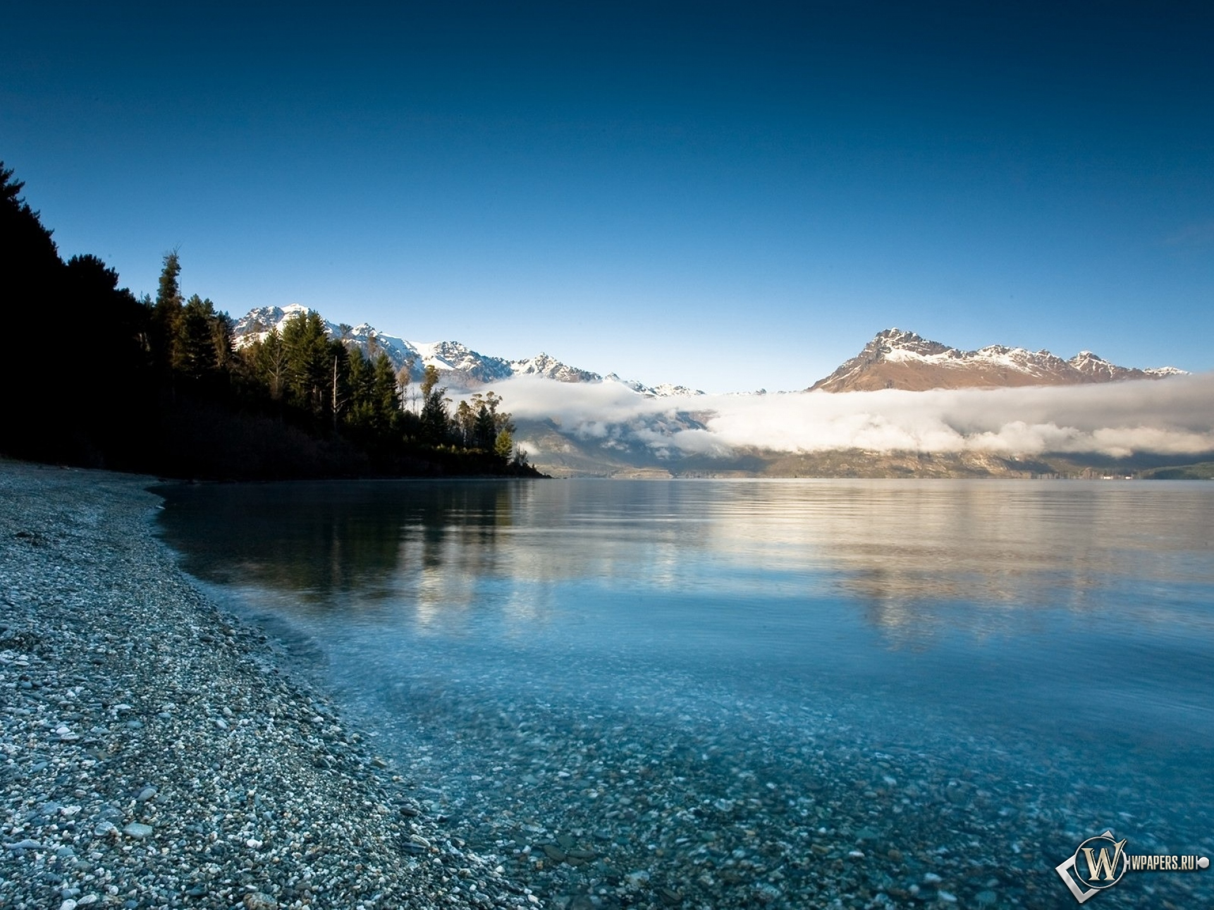
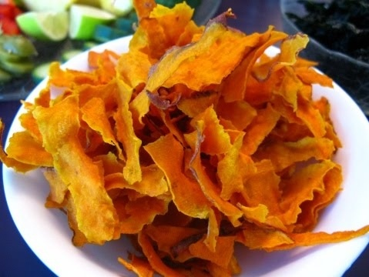
Kumar - one of the varieties of sweet potatoes.

Slide 11
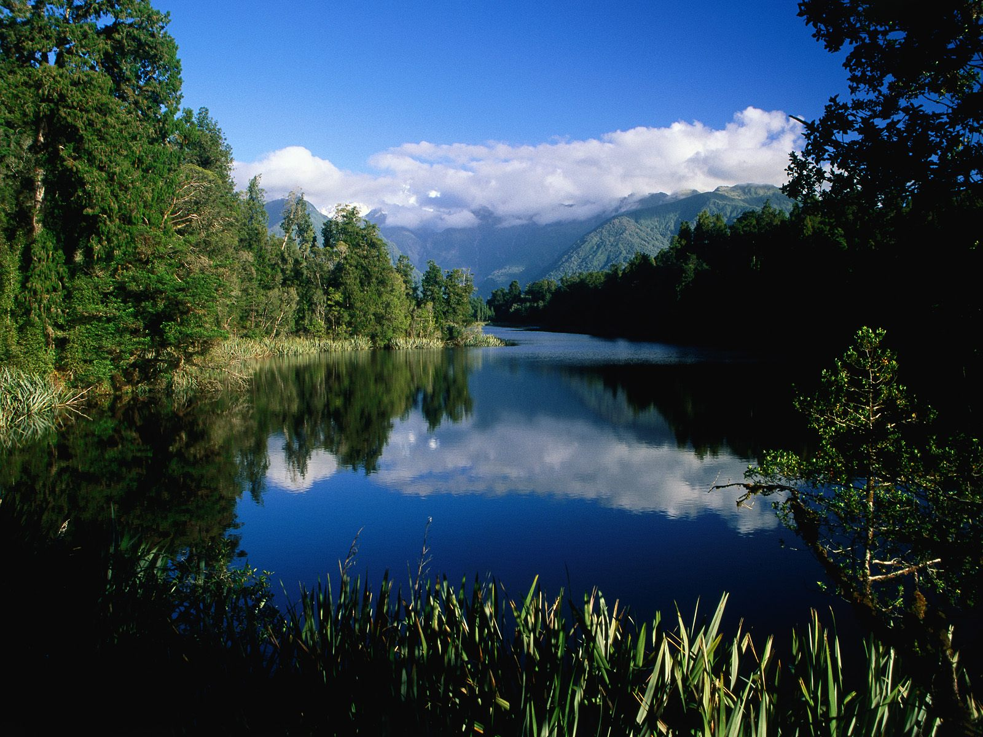
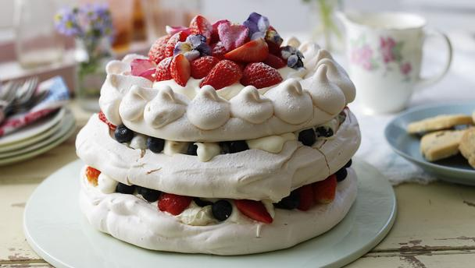
Cake «Pavlova»- meringue cake with fresh fruit, especially popular in New Zealand and Australia.

