Slide 1
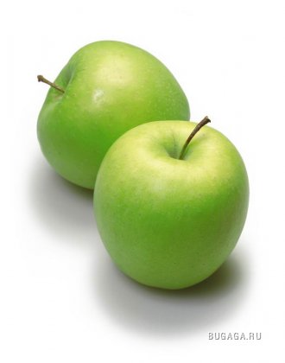
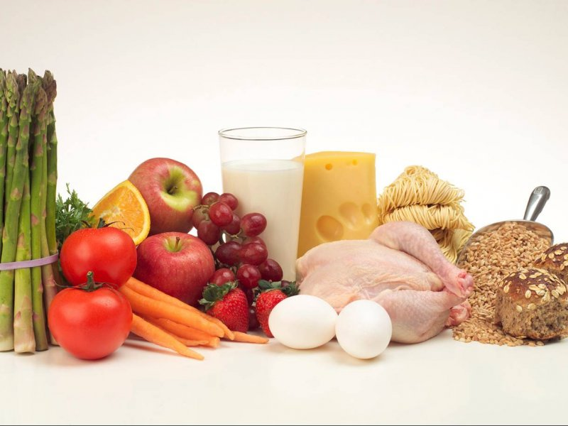
PROJECT:
Foods that give us energy and help us grow
Bezsmola Oxana
Form 8- A

Slide 2
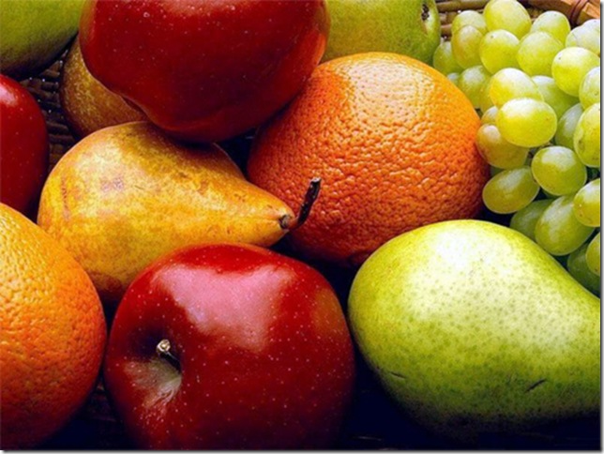

Slide 3
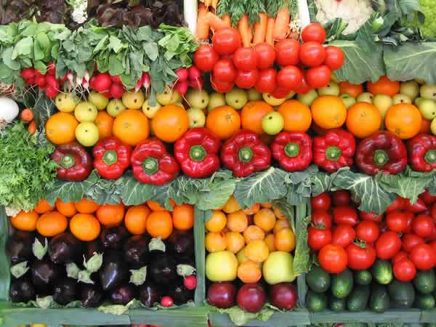

Many of the vegetables we eat are the seed vessels of plants

Slide 4
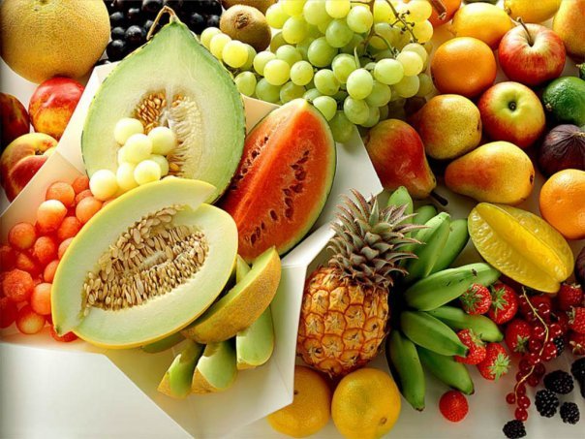

Slide 5
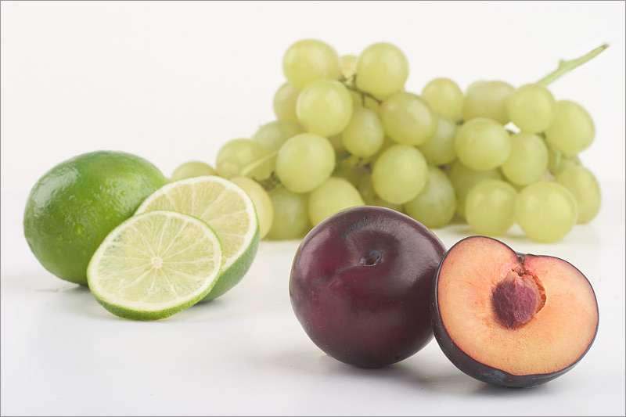
We need vegetables if we are to have a balanced diet and good health.

Slide 6

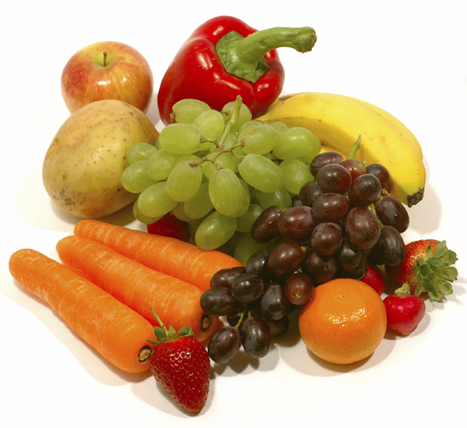
A diet based on rise, or root vegetables is likely to lead to some degree of protein deficiency

Slide 7

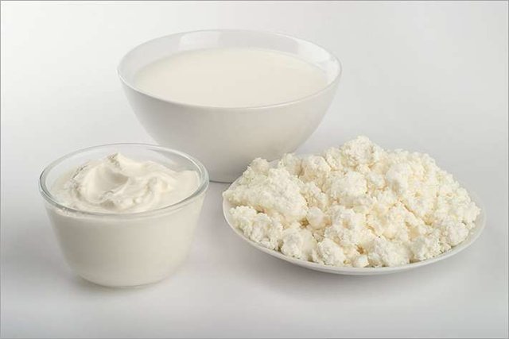
Milk help grow our bone

Slide 8
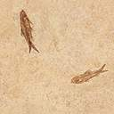
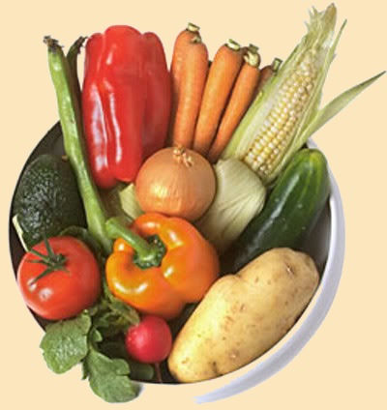
A balanced diet is one consisting of small amount of meat, fish, eggs, dairy products, fruit and vegetables, grins, nuts, and seeds.

Slide 9
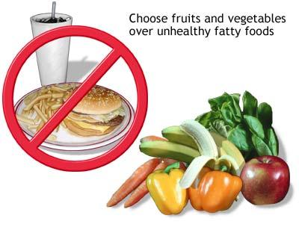

Slide 10
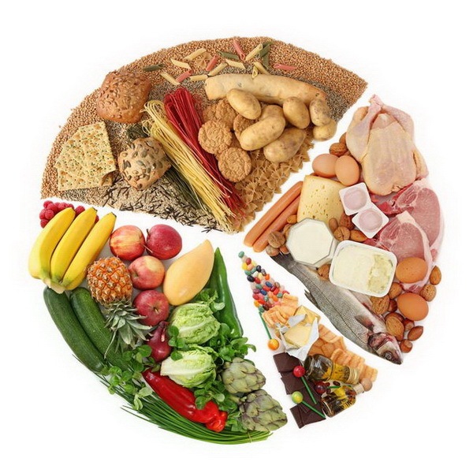
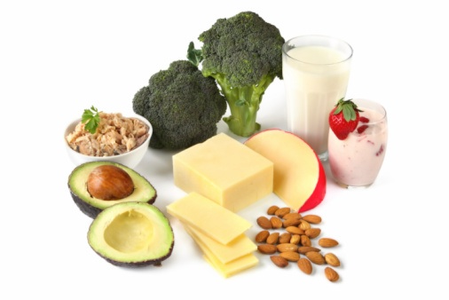
A balanced diet containing the basic food types – proteins, minerals, fats, carbohydrates, vitamins and fluids – is essentail for satisfactori growth development, and health.

Slide 11
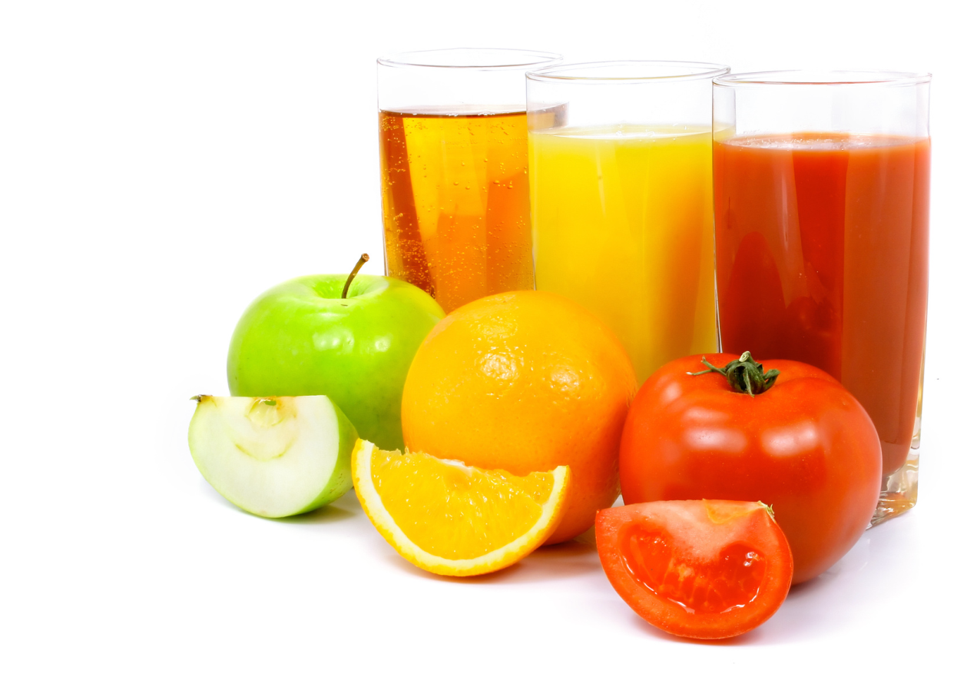
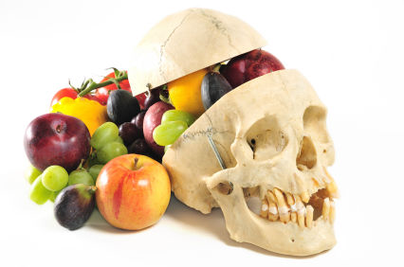
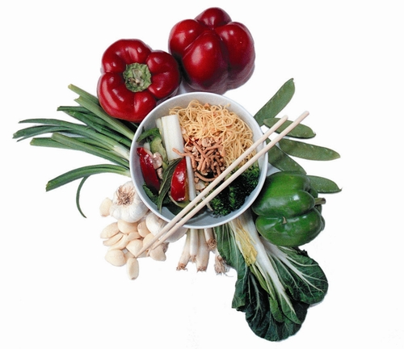
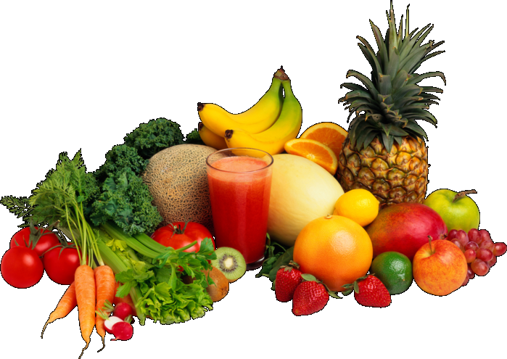
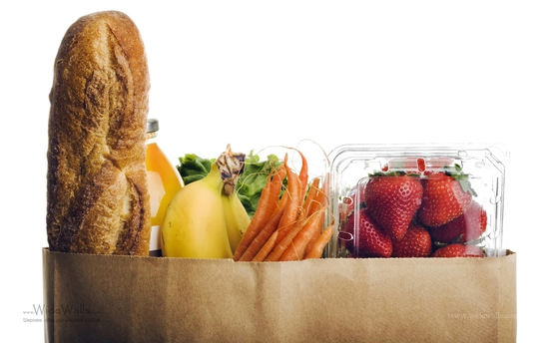
The end

