Slide 1
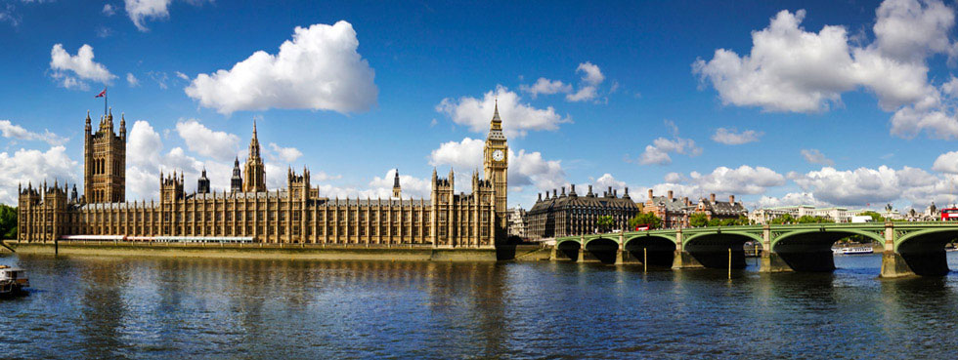
Architecture of the United Kingdom

Slide 2
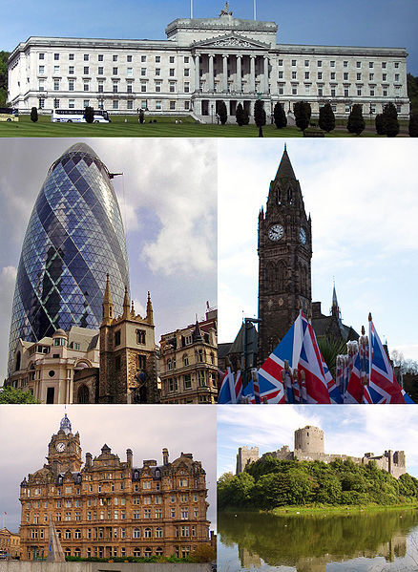
The architecture of the United Kingdom consists of an eclectic combination of architectural styles, ranging from those that predate the creation of the United Kingdom. A listed building is a building or other structure decreed as being of special architectural, historical or cultural significance.

Slide 3
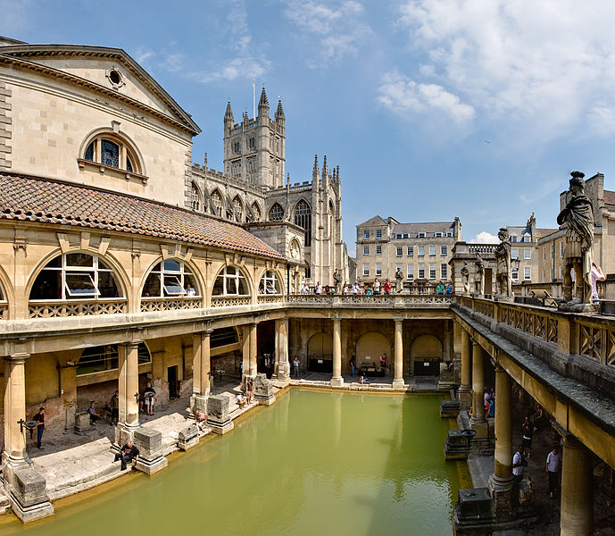
Within the United Kingdom are the ruins of prehistoric structures and ancient neolithic settlements. The architecture of ancient Rome penetrated Roman Britain with "elegant villas, carefully planned towns and engineering marvels like Hadrian's Wall".

Slide 4
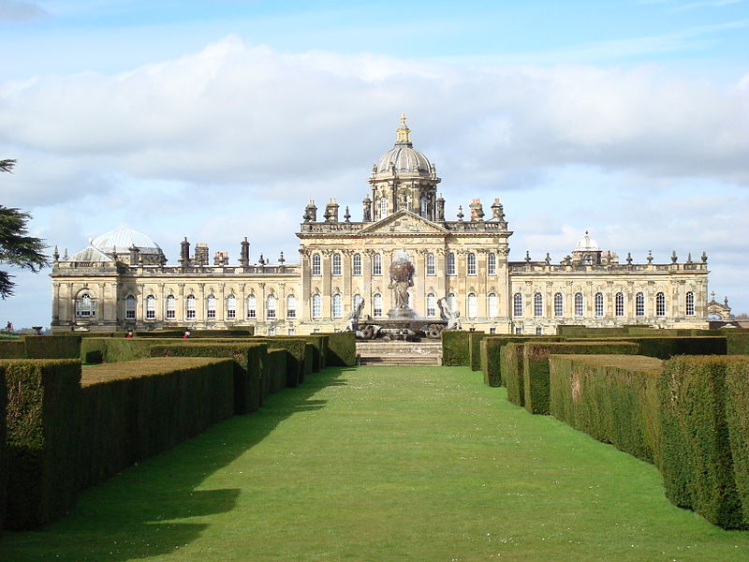
Castle Howard is a stately home in North Yorkshire, England, 15 miles (24 km) north of York. One of the grandest private residences in Britain. Castle Howard has been the home of part of the Howard family for more than 300 years. Today, it is part of the Treasure Houses of England heritage group.

Slide 5
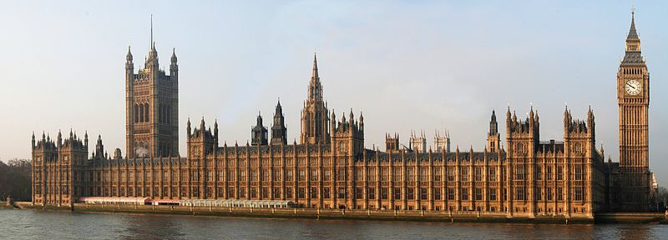
The Palace of Westminster , a UNESCO World Heritage Site, houses the Parliament of the United Kingdom. A collaboration in the Perpendicular Gothic style between Augustus Welby Pugin and Sir Charles Barry, it is described by Linda Colley as "the building that most enshrines Britain's national and imperial pre-tensions"

Slide 6
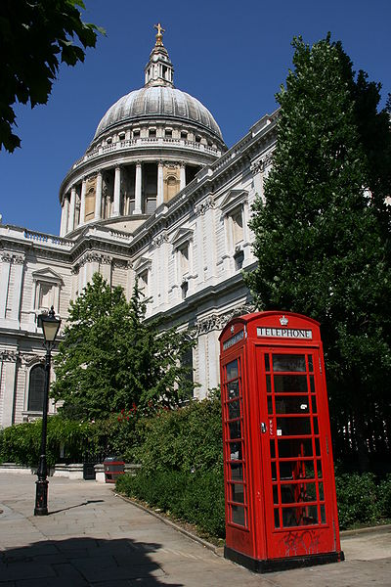
St Paul's Cathedral is a Church of England cathedral, the seat of the Bishop of London and mother church of the Diocese of London. It sits at the top of Ludgate Hill, the highest point in the City of London. In terms of area, St Paul's is the second largest church building in the United Kingdom after Liverpool Cathedral.

Slide 7
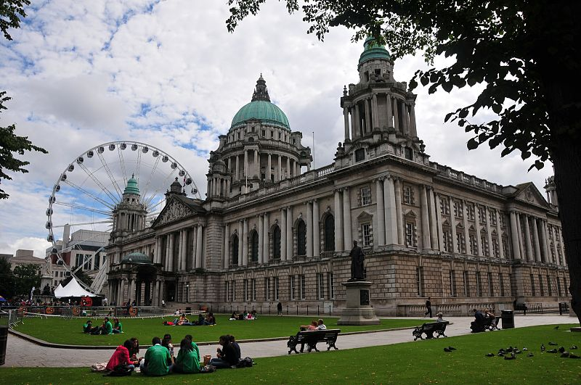
Belfast City Hall is the civic building of the Belfast City Council. The site now occupied by Belfast City Hall was once the home of the White Linen Hall, an important international Linen Exchange. The exterior is built mainly from Portland stone and is in the Baroque Revival style. It covers an area of one and a half acres and has an enclosed courtyard.

Slide 8
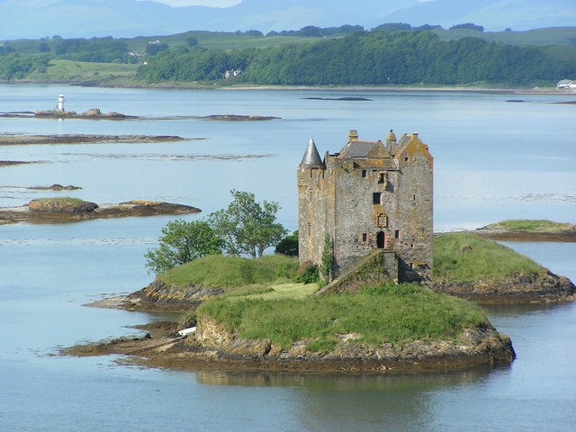
Castle Stalker
The island castle's picturesque appearance, with it's bewitching island setting against a dramatic backdrop of mountains, has made it a favourite subject for postcards and calendars, and something of a cliché image of Scottish Highland scenery. Castle Stalker is entirely authentic; it is one of the best-preserved medieval tower-houses surviving in western Scotland.

Slide 9
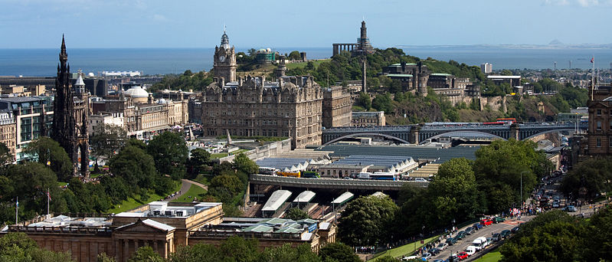
The New Town is a central area of Edinburgh, the capital of Scotland. It is often considered to be a masterpiece of city planning, and is a UNESCO World Heritage Site. The New Town is home to the National Gallery of Scotland and the Royal Scottish Academy, located on The Mound.

Slide 10
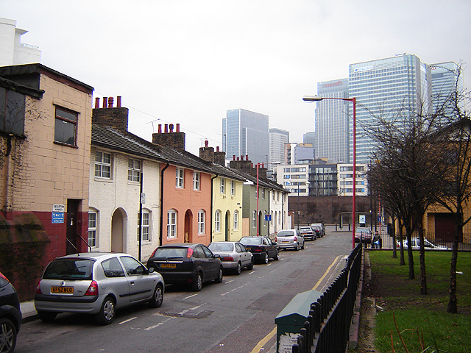
Blackwall is an area of the East End of London, situated in the London Borough of Tower Hamlets on the north bank of the Thames River.
Blackwall is said to have got its name from the colour of the embankment wall constructed along the north side of the Thames during the 18th century.

Slide 11
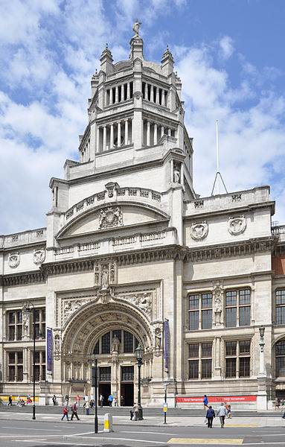
The Victoria and Albert Museum is the world's largest museum of decorative arts and design, housing a permanent collection of over 4.5 million objects. Its collection spans 5,000 years of art, from ancient times to the present day, from the cultures of Europe, North America, Asia and North Africa.

Slide 12
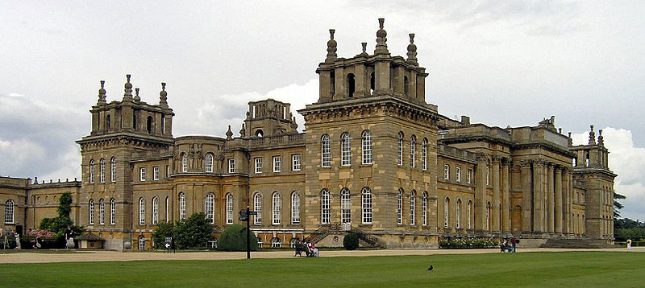
Blenheim Palace is a monumental country house situated in Woodstock residence of the dukes of Marlborough. Its construction was originally intended to be a gift to John Churchill, 1st Duke of Marlborough, from a grateful nation in return for military triumph against the French and Bavarians at the Battle of Blenheim.

Slide 13
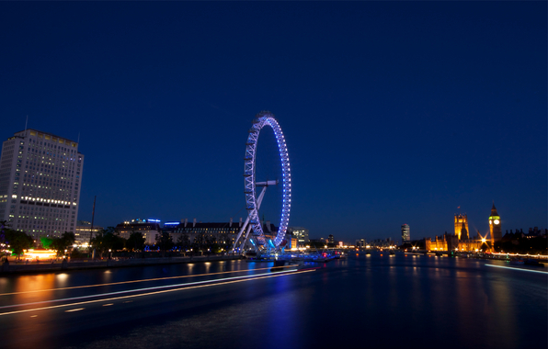
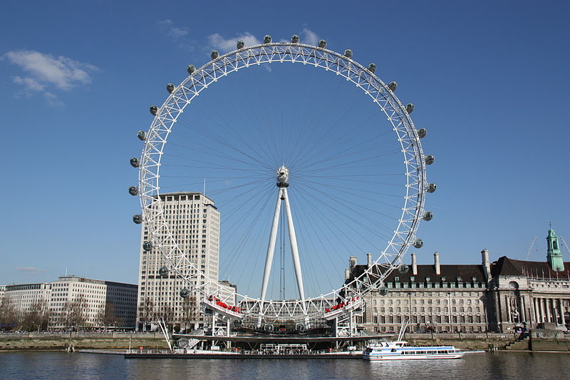
The London Eye is a giant Ferris wheel on the South Bank of the River Thames in London. Also known as the Millennium Wheel, its official name was originally the British Airways London Eye.

Slide 14
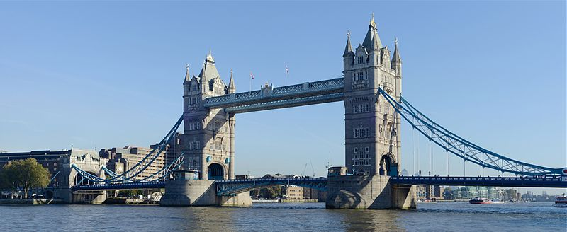
Tower Bridge (built 1886–1894) is a combined bascule and suspension bridge in London which crosses the River Thames. It is close to the Tower of London, from which it takes its name, and has become an iconic symbol of London.

Slide 15
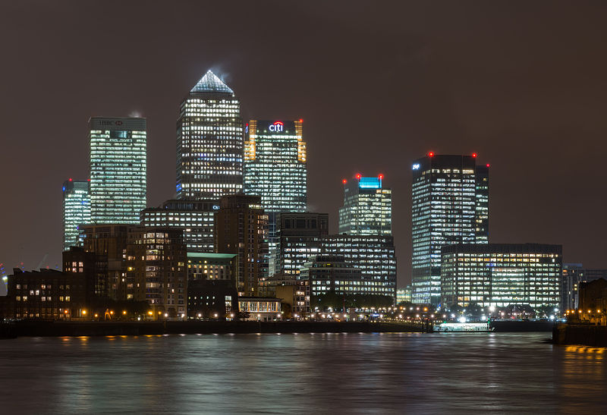
Canary Wharf is a major business district located in Tower Hamlets, London. It is one of London's two main financial centres – along with the traditional City of London – and contains many of the UK's tallest buildings, including the second-tallest, One Canada Square.

Slide 16
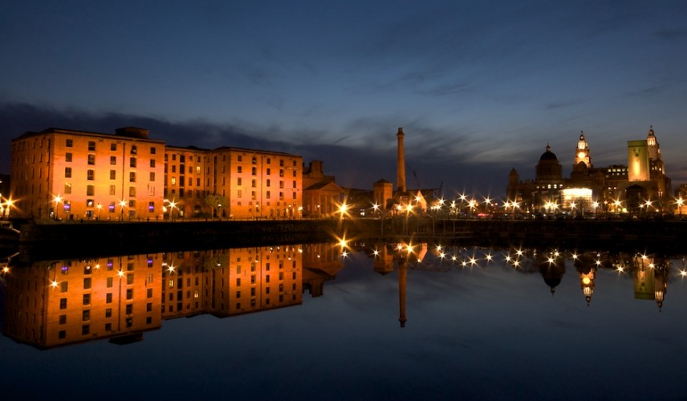
The Albert Dock is a complex of dock buildings and warehouses in Liverpool. Designed by Jesse Hartley and Philip Hardwick, it was opened in 1846, and was the first structure in Britain to be built from cast iron, brick and stone, with no structural wood. As a result, it was the first non-combustible warehouse system in the world.

Slide 17
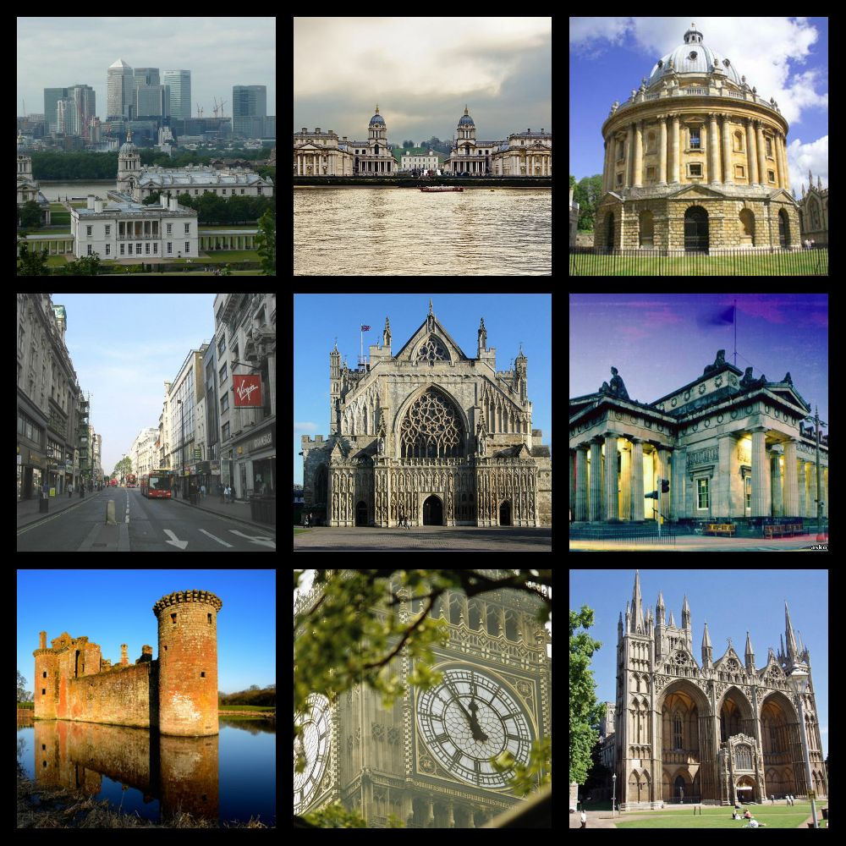
Others…

