Slide 1

Christmas in United States of America
Chehivska Viktoria
Shpak Sofia

Slide 2
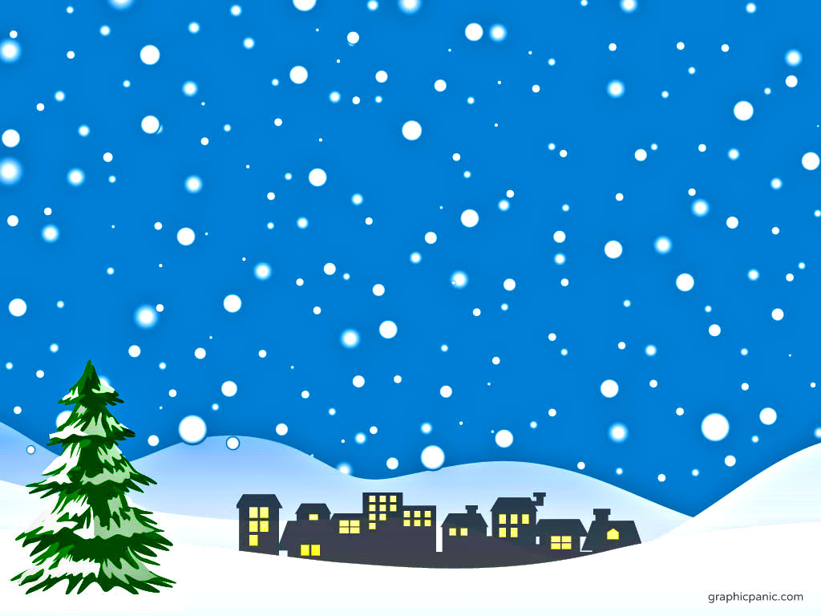
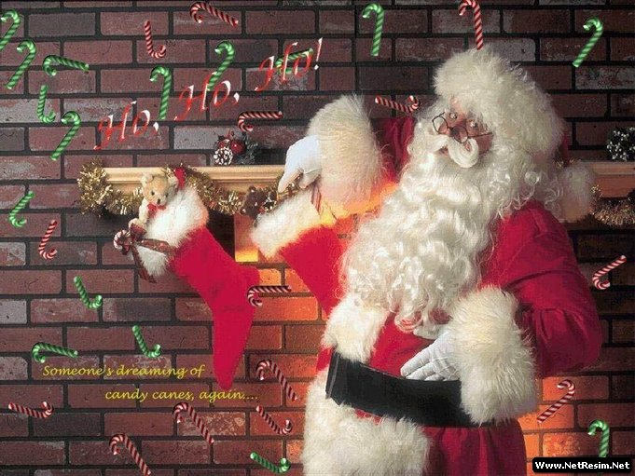
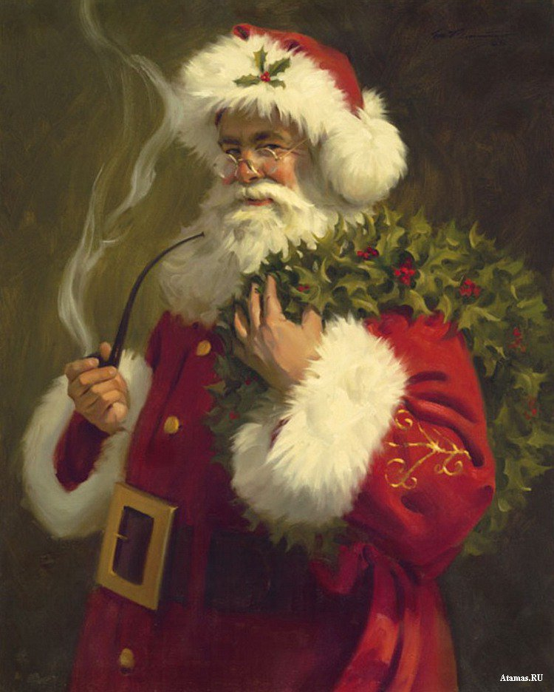
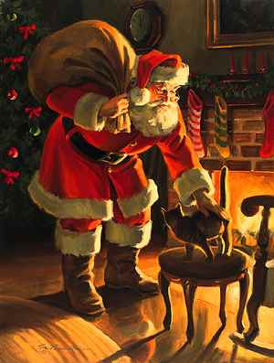
Santa Claus was born in US in the 1860's This first Santa Claus was known as St. Nicholas, he did smoke a pipe, and fly around in a wagon without any reindeer.
In 1863 He was given the name Santa Claus and bore the red suit, pipe, and his reindeer and sleigh.

Slide 3
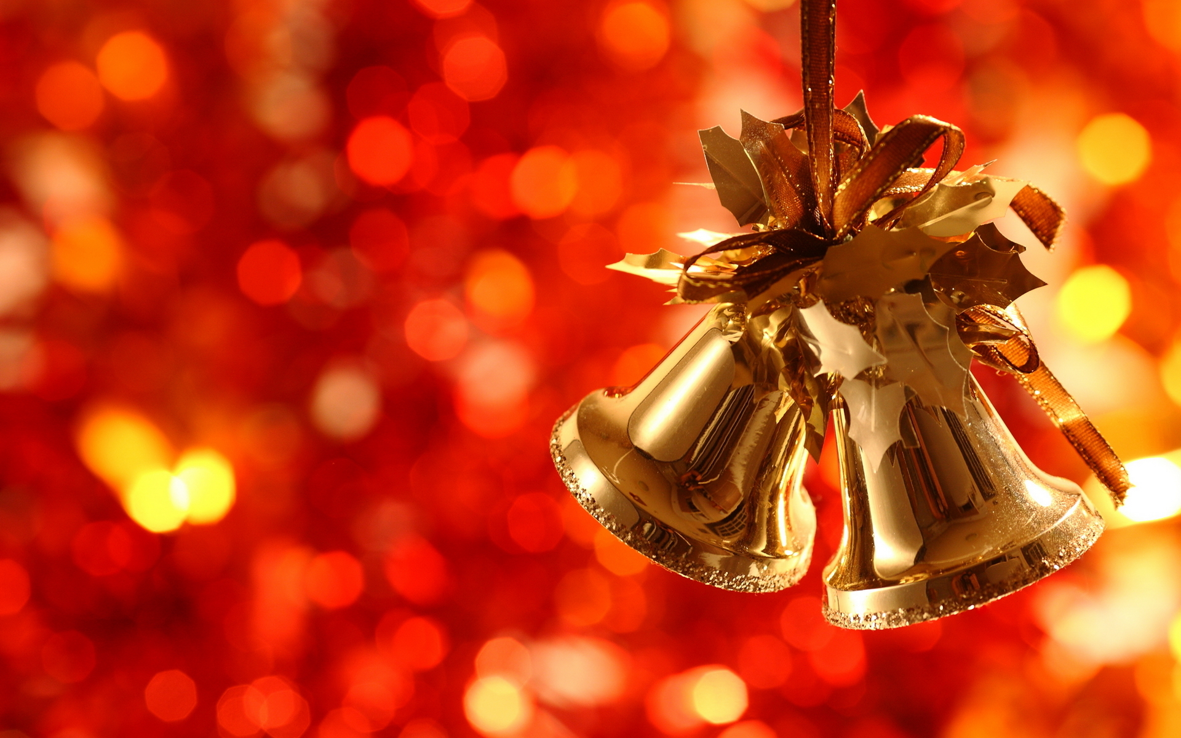
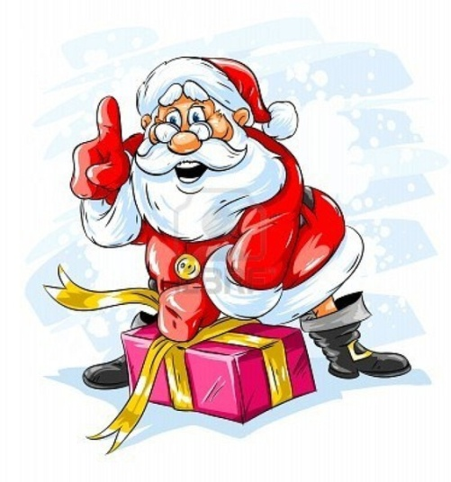
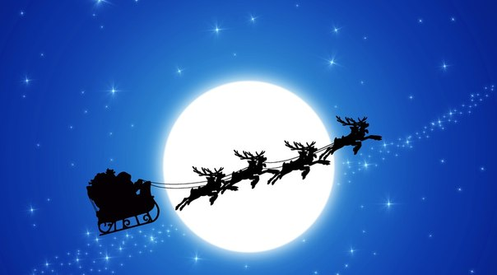
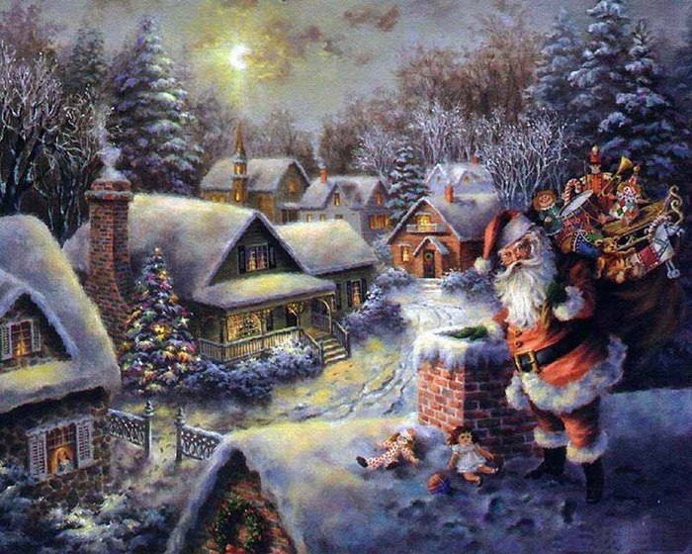
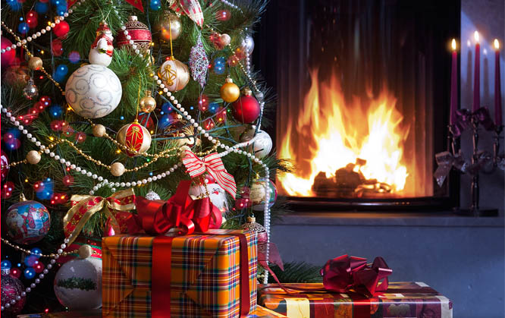
Christmas celebrations vary greatly between regions of the United States, because of the variety of nationalities which have settled in it.

Slide 4
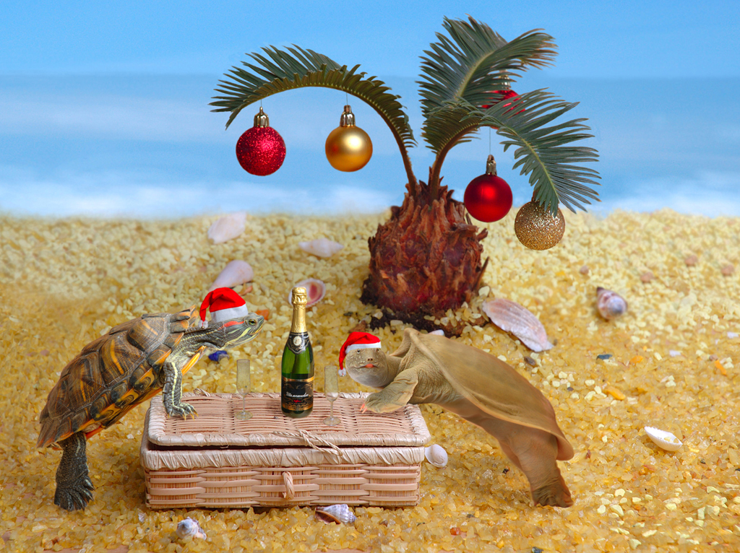
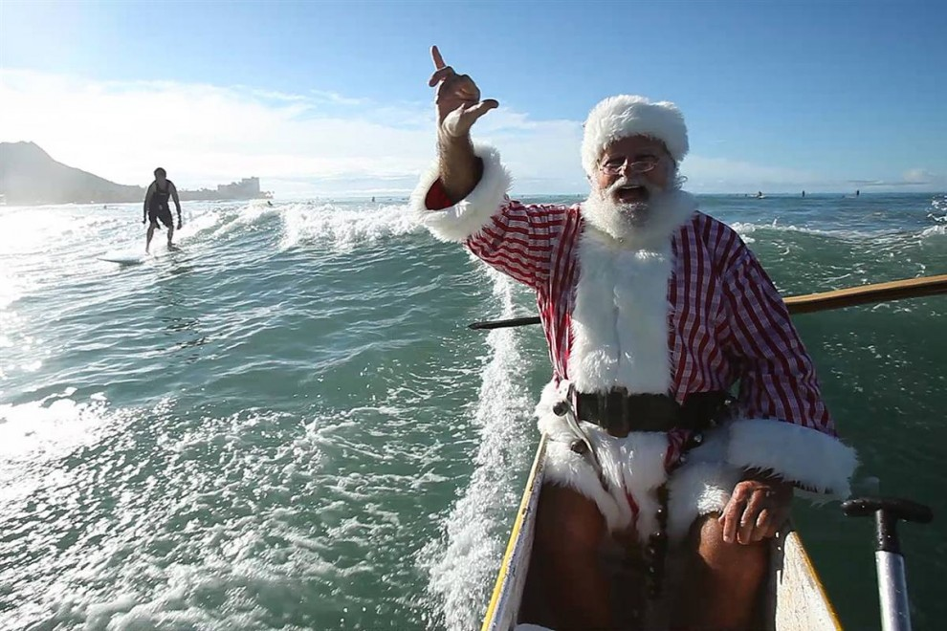
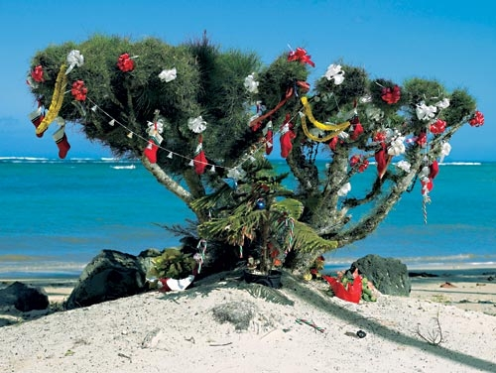
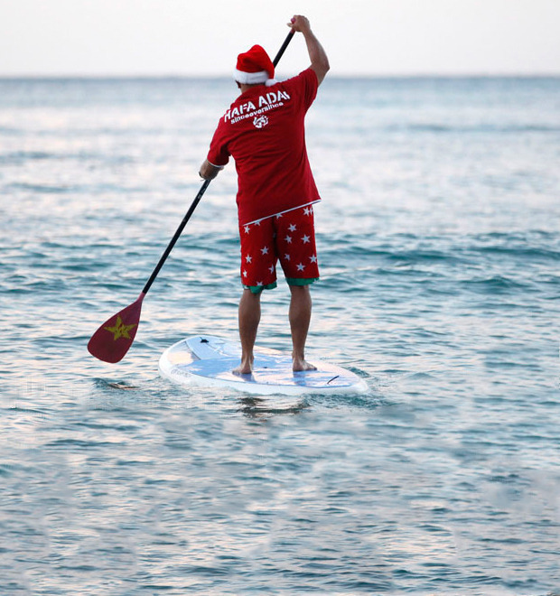
In Hawaii, Christmas starts with the coming of the Christmas Tree Ship, which is a ship bringing a great load of Christmas fare. Santa Claus also arrives by boat.

Slide 5
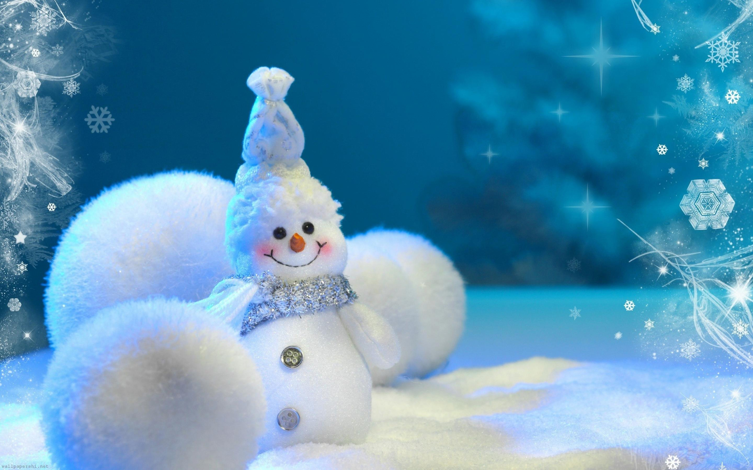
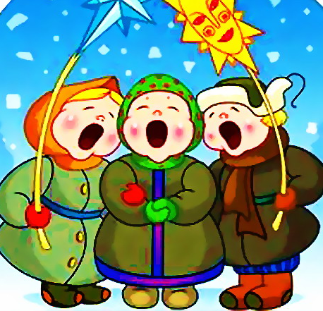
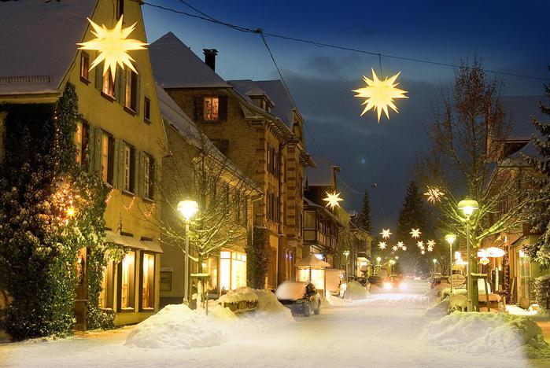
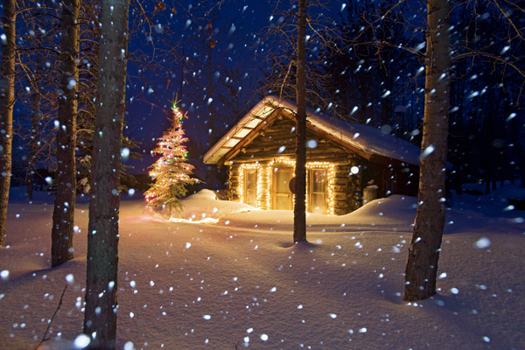
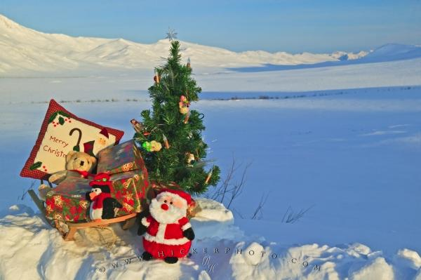
In Alaska, boys and girls with lanterns on poles carry a large figure of a star from door to door. They sing carols and are invited in for supper.

Slide 6

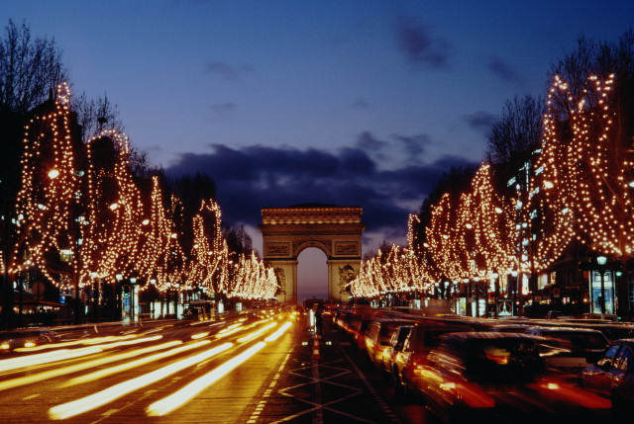
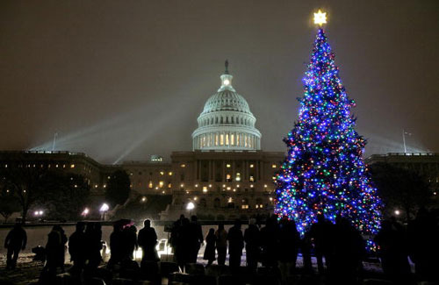
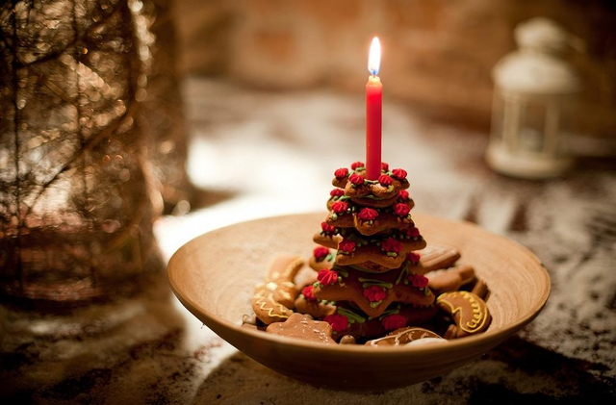
In Washington spectacular tree with Christmas ornaments is lit ceremoniously when the President presses a button and turns on the tree's lights.

Slide 7

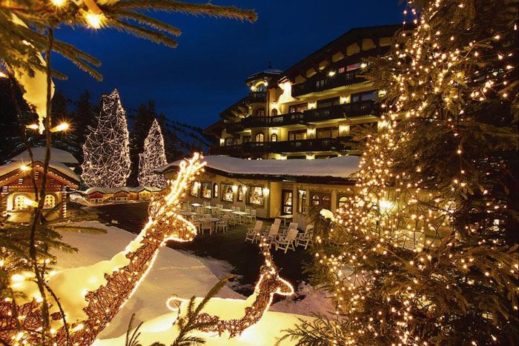
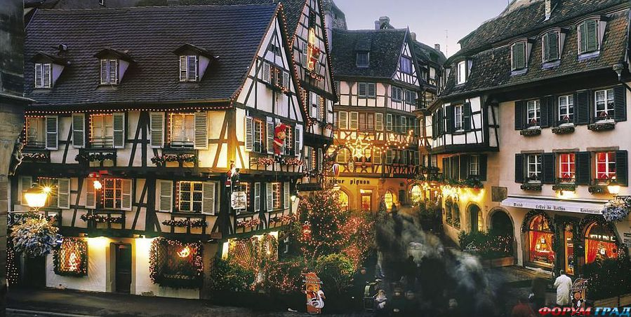
In New Orleans, a huge ox is paraded around the streets decorated with holly and with ribbons tied to its horns.

Slide 8

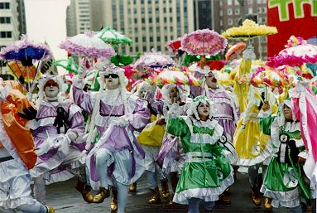
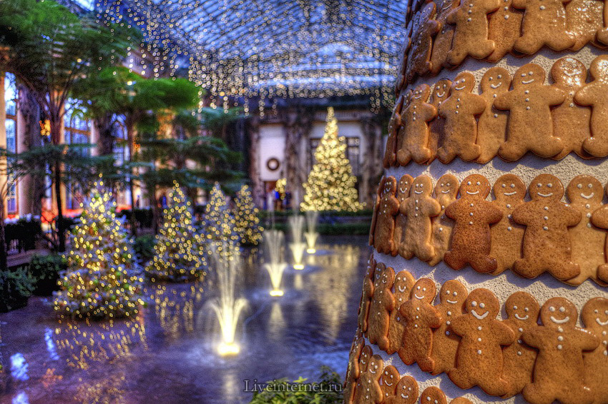
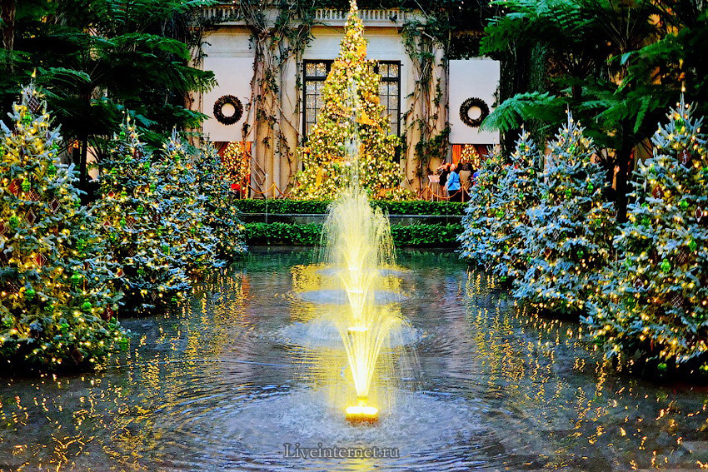
In Philadelphia, a procession called a mummers parade runs for a whole day with bands, dancers and people in fancy dress.

Slide 9
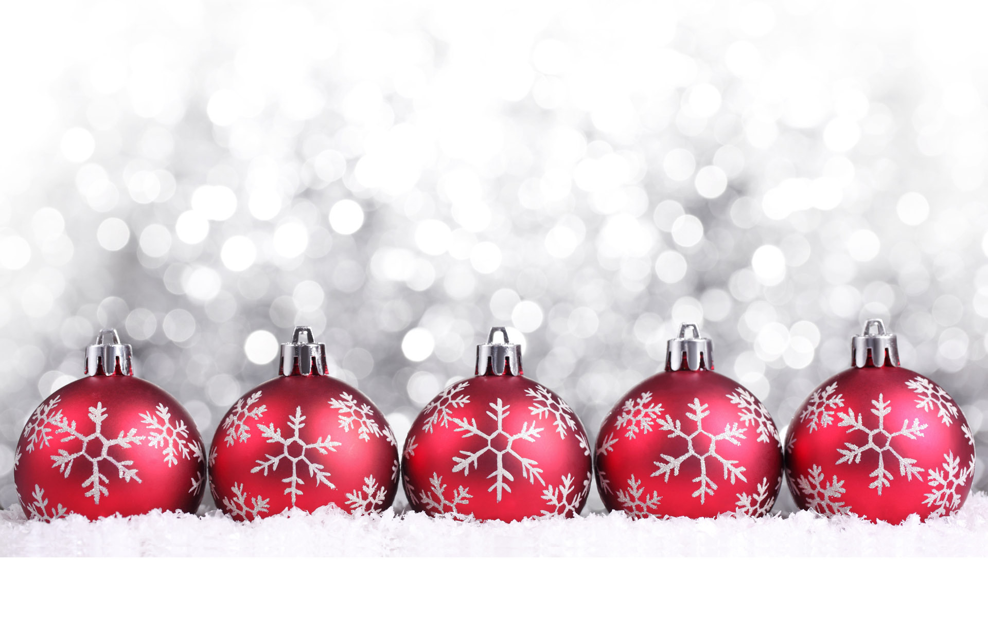
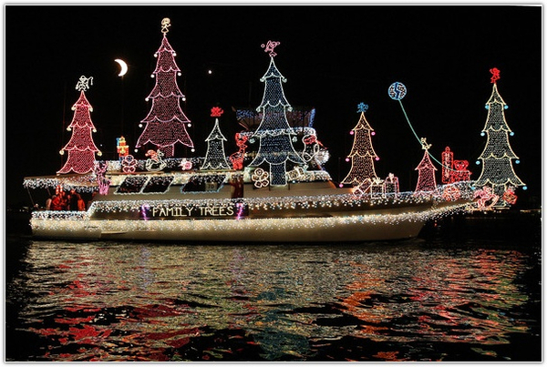
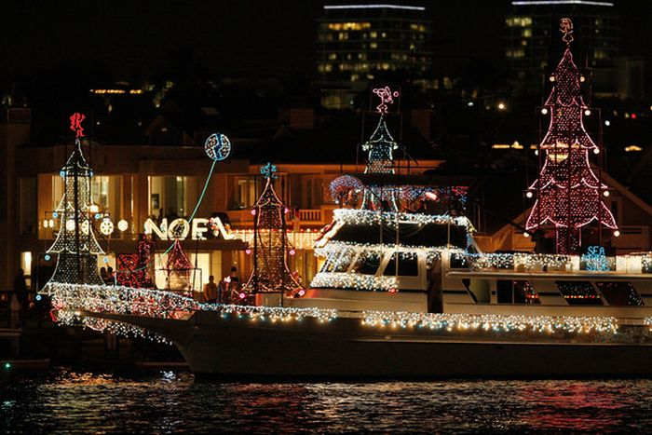
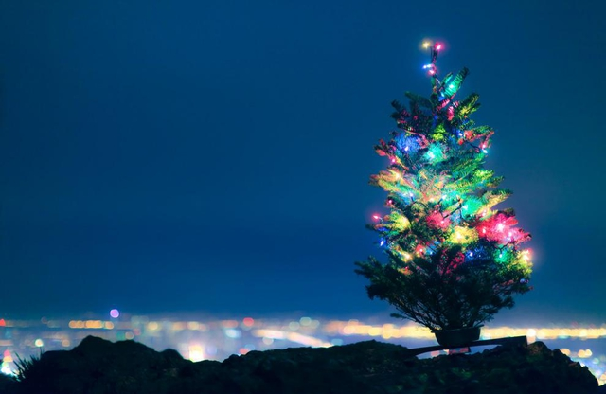
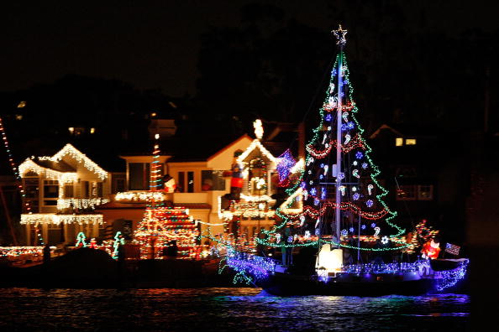
In California, Santa Claus sweeps in on a surf board.

Slide 10
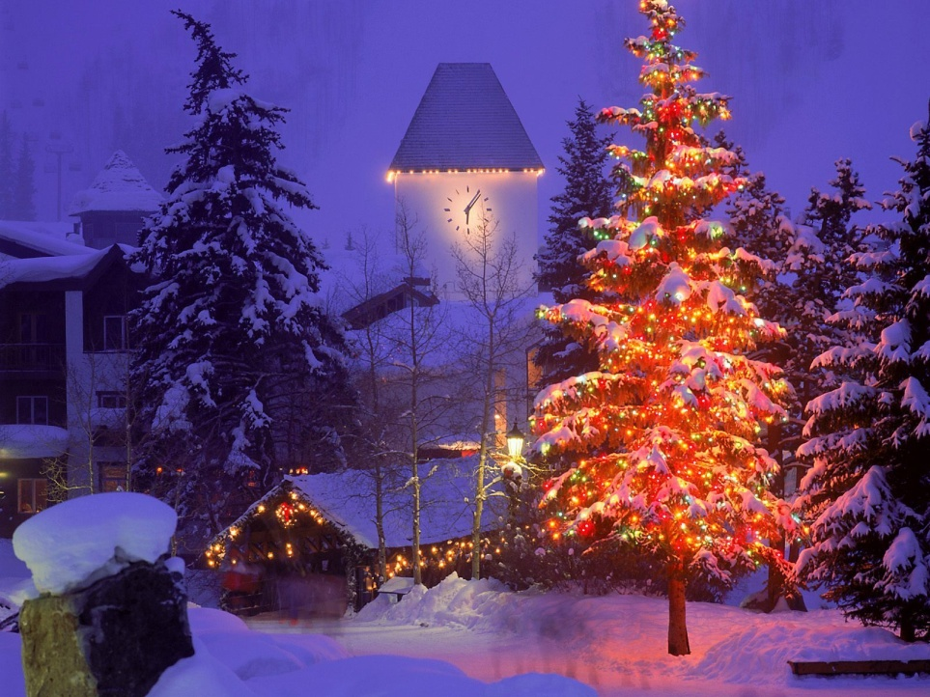
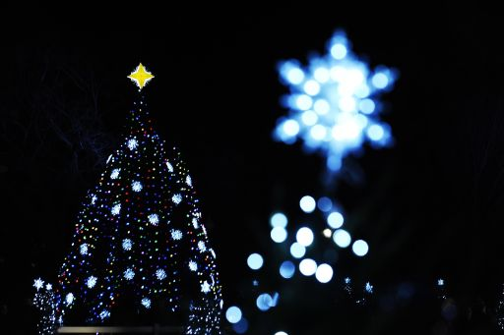
In Colorado, an enormous star is placed on the mountain, it can be seen for many kilometers around, while in Bethlehem, Pennsylvania, a star is lit in early December.

Slide 11
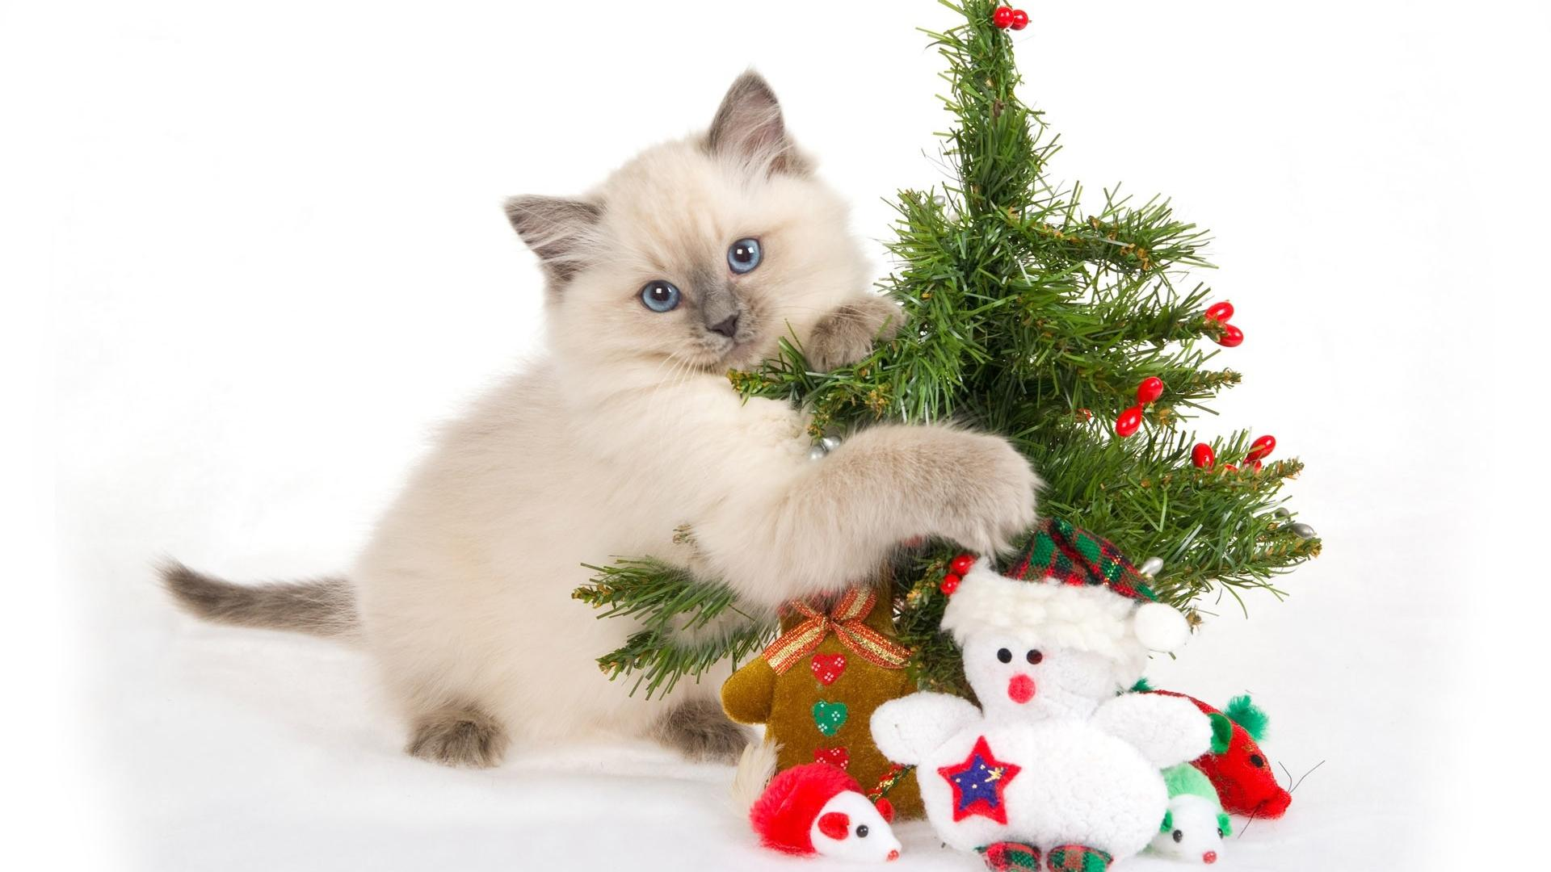
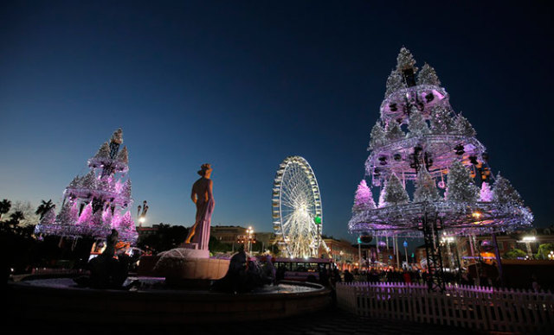

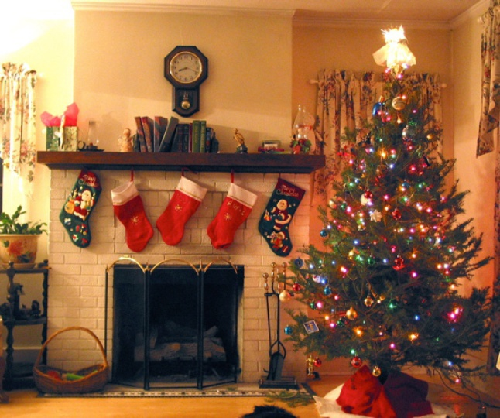


The majority of Americans celebrate Christmas with the exchange of gifts and greetings and with family visits.

Slide 12
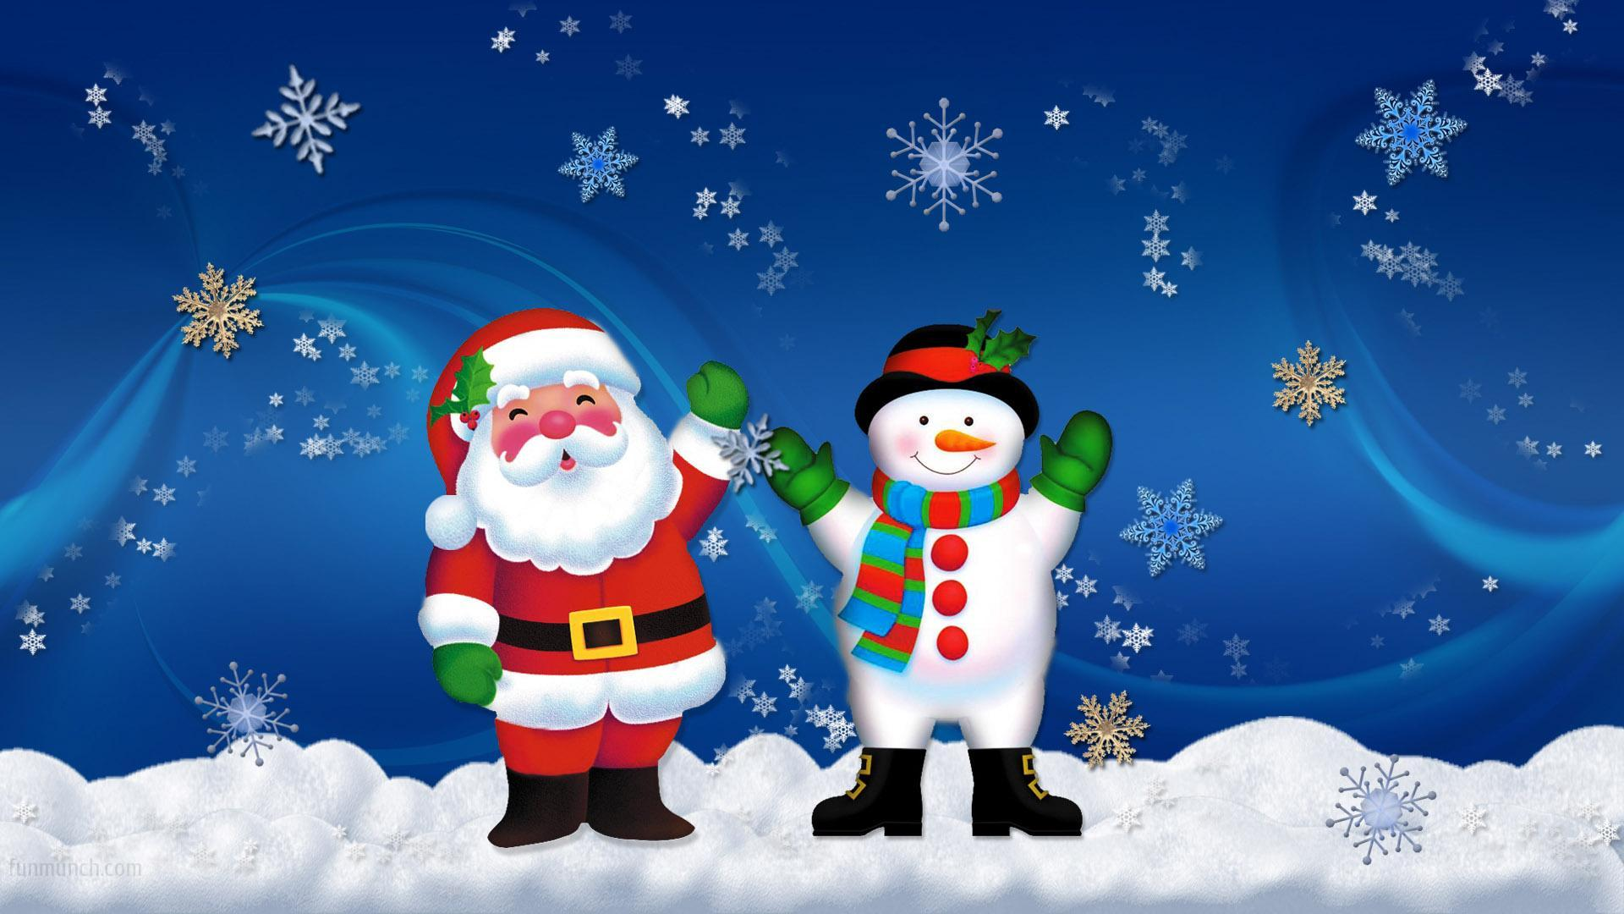
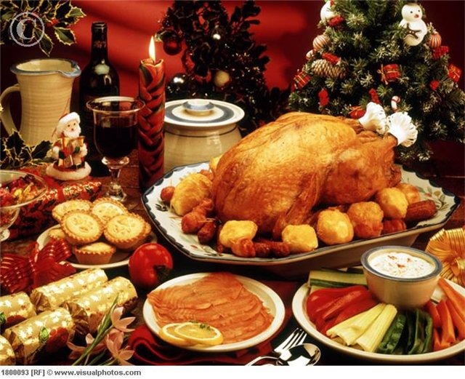
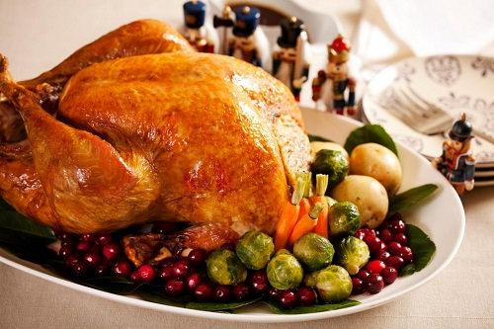
In America the traditional Christmas dinner is roast turkey with vegetables and sauces. For dessert it is rich, fruity Christmas pudding with brandy sauce. Mince pies, pastry cases filled with a mixture of chopped dried fruit.

Slide 13
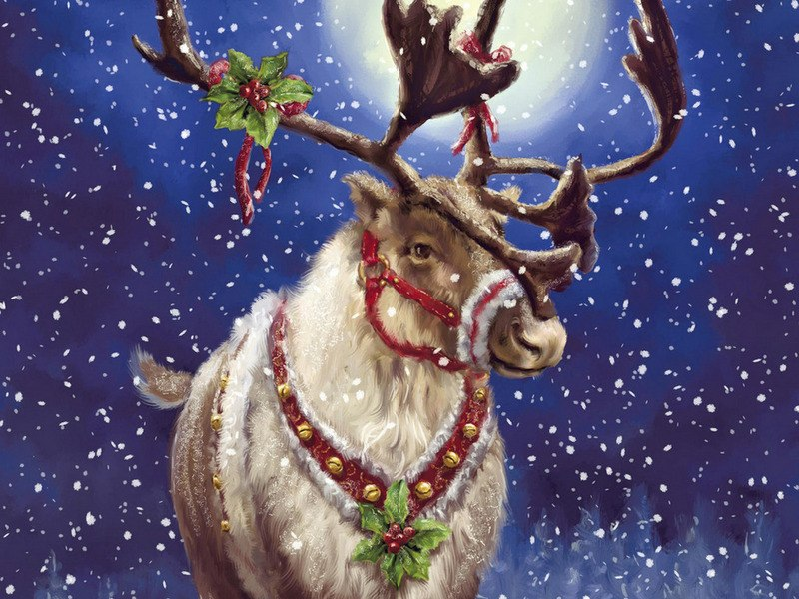
Thank you ☺

