Slide 1

Ukrainian Environmental League

Slide 2
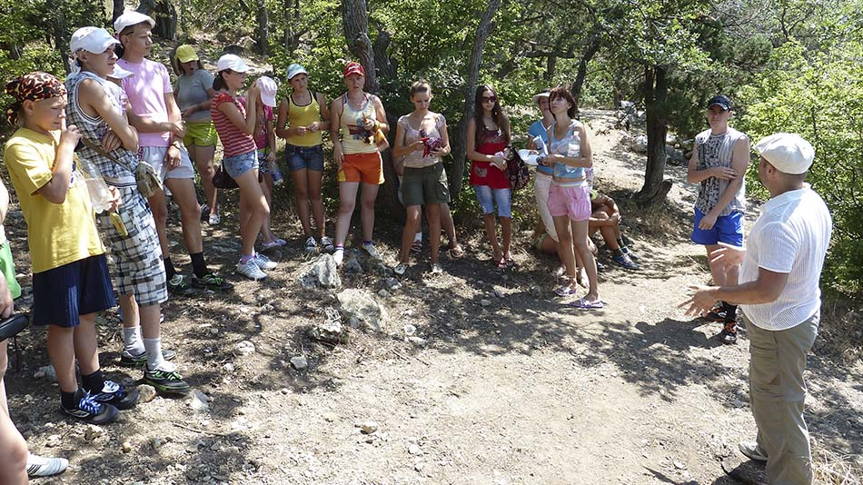
Ukrainian Environmental League is public organization, which was founded in December 12, 1997 year.
It has several main goal their activity:
Improve state of ecology in Ukraine
Inculcate using alternative energy sources
Reduce amount of waste and pollutions

Slide 3
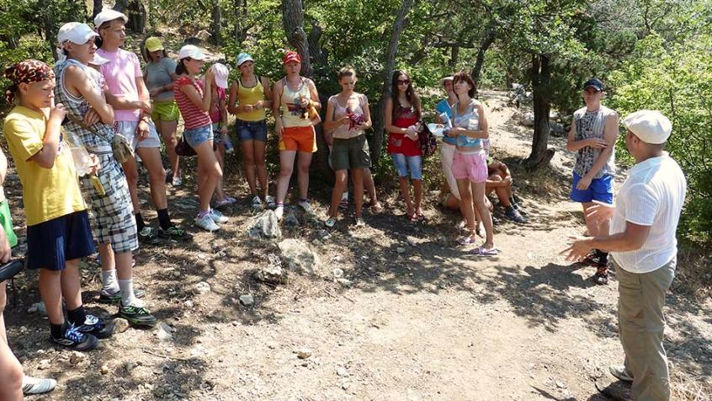
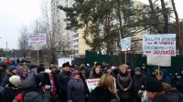

This organization was organized many campaign for environmental protection. UEL cope with deforestation forests in Kiev. UEL started new campaign on summer. This campaign called “No – shale gas in Ukraine”. It prevented use shale gas in Ukraine.

Slide 4
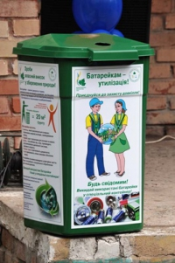
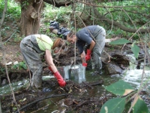
Activities of UEL
This is campaign “Save small river”
UEL collected and recycling more than 14 tons of waste batteries

Slide 5

So this organization helps support campaign for environmental protection. I believe that it will achieve successful in future and our environment will be cleaner.

