Slide 1

«My purpose in life»
Notes:
My purpose in life

Slide 2






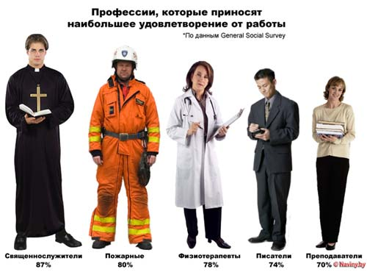


Everyone wants to live a life not in vain, though, and understands that each in his own way. We have been given a lot, lay before us millions of roads. It is difficult to determine precisely in which to go, what to devote your time and effort. It seems to me that every man has his destiny, because we are all different, unique.

Slide 3



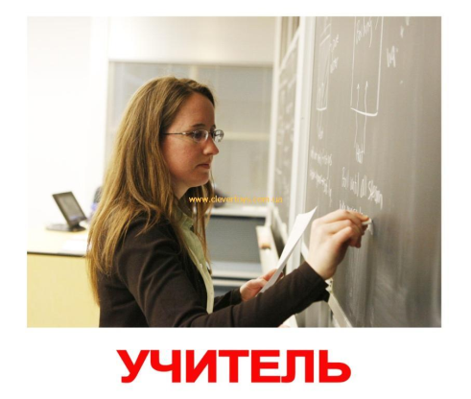


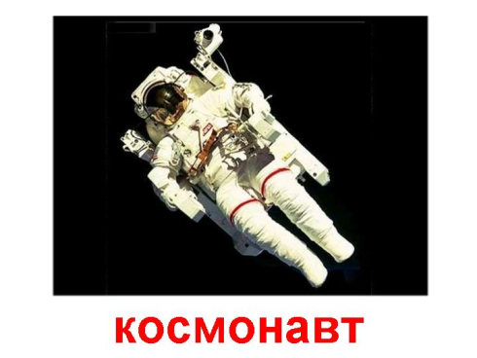
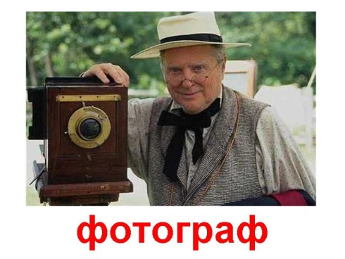
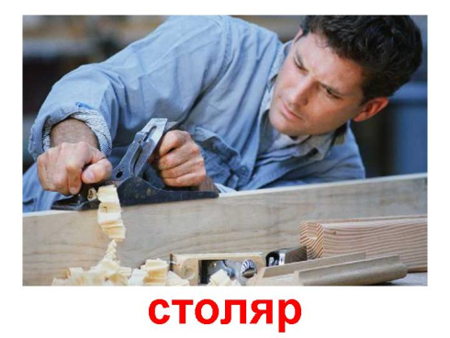
It is not easy to choose a profession. Today there are about four thousand a variety of professions. But you have to choose one, which would bring the person to the job satisfaction and the benefit of people.

Slide 4

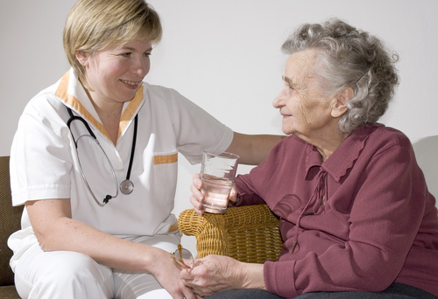
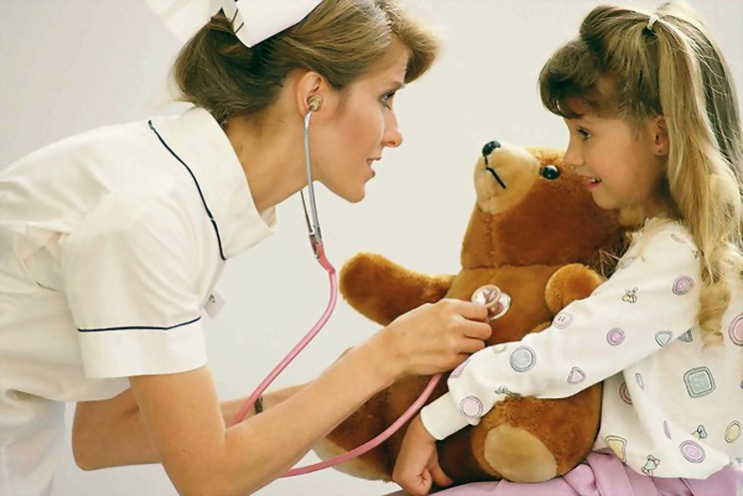


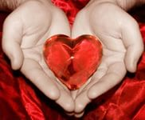
I would like to dedicate his life to the people: I want to become a doctor. Why? Therefore, the greatest miracle and the most precious treasure in the world is human life. To protect the health and life of people is the most noble cause.

Slide 5
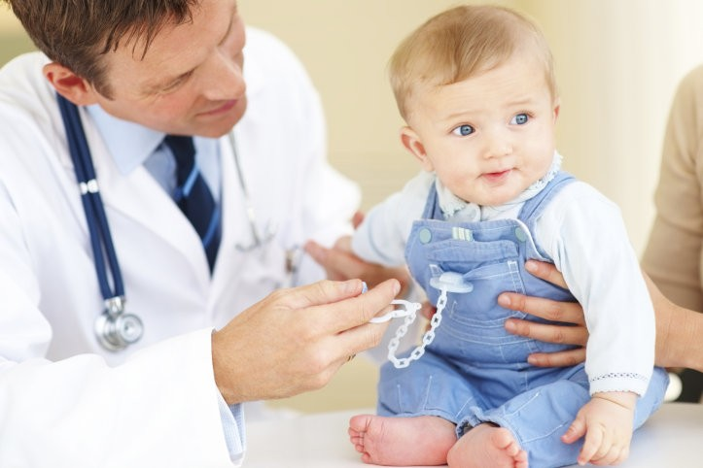
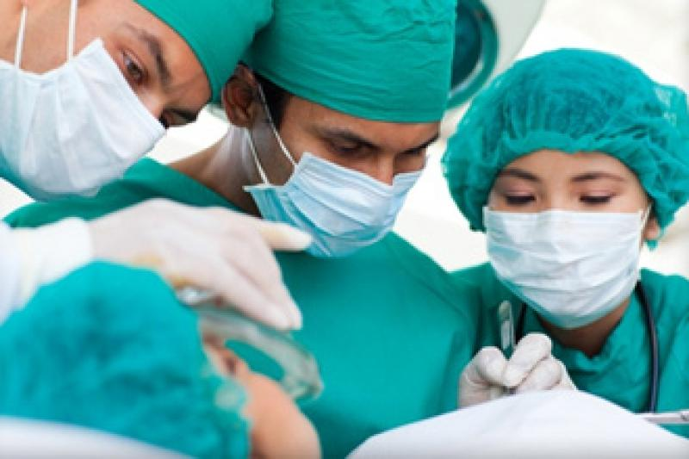
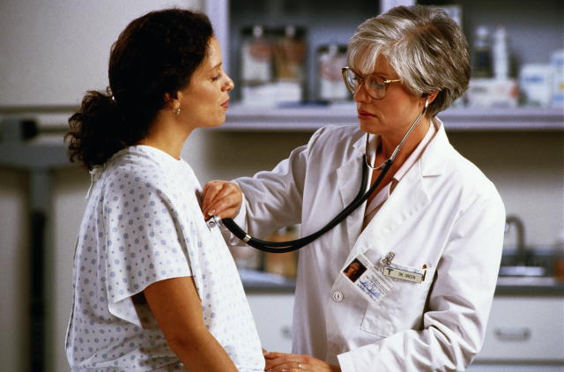

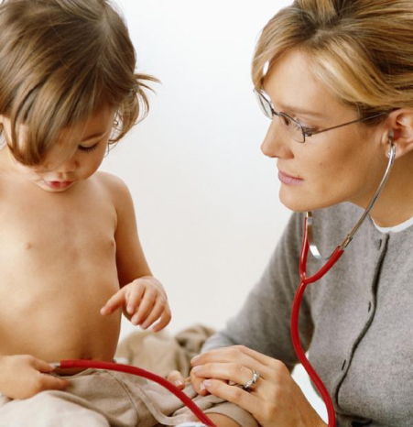



The profession of a doctor is one of the oldest professions on earth. Since childhood, I remember the friendly, gentle people in white coats that came to my aid when I was sick. The profession of a doctor requires constant improvement, more knowledge.

Slide 6
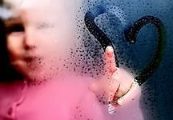
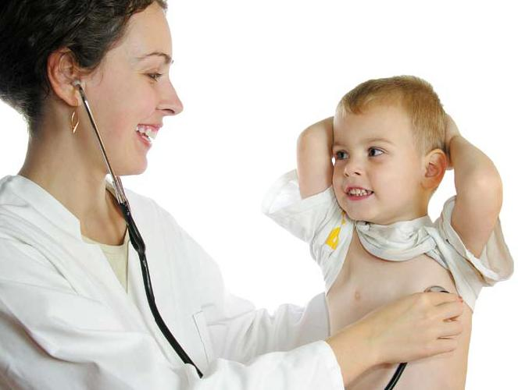




I want to become a doctor because I want to worry about people's health, to prolong their age, in time to save their lives, providing them with professional medical help.

