Slide 1
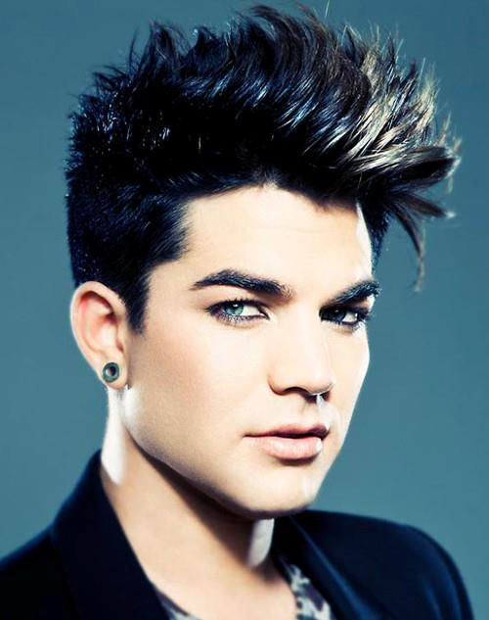
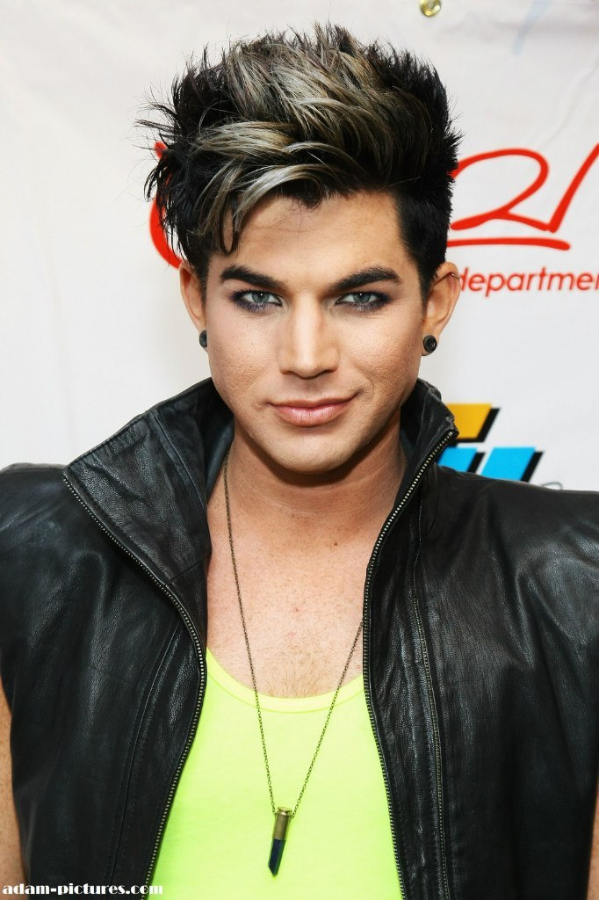
ADAM LAMBERT
By Olha Ostroverkh, form 11-B

Slide 2
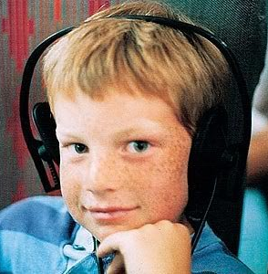
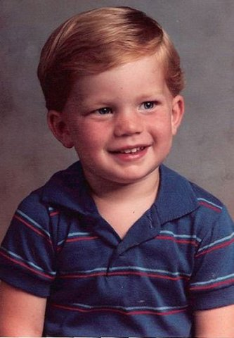
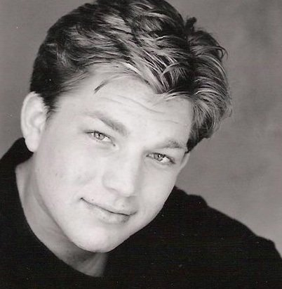
Adam Mitchel Lambert (born January 29, 1982) is an American singer-songwriter and stage actor.
Born in Indianapolis and raised in San Diego, he performed in amateur theatrical productions as a child and teenager.
In 2009, Lambert came to prominence after becoming the runner-up on the eighth season of American Idol.

Slide 3
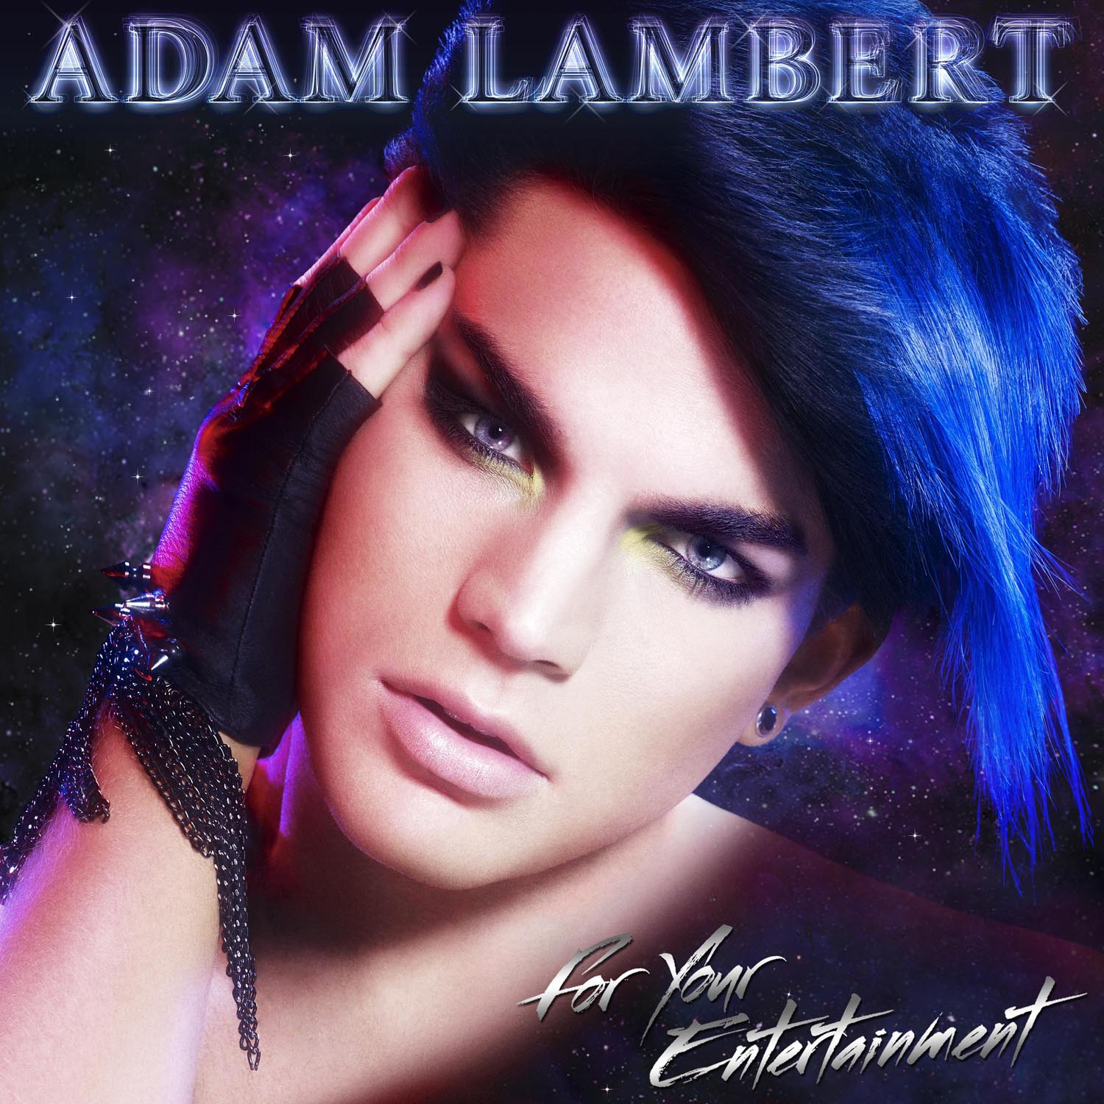
He released his debut album For Your Entertainment in 2009.
It debuted at number three on the US Billboard 200 with 198,000 copies in first-week sales, and reached the top 10 in several countries.
He is the most popular participant of American Idol
All of the songs were written by Adam himself.
Singles "For Your Entertainment", "Whataya Want from Me" and "If I Had You" also became international successes.

Slide 4
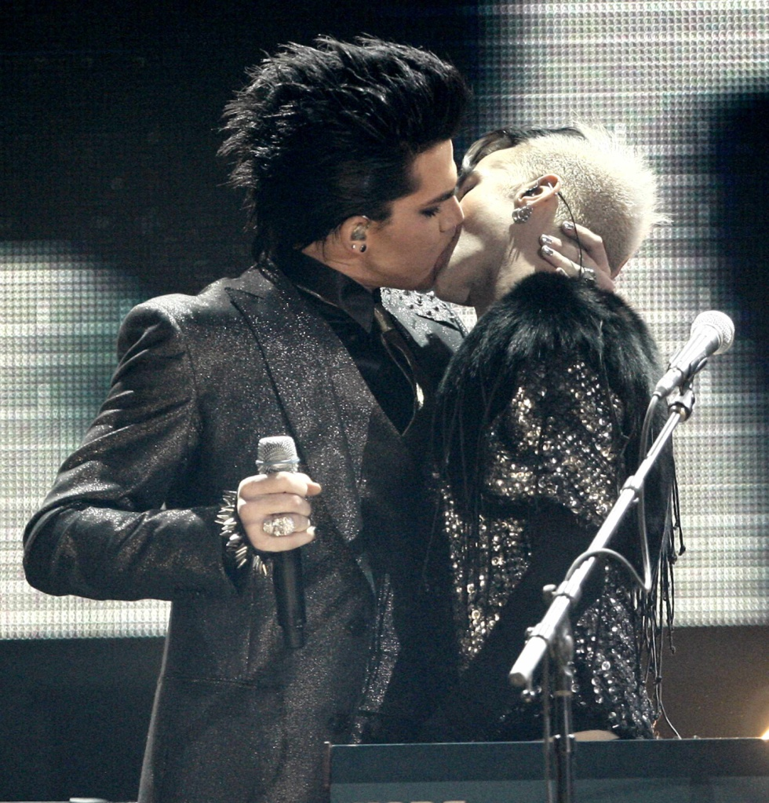
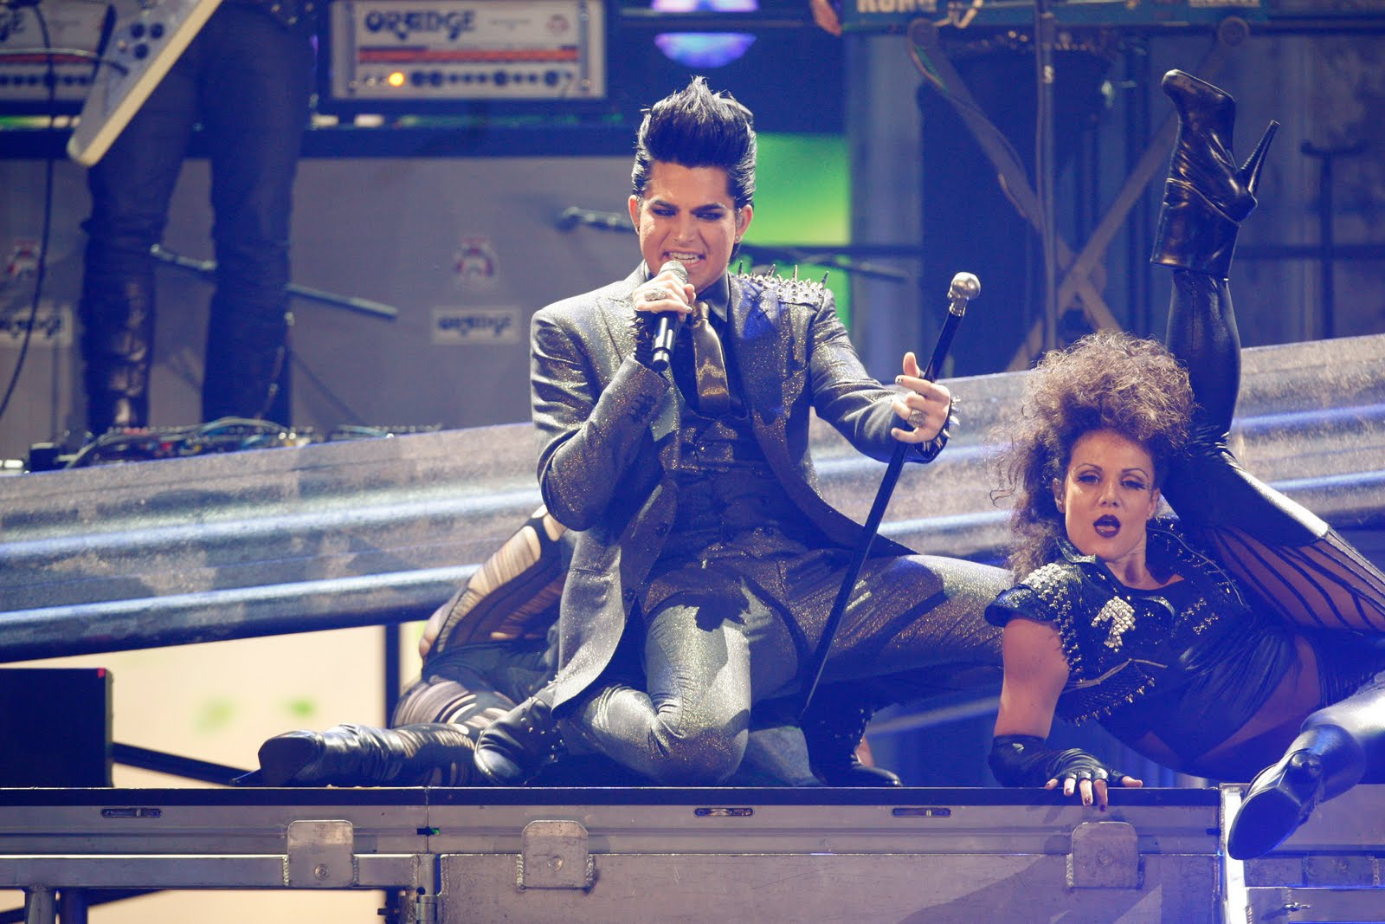
On November 22, 2009, Lambert performed his first single "For Your Entertainment" at the American Music Awards of 2009.
The controversial performance showed Lambert kissing a male bassist. It brought him worldwide fame.

Slide 5
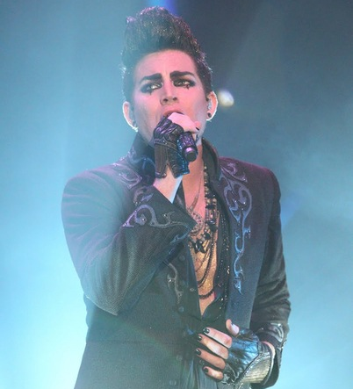
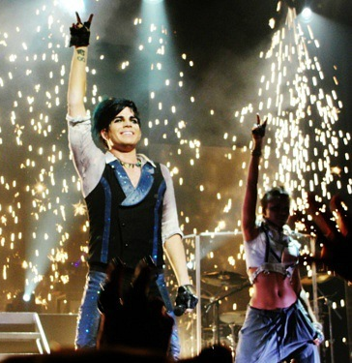
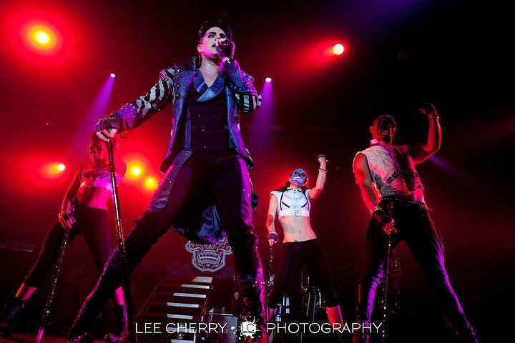
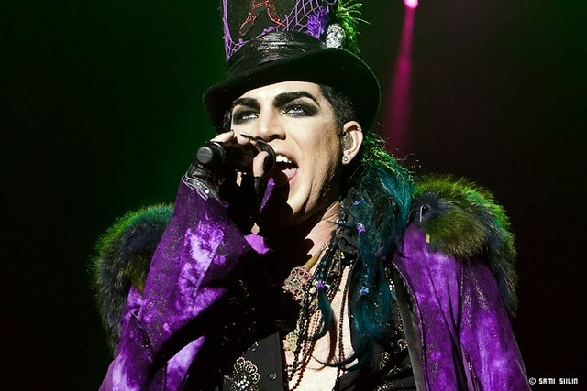
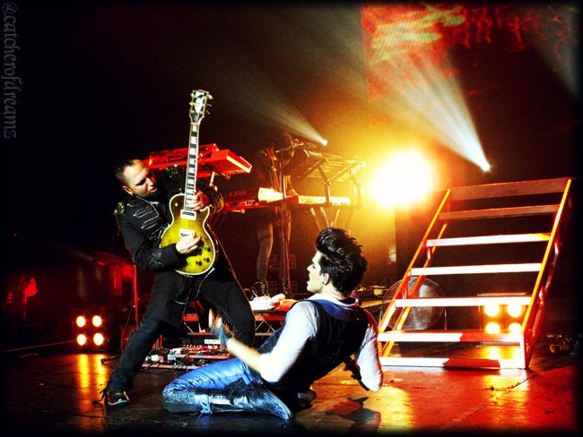
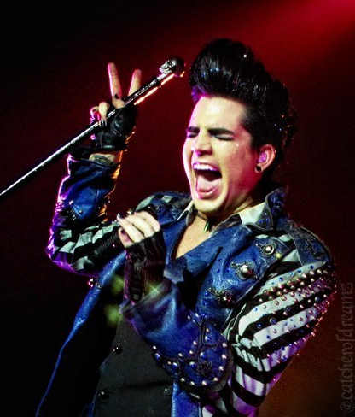
Soon after the album release, he headlined a worldwide concert tour, Glam Nation, the first American Idol contestant to do so in the year following his Idol season.
The concert tour included 136 cities of America, Australia, Europe and Asia.

Slide 6
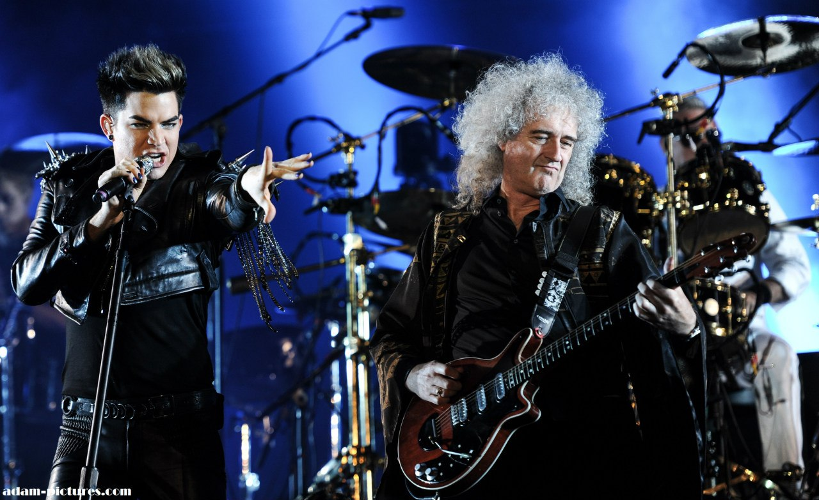
In November 2011, Lambert joined Queen as lead singer at the MTV Europe Music Awards, where the band was honored with the Global Icon Award.
In a "spectacular" performance that closed the show, they performed classic hits “The Show Must Go On”, "We Will Rock You", and "We Are the Champions".

Slide 7
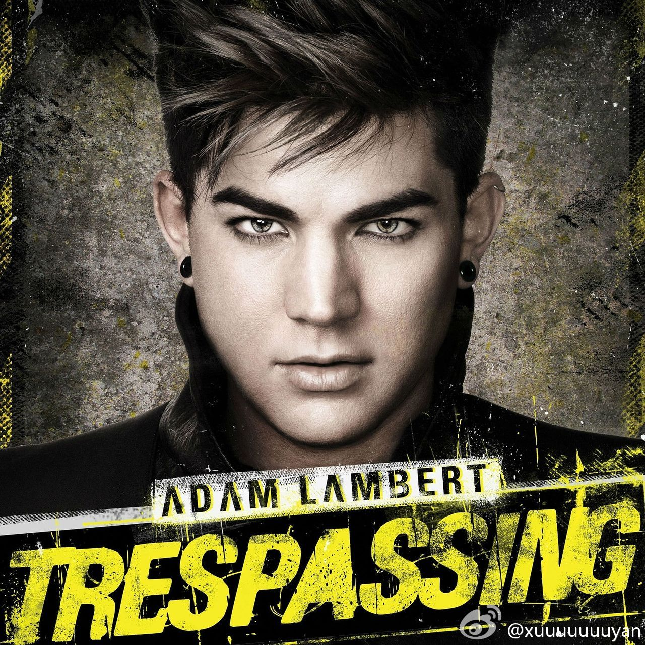
On May 15, 2012 there was released his second album. It is called «Trespassing».
Trespassing was named on iTunes's list of the "Best Rock Albums of 2012," coming in at number nine.

Slide 8
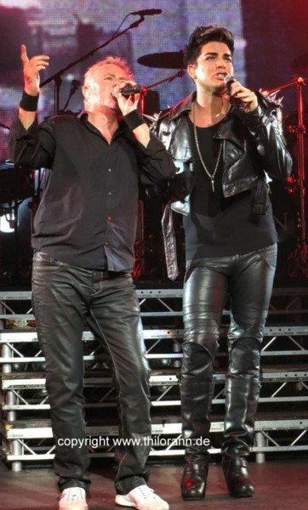
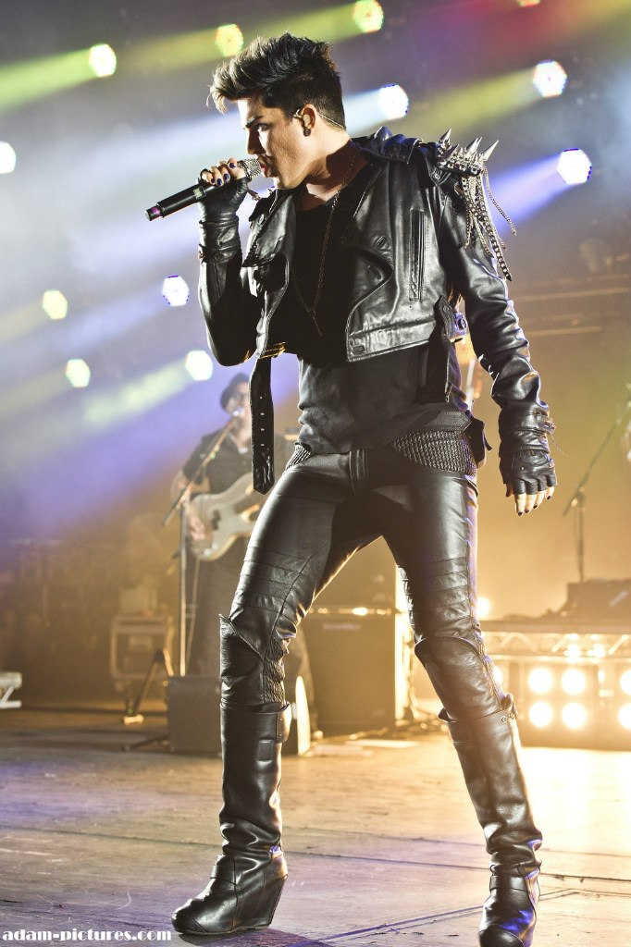
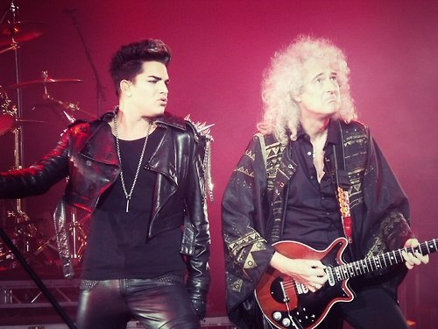
Queen and Adam Lambert made a performance in Kiev on June 30, the eve of the Euro 2012 Championship.
Viewed live by hundreds of thousands of fans in Ukraine's main square, the performance was touted for the strength of Lambert's showmanship, vocal excellence and interpretative skill,which confidently balanced old and new.

Slide 9
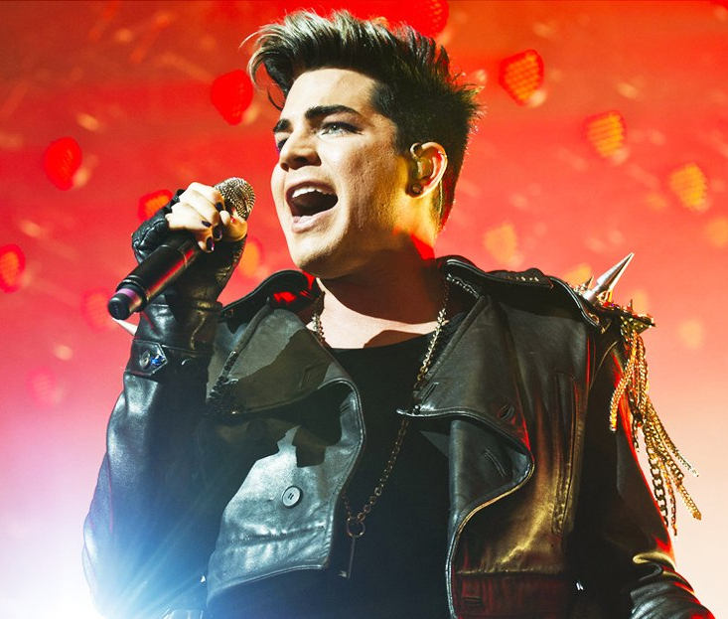
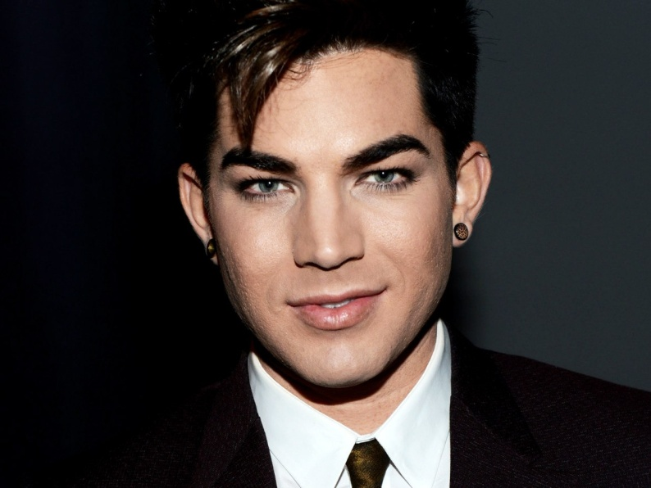
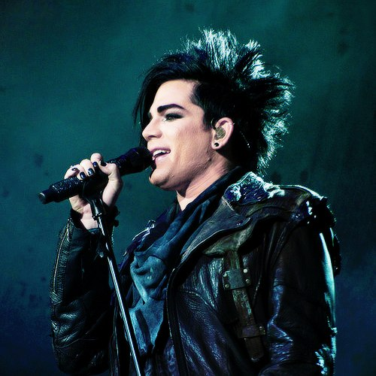
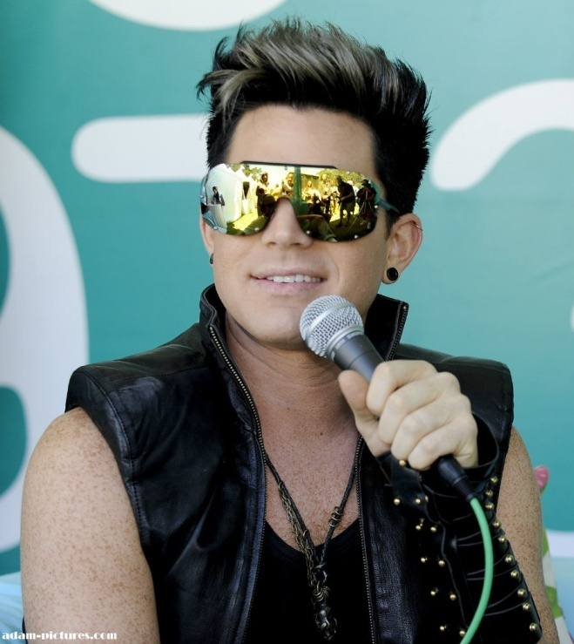
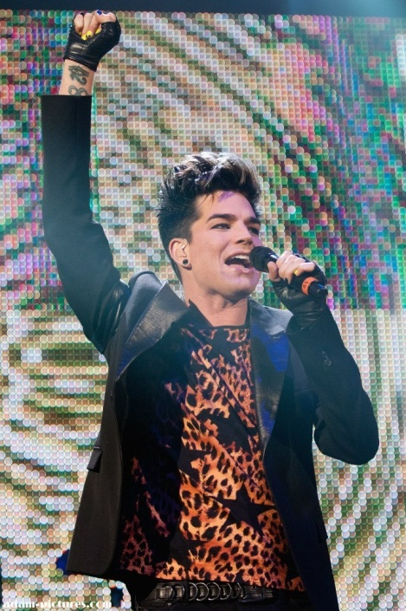
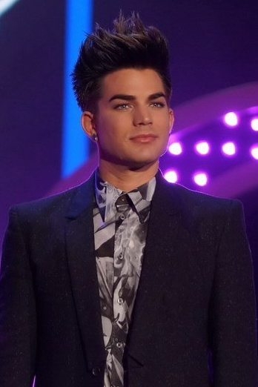
I also watched this concert on TV and just then I heard Adam’s voice, saw him and fell in love.
I consider him really handsome and sexy.

Slide 10
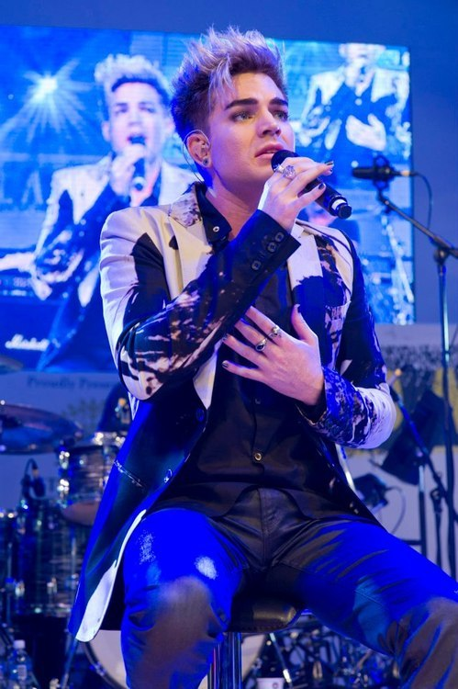
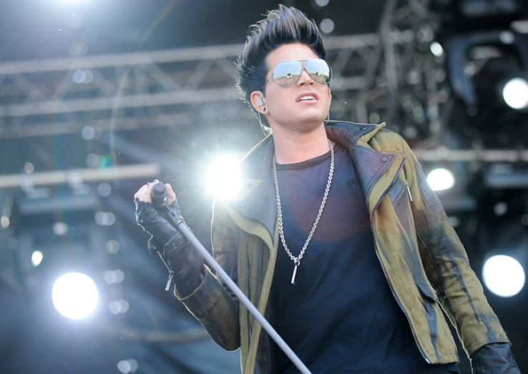
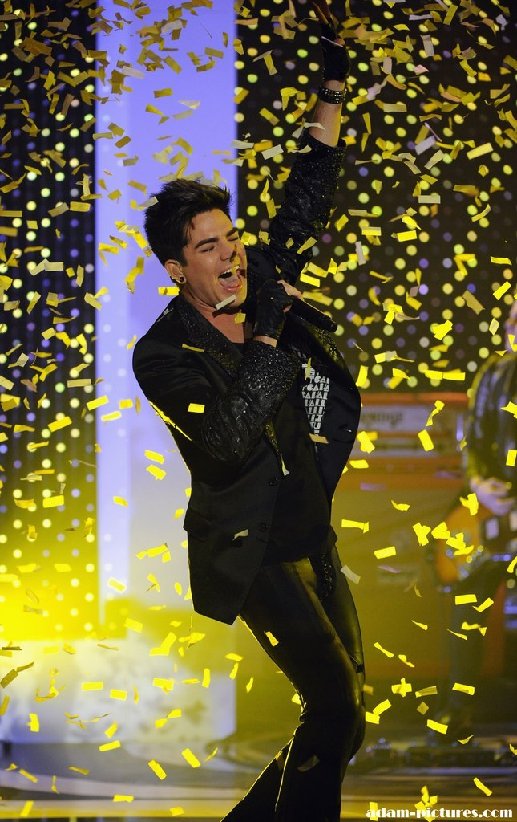
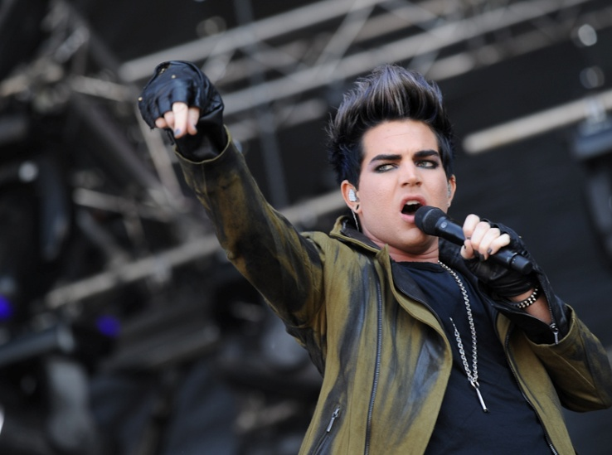
The range of Adam’s voice - four and a half octaves. It’s the maximum possible range of male vocal.
I love his songs very much and I know most of them by heart. I consider the themes raised in his songs actual and very serious.

