Slide 1
Great Britain.
London.

Slide 2
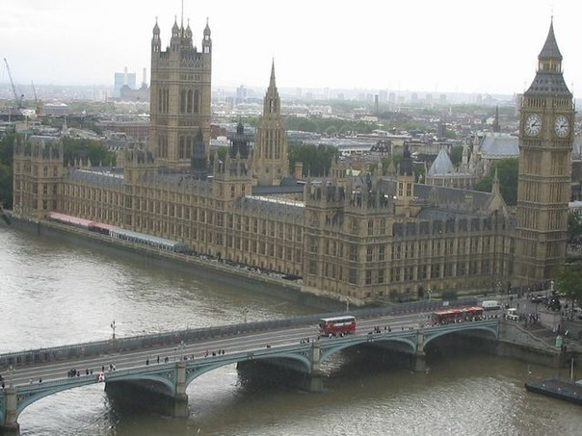
The capital of Great Britain is London. It is situated on the river Thames. The Houses of Parliament is the seat of the British Government.

Slide 3
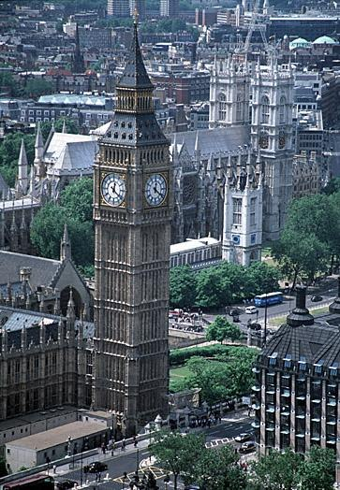
The tallest tower of the Houses of Parliament with the clock on it is Big Ben.

Slide 4
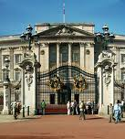
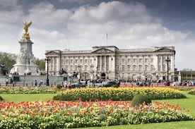
In the centre there is a Buckingham Palace. Queen Elizabeth lives there.

Slide 5
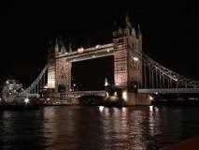
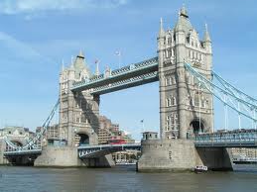
Crossing the river by Tower Bridge…

Slide 6
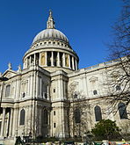
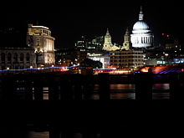
St. Paul’s Cathedral is the biggest English church.

Slide 7
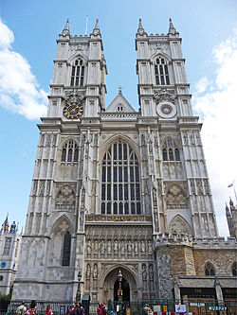
Westminster Abby is one of the oldest building in London. Many kings and queens are buried there.

Slide 8
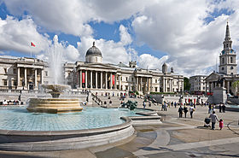
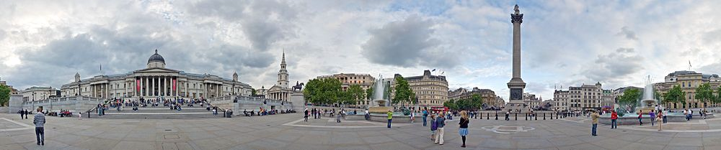
In the centre of Trafalgar Square is the monument to Nelson.

Slide 9
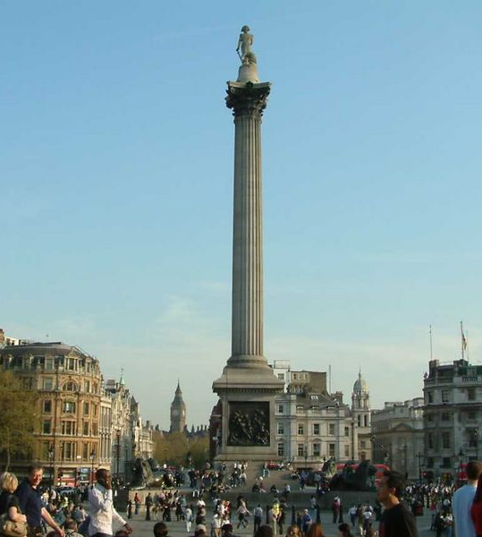
Admiral Nelson is the national hero of Great Britain.

Slide 10
