Slide 1
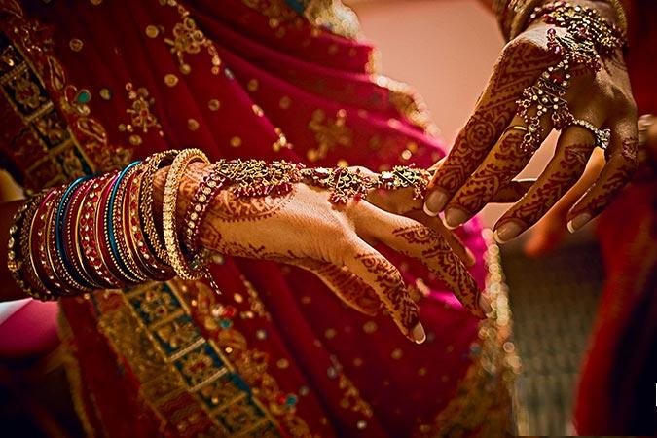
INDIA
Presentation
Melnyk Nastia
from 9 -B
school 10

Slide 2
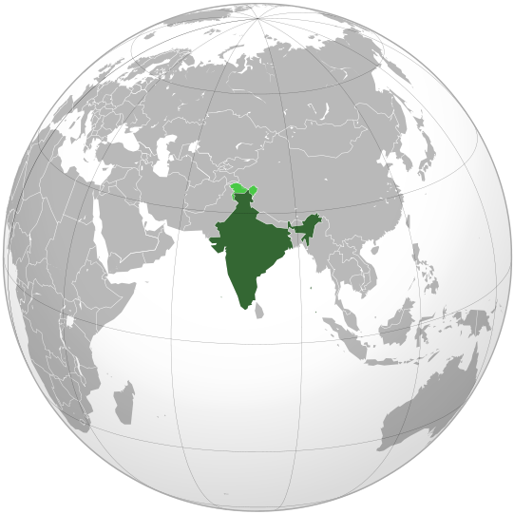
India is located in the South of the Eurasian continent, on the Indian subcontinent. Has borders with Pakistan on the West, China, Nepal and Bhutan to the North-East and Bangladesh and Myanmar (formerly Burma) on the East. In the Indian ocean, it has a border with the Maldives in the South-West of Sri Lanka in the South, and Indonesia in the South-East. From Sri Lanka, it separated Palk Strait and the Gulf of Mannar; Strait REIT-channel between the Islands of the Great Nicobar and Sumatra passes sea border between India and Indonesia.

Slide 3
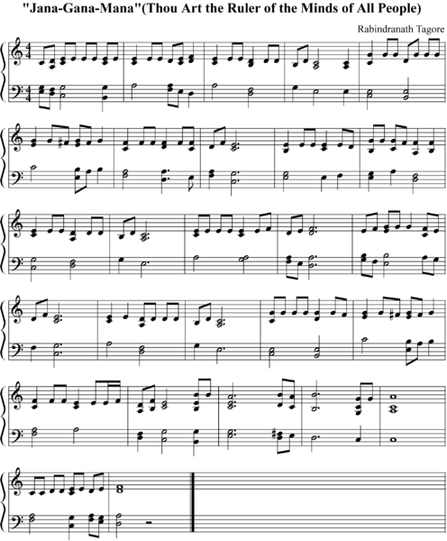
National symbols of India
The national anthem of India - national song "Gangaramani" ("the Soul of the people"), the words and music to which was written by Rabindranath Tagore. For the first time, was executed on December 29, 1911
Motto: (Let the Truth will prevail)

Slide 4
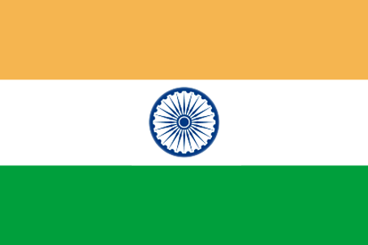
National holiday: January 26 - the Day of Republic (1950)
The national flag of India (adopted July 22, 1947) - he has three horizontal colors: saffron on top, white in the middle and dark green at the bottom. In the center of the white band - the wheel "chakra" in dark blue. Its diameter is about the width as the white band and it has 24 spokes. Chakra - the wheel of the law of dharma.
National emblem symbolizes the commitment of modern India of the ancient principles of peace and goodwill. In capitals - four lions sitting back to back.

Slide 5
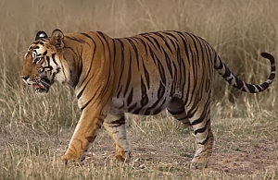
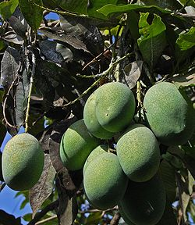
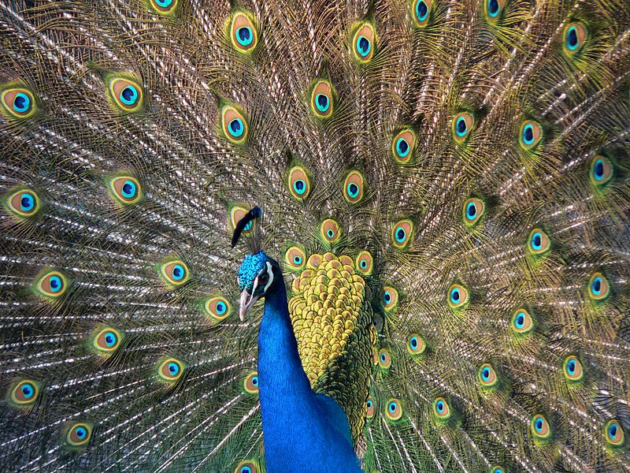
National flower - Lotus.
National animal is a tiger.
National fruit - mango.
The national bird, the peacock

Slide 6
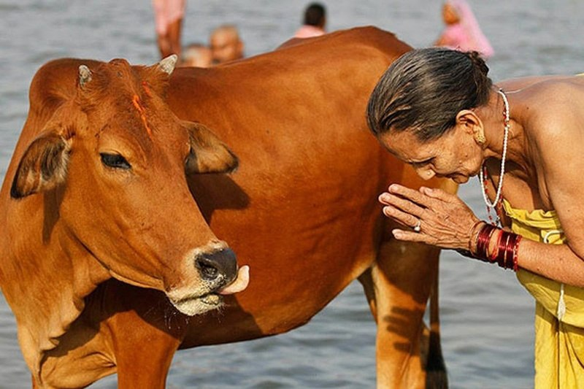
The cow is a sacred animal of India
Holy Cow takes the main place in India. Cow for Hindus equal to the status of the mother, because this animal is such maternal qualities as humility, kindness, wisdom and peace. In India the cow is called "Hau Mata", which literally translates as "the Cow Is the Mother." So, while on holiday in India, it is forbidden to cry out to the cow, beat her and, especially, to eat beef.

Slide 7
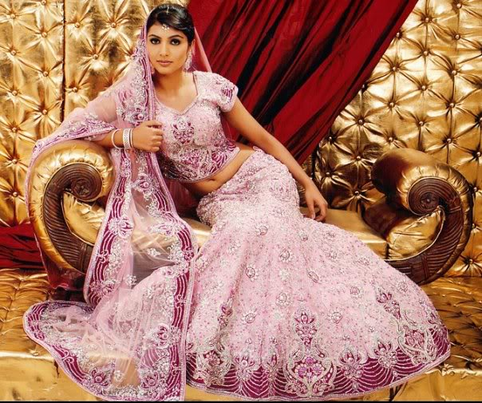
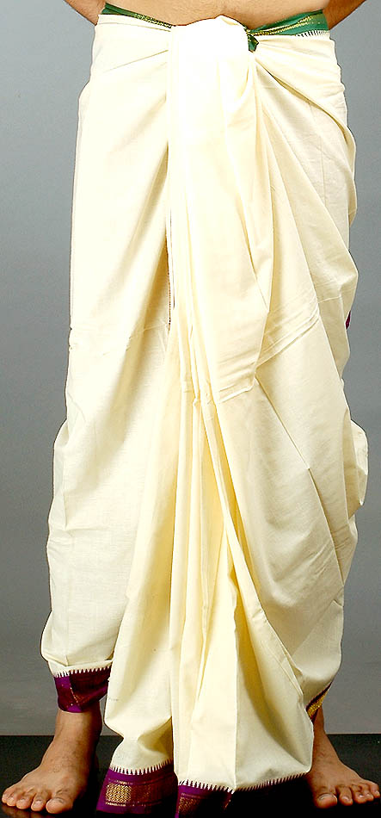
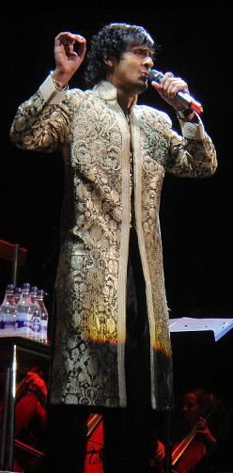
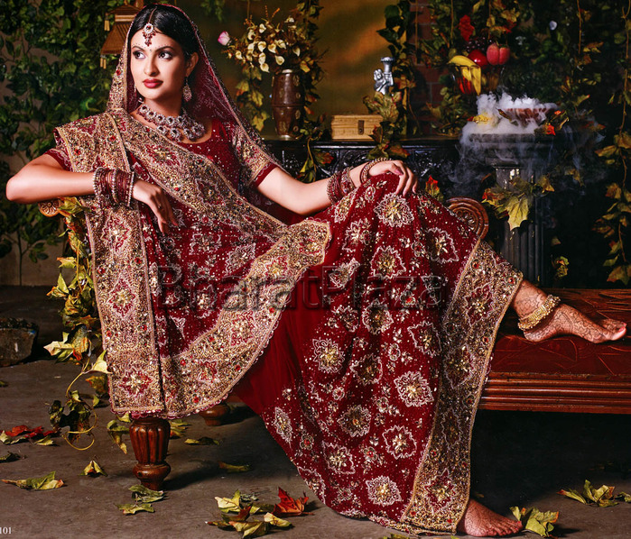
National clothes of India

Slide 8
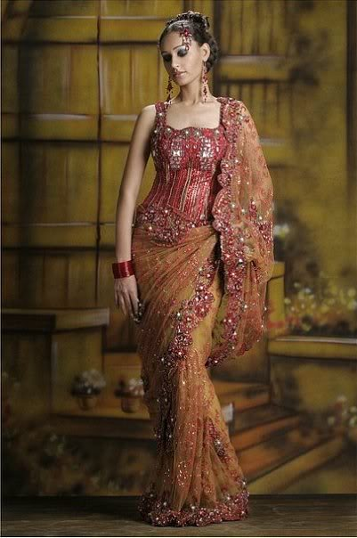
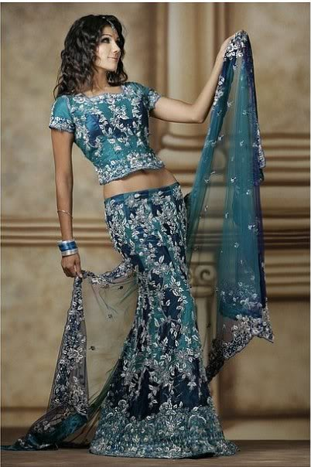
Women's clothing
Traditional Indian women's clothing - Sari. This piece of fabric with a length of 4, 5 to 9 meters and a width of up to 1.2 meters, which is a special wrapped around body.

Slide 9
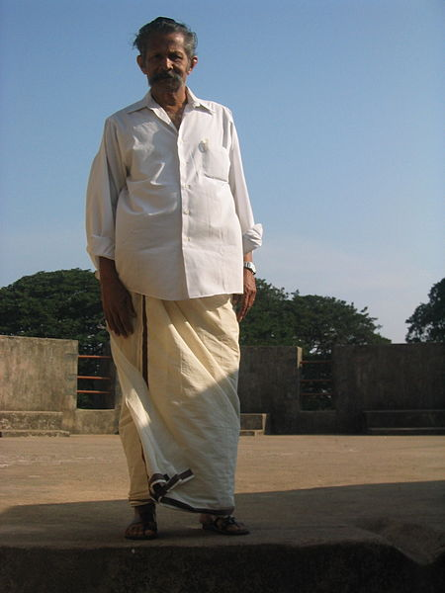
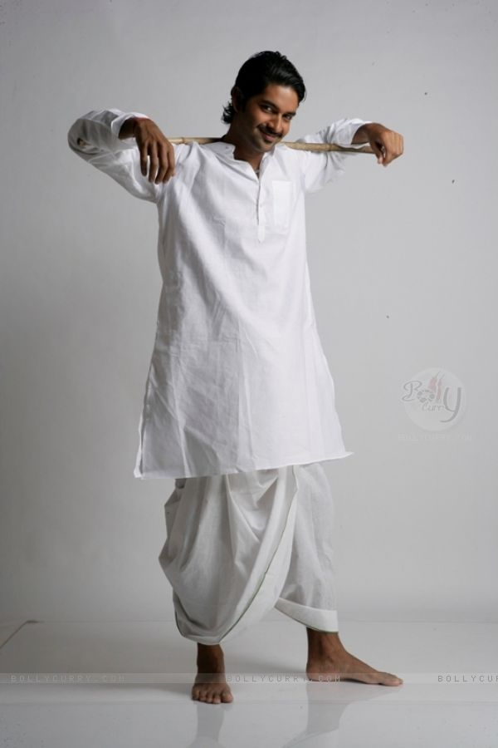
Men's clothing
Dhoti is a traditional garment, which mainly men wear in the villages. This clothing is held up by the belt around the waist. He can be with ornaments and patterns, as well as simple.

