Slide 1
CANADA

Slide 2
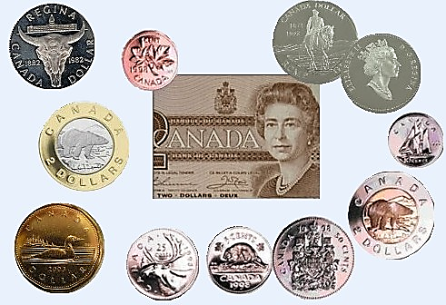
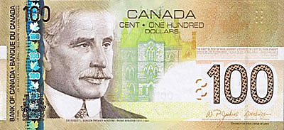
«BUSINESS CARD OF CANADA»
Area - 9,97 million square kilometer.
Population – about 28 million people.
Ottawa is the capital of the Canada.
Canada is a federation of 10 provinces and 2 territories.
Currency – Canadian dollar.

Slide 3
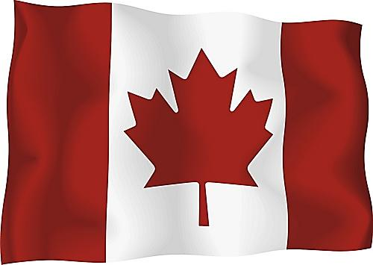
Canada’s people are varied.
57% of all Canadians have some English ancestry and 32% - French ancestry.
English and French are official language of the Canada.
Native people – American Indians and Eskimos – make up about 2% of the country’s population.

Slide 4
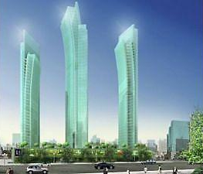
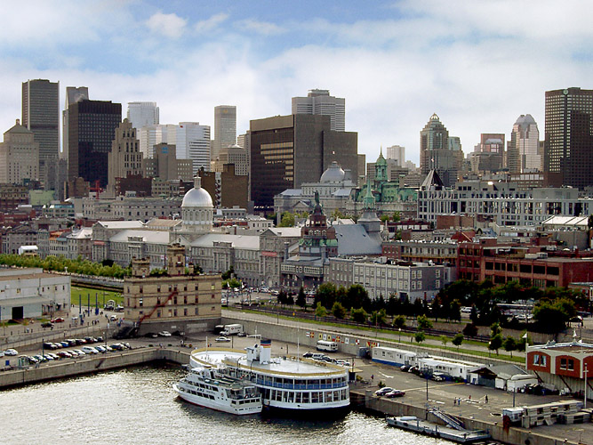
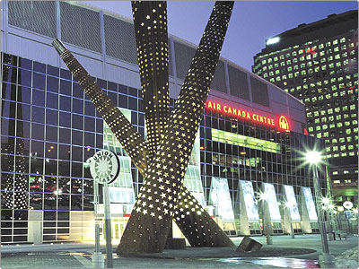
Toronto and Montreal are the largest city.
T
O
R
O
N
T
O
Montreal

Slide 5
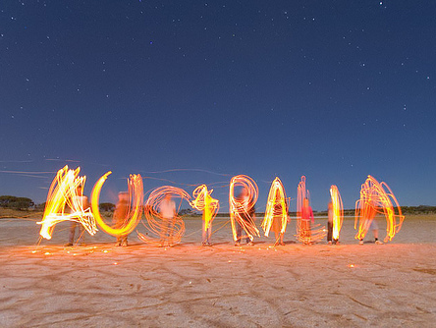

Slide 6
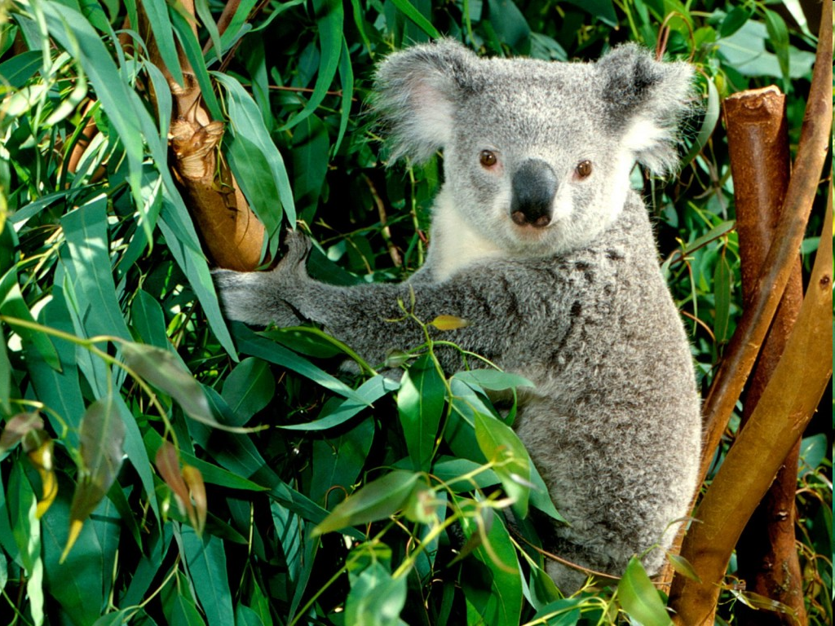
The capital of the country is Canberra.
Australia is the only country in the world that also a continent.
The Commonwealth of Australia is a federation of states.
Australia has six states and two territories.

Slide 7
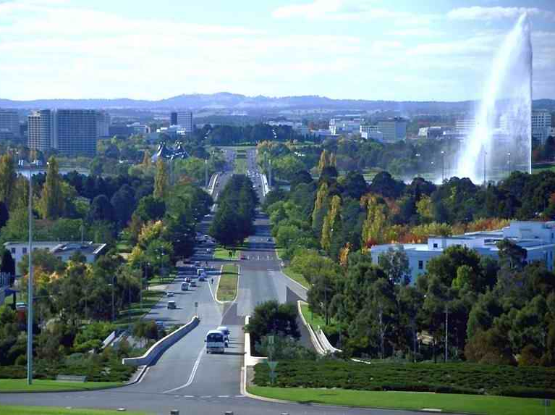
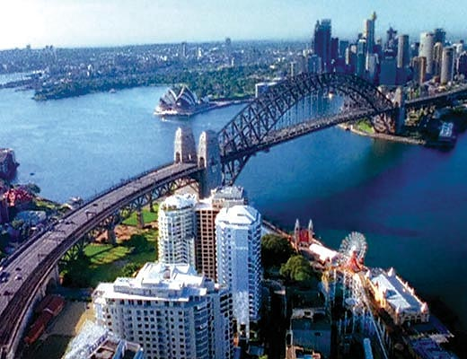
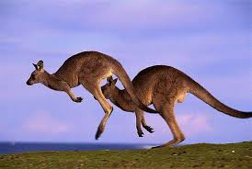
Australia is one of the world’s developed countries.
Australia has modern factories, highly productive mines and farms, and busy cities.
The most important trading partners of Australia are Japan and the United States.

Slide 8
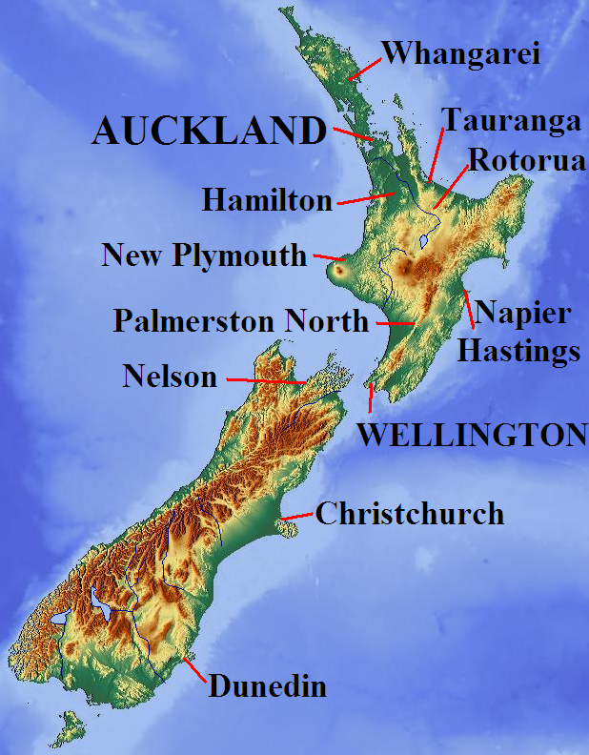
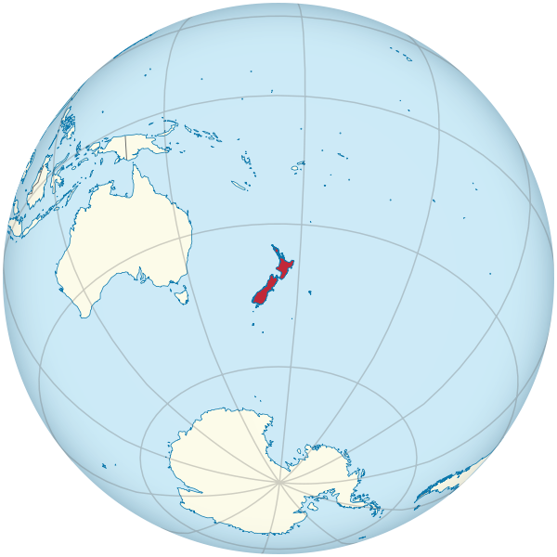
NEW ZEALAND
Wellington is the capital of New Zealand.
New Zealand is an island country in the Southwest Pacific Ocean.
English is the official language.

Slide 9
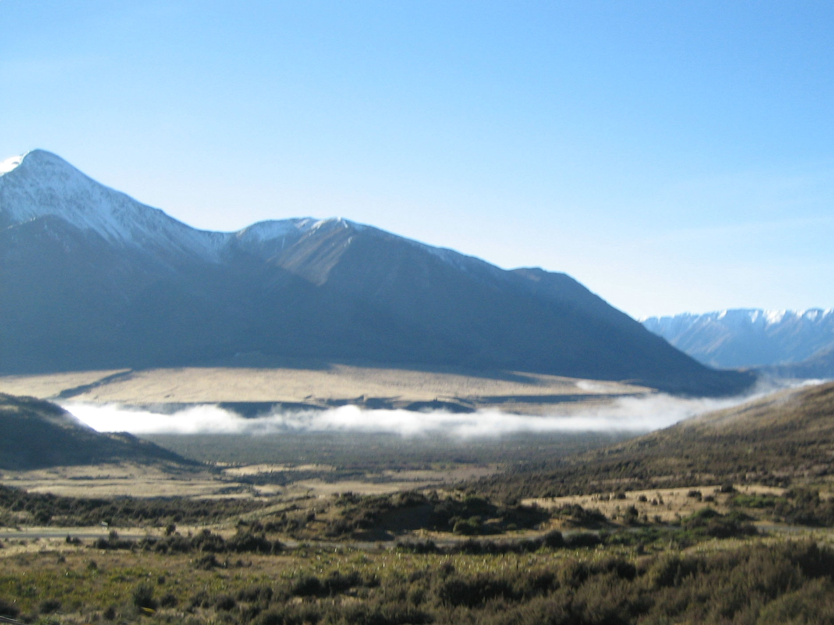
The country once belonged to the British empire.
Today it is an independent member of the Commonwealth of Nations.
New Zealand is a constitutional.
Britain gave New Zealand a constitution in 1852, when it was a British colony.
The first people who settled in New Zealand were a brown-skinned people called Maoris.

Slide 10
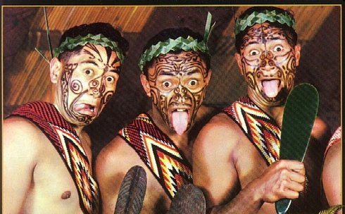
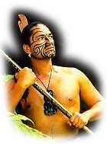
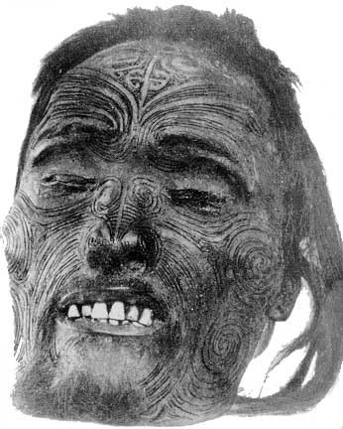
MAORIS

