Slide 1
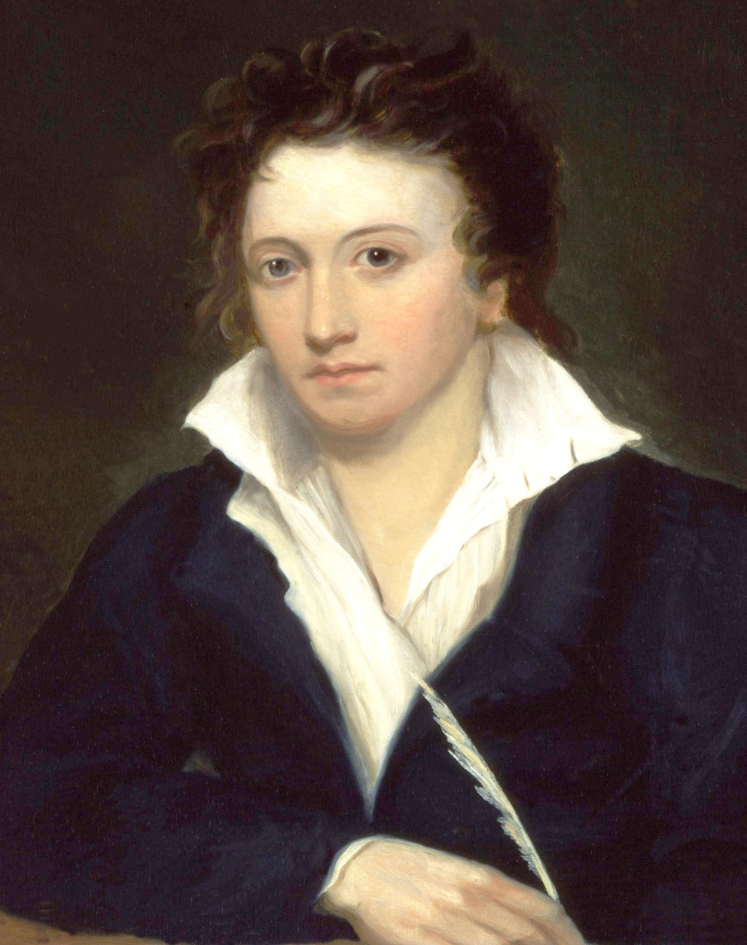
English romanticism
Persy Bysshe Shelley
(1972-1822)
Revolutionary poet-philosopher, author of lyric and journalistic works
Rebellious pathos of tragedy "Cenci"

Slide 2
Biography
The eldest son of a wealthy country squire, Shelley was born on August 4, 1792. From his childhood, he possessed a fierce independence of spirit and bitterly hated all forms of tyranny.
At Eton, he read widely, including political theory and romantic tales. In the fall of 1810. At Oxford, he and Thomas Hogg published The Necessity of Atheism and defiantly refused to answer questions about this work put to them by university authorities, so they were expelled.
Shelley spend his life travelling around Europe, meeting various poets and journalists, writing poems, political pamphlets, essays.
On July 8, 1822 Shelley drowned in a sudden storm while sailing back from Livorno to Lerici in his shooner. Body cremated, except for the heart, which Mary kept.

Slide 3
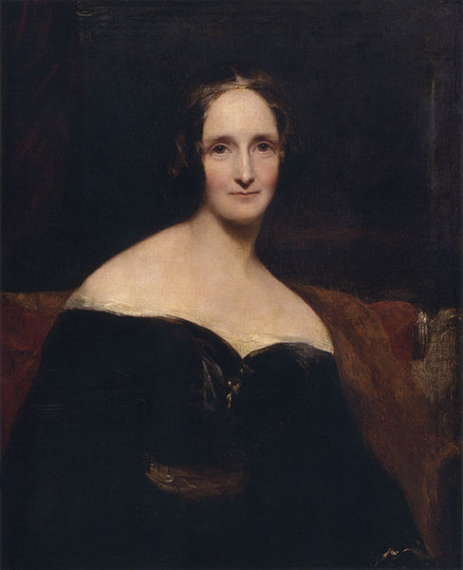
Private life
In 1811, Shelley eloped and engaged with Harriet Westbrook. His love for her was centered on a hope that he could save her from committing suicide.
Three years into his marriage, he left his wife and child to study and travel. He met and fell in love with Mary Godwin, the daughter of the political philosopher William Godwin, author of Political Justice.
Shelley always thought that he saw profound spiritual qualities in ladies he loved.
Shelly’s second wife,
Mary Shelley, the author of Frankenstein.

Slide 4
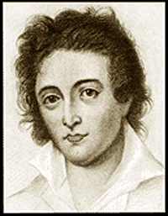
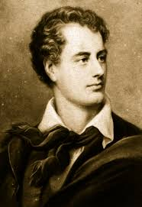
Friendship with Lord Byron
In 1816, Mary’s sister, Claire, had begun dating the Romantic poet Lord Byron and wished to show him off to her sister. Shelley and Byron became best friends. After a long day of boating with Byron, Shelley returned home and wrote Hymn to Intellectual Beauty and was inspired to write Mont Blanc, a pondering on the relationship between man and nature.

Slide 5

Shelley’s publications
His first publication was a Gothic novel, Zastrozzi (1810), in which he gave vent to his atheistic worldview through the villain Zastrozzi.
During 1818, he wrote Julian and Maddalo, a lightly disguised rendering of his boat trips and conversations with Byron in Venice, finishing with a visit to a madhouse. This poem marked the appearance of Shelley's "urbane style". He began the long verse drama Prometheus Unbound, which features talking mountains and a petulant demon who overthrows Zeus.
In 1821, inspired by the death of John Keats, Shelley wrote the elegy Adonais.
In 1822 Shelley moved to Italy and published the journal The Liberal with Leigh Hunt and Lord Byron.

Slide 6
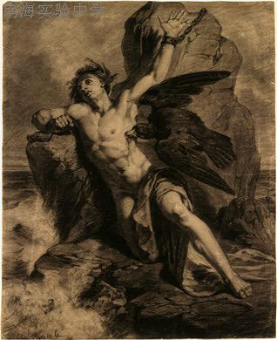

Shelly’s greatest achievements
Queen Mab (1813);
The Revolt of Islam (1817);
The Cenci (1819);
Prometheus Unbound (1819);
Ode to the West Wind (1819);
The Cloud (1820);
To a Skylark (1820);
Adonais (1821).

Slide 7

Shelley’s Poetry
Shelley was a revolutionary and idealist, a dedicated seeker of an ideal world where love and the brotherhood of man would prevail. His poetry expresses his spirit of rebellion, his pervasive melancholy, his love of man and of freedom. He used the objects of nature, which he worshiped, as images of his internal state.

Slide 8


The Cenci (1819)
The horrific tragedy, set in 1599 in Rome, of a young woman executed for pre-meditated murder of her tyrannical father, was a well-known story.
Shelley was first drawn to dramatise the tale after viewing Guido Reni's portrait of Beatrice Cenci, a painting that intrigued Shelley's poetic imagination.

Slide 9
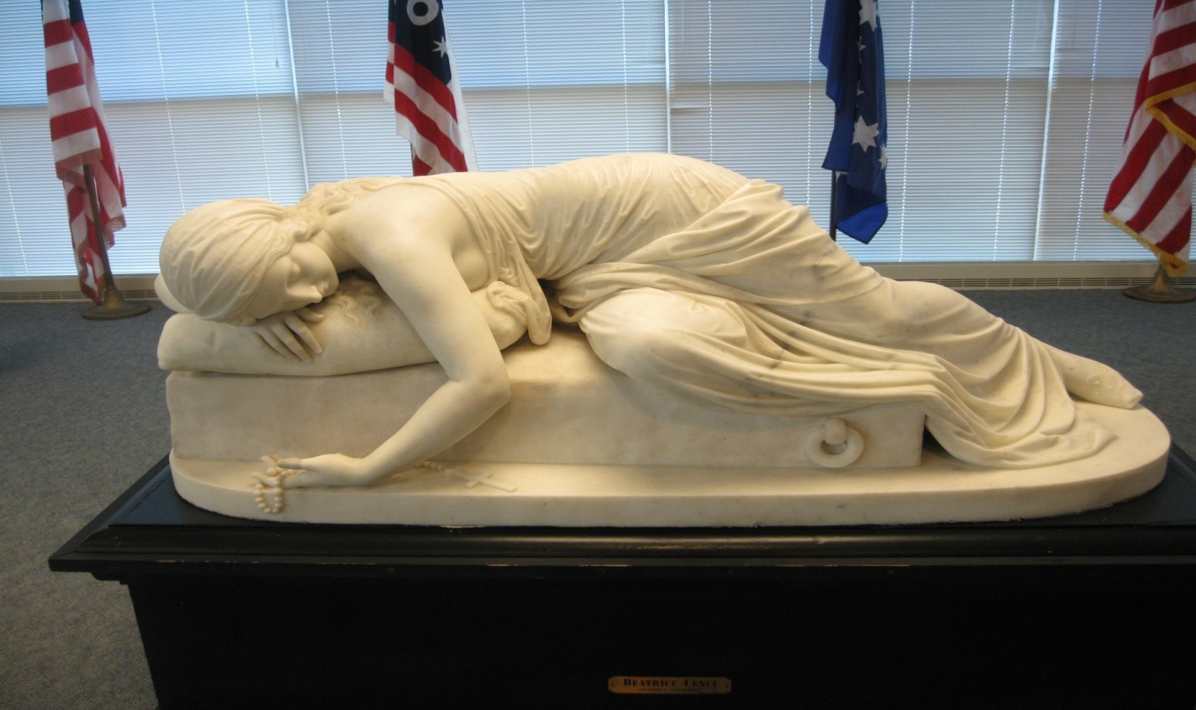
The Cenci (1819)
The sculpture of Beatrice Cenci
The young Beatrice Cenci is kept with her stepmother in the appalling isolation and darkness of a forbidding castle by her cruel father, Francesco, whose enormous debts and misdeeds make him unable, as well as unwilling, to support his offspring. He wants to prevent Beatrice from marrying to avoid paying a dowry. She has suitors, but is unhappily resigned to her lot until her father rapes her.
With the support of her brother, she commands two servants to kill her father, but they waver in their resolve. She taunts them and they return to strangle the man, tossing his body below a balcony as if he had fallen.
The defense argued sexual abuse of Beatrice as a mitigating circumstance, but failed to convince the court. In the doleful final scene, the family accepts their fate with tenderness and courage.

