Slide 1
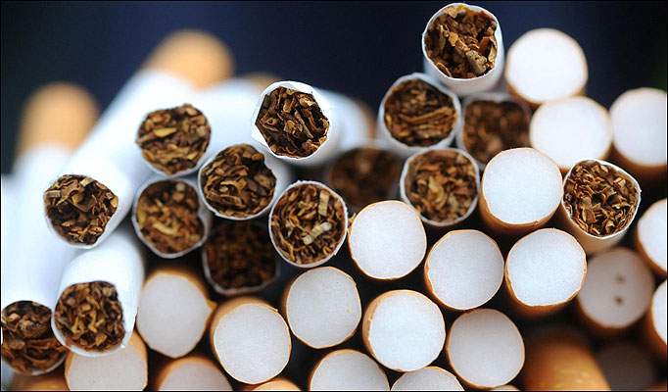
Once You Start, It's Hard to Stop

Slide 2

People start smoking for a variety of different reasons. Some think it looks cool. Others start because their family members or friends smoke. Statistics show that about 9 out of 10 tobacco users start before they're 18 years old. Most adults who started smoking in their teens never expected to become addicted.
That's why people say it's just so much easier to not start smoking at all.

Slide 3
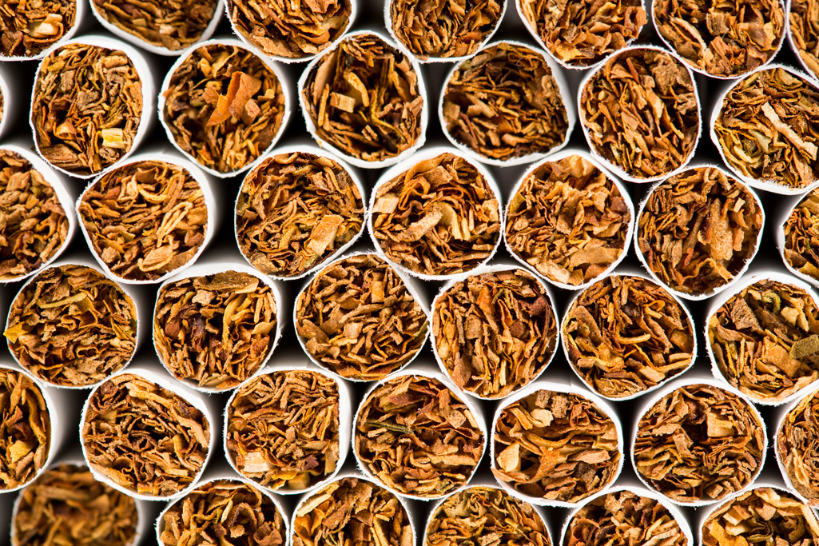
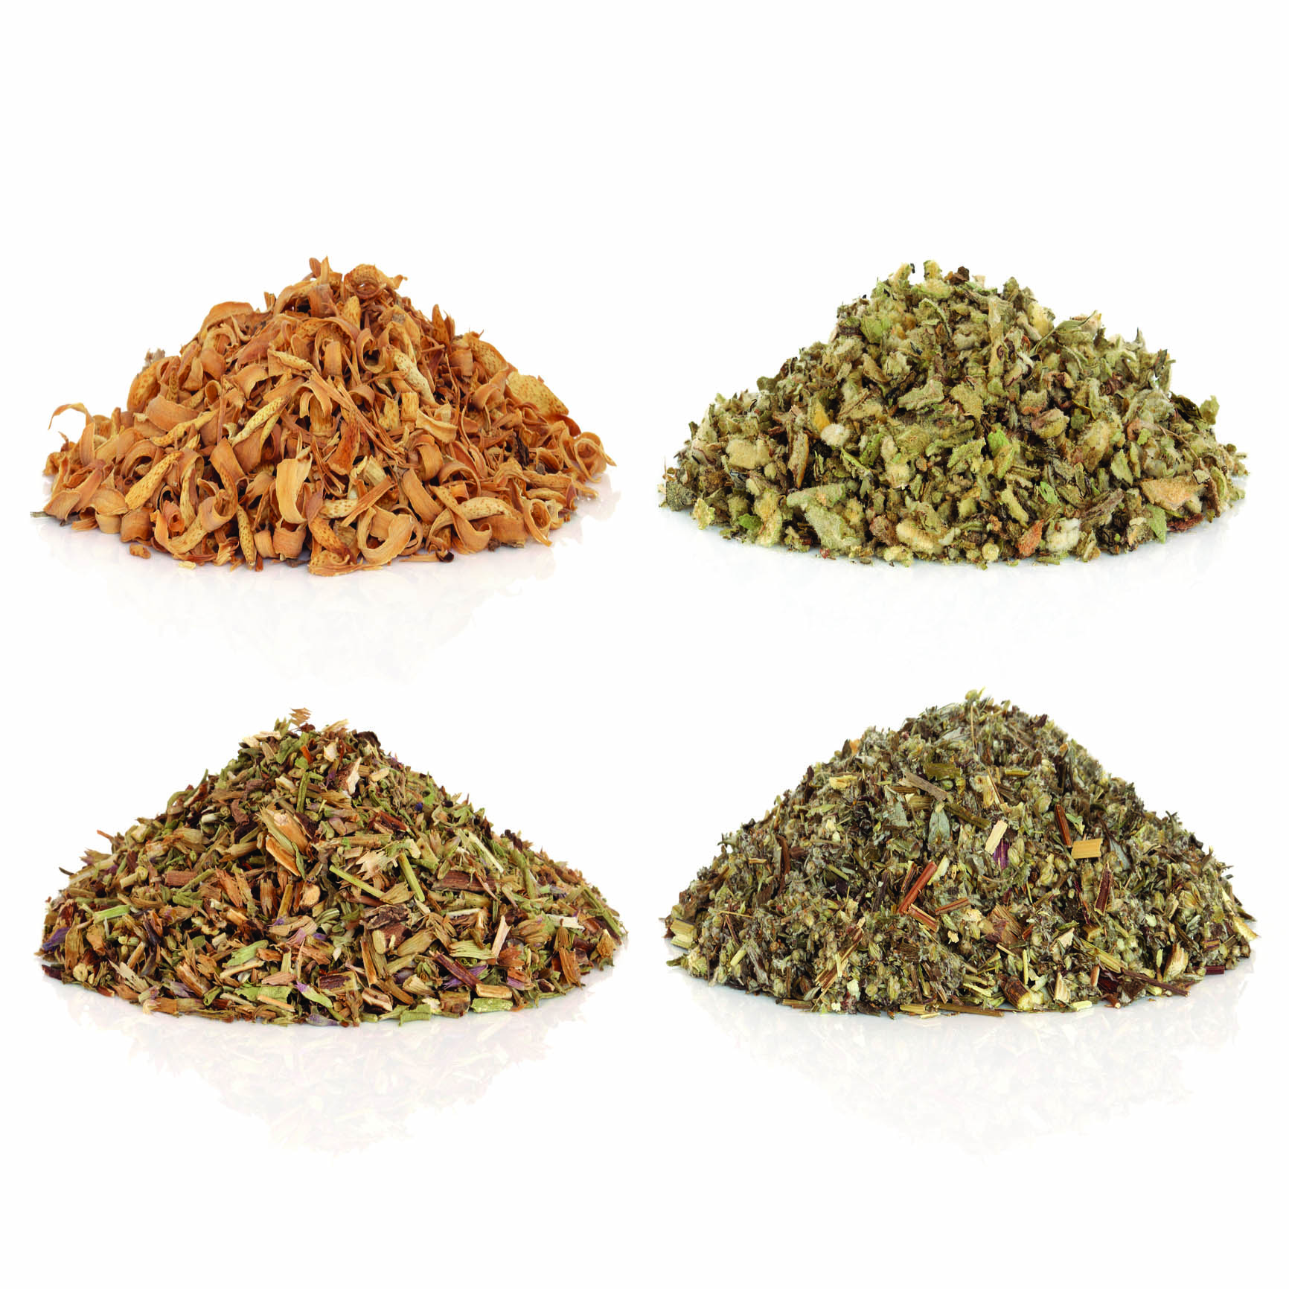
The construction of the cigarette: paper, Additives, tobacco blend, cigarette tube, cigarette butt, cigarette filter
Cigarettes, cigars, and pipe tobacco are made from dried tobacco leaves, and ingredients are added for flavor and to make smoking more pleasant. The smoke from these products is a complex mixture of chemicals produced by the burning of tobacco and its additives.

Slide 4

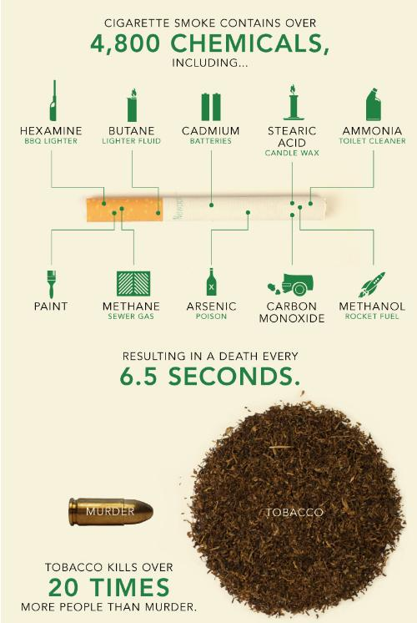
Some of the chemicals found in tobacco smoke include:
- Cyanide
- Benzene
- Formaldehyde
- Methanol (wood alcohol)
- Acetylene (the fuel used in welding torches)
- Ammonia

Slide 5
Some cancer-causing chemicals in tobacco smoke and their other common uses:
1. Nicotine – highly addictive
2. Hydrogen cyanide - used as an industrial pesticide
3. Carbon monoxide - found in car exhausts and used in chemicals manufacturing
4. Nitrogen oxides - a major component of smog
5. Ammonia - used to make fertilizers and explosives
6. Tar - a mixture of dangerous chemicals
7. Arsenic - used in wood preservatives
8. Benzene - an industrial solvent, refined from crude oil
9. Cadmium - used in batteries
10. Formaldehyde- used in mortuaries and paint manufacturing
11. Chromium - used to manufacture dye, paints and alloys
12. Polycyclic aromatic hydrocarbons - a group of dangerous DNA-damaging chemicals

Slide 6
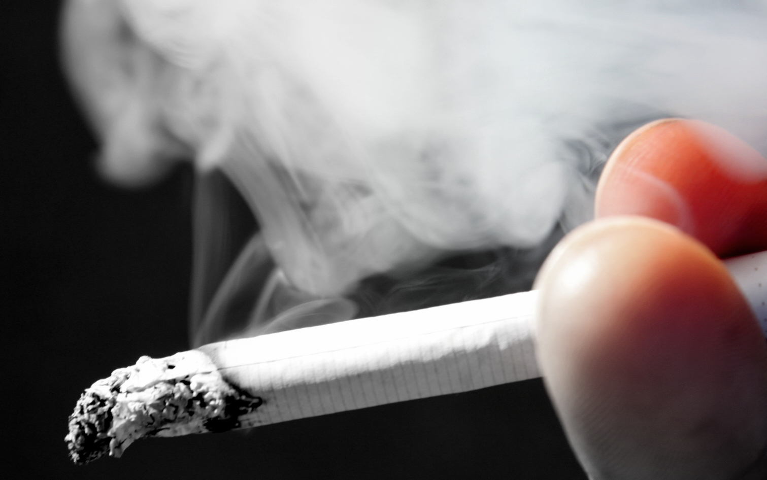
Smoking a cigarette for the first time ever is often toxic enough to make some people vomit,
Kids Health says.

Slide 7

Once nicotine gets into the brain, it causes brain neurons to create dopamine, a neurotransmitter that emits a feeling of pleasure. Dopamine naturally occurs when people are in situations that make them feel good, and nicotine kicks the dopamine creation into overdrive.
Smoking a cigarette, therefore, can give someone an immediate pleasurable reaction and, as people want more of a good thing, the cycle of smoking begins. Nicotine hits the brain and causes pleasure quite quickly, and its effects wear off just as rapidly.

Slide 8
As with many drugs, the body builds up a tolerance to nicotine, NIDA points out. Smokers start to need more nicotine to get the same effect. They usually end up smoking more often to get that same nicotine high. Nicotine tolerance builds up quickly over the course of the day during continuous smoking.
People experiencing nicotine withdrawal are often irritable, have a hard time sleeping and difficulty paying attention or thinking clearly. They also often end up with a huge appetite and intense longing, or craving, for a cigarette. The physical symptoms of nicotine withdrawal eventually lessen over time, frequently disappearing altogether after several weeks without nicotine. Cravings for a cigarette, however, can last a lifetime.

Slide 9
Smoking is responsible for several diseases, such as cancer, long-term (chronic) respiratory diseases, and heart disease, as well as premature death.
Smoking is the largest cause of preventable death in the world. Recent studies have found that smokers can undermine the health of non-smokers in some environments.

Slide 10
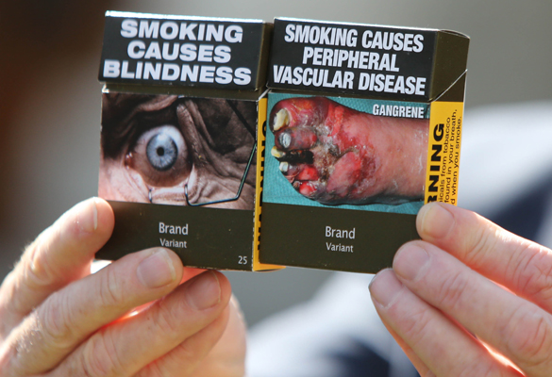

Slide 11
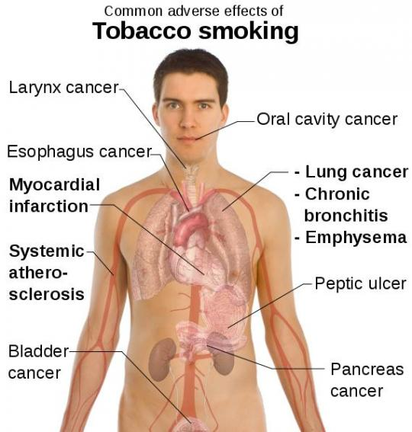
- Bladder cancer
- Kidney cancer
- Cancers of the pharynx and larynx (throat cancer)
- Mouth cancer
- Esophagus cancer
- Cancer of the pancreas
- Stomach cancer
- Some types of leukemia
- Cancer of the nose and sinuses
- Cervical cancer
- Bowel cancer
- Ovarian cancer
- In some cases, also breast cancer
90% of lung cancer patients developed their disease because of smoking. Lung cancer is one of the most common causes of cancer deaths in the world. Smokers also have a significantly higher risk of developing:

Slide 12
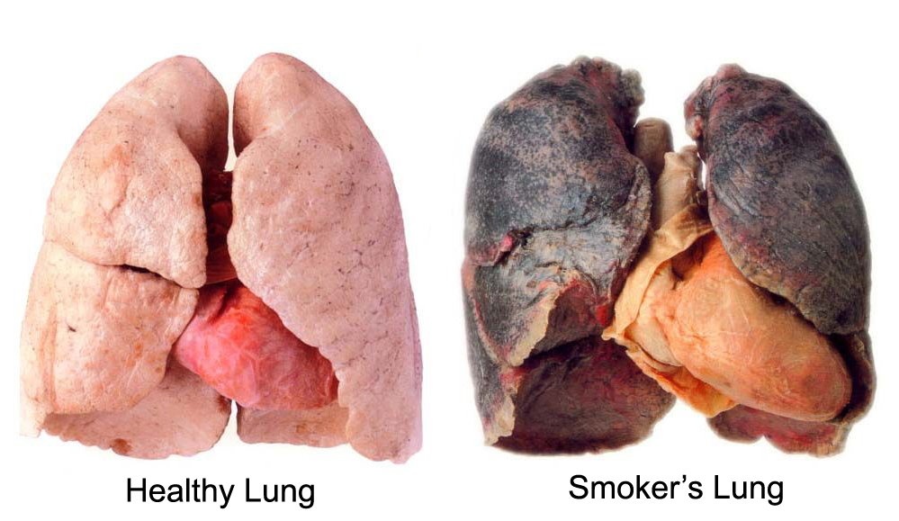
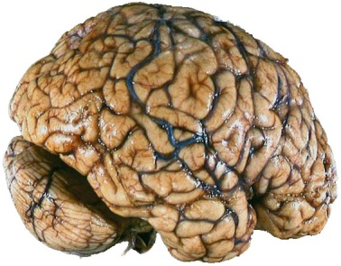
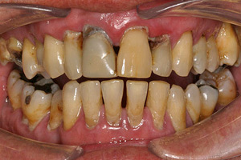
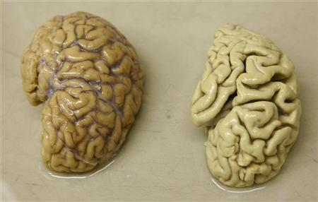
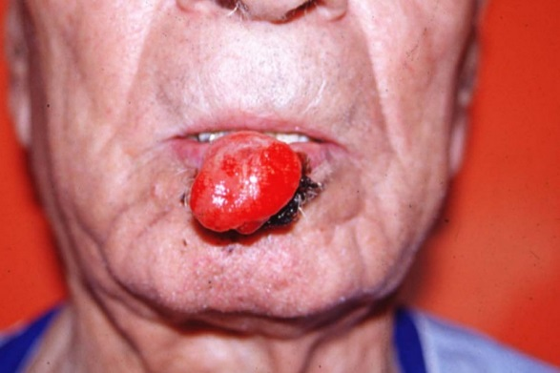

Slide 13
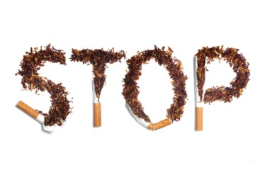
Consider these tips:
Stop and take a deep breath. Taking five to 10 deep breaths is a good start to stress relief. You also get the benefit of inhaling clean air into your lungs without those harmful chemicals!
Go for a walk. Physical activity can release a chemical in your body that improves your mood and relieves stress. Walking for 30 minutes a day can be a healthy distraction, burn extra calories and help your heart.
Try to relax. Stress can make your muscles tense. Relax them by stretching, deep breathing, doing yoga, getting a message or even closing your eyes and visualizing yourself in a peaceful place.
Call a friend. Talking through your highs and lows with family, friends or even a support group can give you comfort and positive reinforcement.
Cut back on caffeine. Caffeine is a stimulant that will increase your heart rate and your anxiety. When you’re trying to decrease your stress, caffeine makes you tense, keeps you up at night and may even cause you to want to smoke.
Take care of your body. Drink lots of water, eat healthy and get extra sleep. You’ll feel more energized and ready to handle stress.

Slide 14
