Slide 1
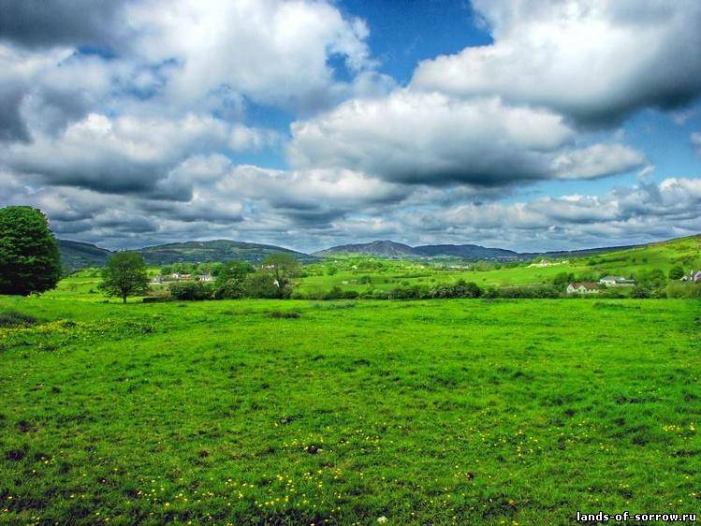
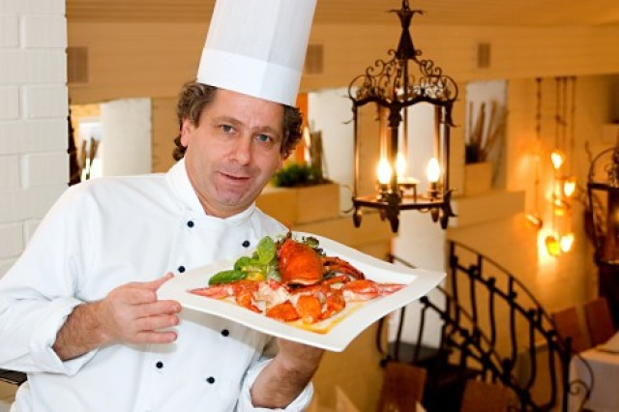
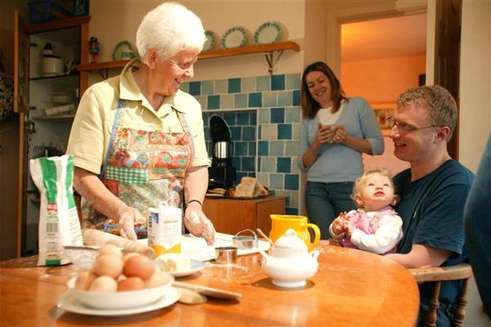
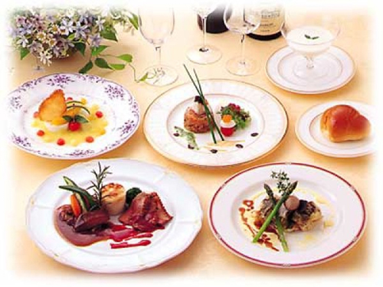
Irish traditional dishes

Slide 2
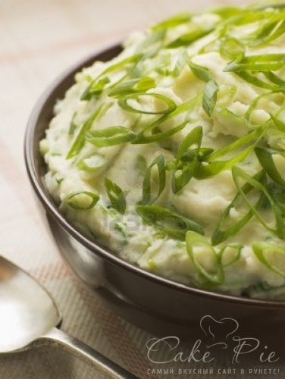
Champ –
– a delicious comfort food dish of potatoes mashed with lots of butter, warm milk and chopped spring onions or, as we call them, scallions.
We also love our spuds fried, roast, baked and simply boiled in thei r ‘jackets’ to be peeled ceremoniously at the table.

Slide 3
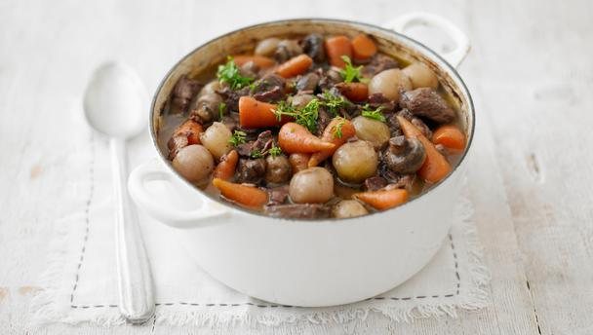
Irish Stew - a hearty casserole traditionally made with meat, potatoes, carrots and onions.

Slide 4
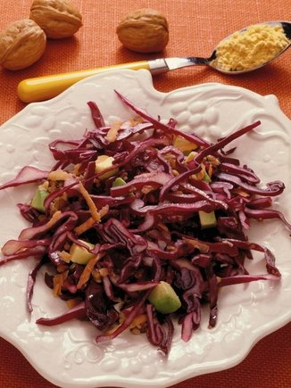
Dulse
- a salty, seaweed snack, originally harvested by fishermen to supplement their income when fishing was slack

Slide 5
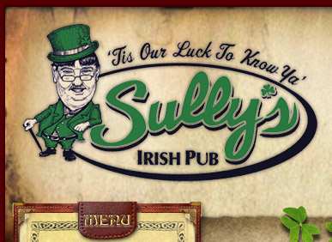
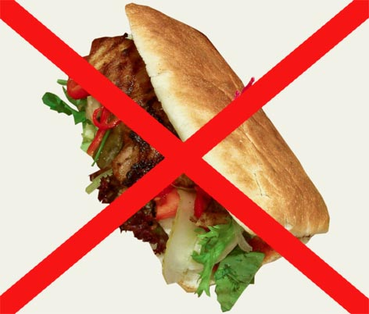
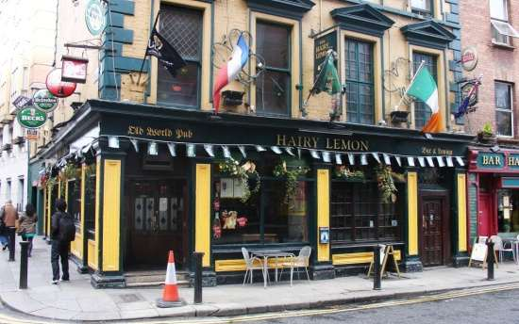
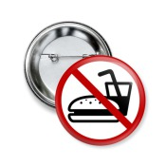

Slide 6
