Slide 1
Presentation on the topic: «London Sights»
Prepared: Inna Dmytrotsa
9 Form
School of Bokiyma

Slide 2
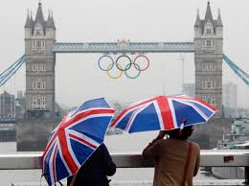
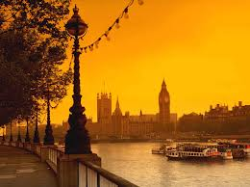
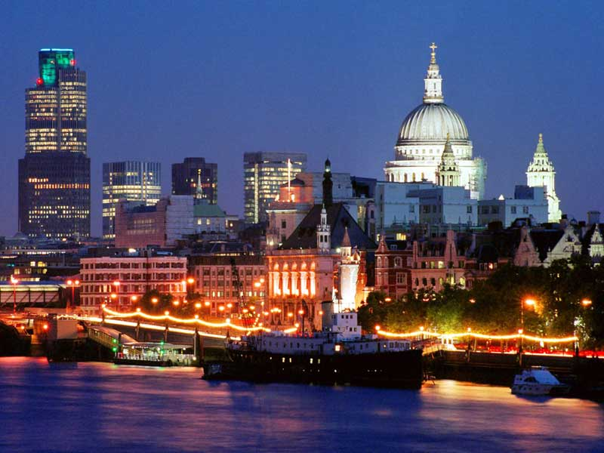
London
London, the capital of England and the United Kingdom, was founded 2000 years ago by the Romans as Londinium. The city has been Western Europe's largest city for centuries: as early as in 1700 more than 575,000 people lived in London. Today London is not only the largest city but also one of the most visited thanks to its numerous famous attractions.

Slide 3
London Sights :
Buckingham Palace
Houses of Parliament
Big Ben
Trafalgar Square
London Eye
The Tower of London
Westminster Abbey
The Greenwich Observatory
Tower Bridge

Slide 4
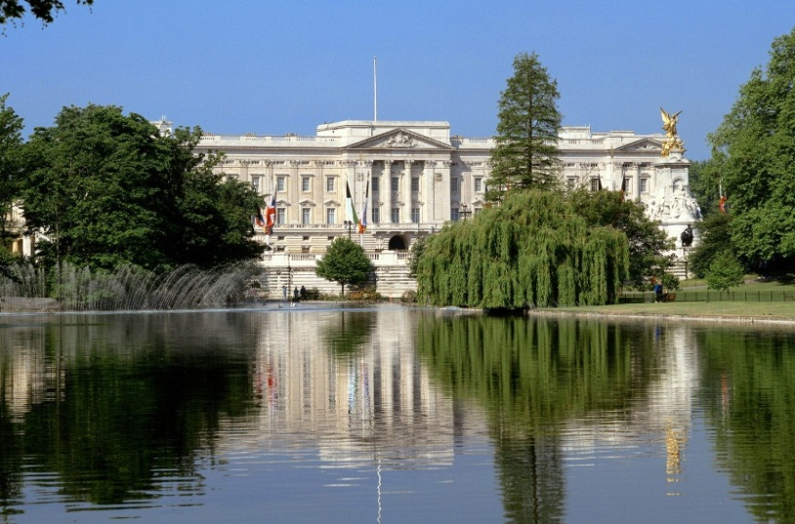
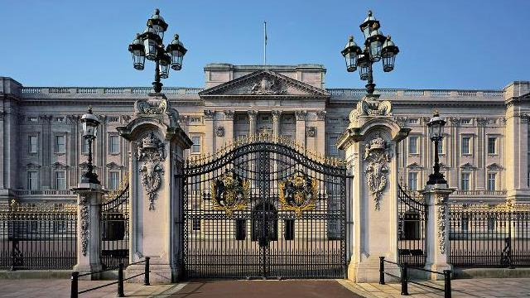
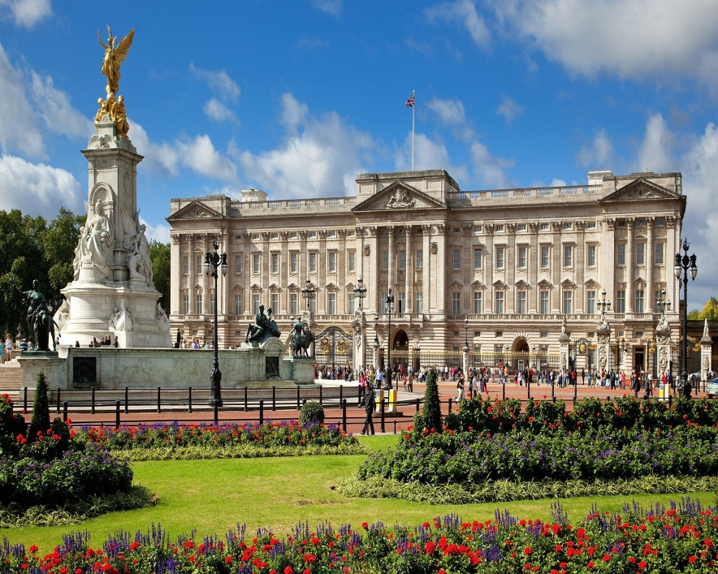
Buckingham Palace
Buckingham Palace is the official London residence and principal workplace of the British monarch. The palace isn't open to the public.

Slide 5
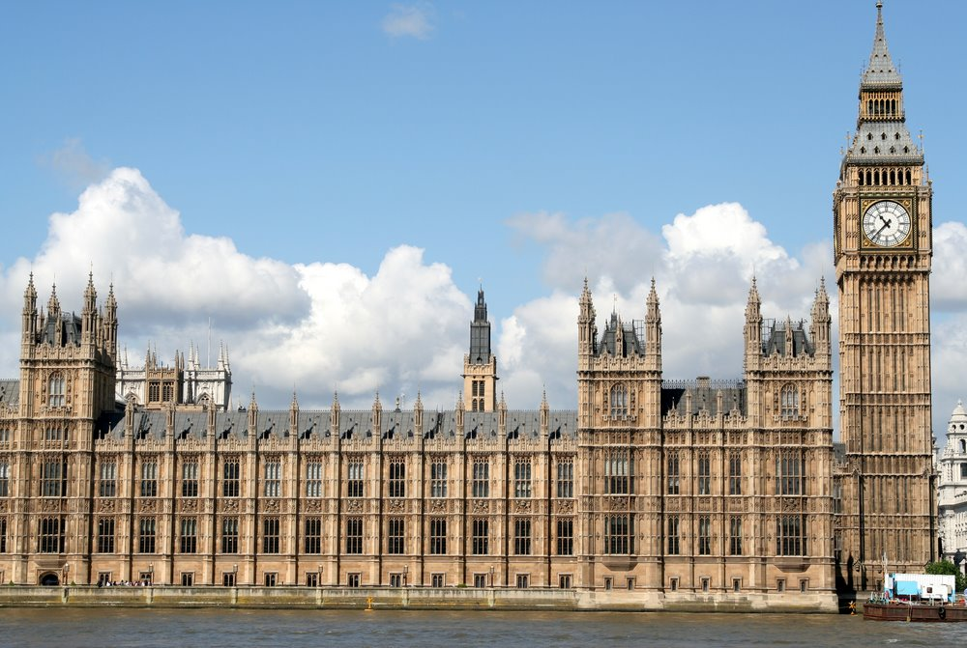
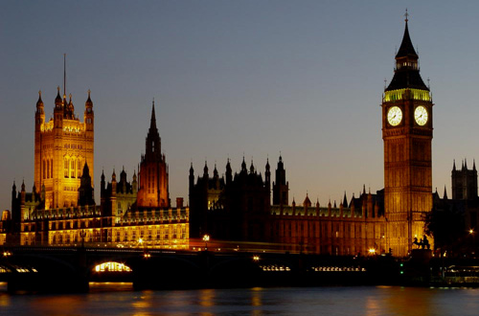
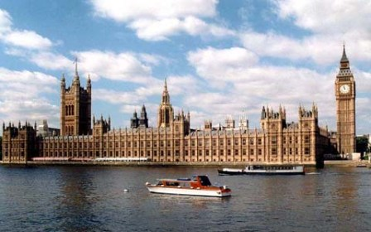
Houses of Parliament
The Houses of Parliament is the seat of the British Government. It is also known as the Palace of Westminster. Big Ben is the name of the clock on the Clock Tower of the Houses of Parliament.

Slide 6
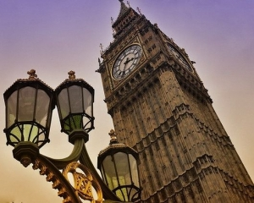
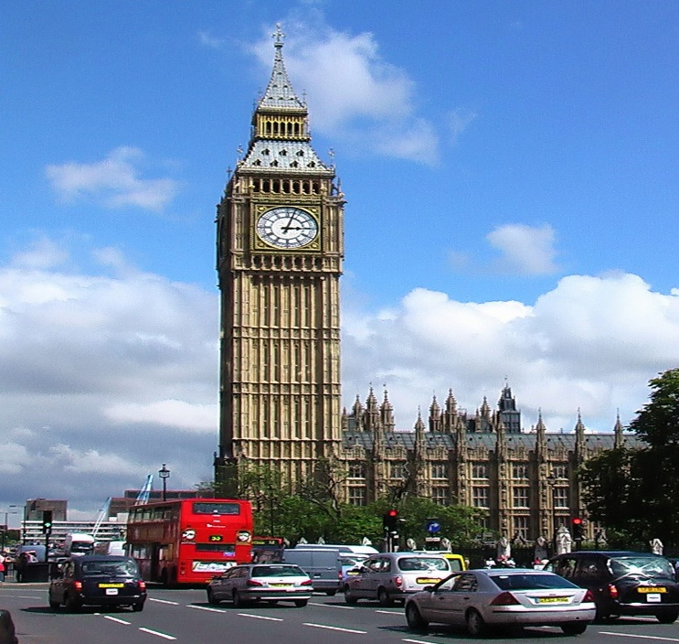
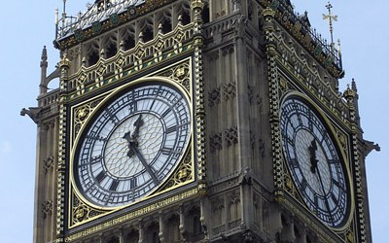
Big Ben
The Clock Tower of the Palace of Westmister - officially named Saint Stephen's Tower - is commonly known as the Big Ben. The tower is one of London's most famous landmarks.

Slide 7
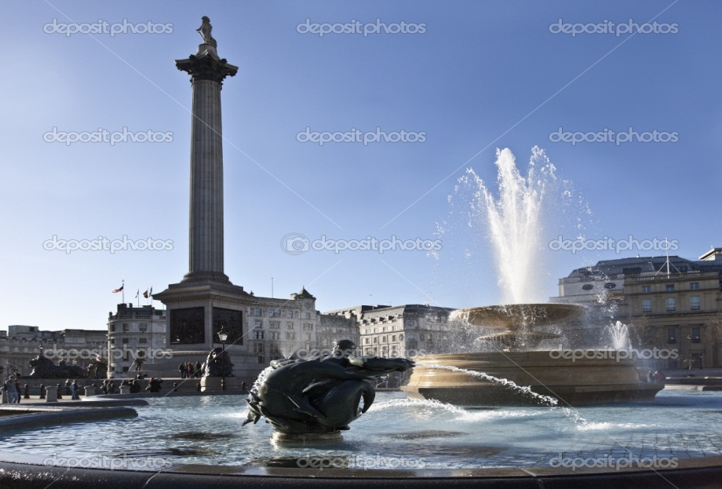
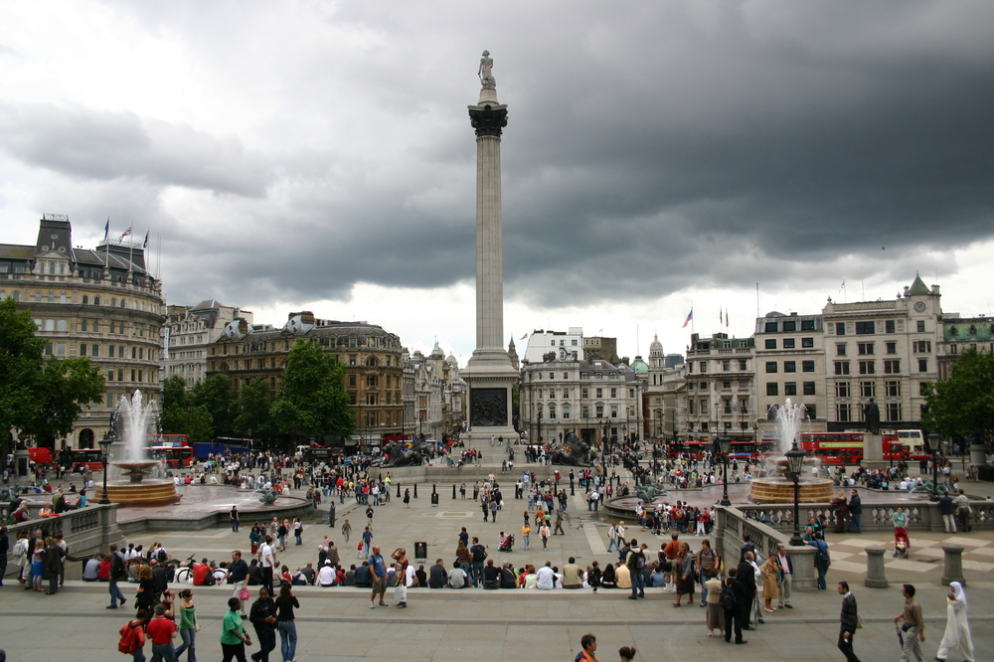
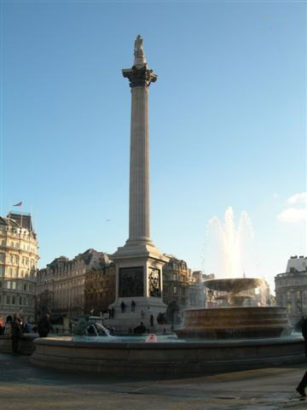
Trafalgar Square
Trafalgar Square, the largest square in London, is often considered the heart of London. In the centre of Trafalgar Square there is a big column. At the top of the column there is a statue of Admiral Nelson who had to fight the French at the Battle of Trafalgar in 1805.

Slide 8
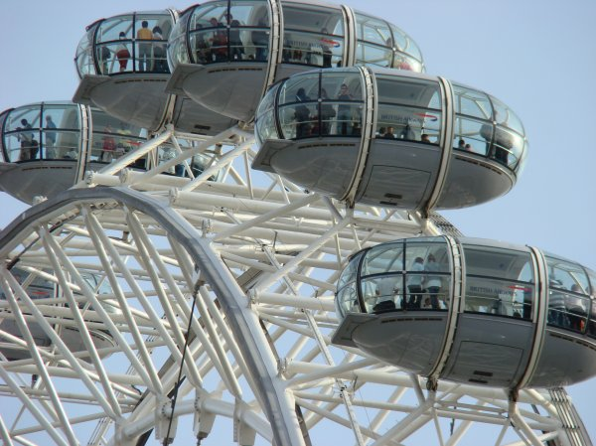
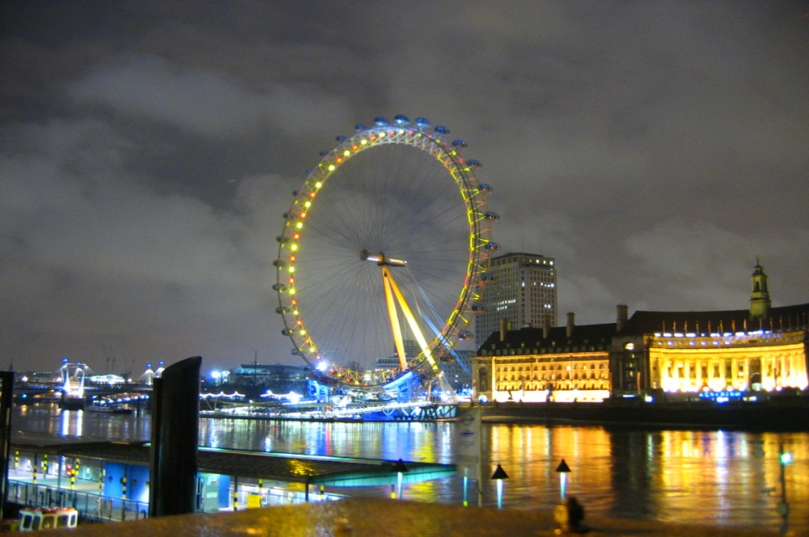
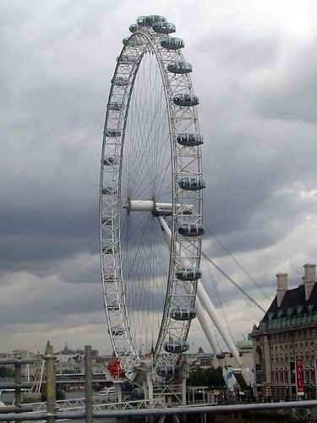
London Eye
London Eye is on the Thames. It's the largest observation wheel in the world. London eye is very popular with tourists.

Slide 9
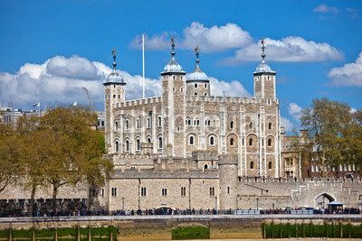
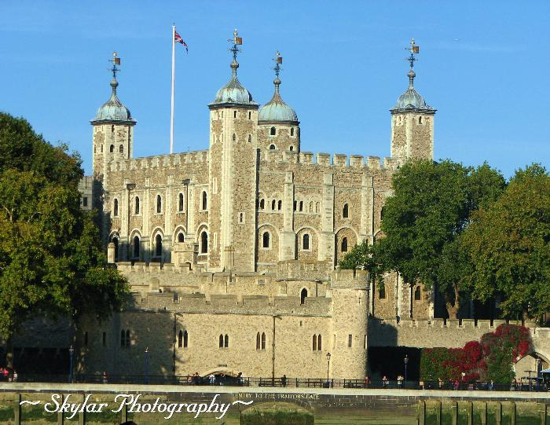
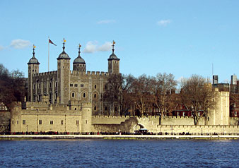
The Tower of London
The Tower of London was a fortress, a castle, a prison in the past. Now it's the oldest museum in London.

Slide 10
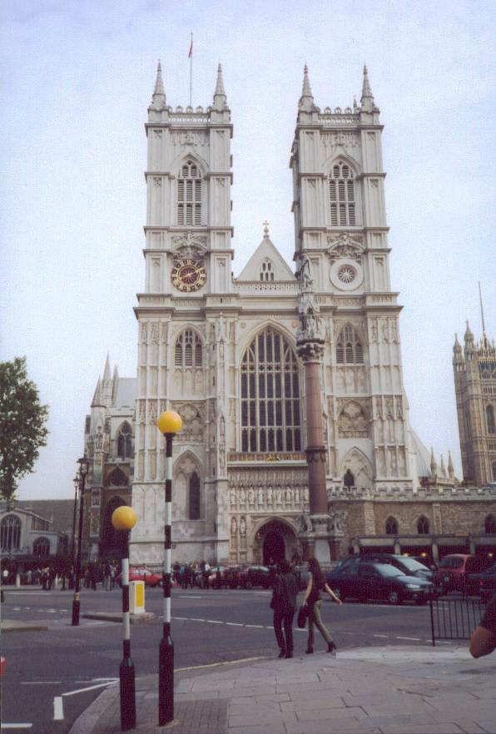
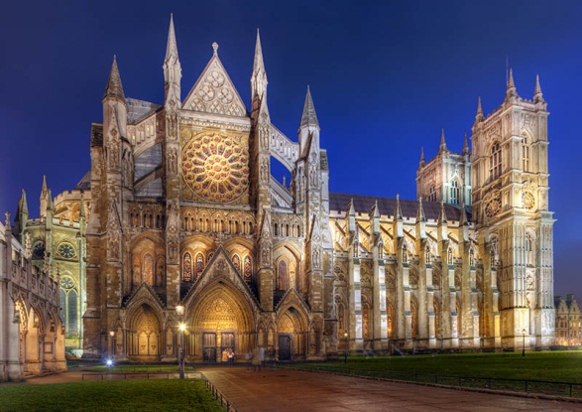
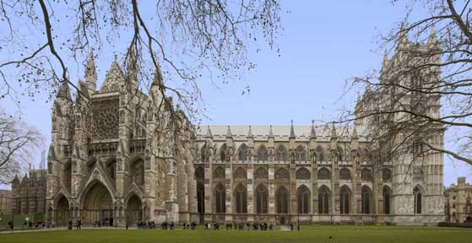
Westminster Abbey
It is the traditional place of coronation and burial site for British monarchs of the Commonwealth realms. It is the most beautiful church and one of the oldest parts of Westminster. Many English kings and queens are buried in Westminster.

Slide 11
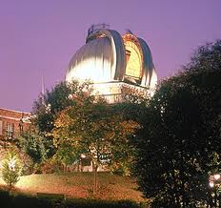
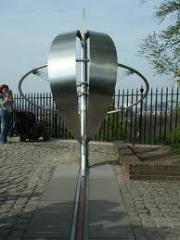
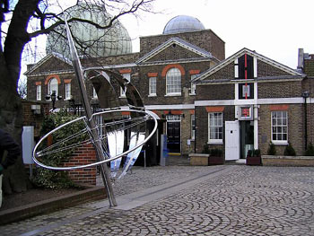
The Greenwich Observatory
Three hundred years ago Greenwich was a village and now it is a part of London. Queen Elizabeth I lived in the Greenwich Palace. The Greenwich Observatory is the center of time and space because the prime meridian of the Earth, which divides east from west passes there. If you stand over the line, you can have one foot in each hemisphere.

Slide 12
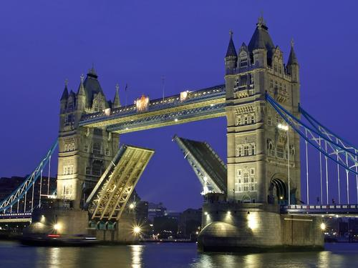
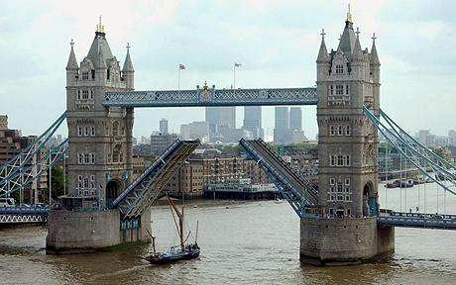
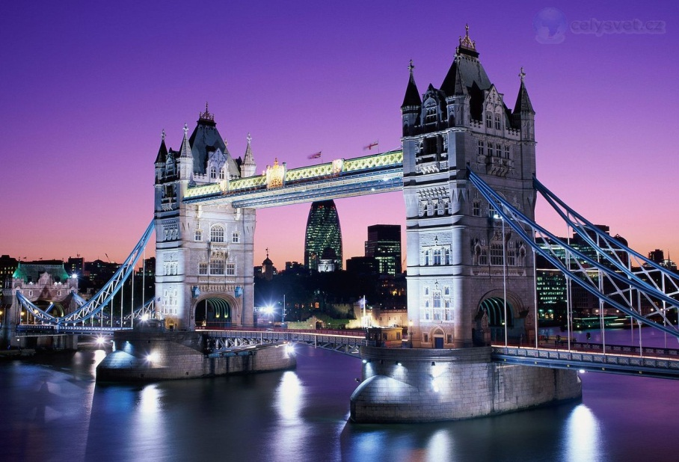
Tower Bridge
London's Tower Bridge is one of the most recognizable bridges in the world. Its Victorian Gothic style stems from a law that forced the designers to create a structure that would be in harmony with the nearby Tower of London.

Slide 13
The end..

