Slide 1
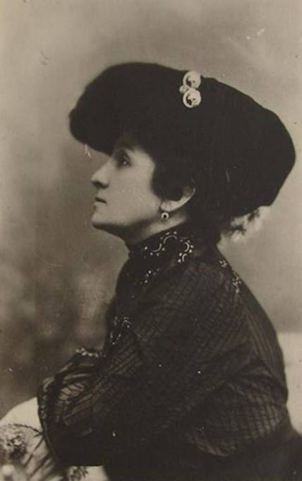
Maria Zankovetska –
"a symbol of Ukrainian Theatre".

Slide 2
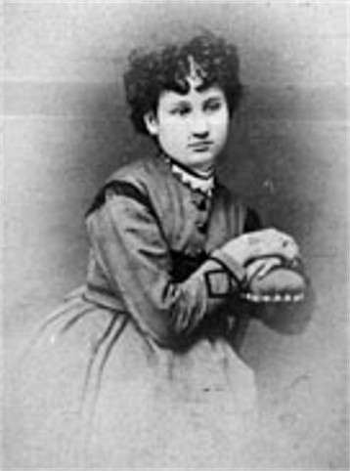
Maria Zankovetska was born on 23rd July, 1854 in the village of Zanki. After finishing studies in a private school in Chernihiv, she studied for two years at a conservatoire in Helsinki.

Slide 3
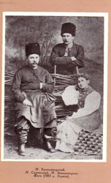
Her talent was noticed by Micola Sadovsky, who became a leading figure of Ukrainian theatre.
Maria dreamed of a professional theatrical career. Together with Micola Sadovsky and Marko Kropivnitsky, she was destined to contribute to the birth of the National Theatre.

Slide 4
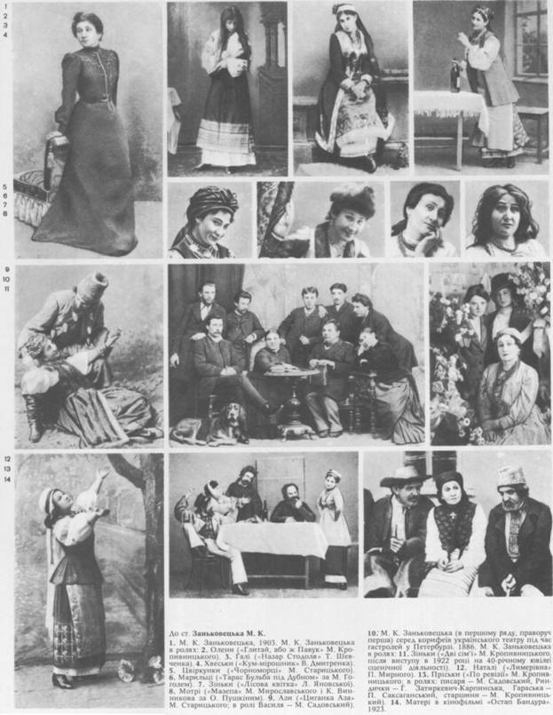
She debuted in 1882 in Ivan Kotliarevsky's Natalka from Poltava as a member of Marko Kropyvnytsky’s troupe. Zankovetska performed as leading actress in the troupes of Kropyvnytsky (1882–3, 1885–8, 1899–1900), Mykhailo Starytsky (1883–5), and Mykola Sadovsky (1888–98), in Saksahansky’s Troupe (1900–3), in Onysym Suslov's troupe (1903–4), in the Society of Ukrainian Actors (1915–17), and in the State People’s Theater (1918–22). Her last performance on stage was in Kyiv in 1922, and that same year a theater in her name was founded.

Slide 5
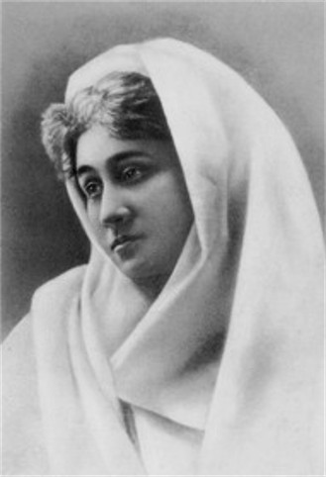
Zankovetska's stage career spanned over 30 dramatic-heroic roles from the populist-ethnographical repertoire, which she played with innate subtlety and intelligence. Among them were Olena in Marko Kropyvnytsky’s Hlytai, abo zh pavuk (The Profiteer, or the Spider), Katria and Aza in Mykhailo Starytsky 's Ne sudylos’ (Not Destined) and Tsyhanka Aza (The Gypsy Aza), Sofiia and Kharytyna in Ivan Karpenko-Kary 's Beztalanna (The Hapless Maiden) and Naimychka (The Hired Girl), Natalia in Panas Myrny 's Lymerivna (The Saddler's Daughter)

Slide 6
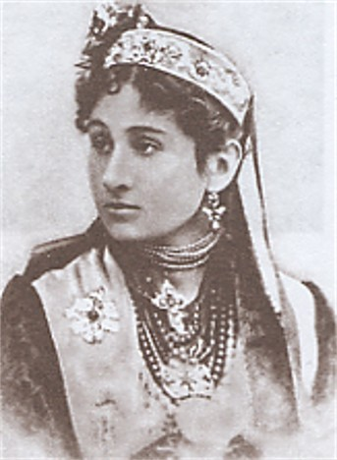
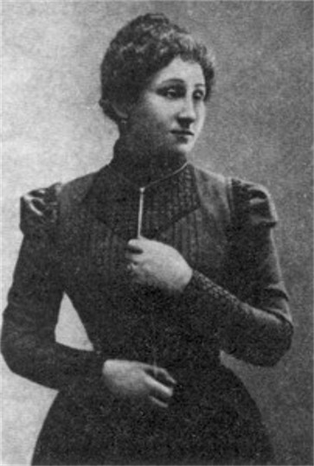
She starred in the films Natalka from Poltava (1910) and Ostap Bandura(1923).

Slide 7
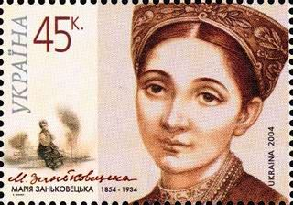
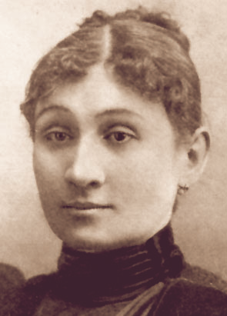
She was highly commented by Konstantin Stanislavsky. The wife of Tzar Alexander III sent a note of thanks to her.
In 1912 the journal "Women's Profiles" came out. It was devoted to outstanding women of the world, and it mentioned M. Zankovetska as one of three great Russian actresses.

Slide 8
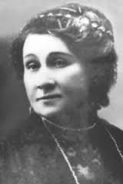
Her talent was sustained by her realization of the importance of what she was doing — educating the people and fostering respect and interest in Ukrainian culture.

