Slide 1
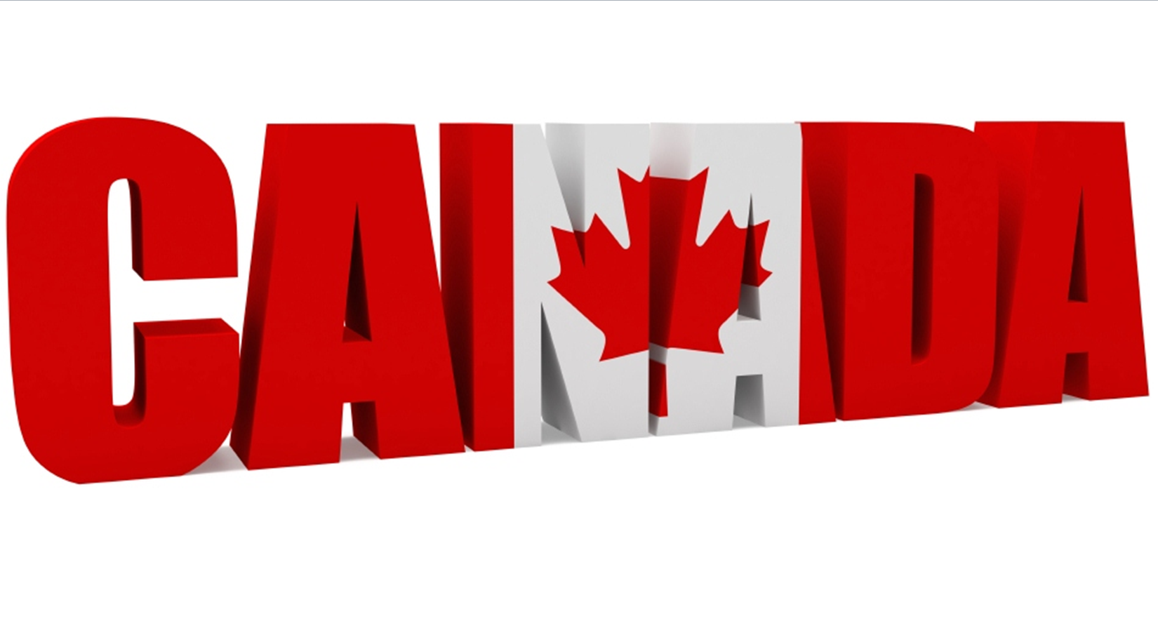

Slide 2
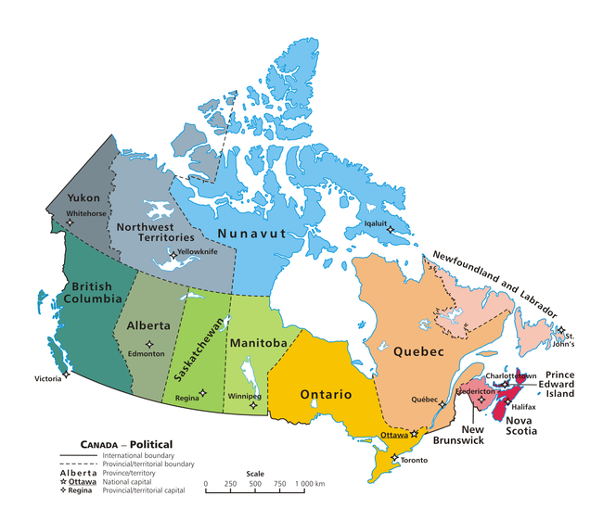
Canada is a country in North America consisting of 10 provinces and 3 territories. Located in the northern part of the continent, it extends from the Atlantic to the Pacific and northward into the Arctic Ocean. At 9.98 million square kilometers in total, Canada is the world's second-largest country by total area, and its common border with the United States is the world's longest land border shared by the same two countries.

Slide 3
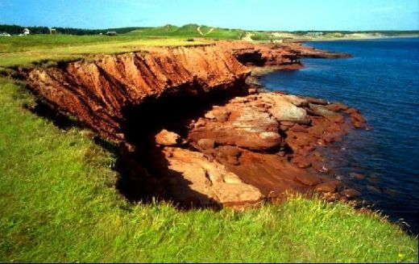
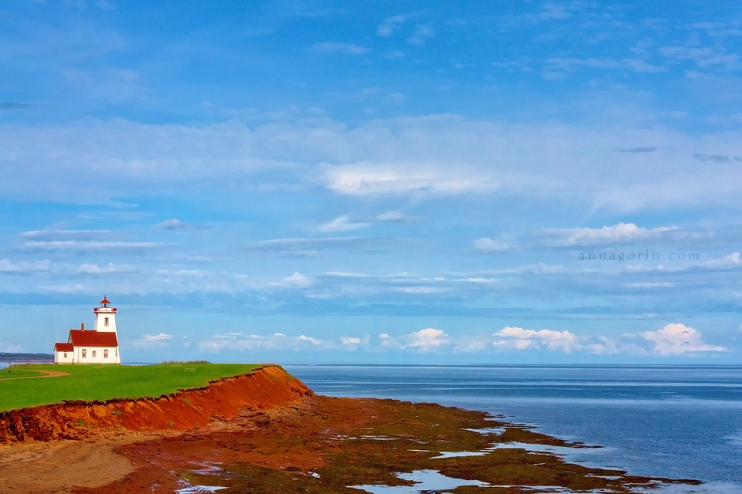
10. Prince Edward Island
Green pastures and the distinct red-soil cliffs make Prince Edward Island a great destination for travellers who are just looking for some relaxation or a fun day at the beach. Take a car to get around, the island is not big so you could see everything in a day.

Slide 4
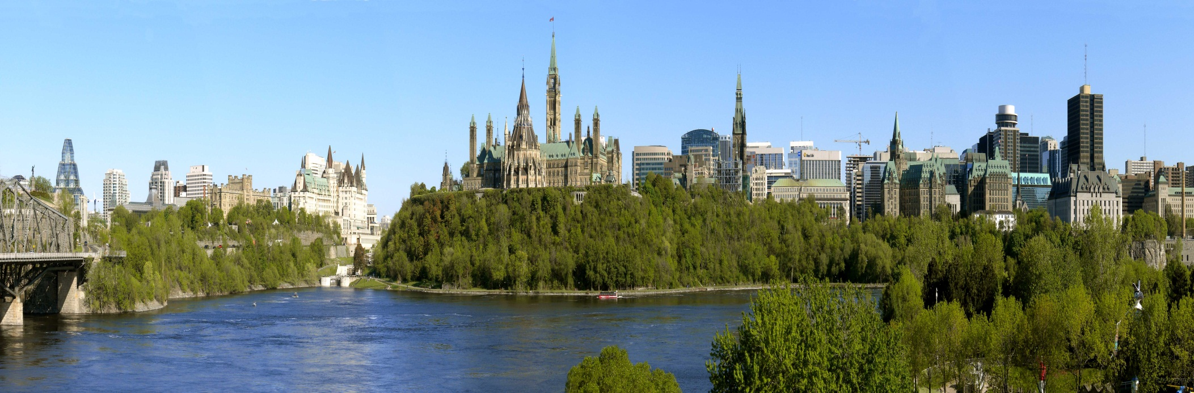
9. Ottawa, Ontario
Ottawa is the Capital City of Canada and a great place to soak in Canadian culture. The Changing of the Guard on Parliament Hill or the RCMP march are always popular sights, along with some world class museums. There are also many parks and bike paths that make summer outdoors fun. The winters aren't bad either. The Rideau Canal, which connects the Ottawa River to the Great Lakes for leisure boaters, makes for the longest skating rink in the world when it freezes.

Slide 5
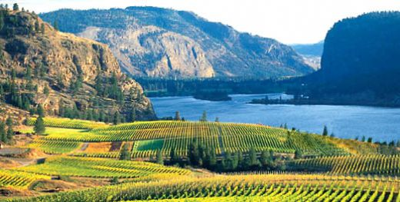
8. Kelowna, British Columbia
Where do Canadians go on vacation? Kelowna, BC. In the heart of the Canadian Rockies is the Okanagan Valley, a river-valley that has some of Canada's best weather. Warm in the summer and mild in the winter; the most you can ask for in the Great White North. The valley produces Canada's world famous B.C. apples (illegal in the U.S.) and wine. The Valley has a marina for the avid boaters and many golf courses. Relaxing at the beach or sitting on the porch of a lakeside cottage is everyone's idea of the perfect destination.

Slide 6
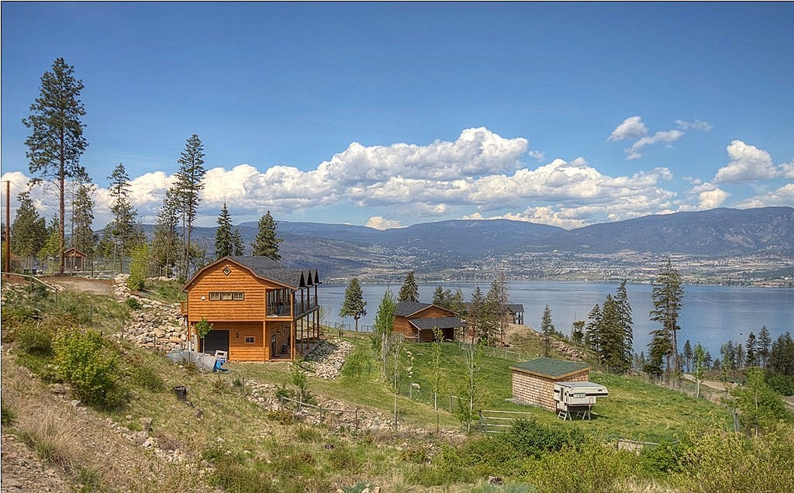
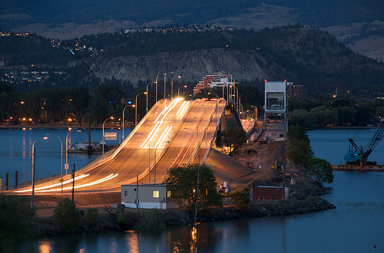

Slide 7
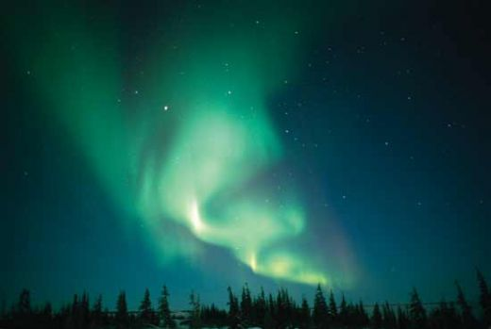
7. Churchill, Manitoba
You might be wondering why Churchill? Well hear me out, Churchill, Manitoba is a small town in northern Manitoba on the shores of the Hudson Bay. The town is the Polar Bear Capital of the World (sightings are year round), Beluga Whale Capital of the World (sightings from late June to late August), and one of the best places to catch a glimpse of an Aurora Borealis or Northern-Lights (sightings from late November through to late March). No-one ever forgets a visit to Churchill. It's the best place to connect to the many wonders of mother nature.

Slide 8
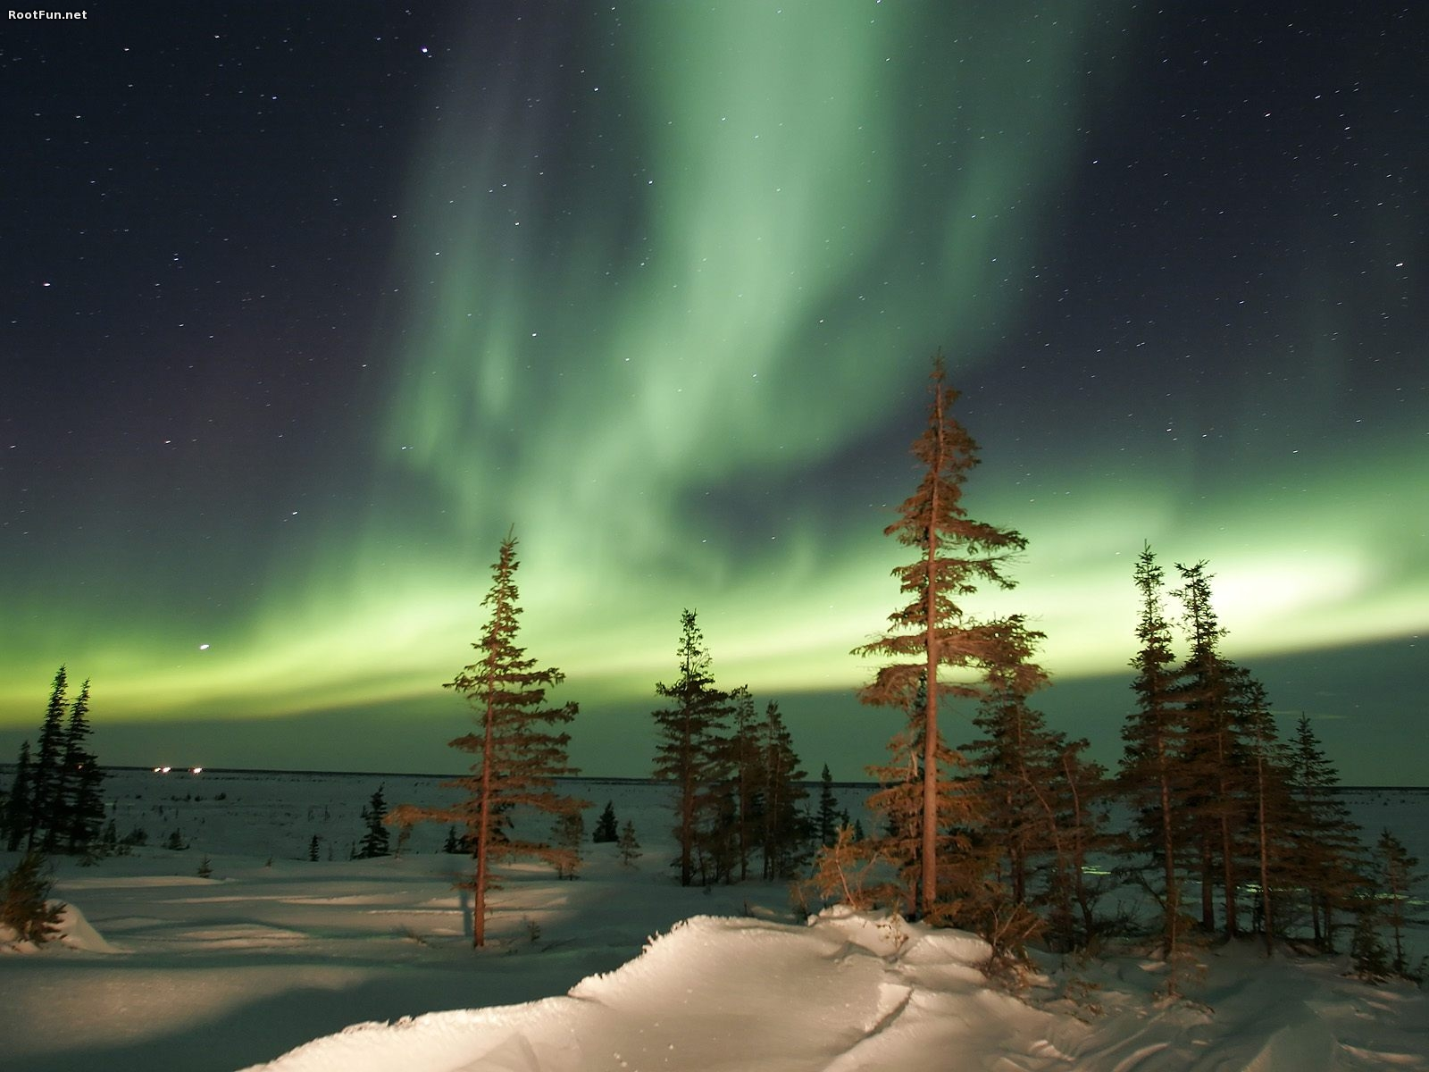

Slide 9
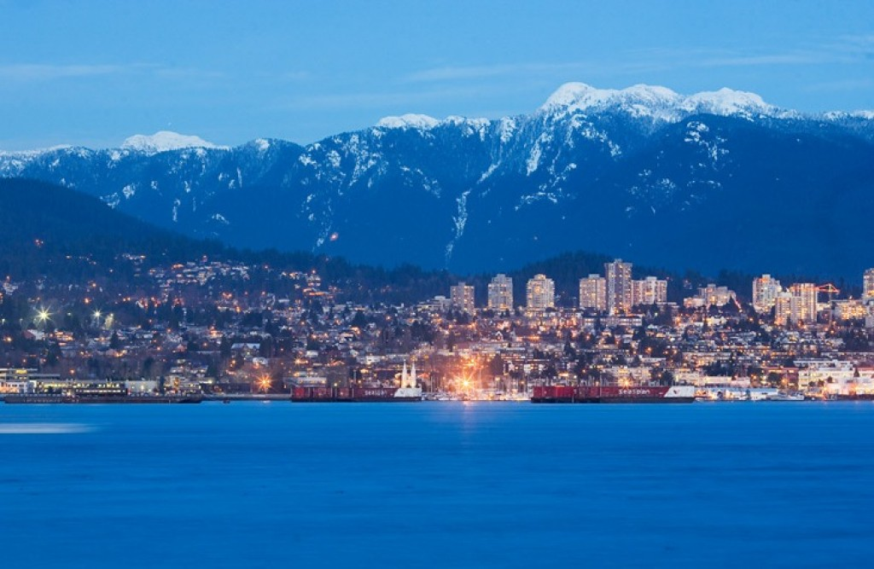
6. Vancouver, British Columbia
Vancouver is a great place to see and do anything and everything. You can enjoy the city's night life, ski at Whistler and go whale-watching along the coast. Camping, hiking, and boating are also just a few of the things you can do when in town. If you love the outdoors and want to see some real wildlife, Vancouver should be on your itinerary.

Slide 10
5. Niagara Falls, Ontario
It's one of those unfortunate 'luck of the draw' things I'm afraid to say, because the majority of the Falls are technically in the United States. This would be fine except that to see it, you have to be on the Canadian side. That's why Niagara Falls lands on Canada's Top-Ten list. To get to the other side there is a pedestrian bridge that links Canada with the United States without the inconvenience of border patrols, yeah!
This tourist town is great for sightseeing and if you happen to be in Toronto, Niagara Falls is not far. Niagara Falls is also a popular place to get married, competing with Las Vegas for favourite wedding destinations. Niagara Falls was also rated as the World's Most Romantic Place.

Slide 11
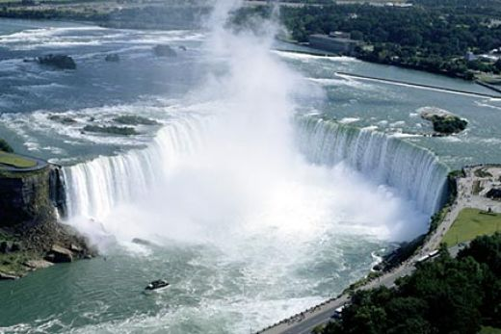
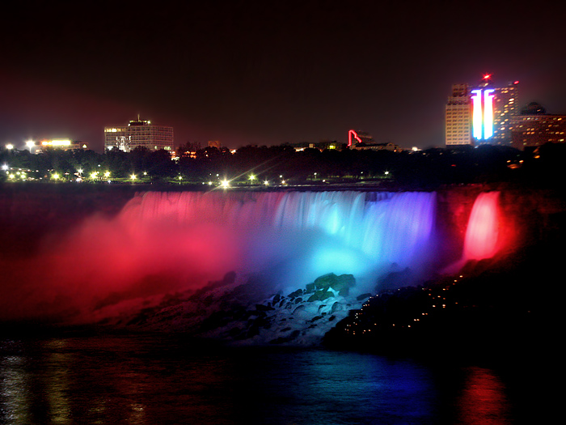

Slide 12
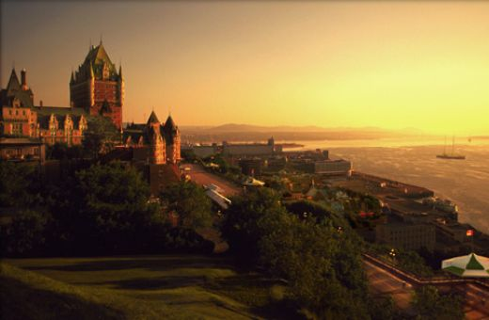
4. Quebec City, Quebec
Visiting Quebec City is like taking a tour of France in North America. Quebec culture is rich and unique from the rest of Canada, and no-where is it as evident as it is in Quebec City.
The world famous Chateaux Frontenac overlooks the St. Lawrence River on a cliff that was once a French Fort. The Old-City is contained in an stone wall that once protected the city from the British Navy. The City Fortress makes Quebec City one of the last walled cities in the world.

Slide 13
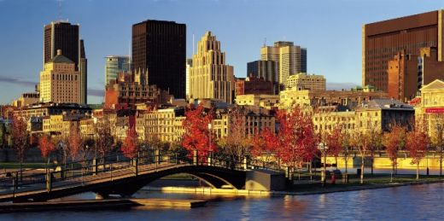
3. Montreal, Quebec
Montreal is perhaps my all-time favourite place to just walk around by myself. No other city will allow you to be on a hill overlooking the city from above; shop at fancy French boutiques; dine at some of the best restaurants in the world; see old historic buildings and modern skyscrapers; enjoy a vibrant nightlife; and watch the sun rise and set at the port - all within walking distance. You will feel as if you have walked into a different dimension. Being the world's second largest French speaking city (second only to Paris) some would compare it to France.

Slide 14
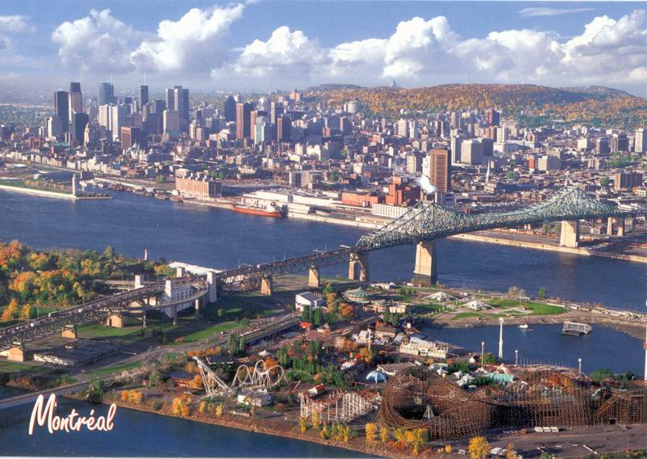

Slide 15
2. Banff, Alberta
Banff is great but a little over-crowded at times. Best to take in the nature experience during the off seasons. But it doesn't matter what time of year it is, there is always stuff to see and do in Banff. Having been to Banff many times, I have never gone and not seen either a bear, elk, deer or mountain goat. With the guaranteed wildlife sightings, you will always enjoy your stay at the Banff Springs Hotel. Be sure to take advantage of their outdoor hot-springs while you are there. Reservations at the hotel are made months in advance but don't fret because there are many other hotels in the area.

Slide 16
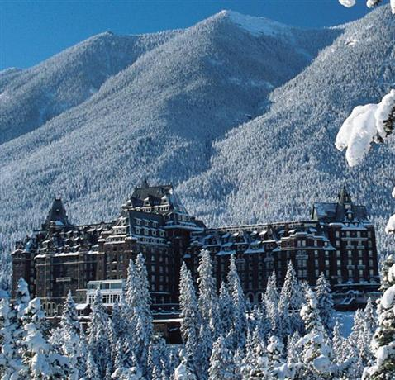
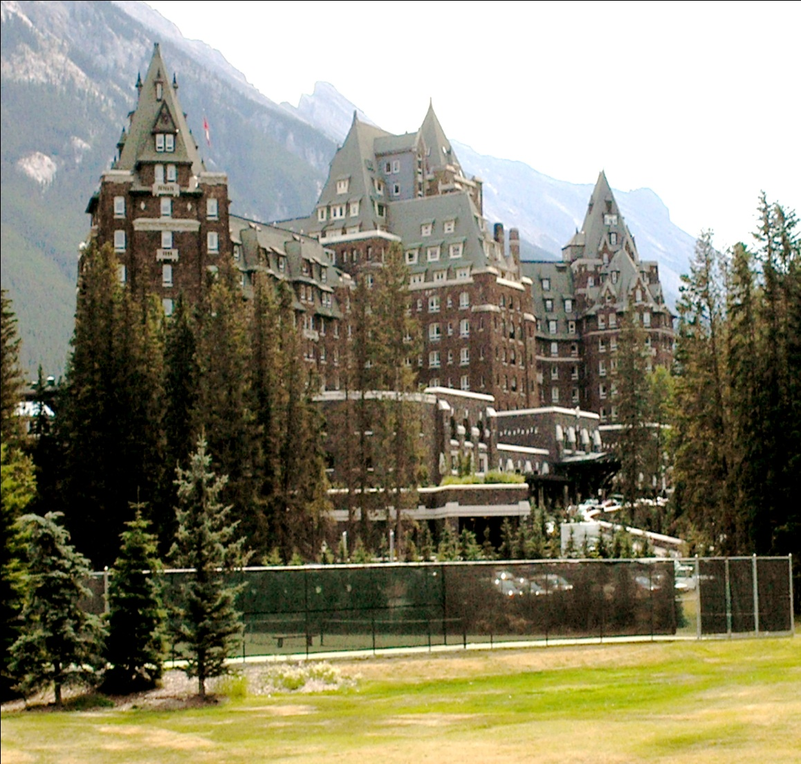

Slide 17
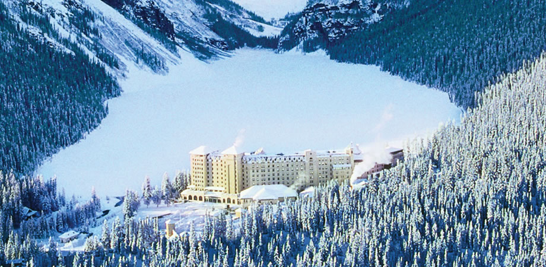
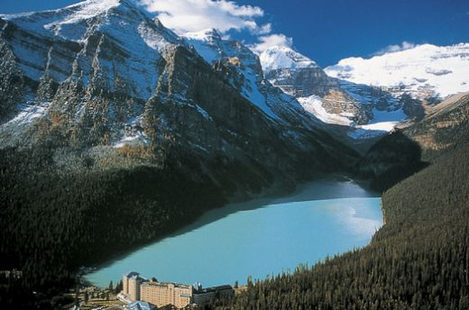
1. Lake Louise, Alberta
The picture says it all. Deep in the Canadian Rockies a large turquoise lake trickles from the thousands year old glacier in the distance.
The Fairmont Hotel is world class and books visitors months in advance. But don't let this deter you from visiting, there are many camp-grounds that make visiting fun and affordable.

Slide 18
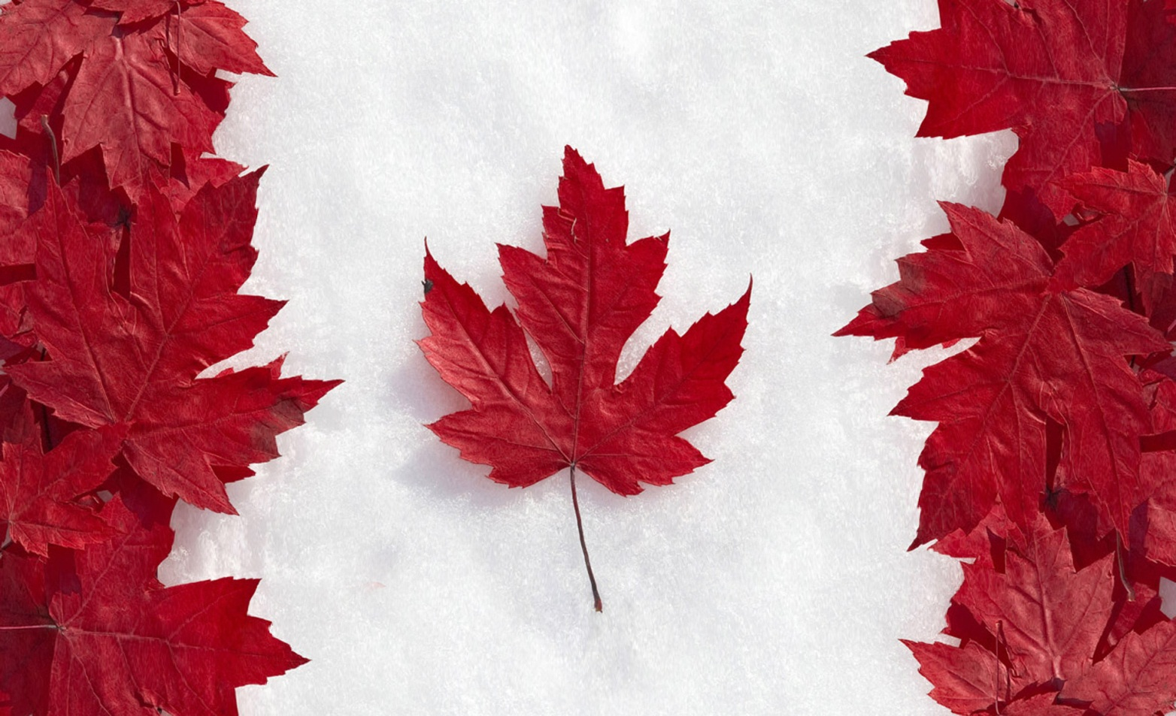
Welcome to Canada!

